Slide 1
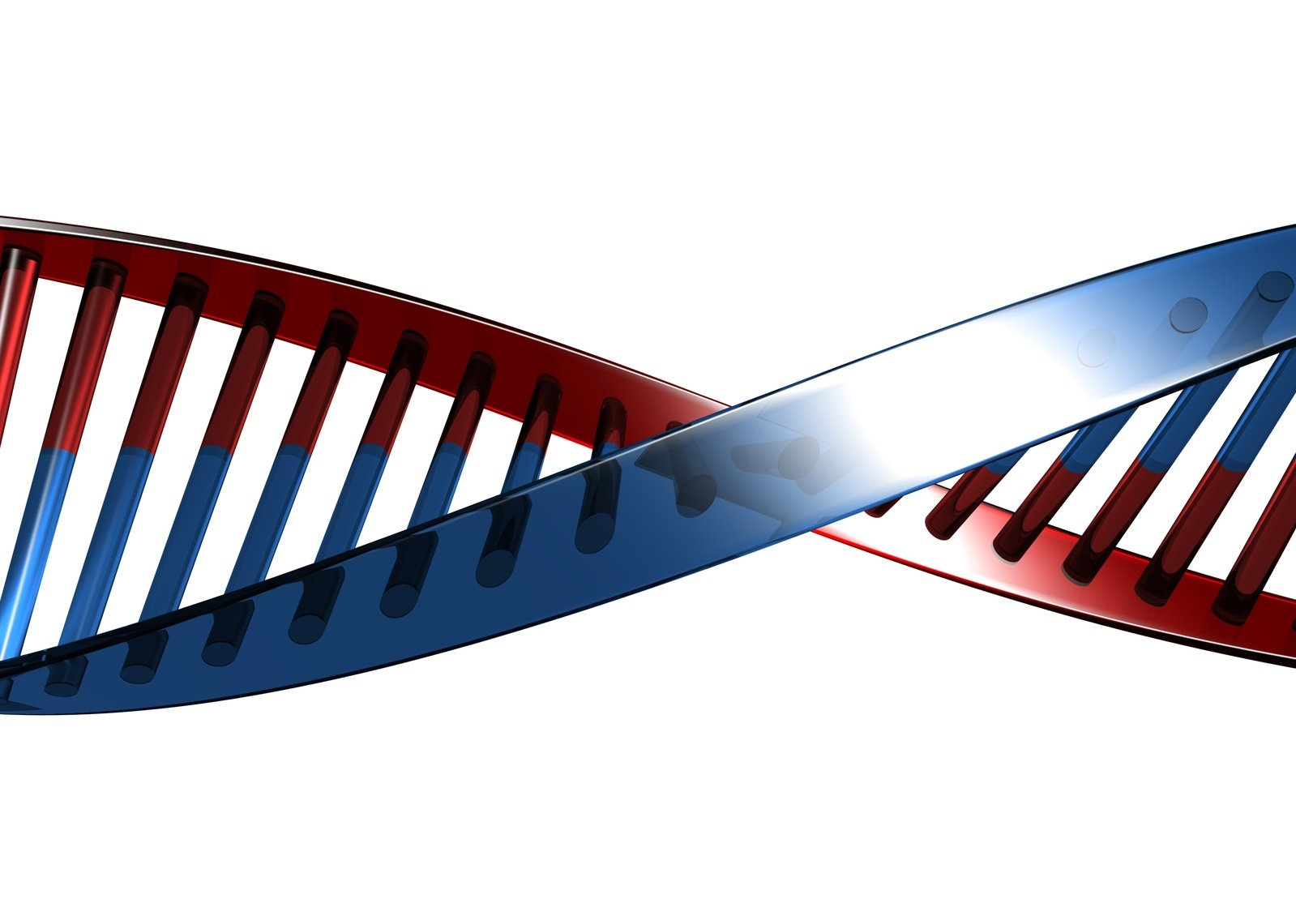

Slide 2
Darwin, Eugenics & Human Races

Slide 3

Human Races?

Slide 4
“On the Natural Variety of Mankind”
1795
German Anthropologist Johann Frederick Blumenbach
“Caucasian”

Slide 5
Charles Darwin
1859 – “On the Origin of Species”

Slide 6


Slide 7
Charles Darwin
1859 – “On the Origin of Species”
1871 – “The Descent of Man”

Slide 8
Ernst Haeckel
Germany’s leading Darwinist

Slide 9
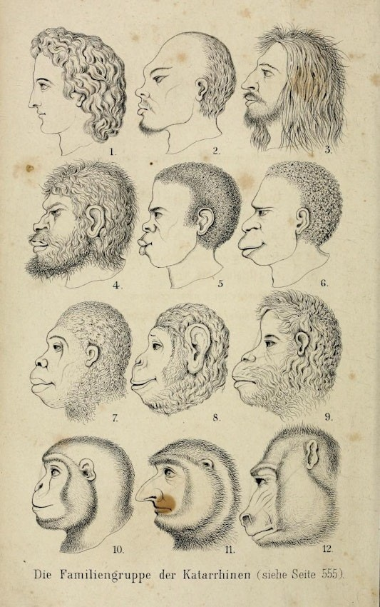

Slide 11
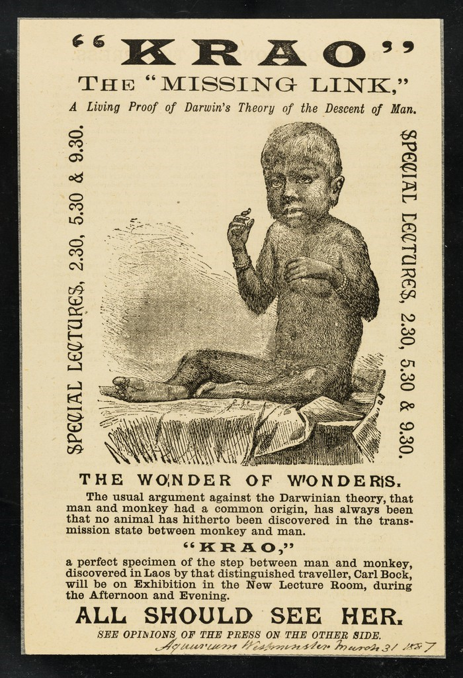

Slide 12
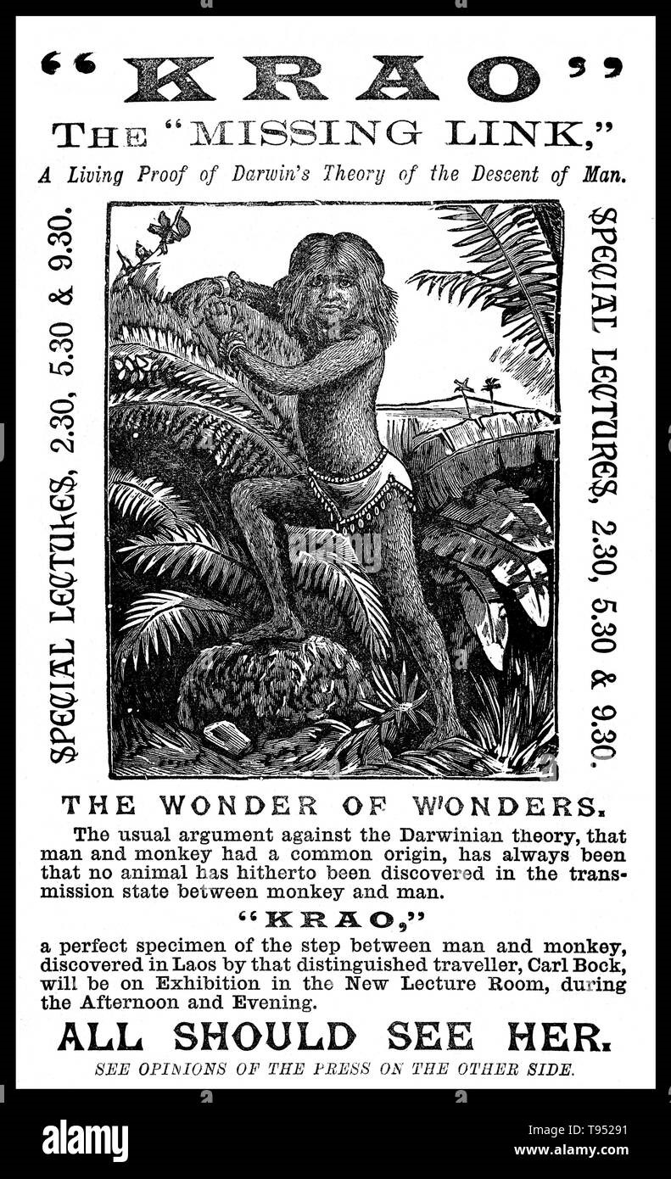

Slide 13
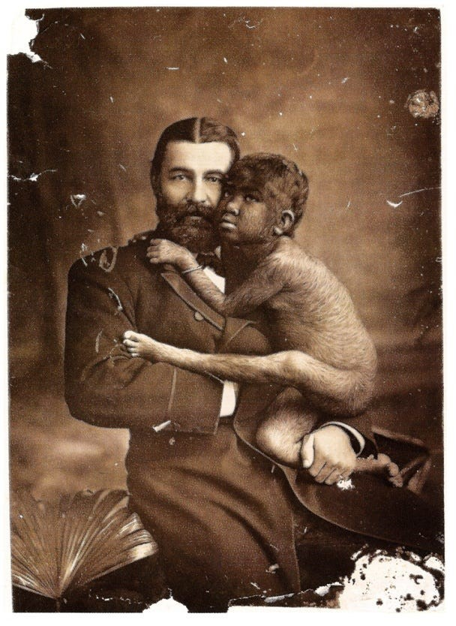

Slide 14
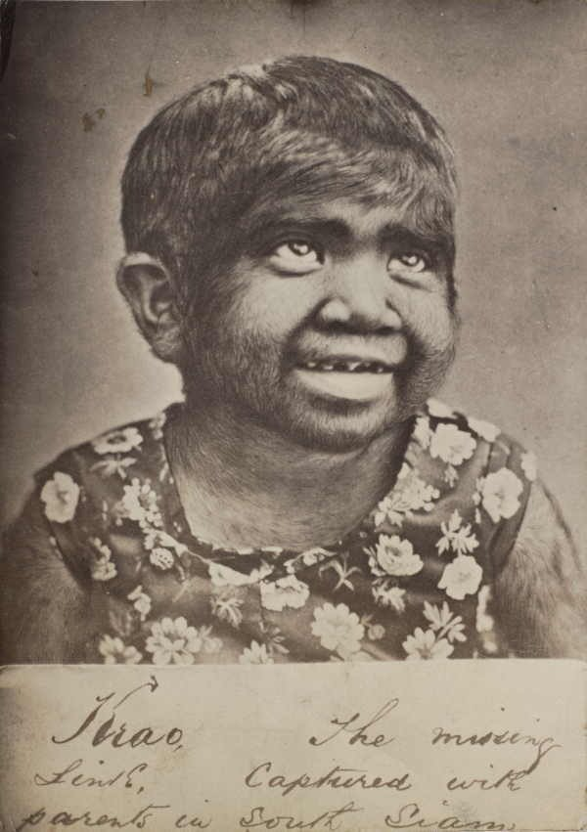

Slide 15
Rise of Scientific Racism

Slide 16
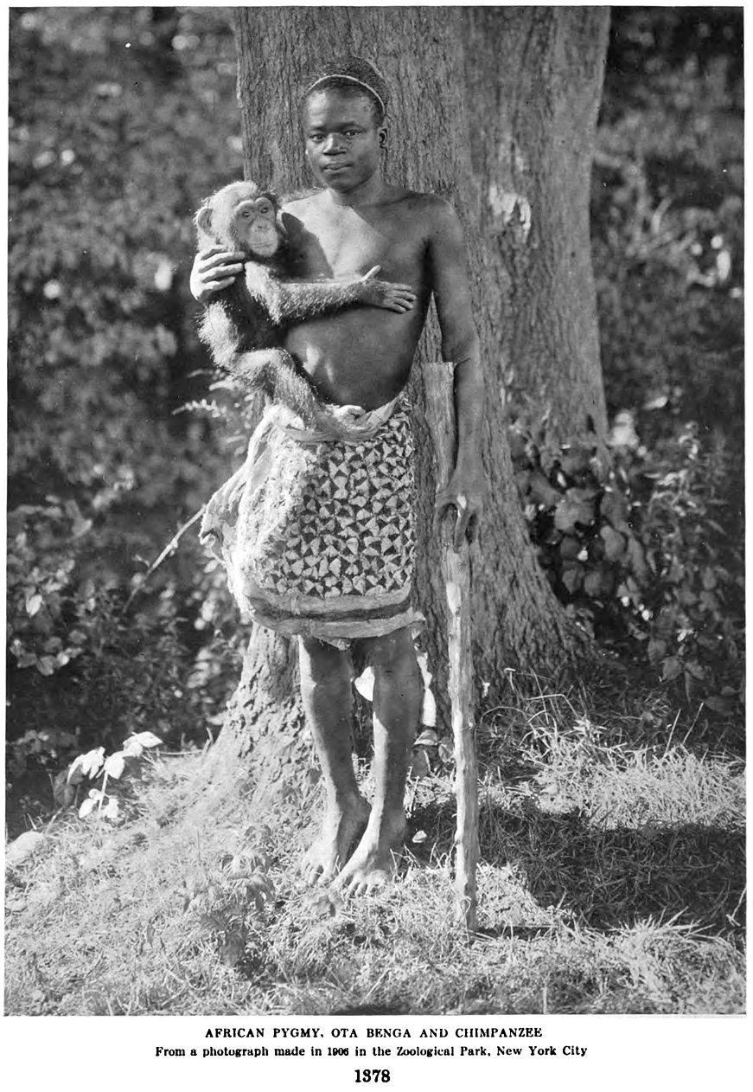

Slide 17
Rise of Scientific Racism
Francis Galton
Cousin of Charles Darwin
“Eugenics” – 1883
  “Breeding better people”

Slide 18
Darwin in 1862
“It is very true what you say about the higher races of men, when high enough, replacing & clearing off the lower races. In 500 years how the Anglo-saxon race will have spread & exterminated whole nations; & in consequence how much the Human race, viewed as a unit, will have risen in rank.”

Slide 19
Darwin in 1881
“Remember what risks the nations of Europe ran, not so many centuries ago of being overwhelmed by the Turks, and how ridiculous such an idea now is. The more civilized so-called Caucasian races have beaten the Turkish hollow in the struggle for existence. Looking to the world at no very distant date, what an endless number of the lower races will have been eliminated by the higher civilized races throughout the world.”

Slide 20
2nd International Congress on Eugenics
New York
Harvard, Yale, Ohio State, UC Berkley, Univ of Texas,
Smithsonian, etc…
“Eugenics was essential to human evolution”
“Scientific justification for racism”

Slide 21
Eugenic Laws

Slide 22
Eugenic Laws & Classrooms

Slide 23
“The Passing of the Great Race”
Madison Grant
1916
Superiority of the Nordic Race
Would become Hitler’s Bible

Slide 24
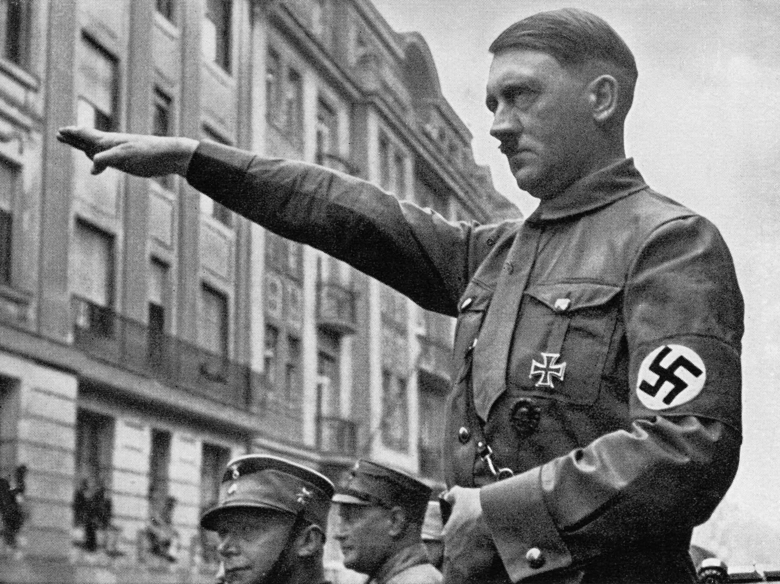

Slide 25
Gen 2:7 And the LORD God formed man of the dust of the ground, and breathed into his nostrils the breath of life; and man became a living being.

Slide 26
Human Races?

Slide 27
Zec 9:6 "A mixed race shall settle in Ashdod, And I will cut off the pride of the Philistines.

Slide 28
Zec 9:6 "A mixed race shall settle in Ashdod, And I will cut off the pride of the Philistines.
mamzêr – Strongs “…that is, born of a Jewish father and a heathen mother”

Slide 29
Gen 3:20 And Adam called his wife's name Eve, because she was the mother of all living.

Slide 30
Act 17:26 And He has made from one blood every nation of men to dwell on all the face of the earth, and has determined their preappointed times and the boundaries of their dwellings,

Slide 31
Rev 7:9 After these things I looked, and behold, a great multitude which no one could number, of all nations, tribes, peoples, and tongues, standing before the throne and before the Lamb, clothed with white robes, with palm branches in their hands,

Slide 32
Rev 7:9 After these things I looked, and behold, a great multitude which no one could number, of all nations, tribes, peoples, and tongues, standing before the throne and before the Lamb, clothed with white robes, with palm branches in their hands,
Rev 14:6 Then I saw another angel flying in the midst of heaven, having the everlasting gospel to preach to those who dwell on the earth to every nation, tribe, tongue, and people

Slide 33
Mat 5:9 Blessed are the peacemakers, For they shall be called sons of God.
Rom 8:14 For as many as are led by the Spirit of God, these are sons of God.
Gal 3:26 For you are all sons of God through faith in Christ Jesus.

Slide 34
Gen 4:26 And as for Seth, to him also a son was born; and he named him Enosh. Then men began to call on the name of the LORD.

Slide 35
Gen 6:1 Now it came to pass, when men began to multiply on the face of the earth, and daughters were born to them,
Gen 6:2 that the sons of God saw the daughters of men, that they were beautiful; and they took wives for themselves of all whom they chose.

Slide 36
Gen 24:3 and I will make you swear by the LORD, the God of heaven and the God of the earth, that you will not take a wife for my son from the daughters of the Canaanites, among whom I dwell;

Slide 37
Gen 24:4 but you shall go to my country and to my family, and take a wife for my son Isaac."

Slide 38
Gen 27:46 And Rebekah said to Isaac, "I am weary of my life because of the daughters of Heth; if Jacob takes a wife of the daughters of Heth, like these who are the daughters of the land, what good will my life be to me?"

Slide 39
Gen 36:2 Esau took his wives from the daughters of Canaan: Adah the daughter of Elon the Hittite; Aholibamah the daughter of Anah, the daughter of Zibeon the Hivite;

Slide 40
Gen 10:15 Canaan begot Sidon his firstborn, and Heth;

Slide 41
Gen 28:1 Then Isaac called Jacob and blessed him, and charged him, and said to him: "You shall not take a wife from the daughters of Canaan.

Slide 42
Exo 34:12 Take heed to yourself, lest you make a covenant with the inhabitants of the land where you are going, lest it be a snare in your midst.

Slide 43
Exo 34:13 But you shall destroy their altars, break their sacred pillars, and cut down their wooden images
Exo 34:14 (for you shall worship no other god, for the LORD, whose name is Jealous, is a jealous God),

Slide 44
Exo 34:15 lest you make a covenant with the inhabitants of the land, and they play the harlot with their gods and make sacrifice to their gods, and one of them invites you and you eat of his sacrifice,
Exo 34:16 and you take of his daughters for your sons, and his daughters play the harlot with their gods and make your sons play the harlot with their gods.

Slide 45
Deu 7:1 "When the LORD your God brings you into the land which you go to possess, and has cast out many nations before you, the Hittites and the Girgashites and the Amorites and the Canaanites and the Perizzites and the Hivites and the Jebusites, seven nations greater and mightier than you,

Slide 46
Deu 7:3 Nor shall you make marriages with them. You shall not give your daughter to their son, nor take their daughter for your son.
Deu 7:4 For they will turn your sons away from following Me, to serve other gods; so the anger of the LORD will be aroused against you and destroy you suddenly.

Slide 47
Jos 23:12 Or else, if indeed you do go back, and cling to the remnant of these nations—these that remain among you—and make marriages with them, and go in to them and they to you,
Jos 23:16 When you have transgressed the covenant of the LORD your God, which He commanded you, and have gone and served other gods, and bowed down to them, then the anger of the LORD will burn against you, and you shall perish quickly from the good land which He has given you."

Slide 48
2Co 6:14 Do not be unequally yoked together with unbelievers. For what fellowship has righteousness with lawlessness? And what communion has light with darkness?
1Co 7:39 A wife is bound by law as long as her husband lives; but if her husband dies, she is at liberty to be married to whom she wishes, only in the Lord.

Slide 49
Darwin, Eugenics & Human Races

