Slide 1
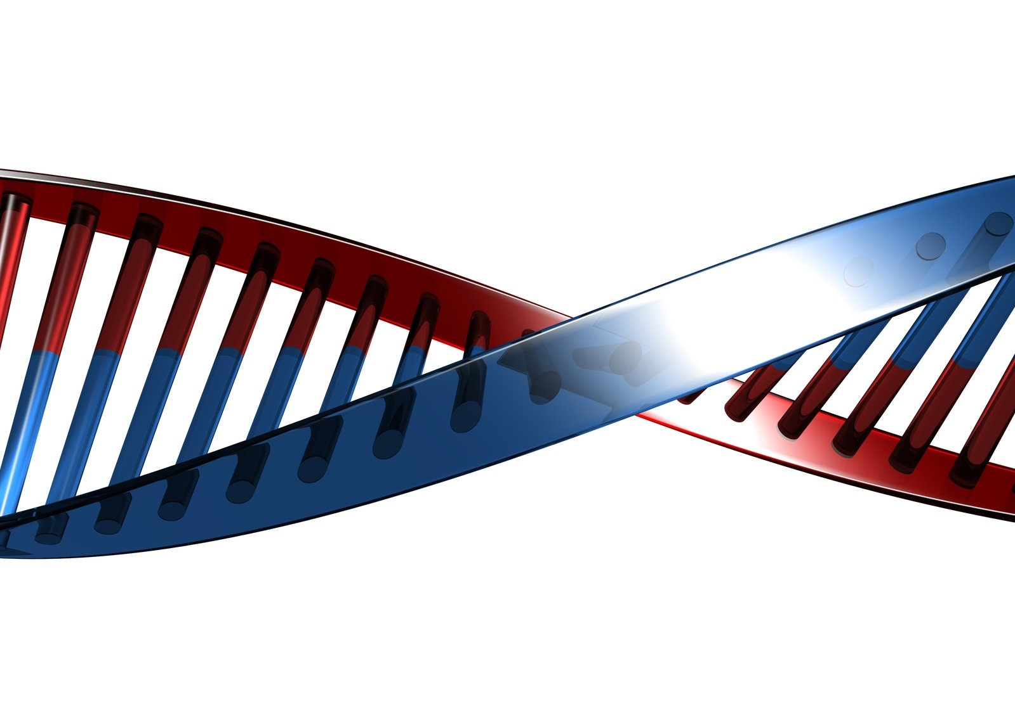
Darwin, Eugenics & Human Races
Part Two

Slide 2

Israelites: A Superior Race?

Slide 3
Deuteronomy 21:10-14
Could marry captives of nations they conquered

Slide 4
Exo 12:48 And when a stranger dwells with you and wants to keep the Passover to the LORD…

Slide 5
Exo 12:48 And when a stranger dwells with you and wants to keep the Passover to the LORD…
BDB: “a temporary inhabitant, a newcomer lacking inherited rights”

Slide 6
Exo 12:48 … let all his males be circumcised, and then let him come near and keep it; and he shall be as a native of the land. For no uncircumcised person shall eat it.
Exo 12:49 One law shall be for the native-born and for the stranger who dwells among you."

Slide 7
Num 15:13 All who are native-born shall do these things in this manner, in presenting an offering made by fire, a sweet aroma to the LORD.
Num 15:14 And if a stranger dwells with you, or whoever is among you throughout your generations, and would present an offering made by fire, a sweet aroma to the LORD, just as you do, so shall he do.

Slide 8
Num 15:15 One ordinance shall be for you of the assembly AND for the stranger who dwells with you, an ordinance forever throughout your generations; as you are, so shall the stranger be before the LORD.
Num 15:16 One law and one custom shall be for you and for the stranger who dwells with you.' "

Slide 9
Jer 18:7 The instant I speak concerning a nation and concerning a kingdom, to pluck up, to pull down, and to destroy it,
Jer 18:8 IF that nation against whom I have spoken turns from its evil, I will relent of the disaster that I thought to bring upon it.

Slide 10
Jer 18:9 And the instant I speak concerning a nation and concerning a kingdom, to build and to plant it,
Jer 18:10 IF it does evil in My sight so that it does not obey My voice, then I will relent concerning the good with which I said I would benefit it.

Slide 11
Church today: Superior people?

Slide 12
1Co 1:26 For you see your calling, brethren, that not many wise according to the flesh, not many mighty, not many noble, are called.
1Co 1:27 But God has chosen the foolish things of the world to put to shame the wise, and God has chosen the weak things of the world to put to shame the things which are mighty;

Slide 13
1Co 1:28 and the base things of the world and the things which are despised God has chosen, and the things which are not, to bring to nothing the things that are,
1Co 1:29 that no flesh should glory in His presence.

Slide 14
Gen 10:1 Now this is the genealogy of the sons of Noah: Shem, Ham, and Japheth. And sons were born to them after the flood.

Slide 15
Noah & wife
Shem & wife
Ham & wife
Japheth & wife

Slide 16
Gen 1:28 Then God blessed them, and God said to them, "Be fruitful and multiply; fill the earth…

Slide 17
Gen 1:28 Then God blessed them, and God said to them, "Be fruitful and multiply; fill the earth…
Gen 9:1 So God blessed Noah and his sons, and said to them: "Be fruitful and multiply, and fill the earth.

Slide 18
Gen 9:18 Now the sons of Noah who went out of the ark were Shem, Ham, and Japheth. And Ham was the father of Canaan.
Gen 9:19 These three were the sons of Noah, and from these the whole earth was populated.

Slide 19
Gen 10:1 Now this is the genealogy of the sons of Noah: Shem, Ham, and Japheth. And sons were born to them after the flood.
Gen 10:2 The sons of Japheth were…
Gen 10:5 From these the coastland peoples of the Gentiles were separated into their lands, everyone according to his language, according to their families, into their nations.

Slide 20
Gen 10:6 The sons of Ham were Cush, Mizraim, Put, and Canaan.
Gen 10:20 These were the sons of Ham, according to their families, according to their languages, in their lands and in their nations.

Slide 21
Gen 10:21 And children were born also to Shem, …
Gen 10:31 These were the sons of Shem, according to their families, according to their languages, in their lands, according to their nations.

Slide 22
Gen 10:32 These were the families of the sons of Noah, according to their generations, in their nations; and from these the nations were divided on the earth after the flood.

Slide 23
Act 17:26 And He has made from one blood every nation of men to dwell on all the face of the earth, and has determined their preappointed times and the boundaries of their dwellings,
Act 17:27 so that they should seek the Lord, in the hope that they might grope for Him and find Him, though He is not far from each one of us;

Slide 24
Gen 11:1 Now the whole earth had one language and one speech.
Gen 11:2 And it came to pass, as they journeyed from the east, that they found a plain in the land of Shinar, and they dwelt there.

Slide 25
Gen 11:4 And they said, "Come, let us build ourselves a city, and a tower whose top is in the heavens; let us make a name for ourselves, … lest… we be scattered abroad over the face of the whole earth."

Slide 26
Gen 11:6 And the LORD said, "Indeed the people are one and they all have one language, and this is what they begin to do; now nothing that they propose to do will be withheld from them.
Gen 11:7 Come, let Us go down and there confuse their language, that they may not understand one another's speech."

Slide 27
Gen 11:8 So the LORD scattered them abroad from there over the face of all the earth, and they ceased building the city.
Gen 11:9 Therefore its name is called Babel, because there the LORD confused the language of all the earth; and from there the LORD scattered them abroad over the face of all the earth.

Slide 28


Slide 30
Why do we look so different?

Slide 32



Slide 33
B
B

Slide 34
B
B
B
B
B
B

Slide 35
B
b

Slide 36
B
b
B
b
B
b

Slide 37
B
B
B
B
B
B
B
B

Slide 38
B
B
B
B
B
B
B
B
B
B
B
B

Slide 39
B
B
B
B
B
B
B
b
B
b
B
b

Slide 40
B
B
B
B
B
B
B
B
B
B
B
B

Slide 41
B
B
B
B
B
B
B
b
B
b
B
b

Slide 42
B
b
B
B
B
b
B
b
B
b
b
b

Slide 43
b
b
b
b
b
b
b
b
b
b
b
b

Slide 44
B
B
b
B
b
B
b
b
B
b
B
b

Slide 45
Gen 1:24 Then God said, "Let the earth bring forth the living creature according to its kind: cattle and creeping thing and beast of the earth, each according to its kind"; and it was so.
Gen 1:25 And God made the beast of the earth according to its kind, cattle according to its kind, and everything that creeps on the earth according to its kind. And God saw that it was good.

Slide 46
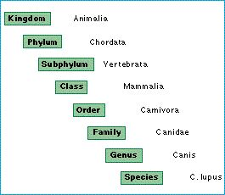

Slide 47


Slide 48


Slide 49
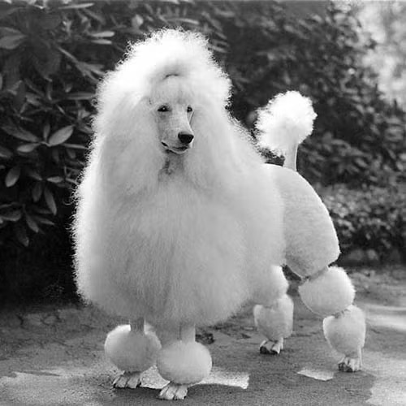

Slide 50
Adam & Eve:
Full of all the genetic variations

Slide 51
Human Genome Project:
Human ~ 3 million base pairs in our DNA

Slide 52


Slide 53
Difference between two strangers
2 out of every 1,000 rungs on the ladder (.2% variance)

Slide 54


Slide 55
Genes for Appearance
1 out of every 10,000 rungs on the ladder (.01% of our genes)

Slide 56
Evolutionists Journal in 2008 concluded:
“The idea of race from a genetic standpoint has been abolished.”

Slide 57
Human Genome Project’s conclusion:
“There is only one race…the human race.”

Slide 61
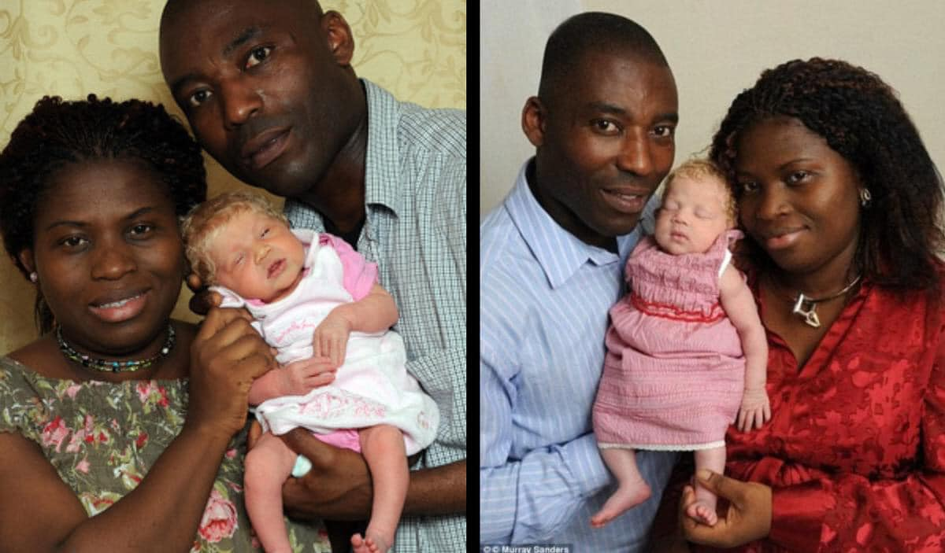

Slide 62
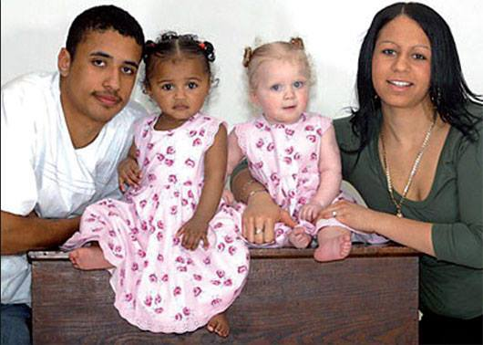

Slide 63
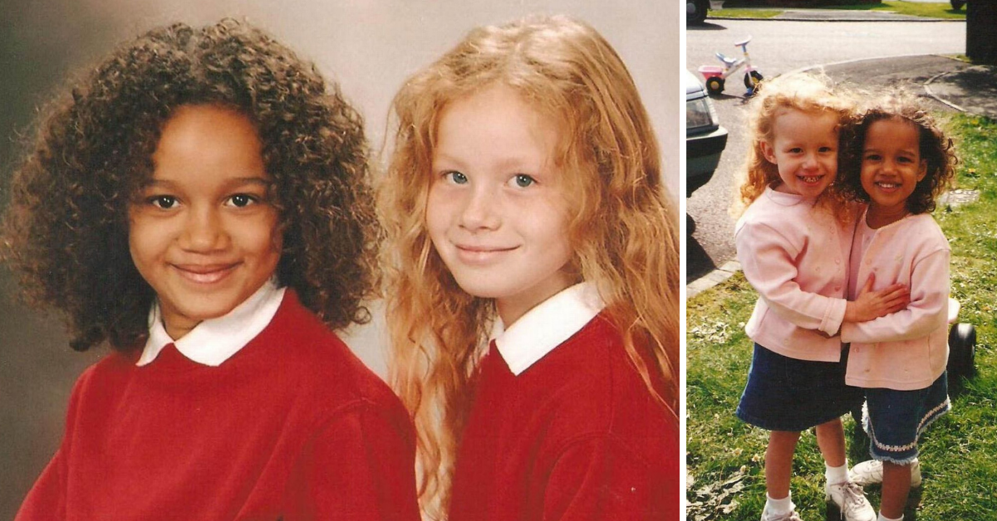

Slide 64


Slide 65
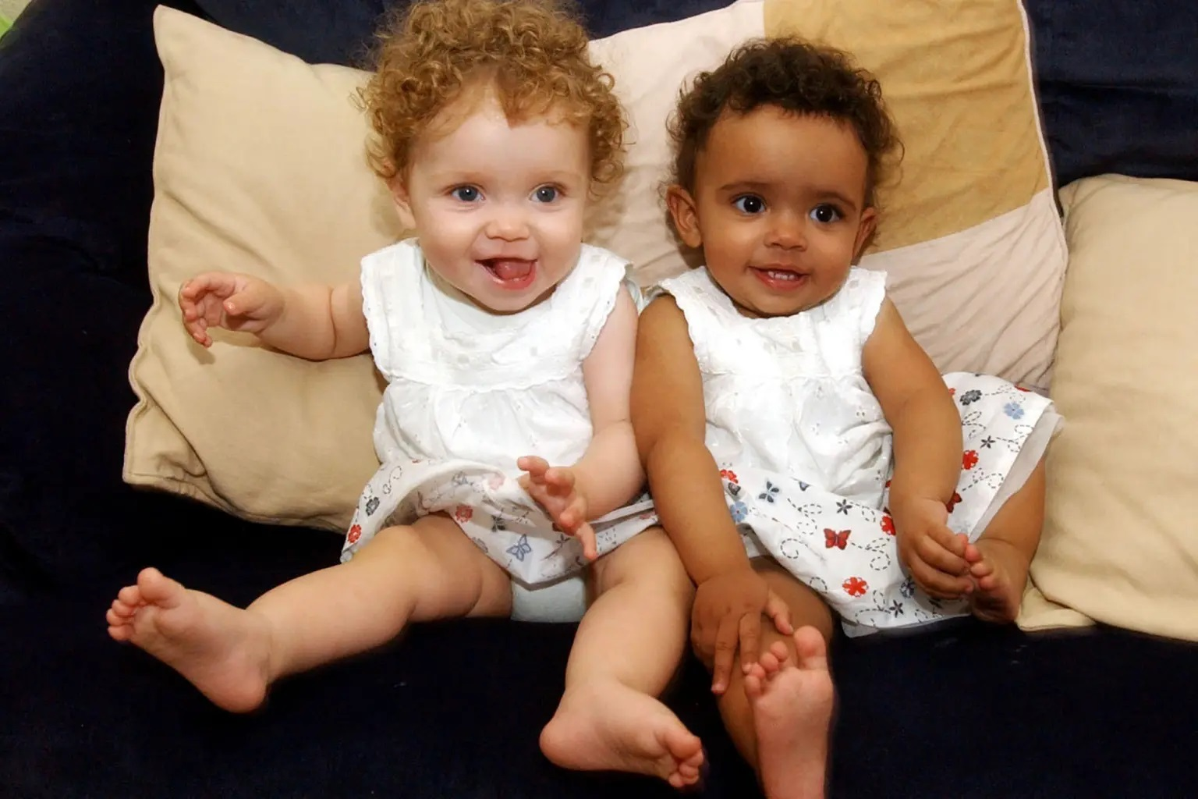

Slide 66


Slide 67


Slide 68
Curse of Ham?

Slide 69
Gen 9:20 And Noah began to be a farmer, and he planted a vineyard.
Gen 9:21 Then he drank of the wine and was drunk, and became uncovered in his tent.
Gen 9:22 And Ham, the father of Canaan, saw the nakedness of his father, and told his two brothers outside.

Slide 70
Gen 9:23 But Shem and Japheth took a garment, laid it on both their shoulders, and went backward and covered the nakedness of their father. Their faces were turned away, and they did not see their father's nakedness.

Slide 71
Gen 9:24 So Noah awoke from his wine, and knew what his younger son had done to him.
Gen 9:25 Then he said: "Cursed be Canaan; A servant of servants He shall be to his brethren."

Slide 72
Gen 9:26 And he said: "Blessed be the LORD, The God of Shem, And may Canaan be his servant.
Gen 9:27 May God enlarge Japheth, And may he dwell in the tents of Shem; And may Canaan be his servant."

Slide 73
Gen 9:24 So Noah awoke from his wine, and knew what his younger son had done to him.
Gen 9:25 Then he said: "Cursed be Canaan; A servant of servants He shall be to his brethren."

Slide 74
Gen 9:24 So Noah awoke from his wine, and knew what his younger son had done to him.
Gen 9:25 Then he said: "Cursed be Canaan; A servant of servants He shall be to his brethren."

Slide 75
Shem…Ham…Japheth
Compare:
Genesis 5:32, 6:10, 7:13, 9:18, 10:1
1 Chronicles 1:4

Slide 76
Gen 9:24 So Noah awoke from his wine, and knew what his younger son had done to him.
Gen 9:25 Then he said: "Cursed be Canaan; A servant of servants He shall be to his brethren."

Slide 77
Gen 10:6 The sons of Ham were Cush, Mizraim, Put, and Canaan.
1Ch 1:8 The sons of Ham were Cush, Mizraim, Put, and Canaan.

Slide 78
Gen 9:24 So Noah awoke from his wine, and knew what his youngest grandson had done to him.
Gen 9:25 Then he said: "Cursed be Canaan; A servant of servants He shall be to his brethren."

Slide 79
Gen 24:3… you will not take a wife for my son from the daughters of the Canaanites
Exo 34:12… Take heed to yourself, lest you make a covenant with the inhabitants of the land where you are going [i.e. Canaanites]
Deut 7:1…"When the LORD your God brings you into the land which you go to possess, and has cast out many nations before you…[i.e. Canaanites]

Slide 80
Deu 7:3 Nor shall you make marriages with them
Deu 7:4 For they will turn your sons away from following Me, to serve other gods…

Slide 81
UCG Q&A: “Does the Bible Promote Racism?
“Attempts to interject race into stories such as those of Ham and Cain are completely without basis. Such interpretations are in direct conflict with Scripture. Such claims display an ignorance of God's love for all mankind and His desire to honor us as His sons and daughters for all eternity.”

Slide 82
1Sa 16:6 So it was, when they came, that he looked at Eliab and said, "Surely the LORD's anointed is before Him!"
1Sa 16:7 But the LORD said to Samuel, "Do not look at his appearance or at his physical stature, because I have refused him. For the LORD does not see as man sees; for man looks at the outward appearance, but the LORD looks at the heart."

Slide 83
Jas 2:1 My brethren, do not hold the faith of our Lord Jesus Christ, the Lord of glory, with partiality.
Jas 2:2 For if there should come into your assembly a man with gold rings, in fine apparel, and there should also come in a poor man in filthy clothes,

Slide 84
Jas 2:3 and you pay attention to the one wearing the fine clothes and say to him, "You sit here in a good place," and say to the poor man, "You stand there," or, "Sit here at my footstool,"
Jas 2:4 have you not shown partiality among yourselves, and become judges with evil thoughts?

Slide 85
Act 10:34 Then Peter opened his mouth and said: "In truth I perceive that God shows no partiality.
Act 10:35 But in every nation whoever fears Him and works righteousness is accepted by Him.

Slide 86
Gal 3:28 There is neither Jew nor Greek, there is neither slave nor free, there is neither male nor female; for you are all one in Christ Jesus.

Slide 87
Rev 14:6 … having the everlasting gospel to preach to those who dwell on the earth to every nation, tribe, tongue, and people—

Slide 88
One blood…
One family…
One Savior!

Slide 89
Darwin, Eugenics & Human Races
Part Two

