Slide 1
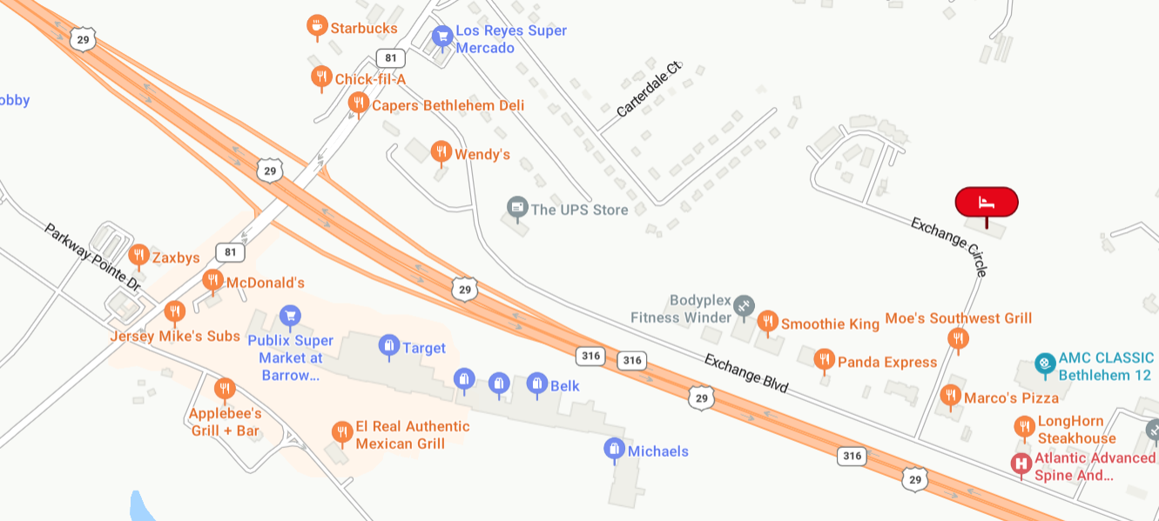
City of Winder
Turn off of Hwy 81 at Waffle House
City of Winder
Hwy 316 East/West
Holiday Inn Express – Winder 775 Exchange Circle, Winder
Hwy 81
Large Electronic Sign next to road – landmark to turn to Hotel.

