Slide 1
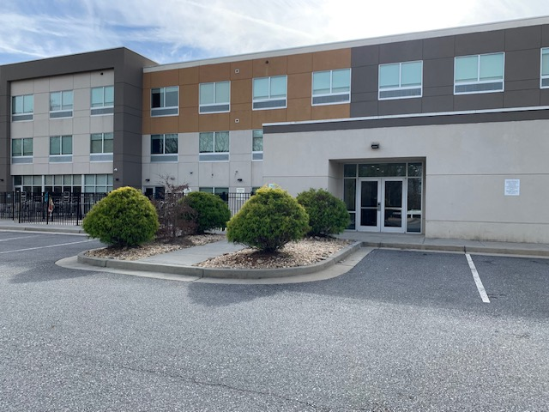
Church Parking at the Rear of the Hotel
Rear Meeting Room Entrance
Pool

