Slide 1
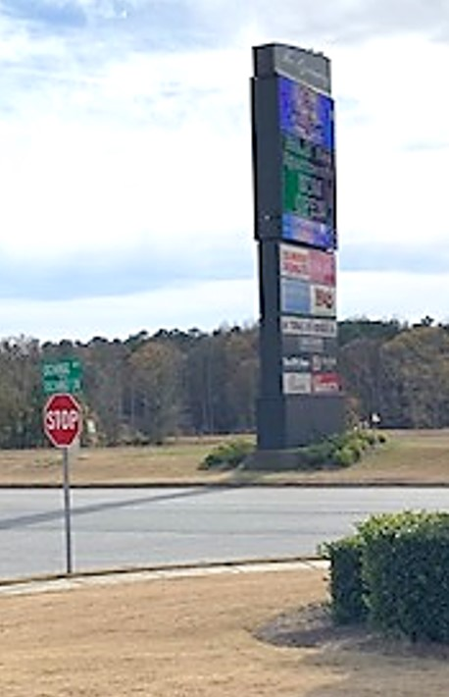
Heading to the Holiday Inn on Exchange Blvd (the access road beside Hwy 316) –
Turn left at this tall electronic sign onto Exchange Circle - it leads straight to the hotel.

