Slide 2
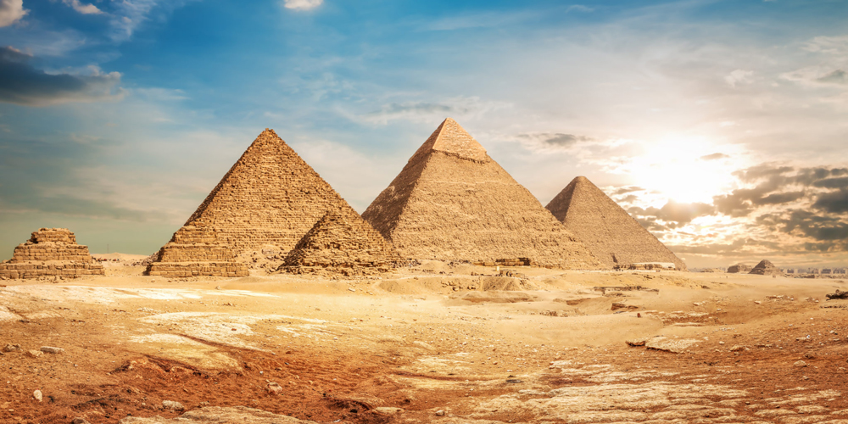
Happy Sabbath

Slide 3
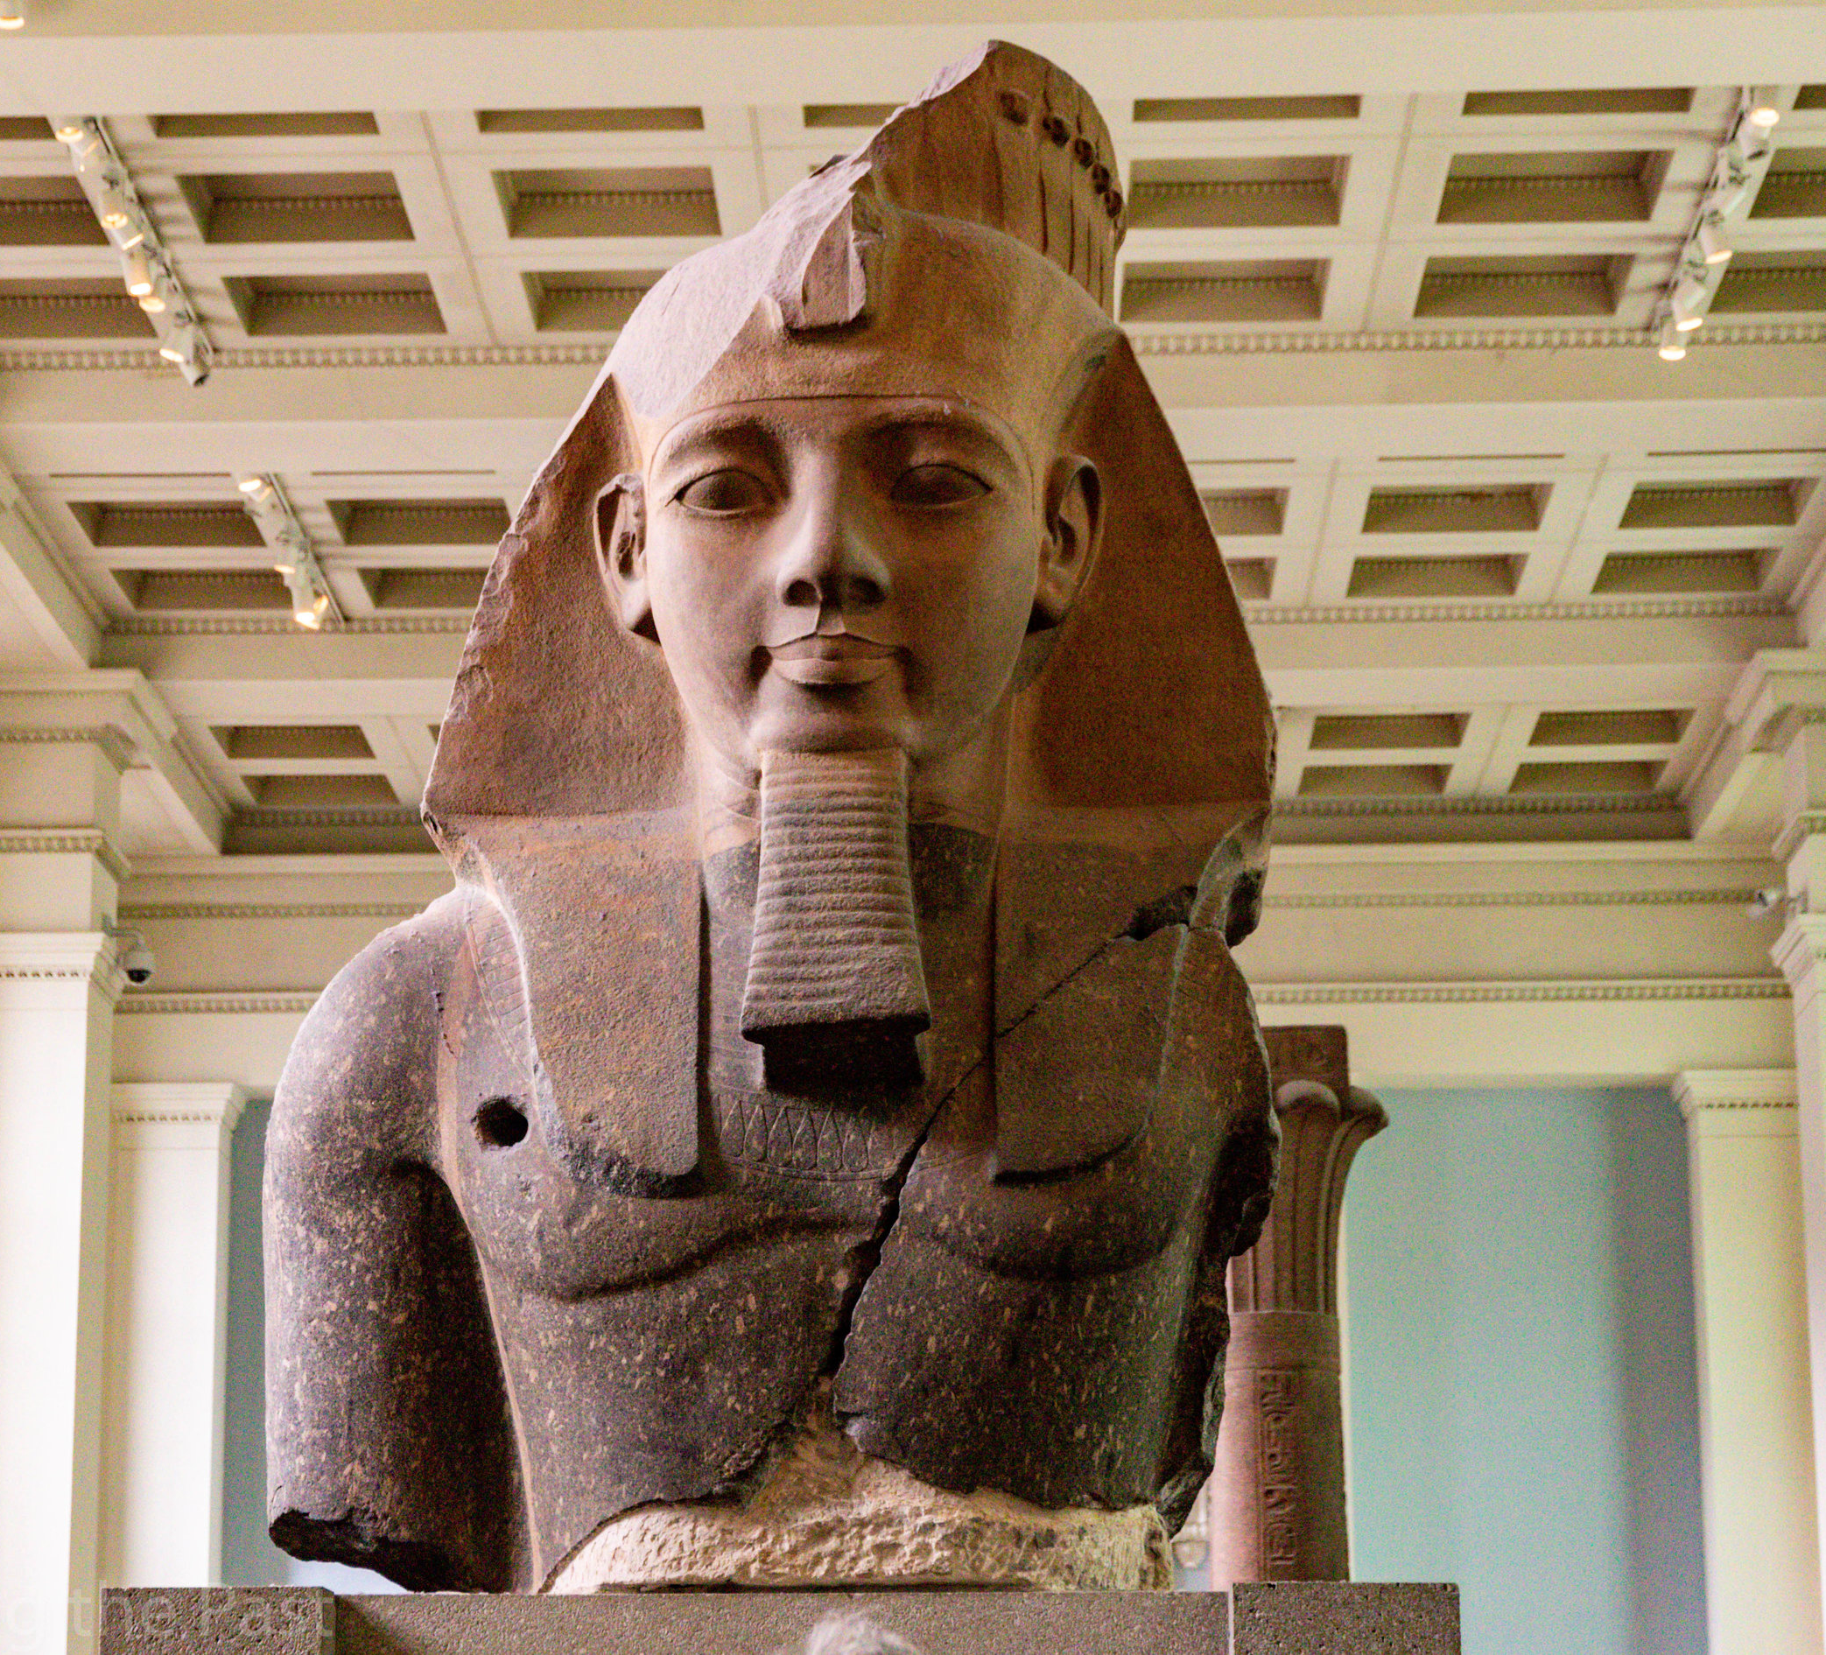
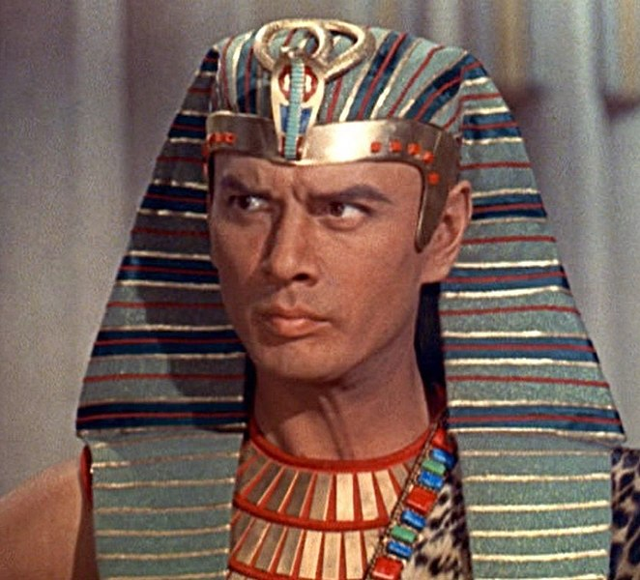
RAMESES II

Slide 4
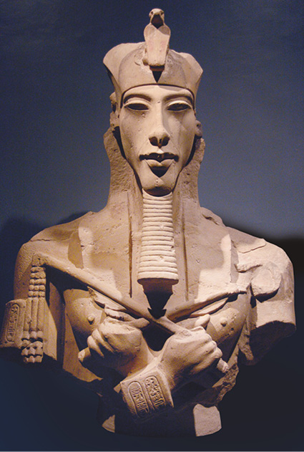
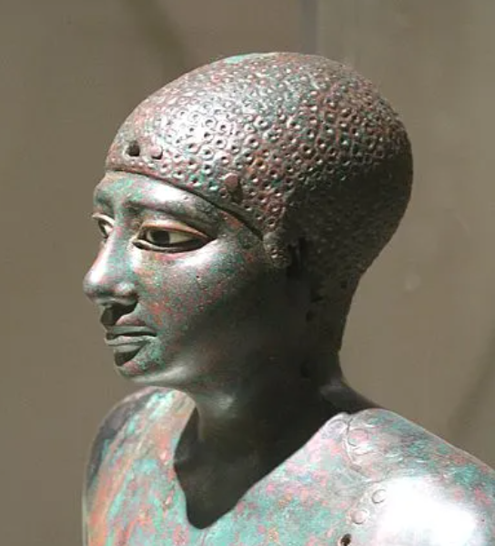
Akhenaten
Nemtyemsaf II

Slide 5
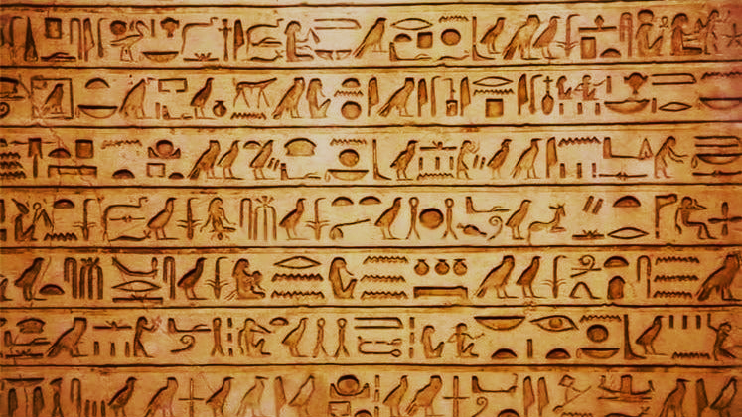
“. . . And they built for Pharaoh supply cities, Pithom and Rameses”
Exodus 1:11

Slide 7
Anachronism (noun) a thing belonging or appropriate to a period other than that in which it exists

Slide 9
“. . .as they are to this day”

Slide 11
“And Joseph situated his father and his brothers, and gave them a possession in the land of Egypt, in the best of the land, in the land of Rameses, as Pharaoh had commanded”
Genesis 47:11

Slide 12
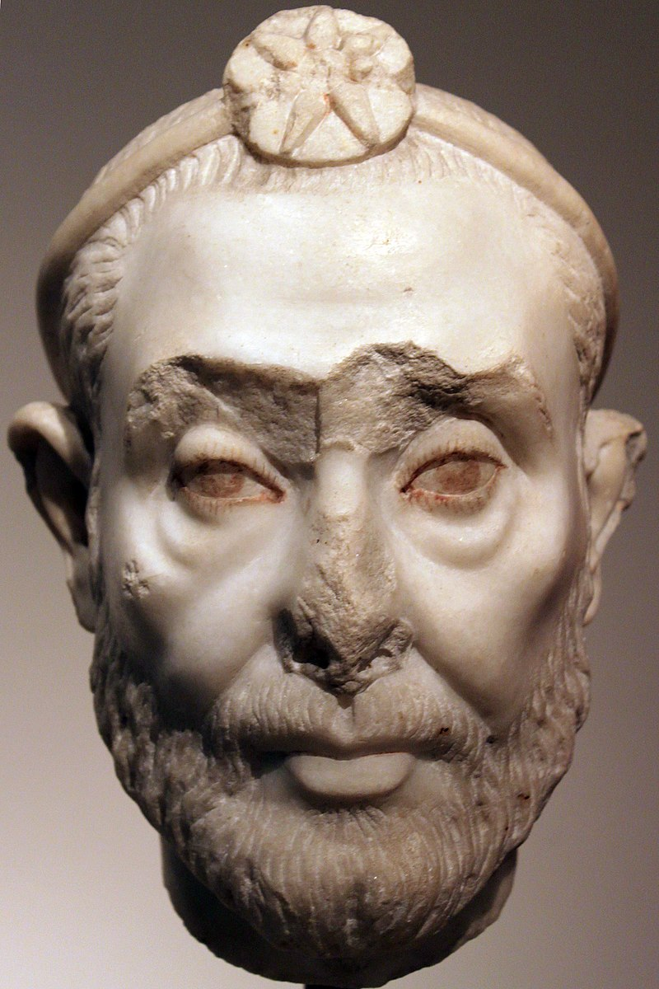
Manetho
Egyptian Priest from the Ptolemaic Period

Slide 13
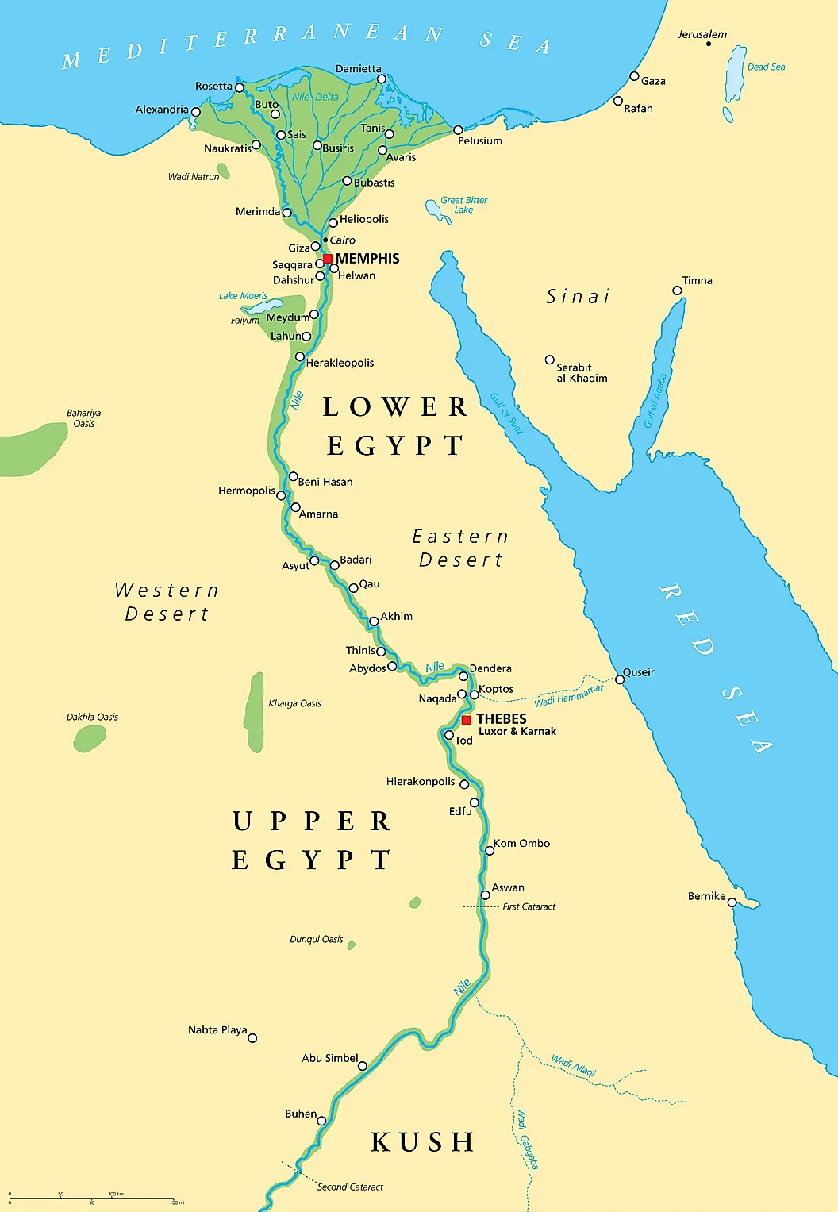
Nile Delta

Slide 14
“. . .as it’s called to this day”

Slide 15


Slide 16
“O Lord our God, other lords beside Thee have had dominion over us. But by Thee only do we make mention of Thy name . . . Thou punished and destroyed them and made all their memory to perish”
Isaiah 26:13-14

Slide 17
Damnatio Memoriae

Slide 19
“It is the glory of God to conceal a matter, but the glory of kings is to search out a matter.”
Proverbs 25:2

Slide 20
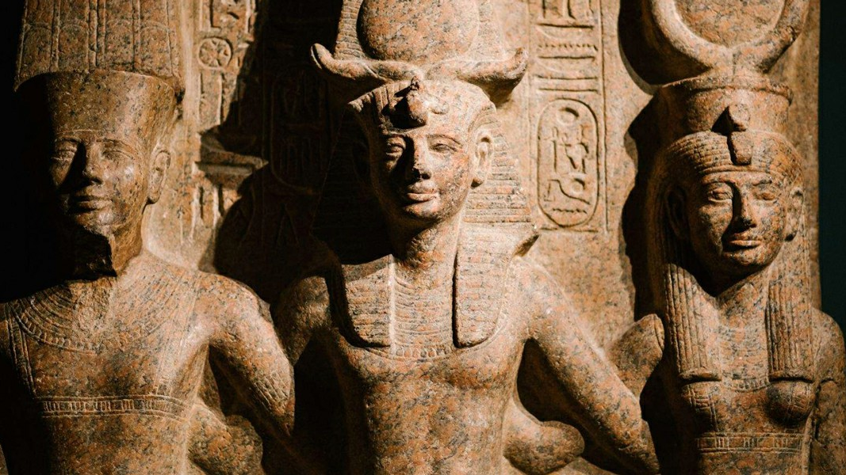
The Exodus
The Judges

Slide 21
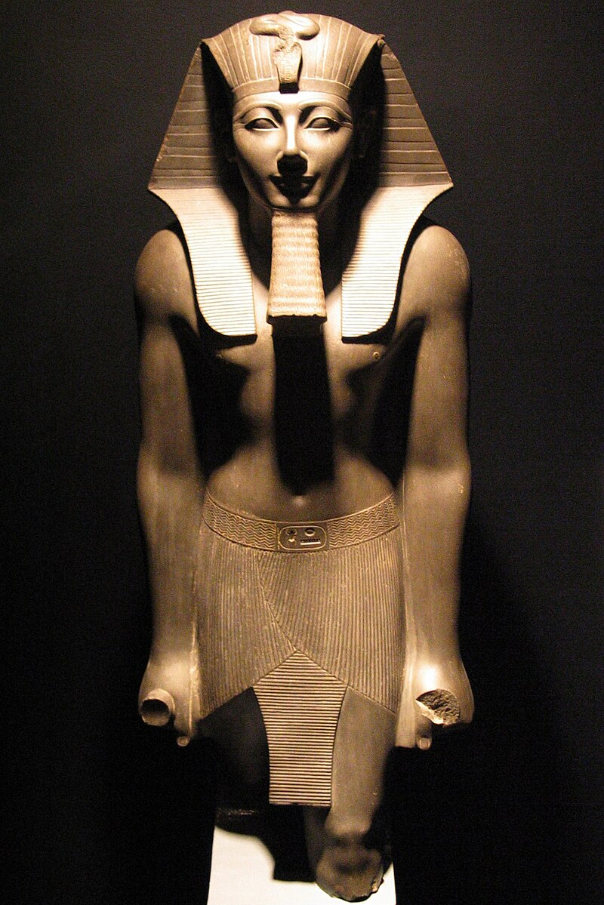
Thutmosid Dynasty
1570 – 1300 B.C.

Slide 22
“And it came to pass in the 480th year after the children of Israel had come out of the land of Egypt, in the fourth year of Solomon’s reign . . . He began to build the house of the Lord.”
1st Kings 6:1

Slide 24
Solomon’s
4th Year
1446 BC
480 Years

Slide 26
“And it came to pass in the 440th year after the departure of the children of Israel out of Egypt . . .”
1st Kings 6:1 (Septuagint)

Slide 28
Septuagint
???
???
Masoretic & KJV

Slide 30
1st Jubilee Begins = Entering Promised Land
Leviticus 25:9

Slide 31
1st Jubilee Begins = Entering Promised Land
Leviticus 25:9
Jubilee Begins = 25th Year of Exile
Ezekiel 40:1

Slide 32
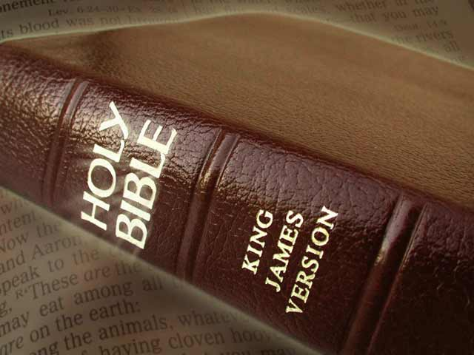
1st Jubilee Begins = 1406 BC
Exodus = 1446 BC

Slide 33
Moses
Birth
Midian
Exodus
Death
1526 BC
1486 BC
1446 BC
1406 BC

Slide 34
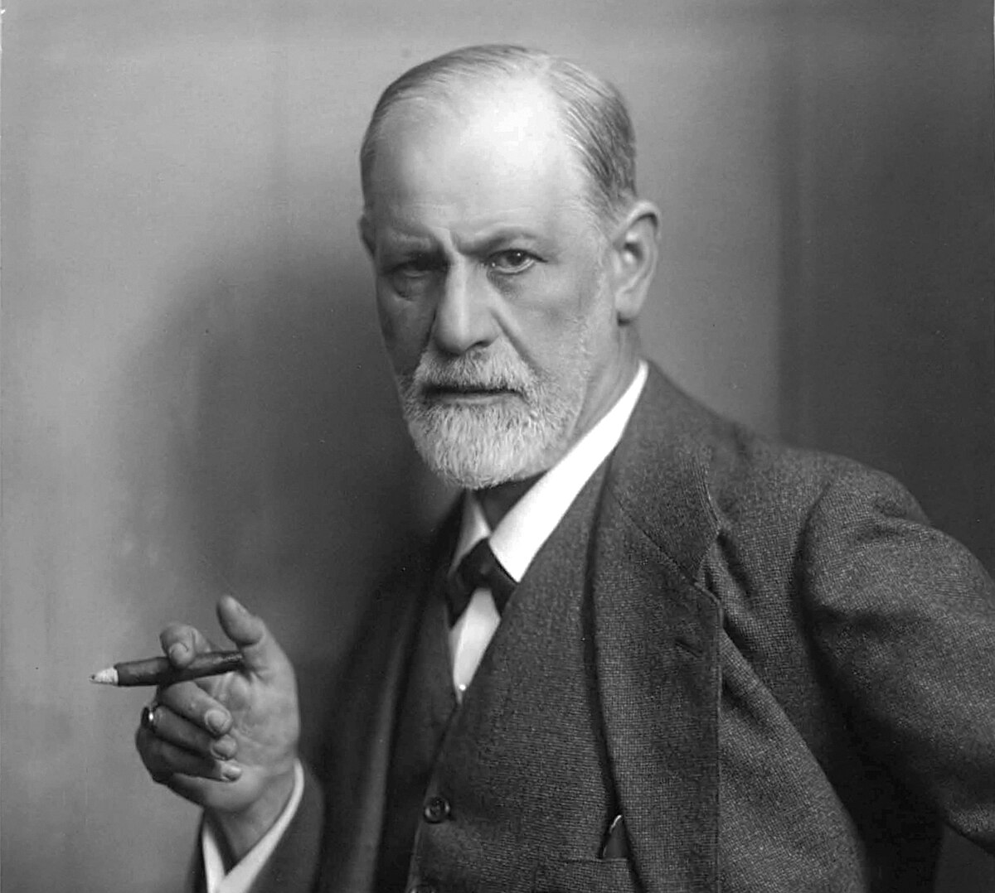

Akhenaten

Slide 35
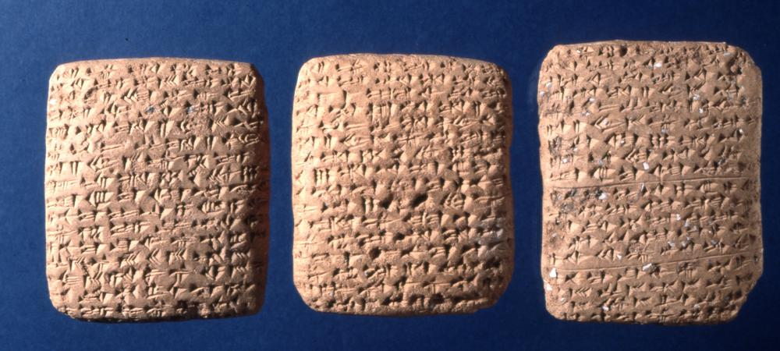
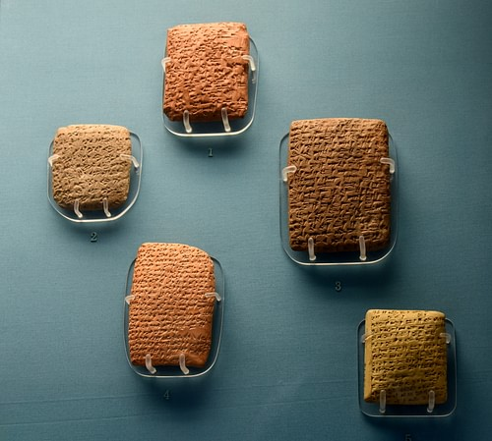
Amarna Letters

Slide 36
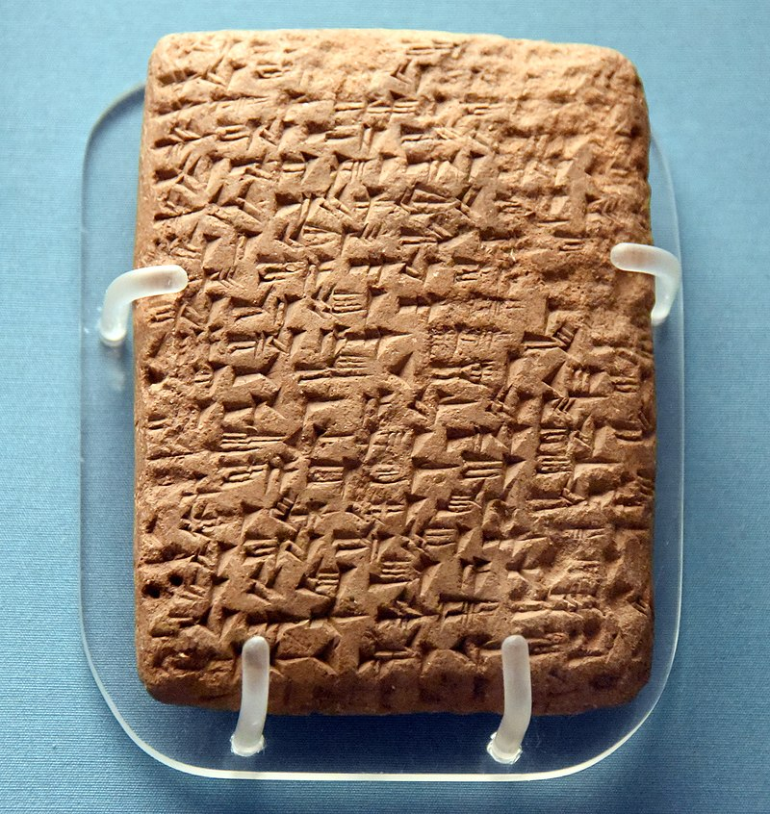
EA 299
“To the king, my lord . . . since the Habiru are stronger than we, may the king, my lord, give me his help, and may the king, my lord, get me away from the Habiru lest the Habiru destroy us.”

Slide 37
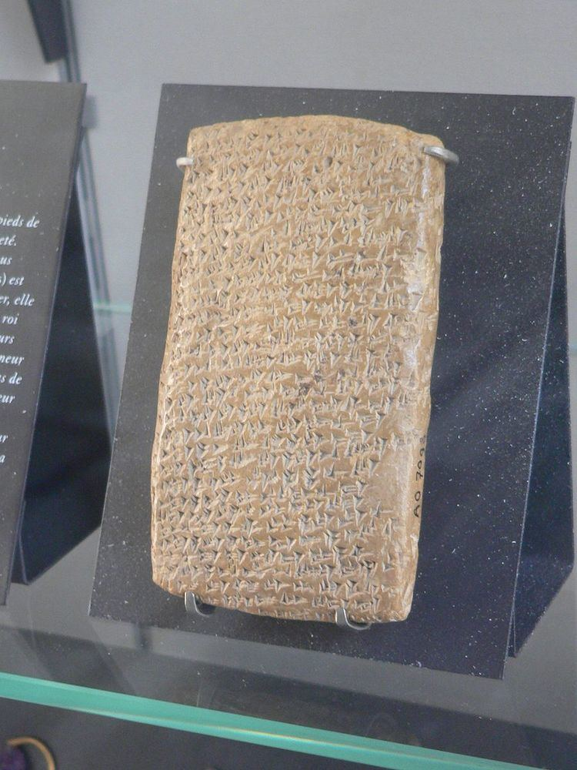
EA 286
“Message of Abdi-Heba, your servant . . . May the king provide for his land! All the lands of the king my lord, have deserted . . . Lost are all the mayors; there is not a mayor remaining to the king, my lord . . . The king has no lands. The Habiru have plundered all the lands of the king. If there are archers this year, the lands of the king, my lord, will remain.”

Slide 38
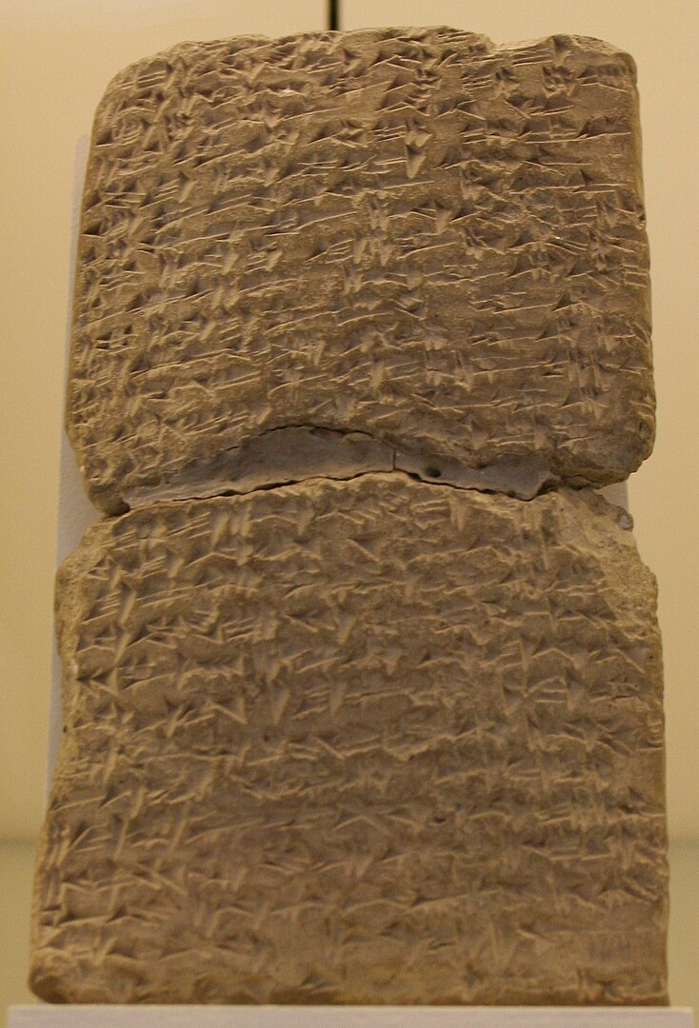
EA 288
“May the king give thought to his land; the land of the king is lost. All of it has attacked me . . . I am situated like a ship in the midst of the sea . . . Now the Habiru have taken the very cities of the king. Not a single mayor remains to the king, my lord; all are lost”

Slide 39

Acco
Armana
Bible
(EA 88, 366)
(Judges 1:31)

Slide 40
Achshaph
Armana
Bible
(EA 366)
(Joshua 11:1; 12:20)

Slide 41
Aijalon
Armana
Bible
(EA 287)
(Joshua 10:12; 21-24)

Slide 42
Beth-Shean
Armana
Bible
(EA 289)
(Joshua 17:16)
(Judges 1:27)

Slide 43
Gebal (Byblos)
Armana
Bible
(EA 68, 73, 74)
(76, 77, 88)
(90, 121, 188)
(Joshua 13:5)

Slide 44
Hebron
Armana
Bible
(EA 271, 284, 366)
(Joshua 10:5)
(verses 33, 36-37)

Slide 45
Shechem
Armana
Bible
(EA 289)
(Joshua 24:1)

Slide 46
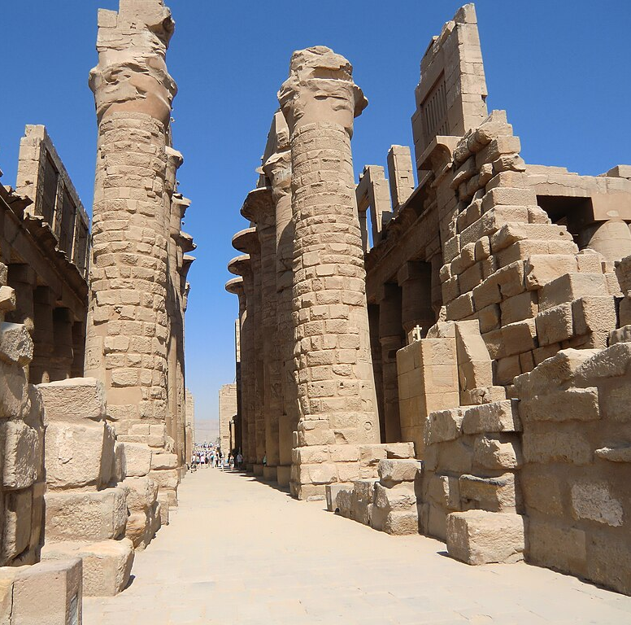
Akhenaten
“The temples of the gods are fallen to ruin; their bodies do not endure . . . I have watched as they have ceased their appearances, one after the other. All of them have stopped, except the god who gave birth to himself. And no one knows the mystery of how he performs his tasks. This god goes where he pleases and no one else knows his going.”
Pylon inscription at karnak

Slide 47
“. . .against all the gods of Egypt”
Exodus 12:12

Slide 48
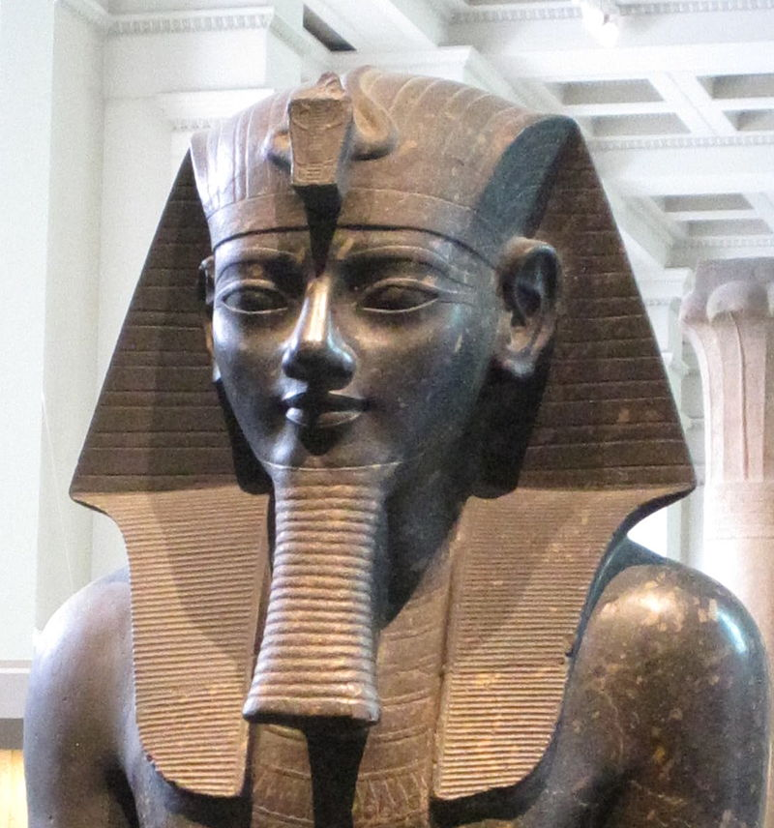
Amenhotep III
Akhenaten

Slide 49
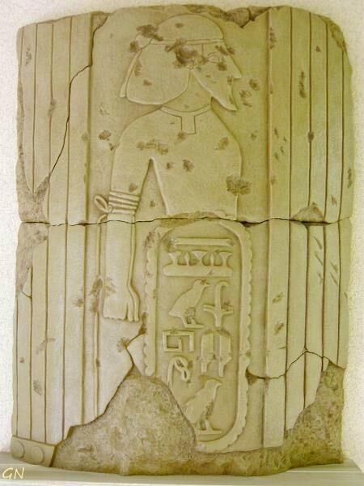
Temple column at soleb
“The land of the Shasu of YHVH”

Slide 50
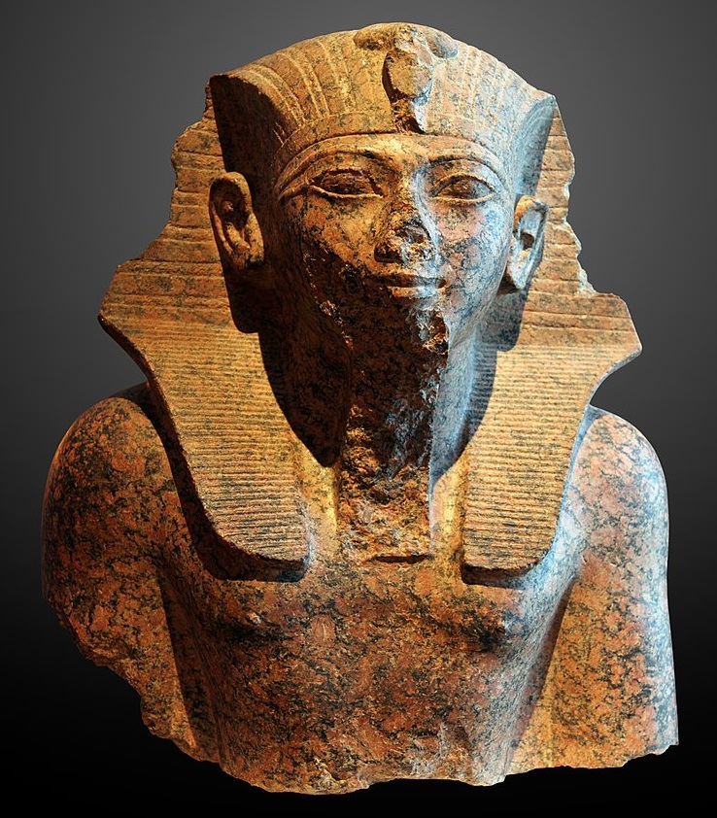
Thutmose IV
Amenhotep III

Slide 51
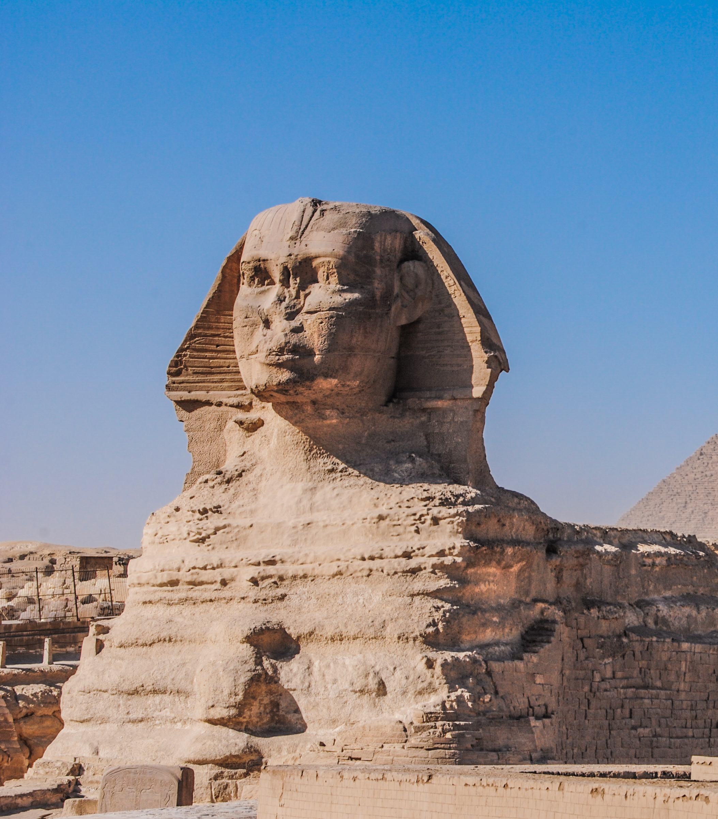
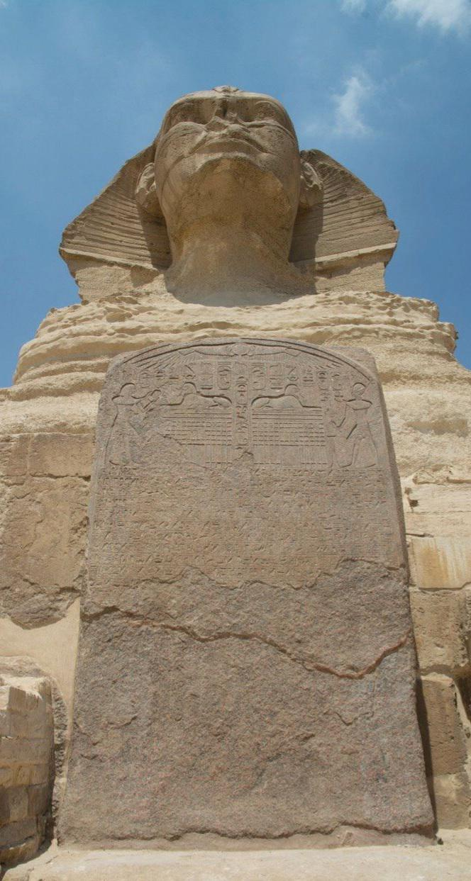
The Sphinx Dream Stele

Slide 52
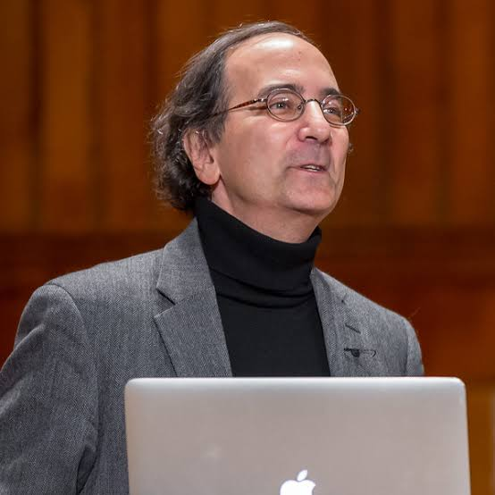
Peter Der Manuelian
Egyptologist
“It is unfortunate that the events surrounding the accession of Thutmose IV are so obscure . . . Especially since his Dream Stele between the paws of the Great Sphinx suggests that he was not the originally intended heir to the throne.”

Slide 53
“And it came to pass at midnight, that the Lord smote all the firstborn in the land of Egypt, from the first-born of Pharaoh that sat on his throne unto the first-born of the captive that was in the dungeon . . .”
Exodus 12:29

Slide 54

Pharaoh???
Thutmose IV

Slide 55
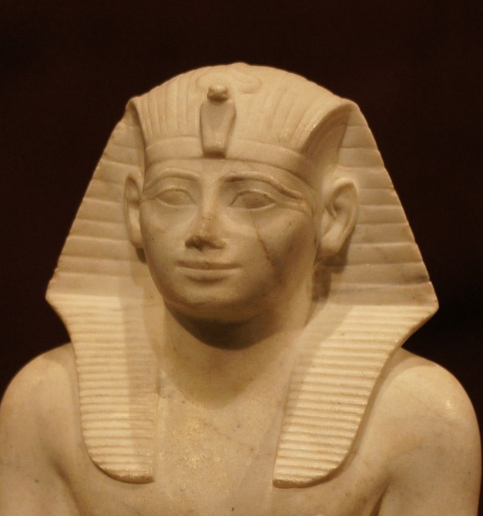
Thutmose III
Pharaoh???

Slide 56
“Now it came about in the course of those many days that the king of Egypt died. And the sons of Israel sighed because of the bondage, and they cried out; and their cry for help because of the bondage rose up to God.”
Exodus 2:23 (NASB)

Slide 57
“Now it came about in the course of those many days that the king of Egypt died. And the sons of Israel sighed because of the bondage, and they cried out; and their cry for help because of the bondage rose up to God.”
Exodus 2:23 (NASB)

Slide 59
“Now the Lord said to Moses in Midian, ‘Go, return to Egypt: For all the men who sought your life are dead.’”
Exodus 4:19

Slide 60
Thutmose III
Amenemhat

Slide 61
Thutmose III
Amenemhat
Pharaoh???

Slide 62
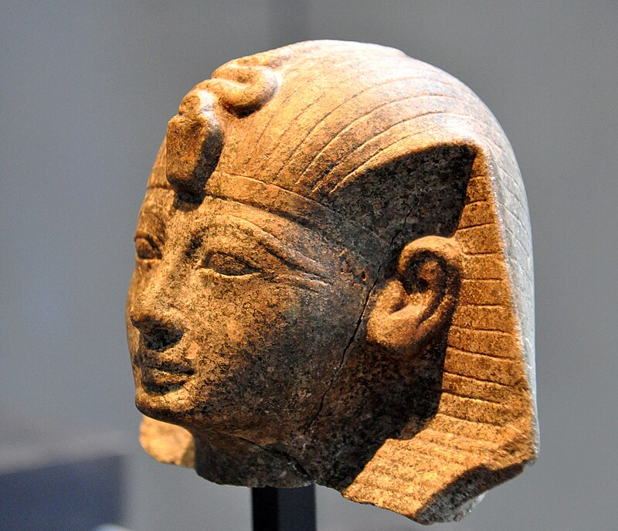
Amenhotep II

Slide 63
Peter Der Manuelian
Egyptologist
“. . . seem to emphasize first and foremost the glorification of the king through examples of excessive cruelty . . . [he] may have taken royal ruthlessness to new extremes.”

Slide 64
Peter Der Manuelian
Egyptologist

Slide 65
Peter Der Manuelian
Egyptologist
“A penchant for what seems almost a casual narration of the king’s gruesome treatment of his enemies.”

Slide 66

“. . . Set ablaze in a fiery holocaust.”

Slide 68
“mixed multitude” (Ex. 12:38)

Slide 69
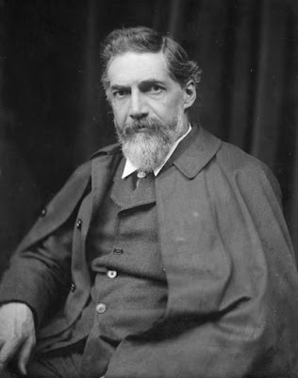
Sir William Petrie
Egyptologist
“Of the remainder of his reign, we know nothing. Nothing strikes us as more extraordinary than the condition of injury and confusion in which the most important buildings of Egypt seem to have remained. The most imposing works stood amidst half-ruined and unfinished halls; other structures were either incomplete or half-ruined.”

Slide 70

Dr. Scott Stripling
Archaeologist
“Much of [the] Avaris Stratum points to the presence of a Semitic population until a mysterious abandonment in the mid-18th Dynasty.”

Slide 71
“By faith, Moses . . . Refused to be called the son of Pharaoh’s daughter, choosing rather to suffer affliction with the people of God than to enjoy the passing pleasures of sin, esteeming the reproach of Christ greater riches than the treasures in Egypt.”
Hebrews 11:24

Slide 72
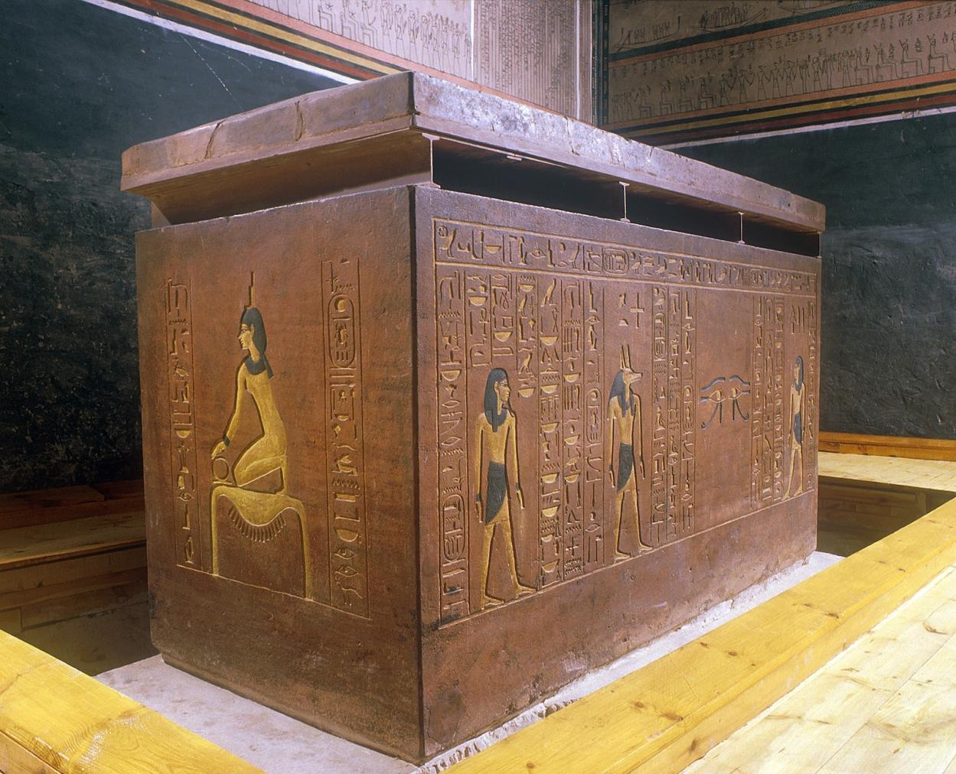
Amenhotep II

Slide 73
“. . . And Israel saw the Egyptians dead on the seashore”
Exodus 14:30

Slide 75
“So, the Lord overthrew the Egyptians in the midst of the sea. Then the waters returned and covered the chariots, the horsemen, and all the army of Pharaoh that came into the sea after them. Not so much as one of them remained.”
Exodus 14:27-28

Slide 77
“He saved them from the hand of him who hated them and redeemed them from the hand of the enemy. The waters covered their enemies; there was not one of them left.”
Psalm 106:10-11

Slide 79
“To Him who divided the Red Sea in two . . . And made Israel pass through the midst of it
. . . But overthrew Pharaoh and his army in the Red Sea . . .”
Psalm 136:13-15

Slide 80
“To Him who divided the Red Sea in two . . . And made Israel pass through the midst of it
. . . But overthrew Pharaoh and his army in the Red Sea . . .”
Psalm 136:13-15

Slide 81
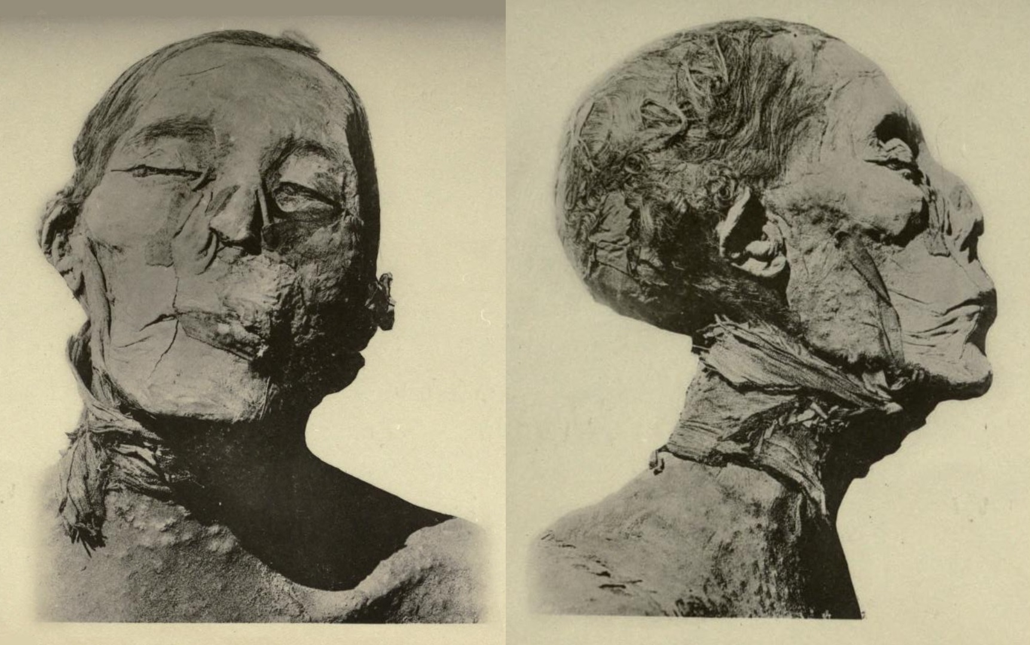
Amenhotep II

Slide 82
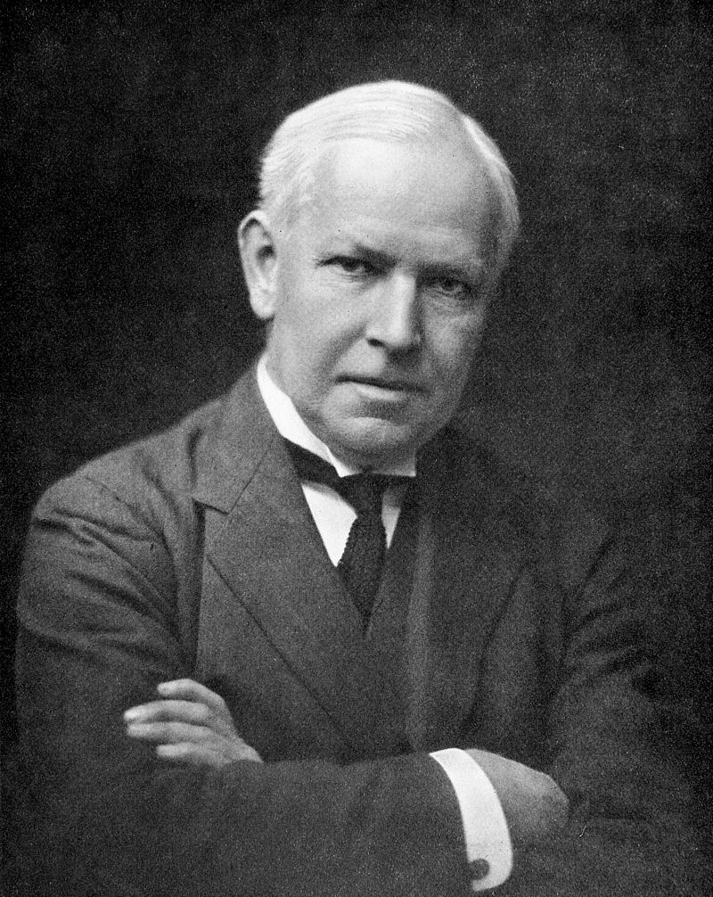
Grafton Elliot Smith
Egyptologist & Anatomist
“The skin over the whole body is thickly studded with small projections or tubercles . . . At present I am unable to determine whether they are the results of some disease or merely the effects of the embalmer’s salt-bath, but they certainly are unusual.”

Slide 83
American Journal of Physical Anthropology
“We have two interesting scenarios: The first suggests that this is Amenhotep II, with a body bearing the scars of plague or disease. The second suggests that this is someone else entirely from the time-period, with the pharaoh’s body remaining at large. Based on the collective evidence, the former seems the most probable: That this is Amenhotep II . . . [His] body could have been recovered from Egypt’s defeat at the Red Sea and subsequently embalmed in accordance with Egyptian tradition.”

Slide 84
Happy Sabbath

