Slide 1


Slide 2
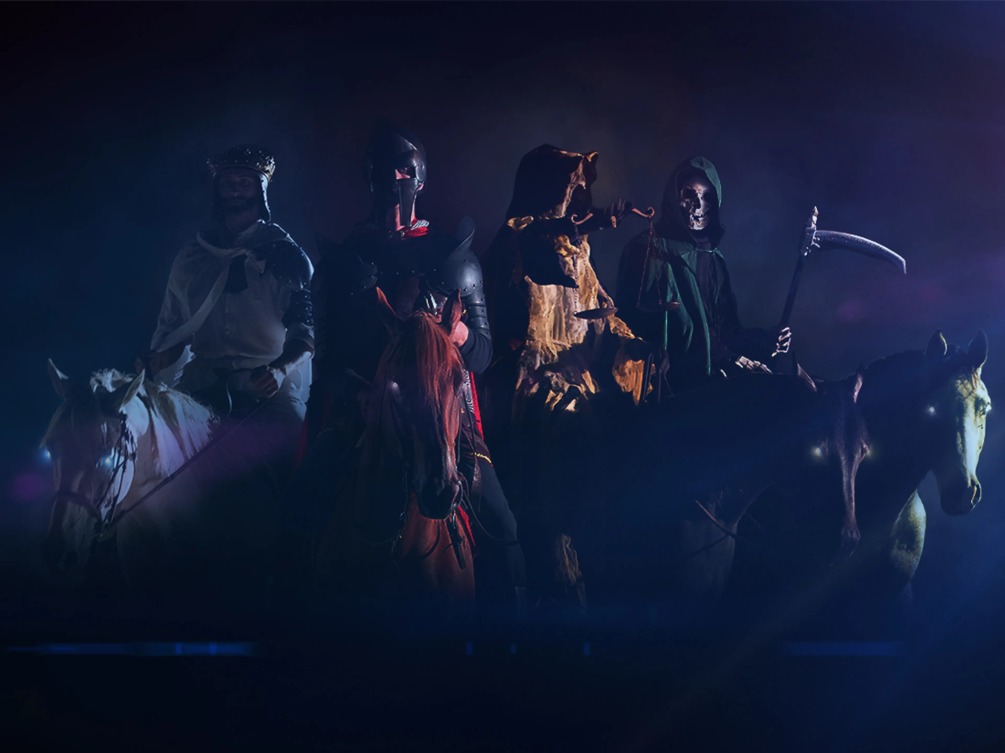

Slide 3
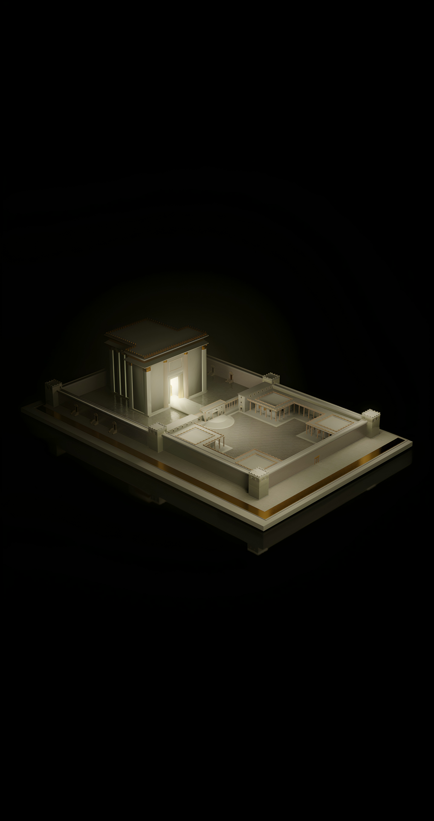

Slide 4
The Beast that Was, Is Not and Yet Is
Sermon by Troy Phelps

Slide 5
Daniel 2

Slide 6
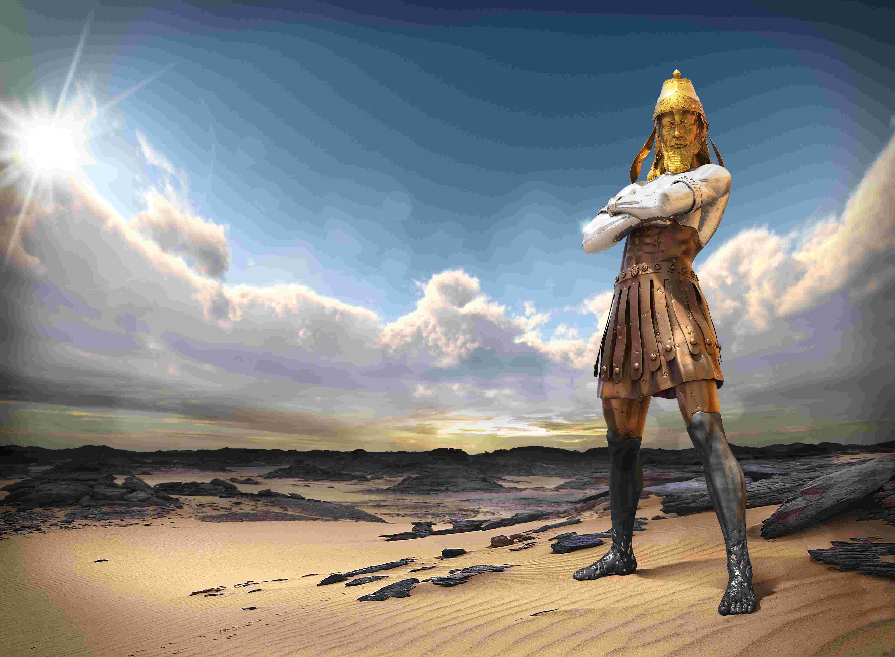

Slide 8
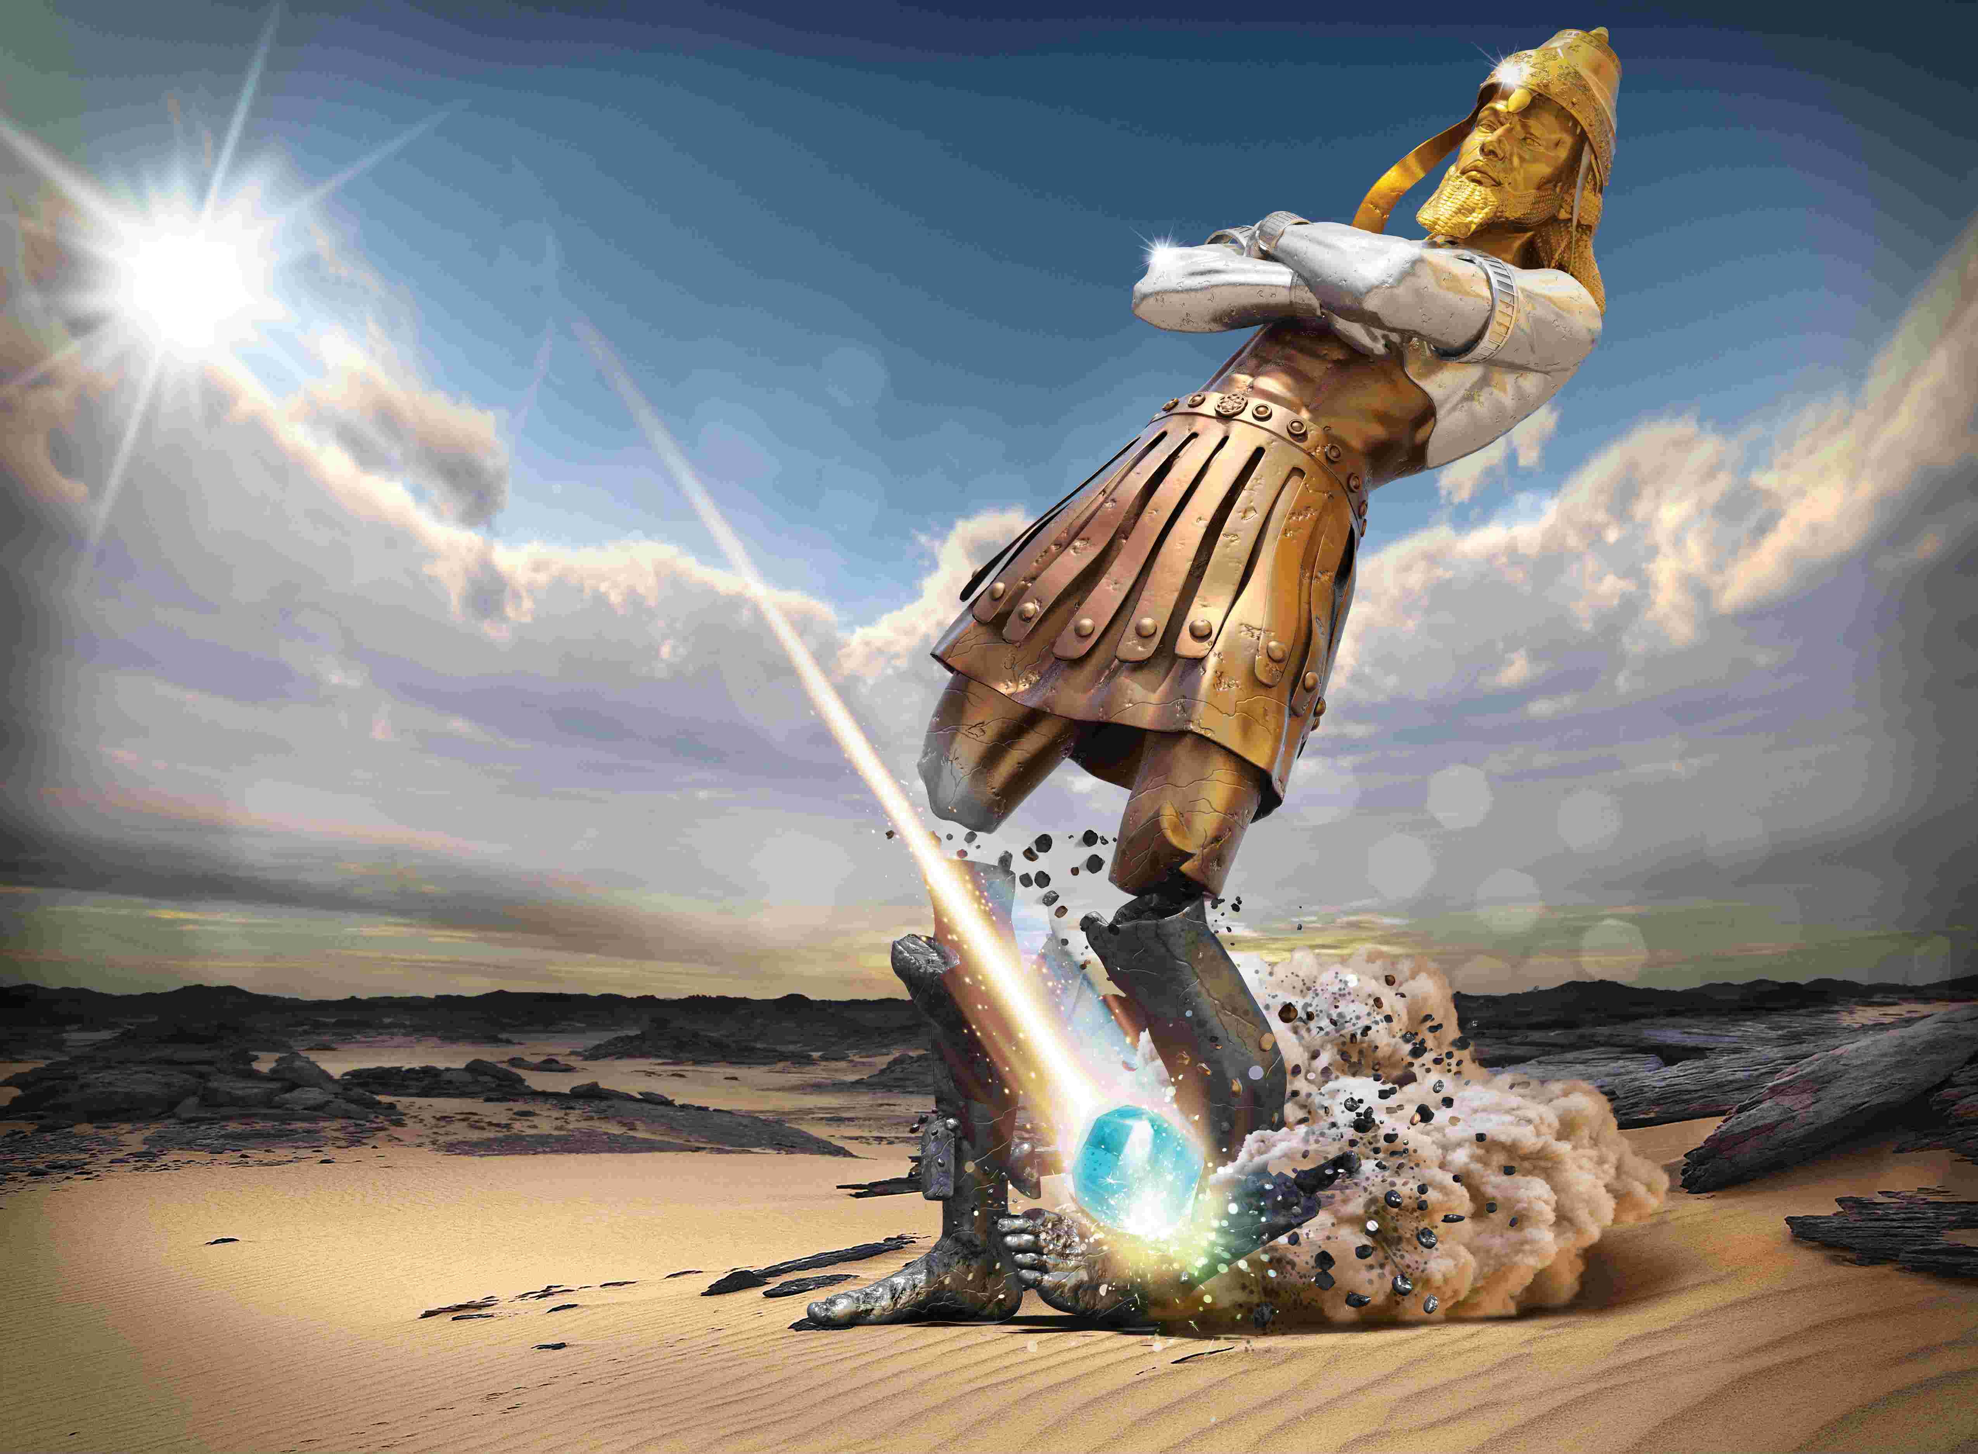

Slide 11
Daniel 2

Slide 12
Daniel 2
GOLD | NEBUCHADNEZZAR | BABYLONIAN EMPIRE

Slide 13
Daniel 2
GOLD | NEBUCHADNEZZAR | BABYLONIAN EMPIRE
SILVER | CYRUS THE GREAT | MEDO-PERSIAN EMPIRE

Slide 14
Daniel 2
GOLD | NEBUCHADNEZZAR | BABYLONIAN EMPIRE
SILVER | CYRUS THE GREAT | MEDO-PERSIAN EMPIRE
BRONZE | ALEXANDER THE GREAT | GREEK EMPIRE

Slide 15
Daniel 2
GOLD | NEBUCHADNEZZAR | BABYLONIAN EMPIRE
SILVER | CYRUS THE GREAT | MEDO-PERSIAN EMPIRE
BRONZE | ALEXANDER THE GREAT | GREEK EMPIRE
IRON (IRON/CLAY) | AUGUSTUS | ROMAN EMPIRE

Slide 18
Daniel 7

Slide 20
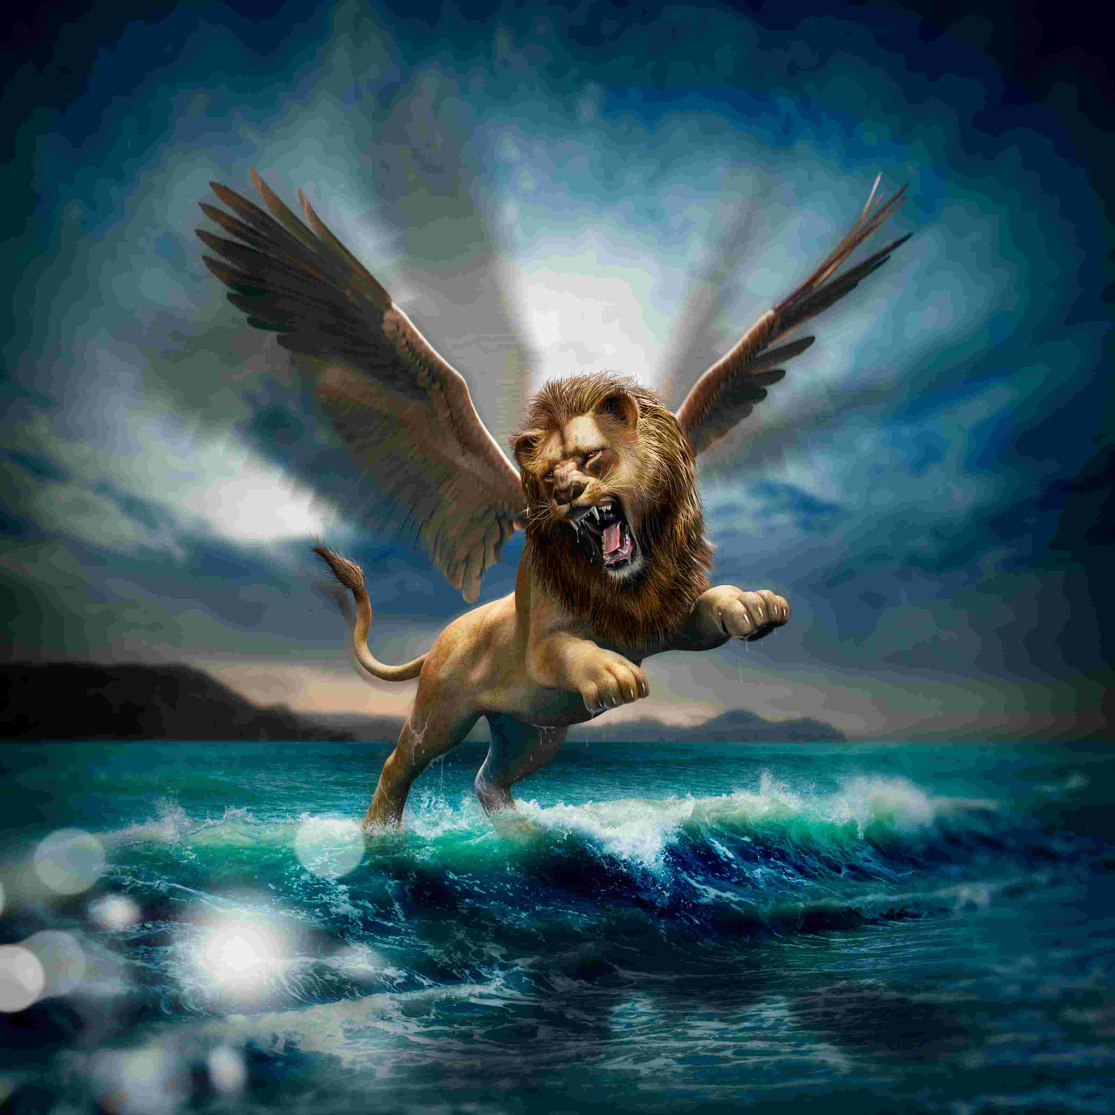

Slide 21
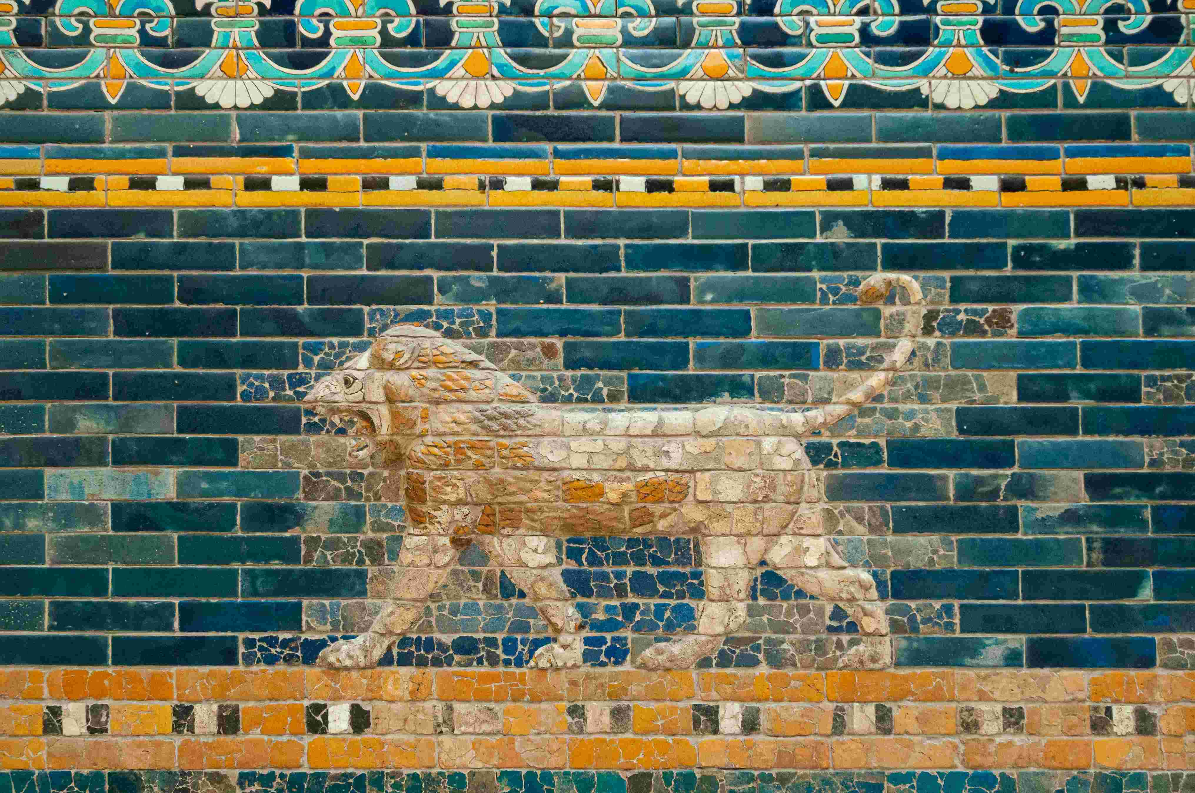

Slide 22
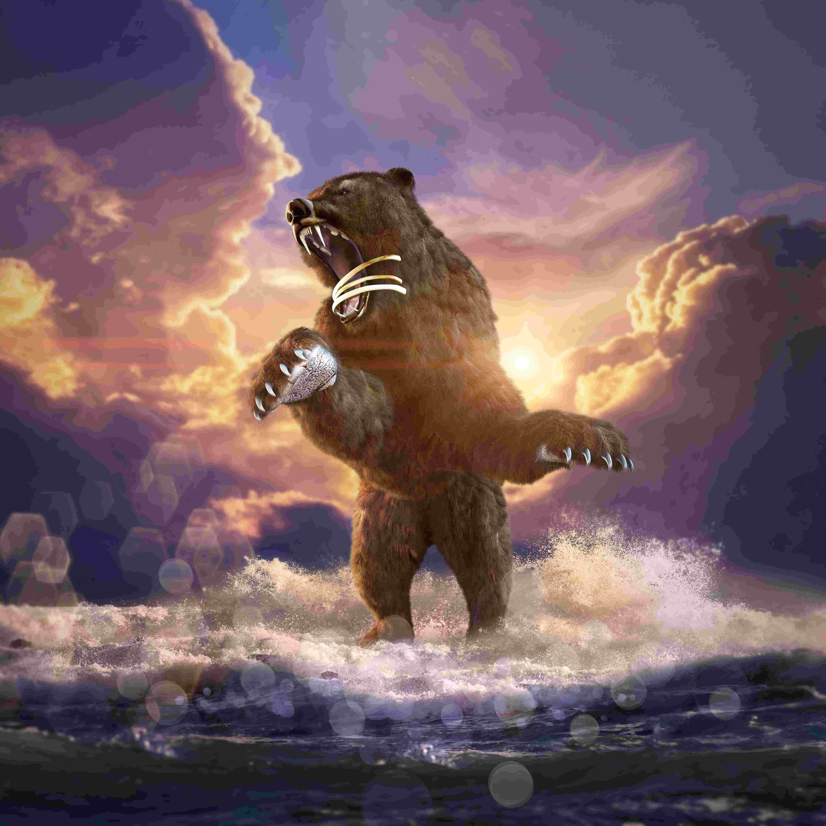

Slide 23
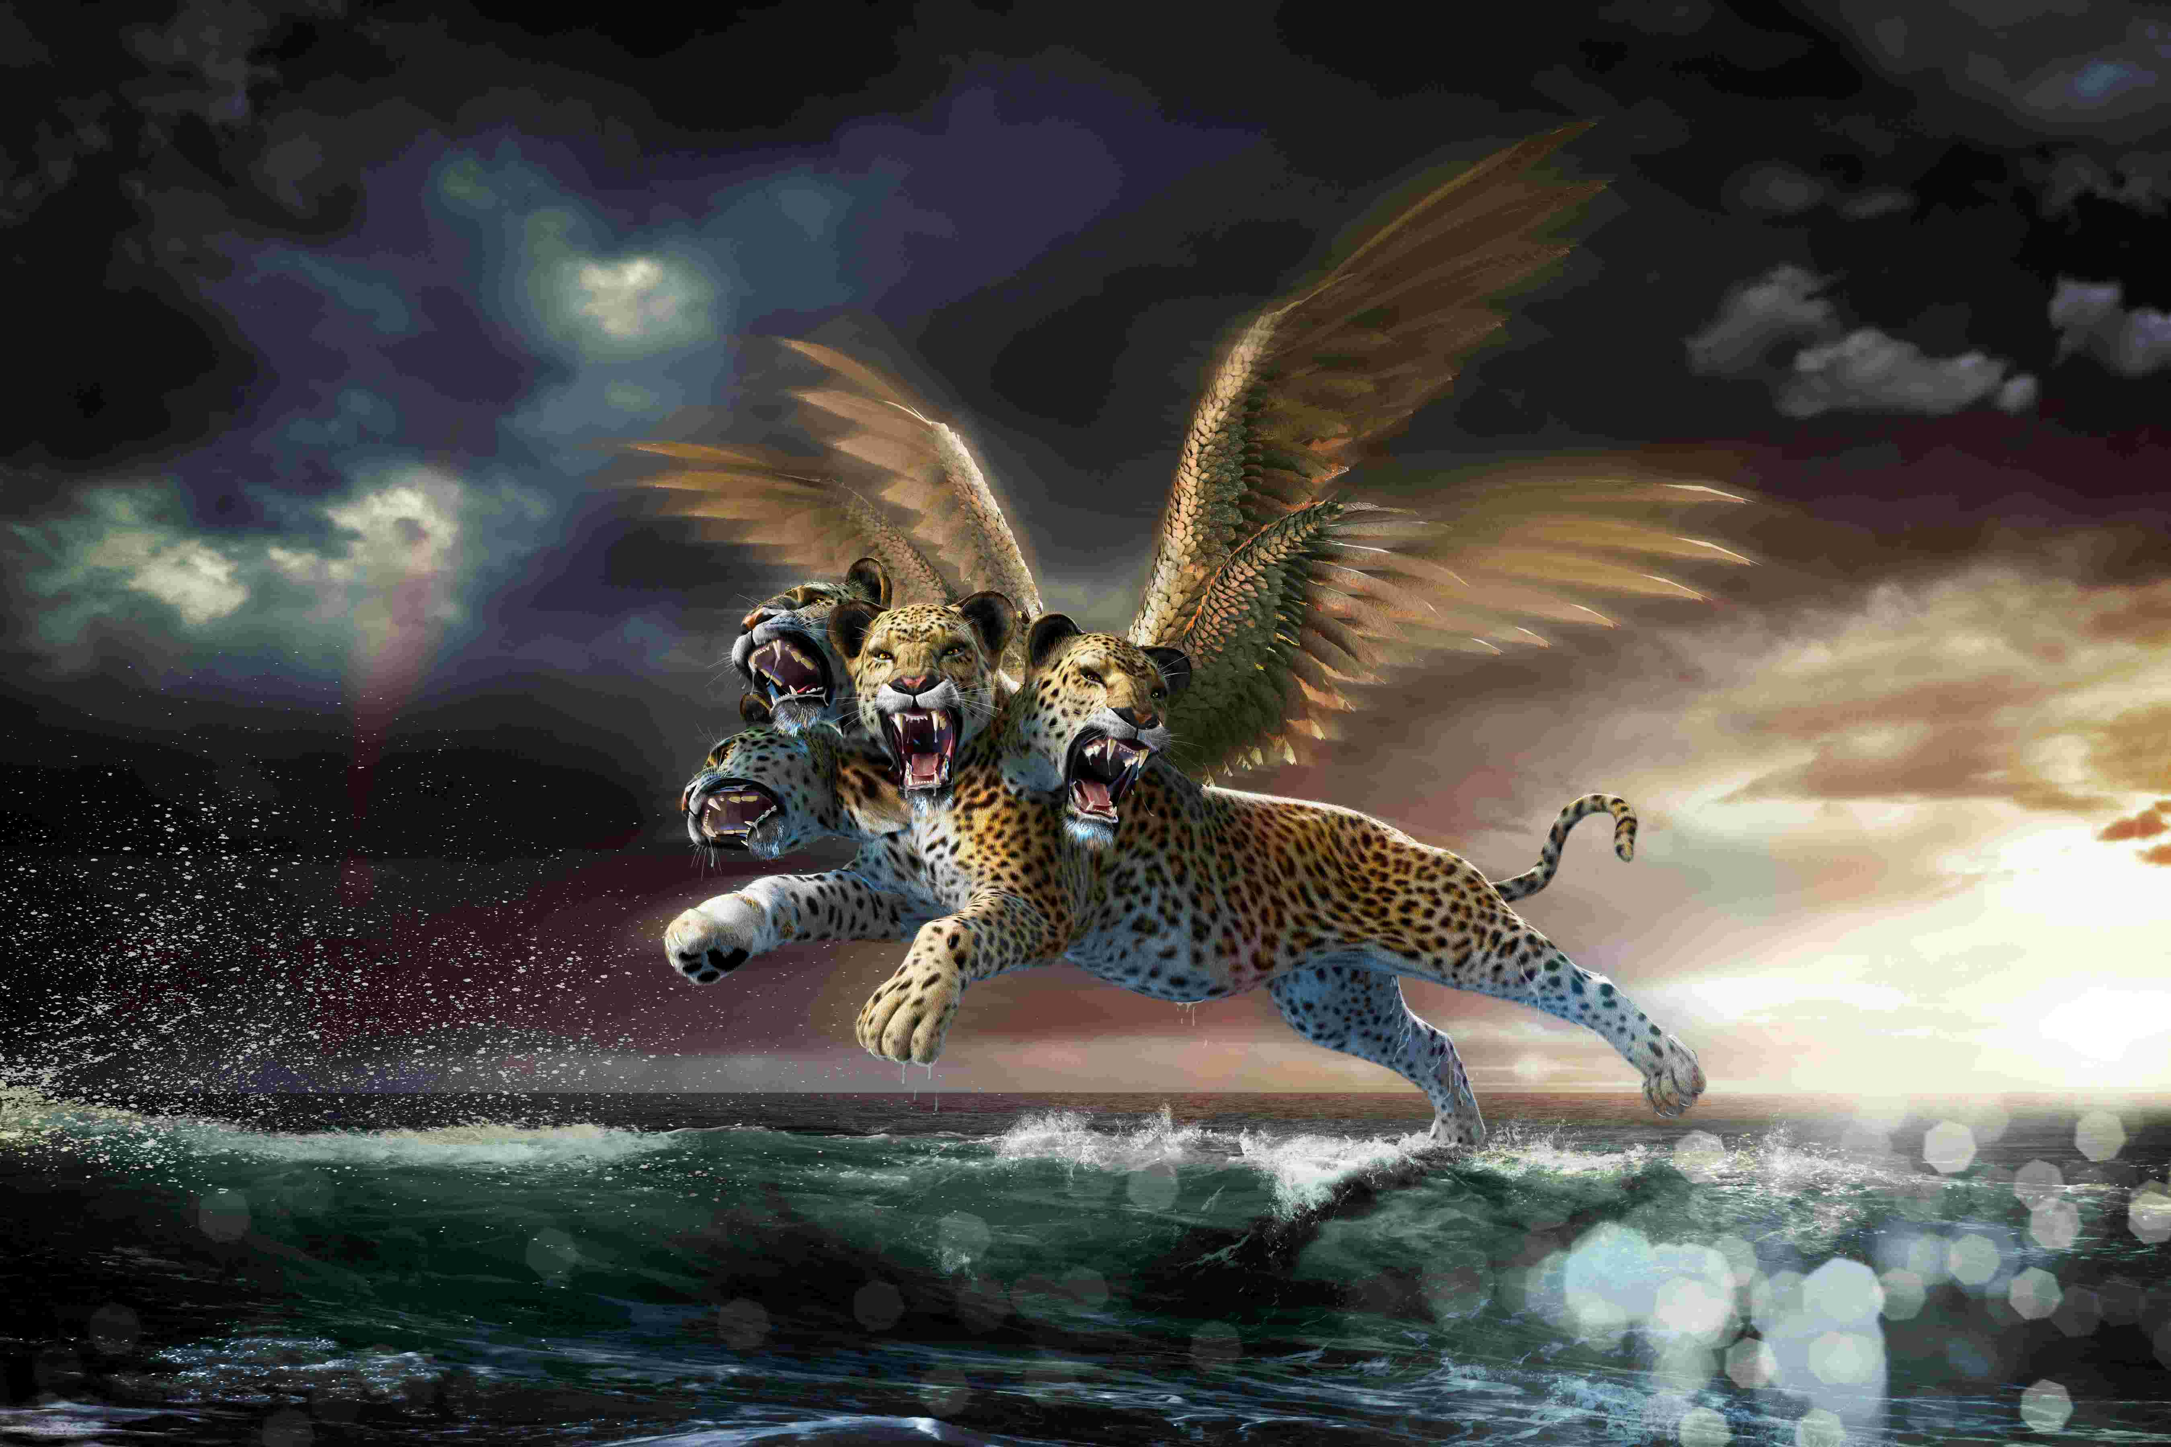

Slide 24
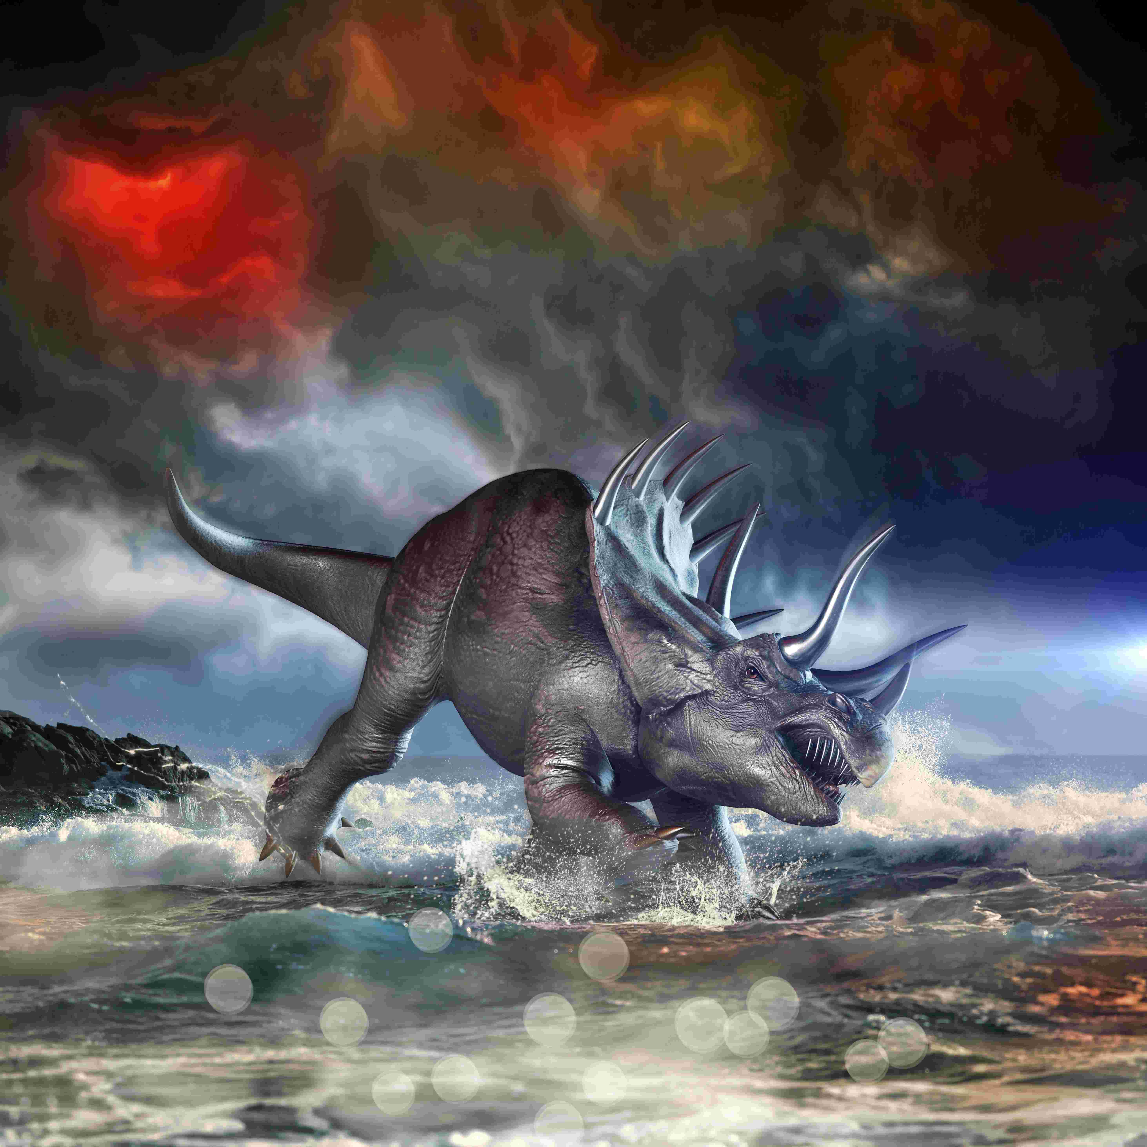

Slide 25
Revelation 13

Slide 26
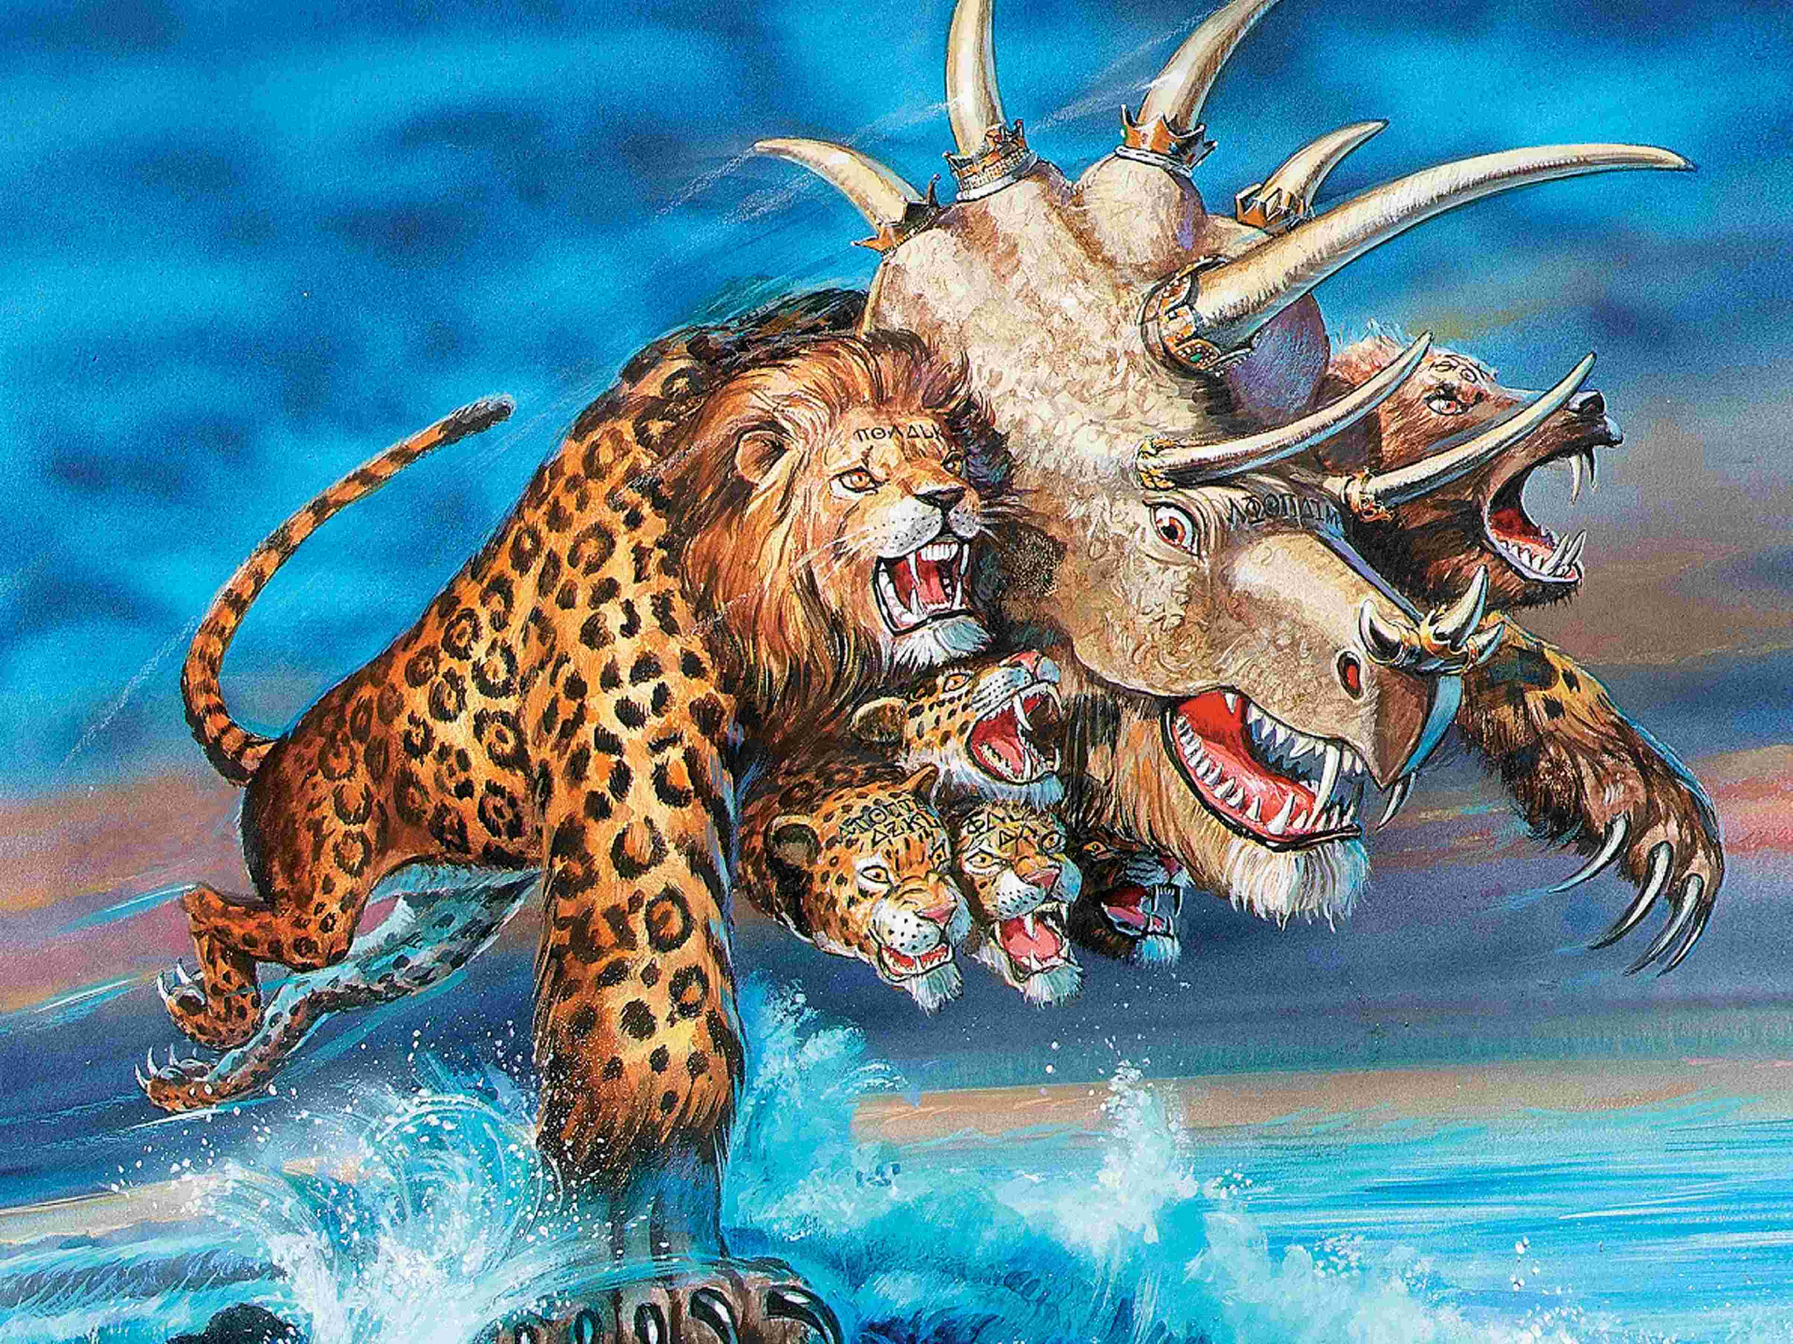

Slide 28
1 | PLUCKED OUT BY POPE | HERULI
2 |  | OSTROGOTHS
3 |  | VANDALS
4 | 1 | JUSTINIAN – “Imperial Restoration”
5 | 2
6 | 3
7 | 4
8 | 5
9 | 6
10 | 7

Slide 29
1 | PLUCKED OUT BY POPE | HERULI
2 |  | OSTROGOTHS
3 |  | VANDALS
4 | 1 | JUSTINIAN – “Imperial Restoration”
5 | 2 | CHARLEMAGNE – “Holy Roman Emperor”
6 | 3
7 | 4
8 | 5
9 | 6
10 | 7

Slide 30
1 | PLUCKED OUT BY POPE | HERULI
2 |  | OSTROGOTHS
3 |  | VANDALS
4 | 1 | JUSTINIAN – “Imperial Restoration”
5 | 2 | CHARLEMAGNE – “Holy Roman Emperor”
6 | 3 | OTTO the GREAT – “Great Emperor”
7 | 4
8 | 5
9 | 6
10 | 7

Slide 31
1 | PLUCKED OUT BY POPE | HERULI
2 |  | OSTROGOTHS
3 |  | VANDALS
4 | 1 | JUSTINIAN – “Imperial Restoration”
5 | 2 | CHARLEMAGNE – “Holy Roman Emperor”
6 | 3 | OTTO the GREAT – “Great Emperor”
7 | 4 | Charles the 5th – “Sun never sets”
8 | 5
9 | 6
10 | 7

Slide 32
1 | PLUCKED OUT BY POPE | HERULI
2 |  | OSTROGOTHS
3 |  | VANDALS
4 | 1 | JUSTINIAN – “Imperial Restoration”
5 | 2 | CHARLEMAGNE – “Holy Roman Emperor”
6 | 3 | OTTO the GREAT – “Great Emperor”
7 | 4 | Charles the 5th – “Sun never sets”
8 | 5 | Napoleon
9 | 6
10 | 7

Slide 33
1 | PLUCKED OUT BY POPE | HERULI
2 |  | OSTROGOTHS
3 |  | VANDALS
4 | 1 | JUSTINIAN – “Imperial Restoration”
5 | 2 | CHARLEMAGNE – “Holy Roman Emperor”
6 | 3 | OTTO the GREAT – “Great Emperor”
7 | 4 | Charles the 5th – “Sun never sets”
8 | 5 | Napoleon
9 | 6 | Hitler-Mussolini Axis
10 | 7

Slide 34
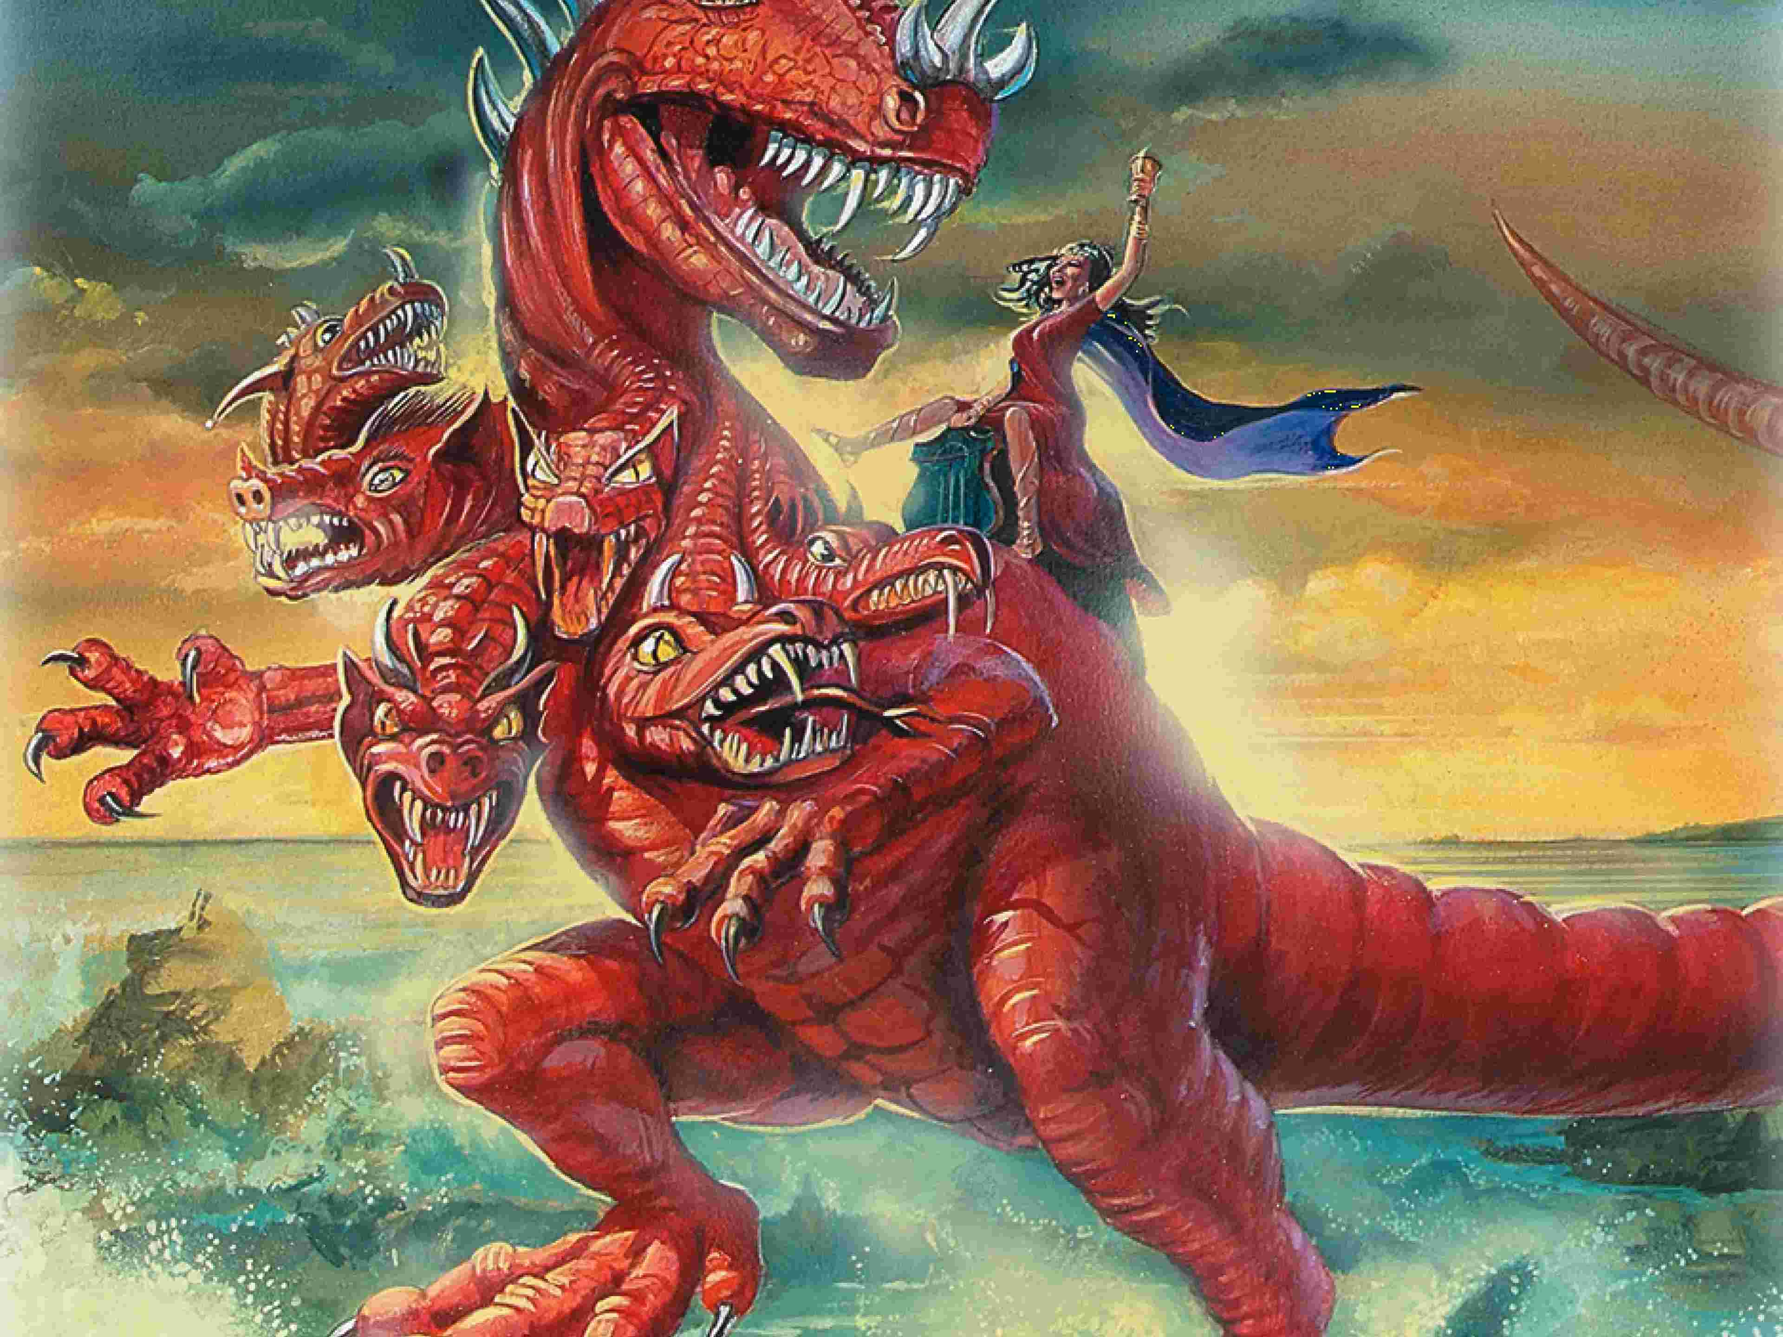

Slide 35
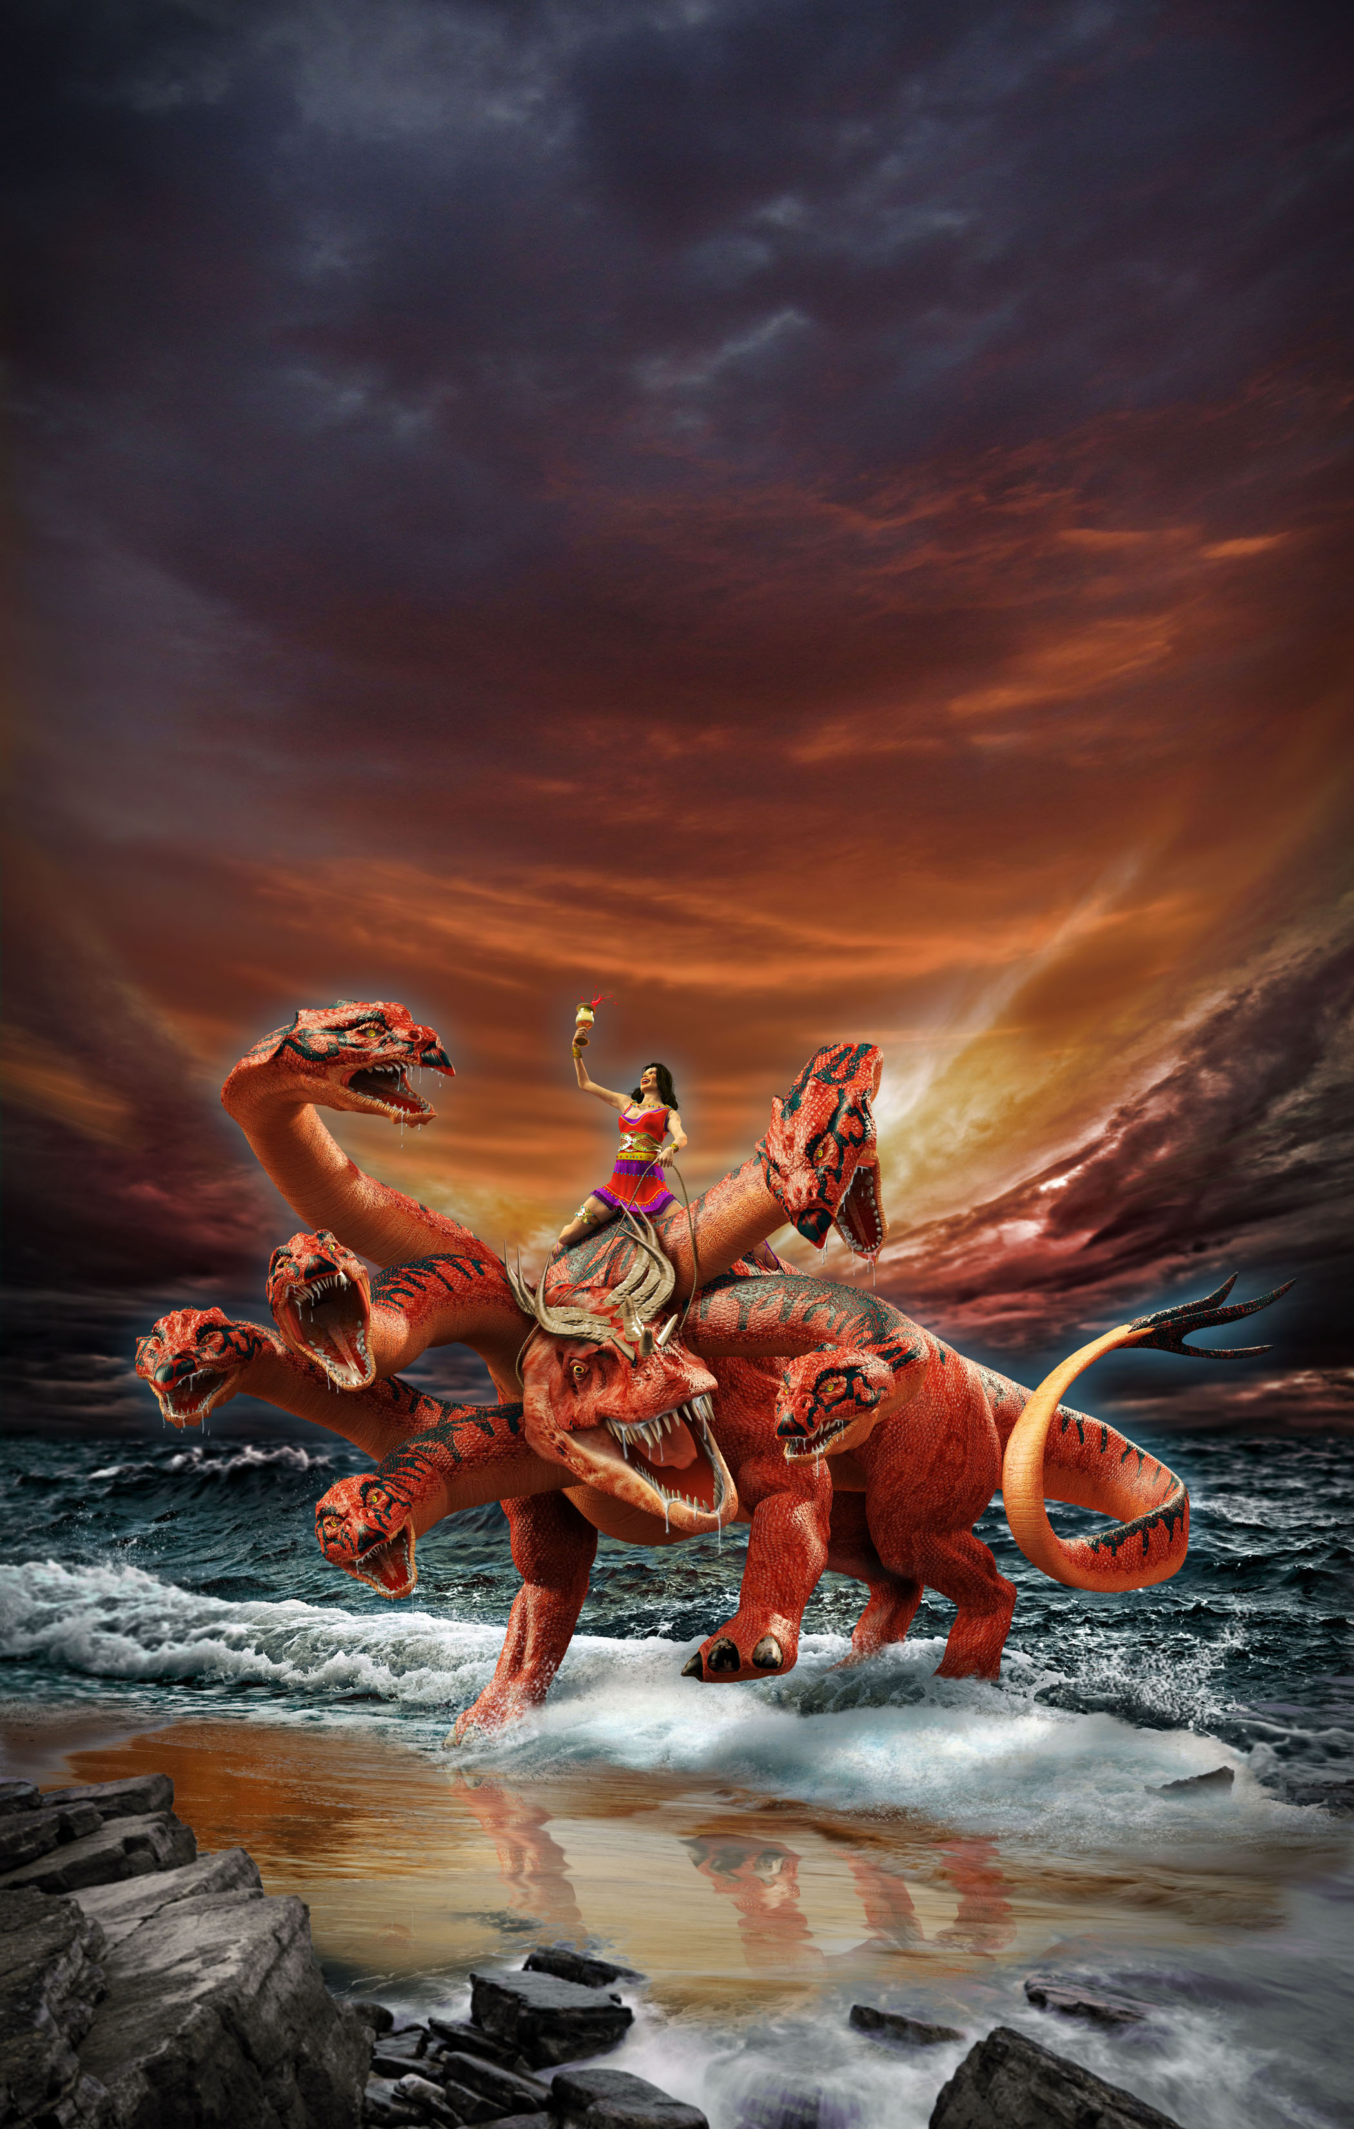

Slide 36
The Beast that Was, Is Not and Yet Is
Sermon by Troy Phelps

