Slide 1
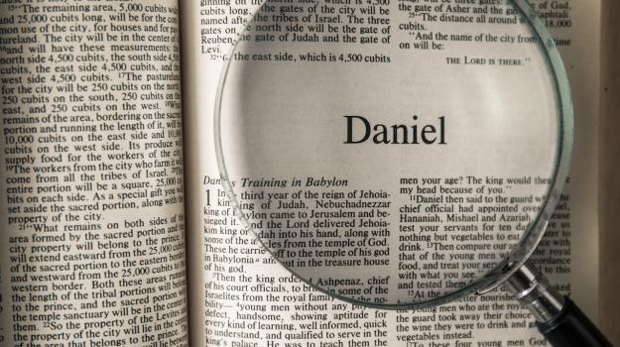

Slide 2
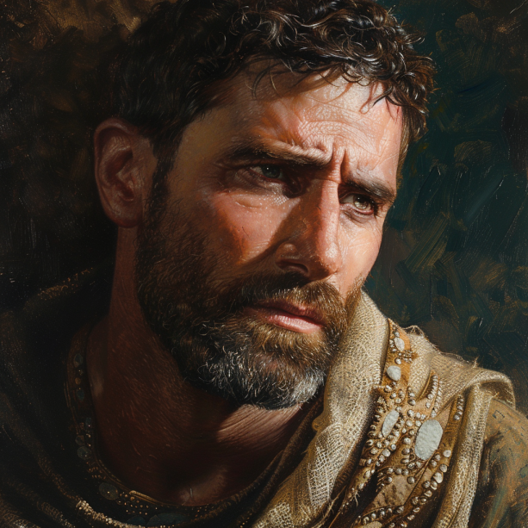

Slide 3

Daniel 8: A Ram, a Goat, and a Double Prophecy
Philip J. Aust
Sermon

Slide 4
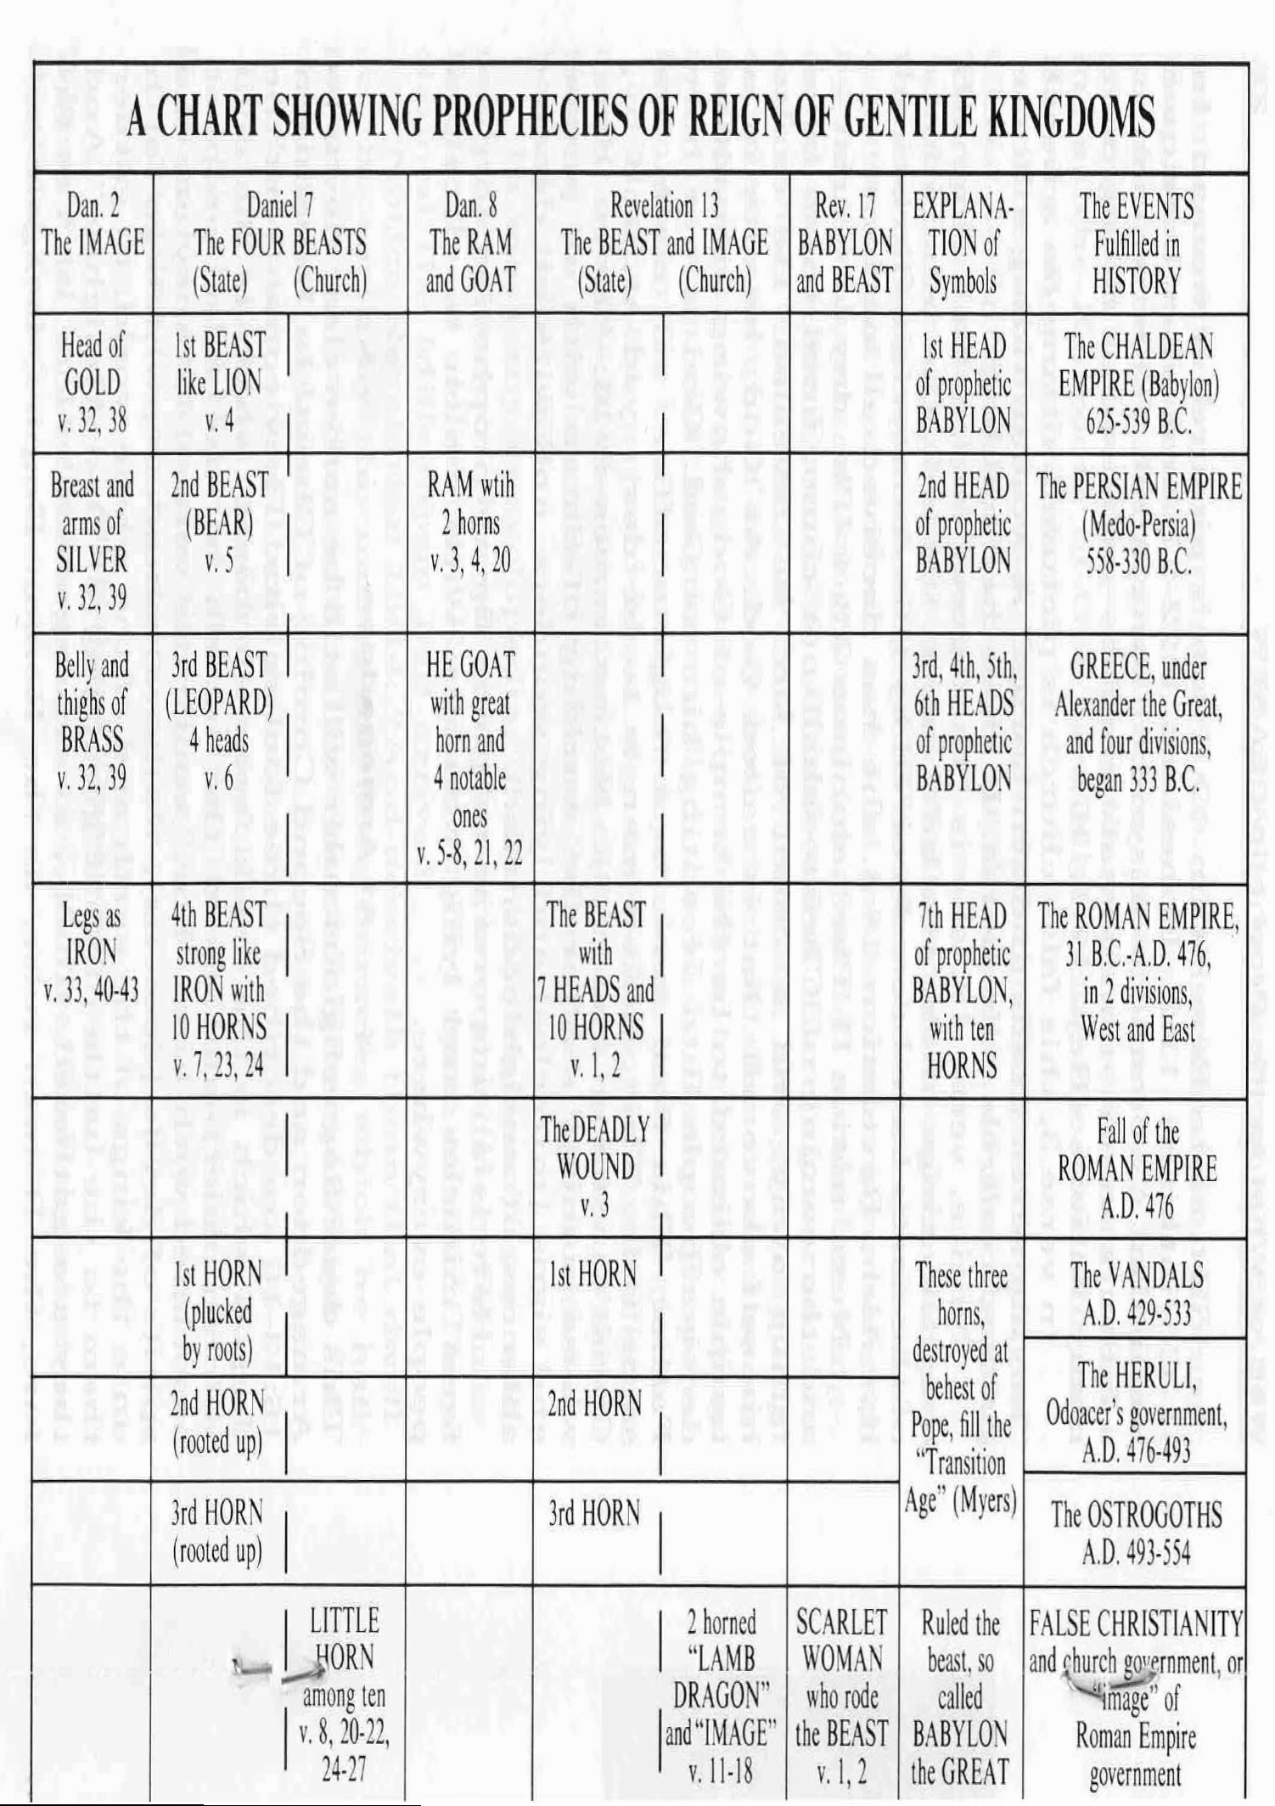

Slide 5
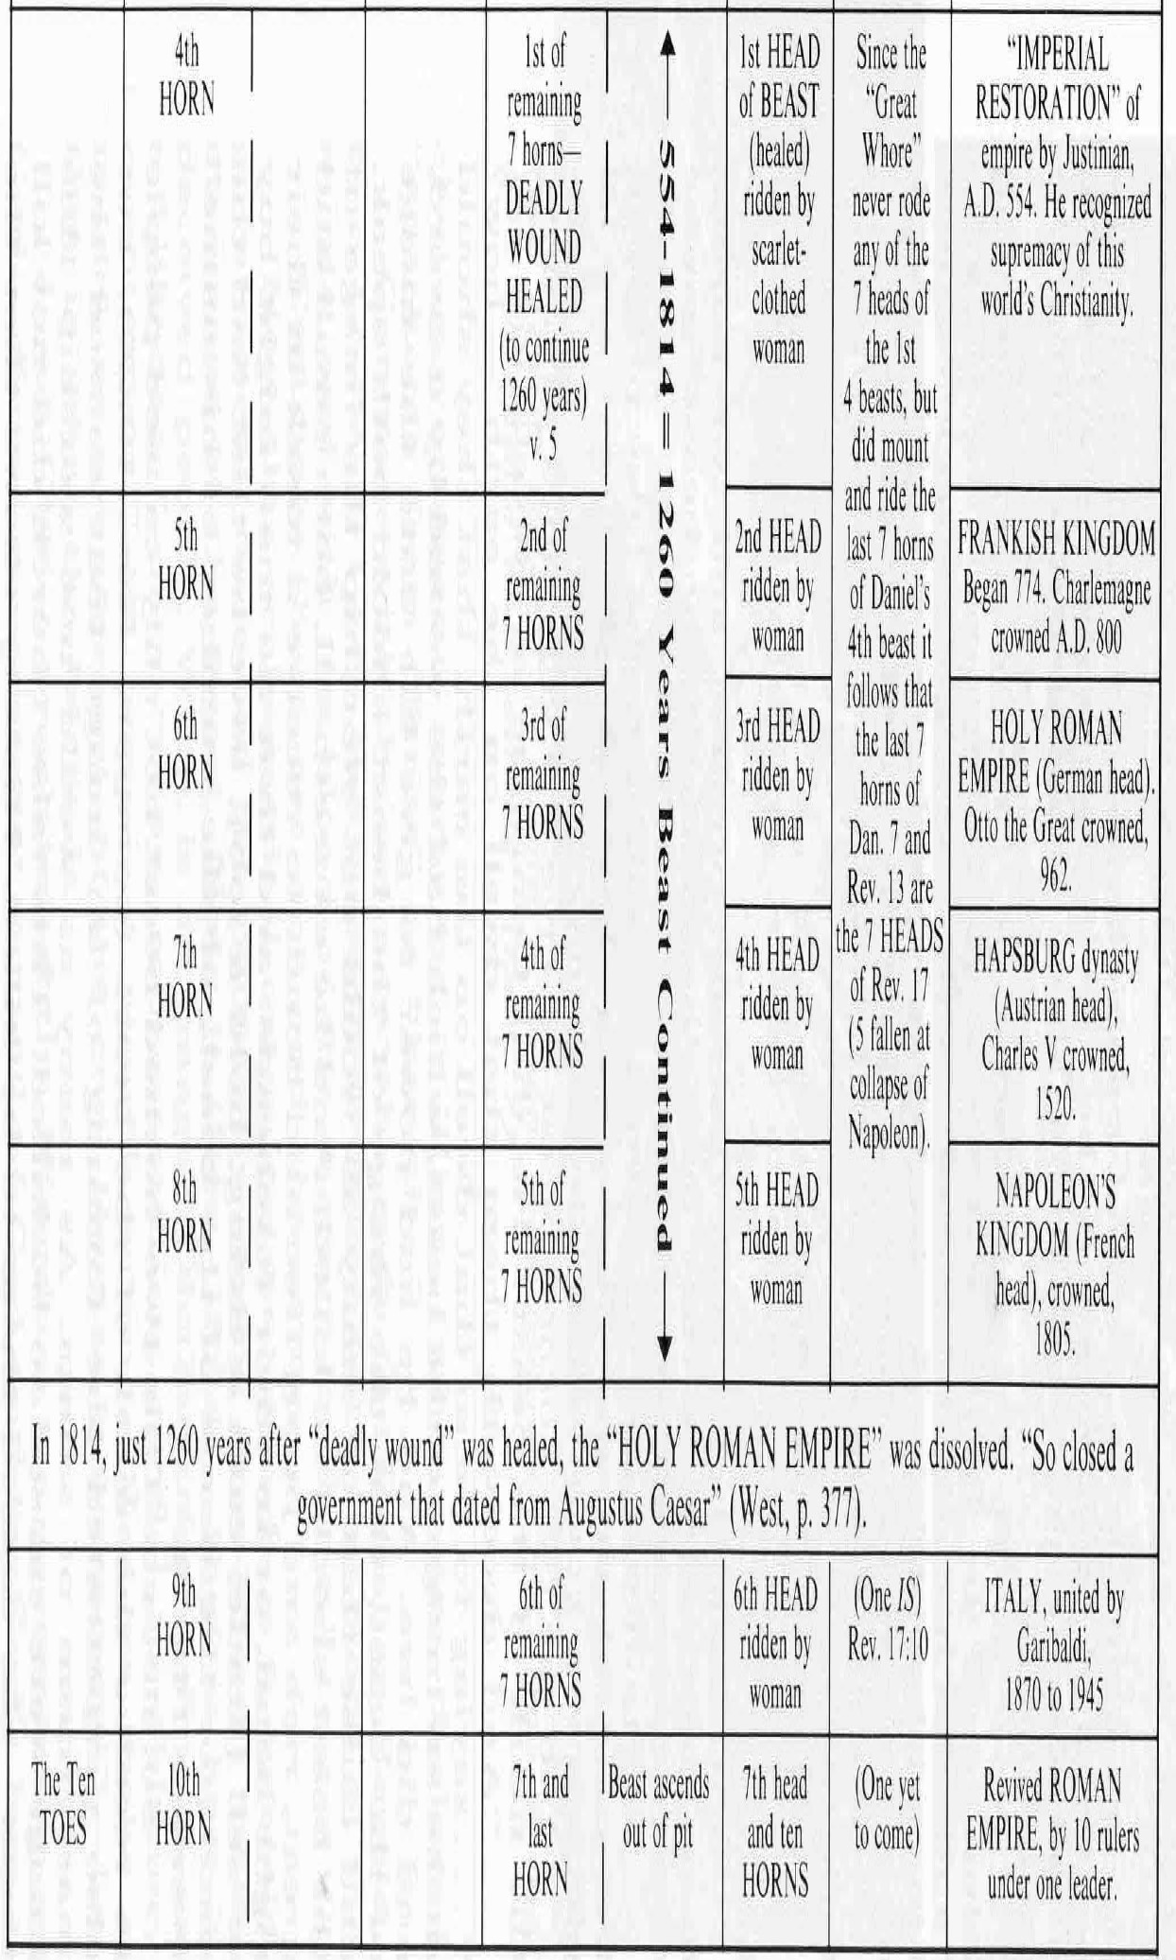

Slide 6
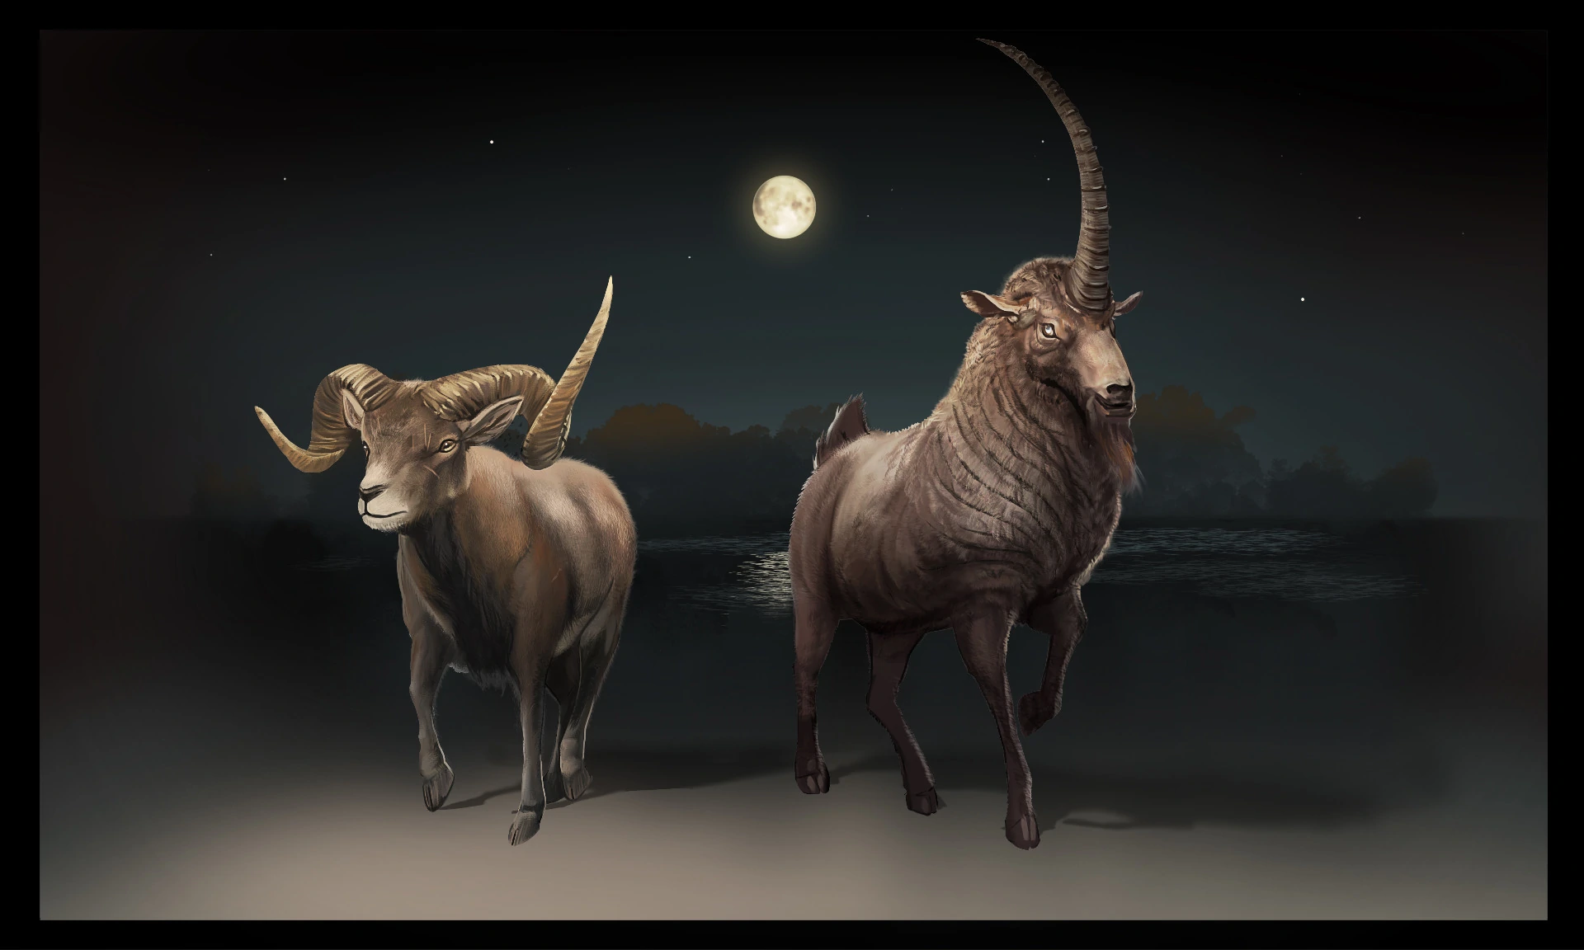

Slide 7
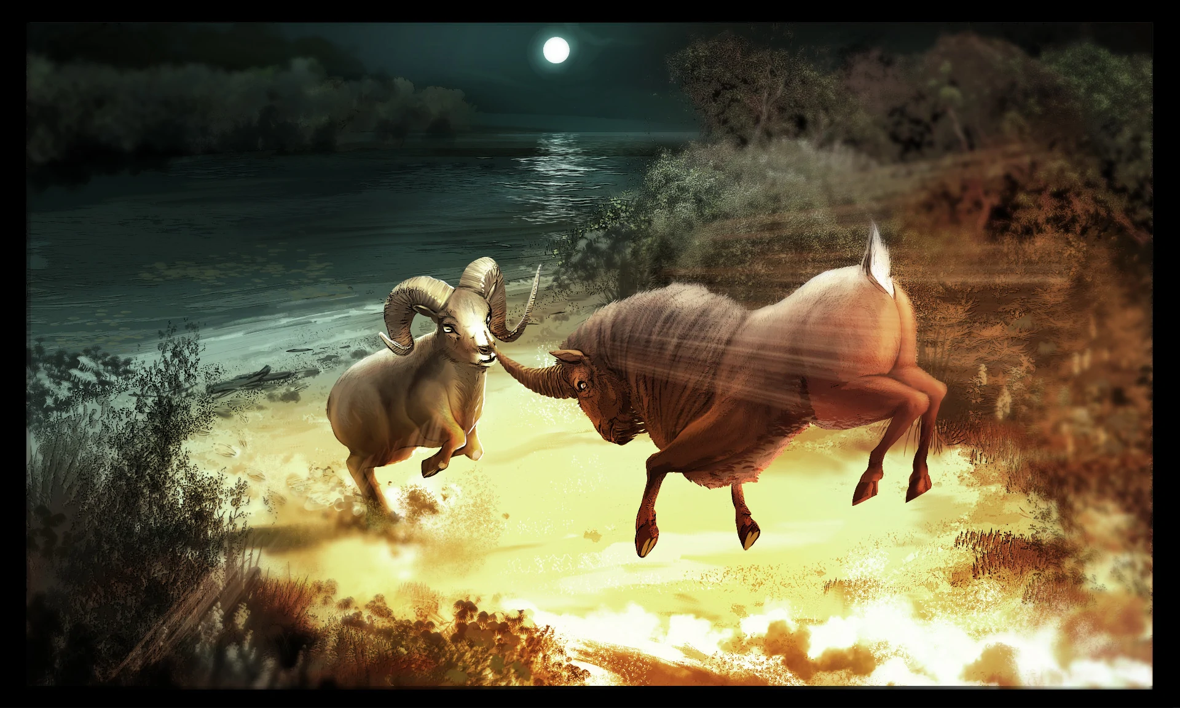

Slide 8
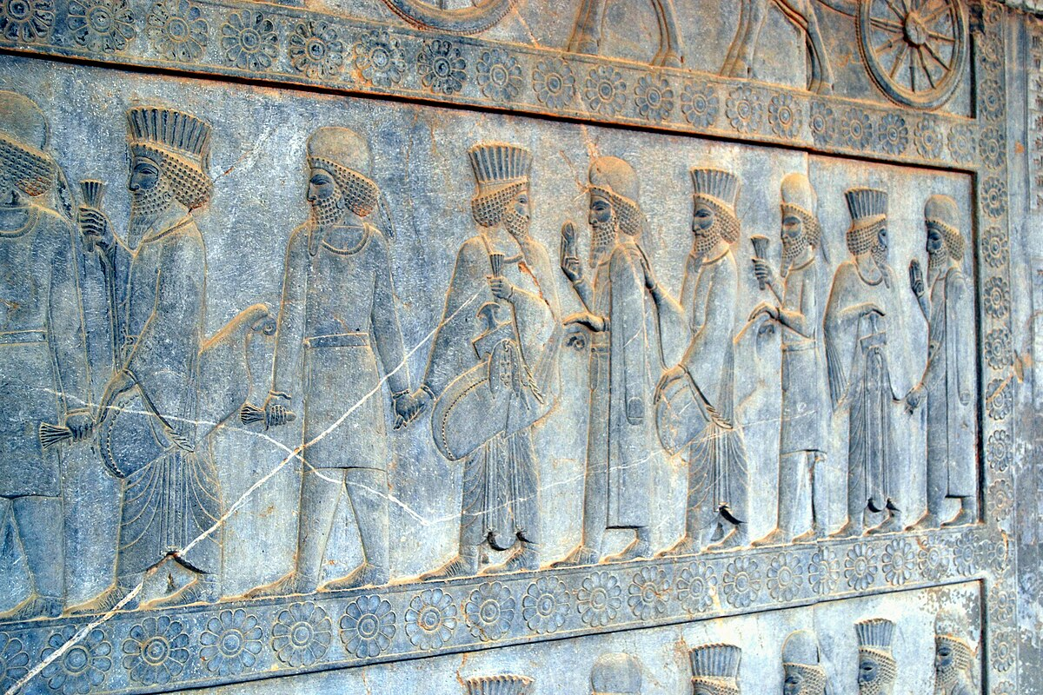

Slide 9
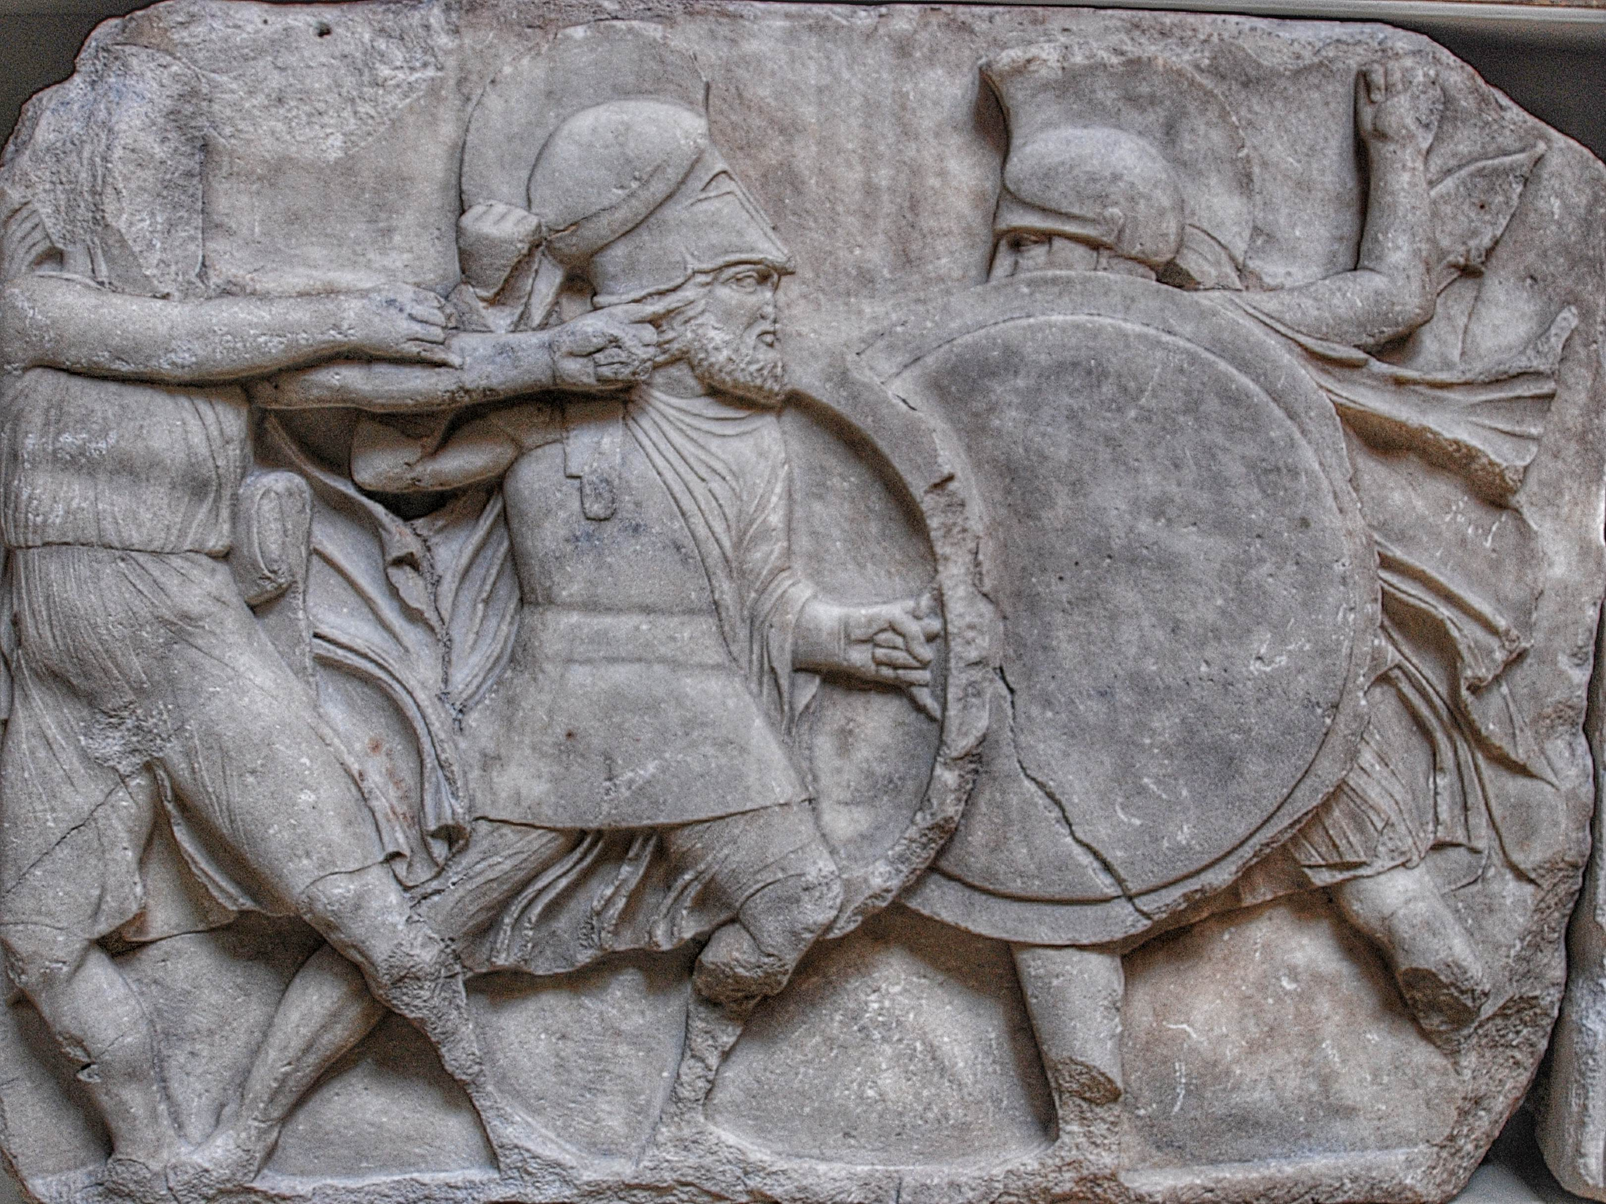

Slide 10
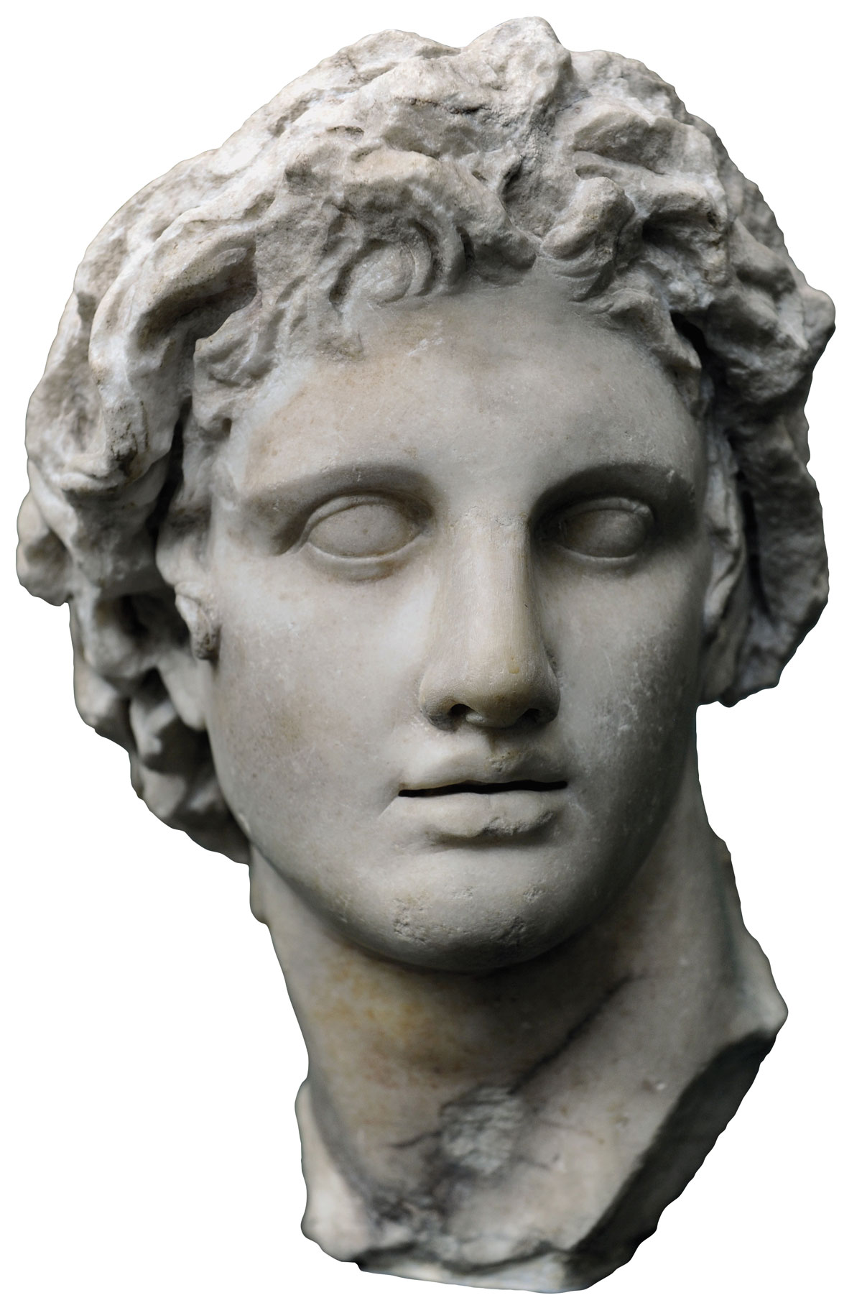
Alexander the Great

Slide 11
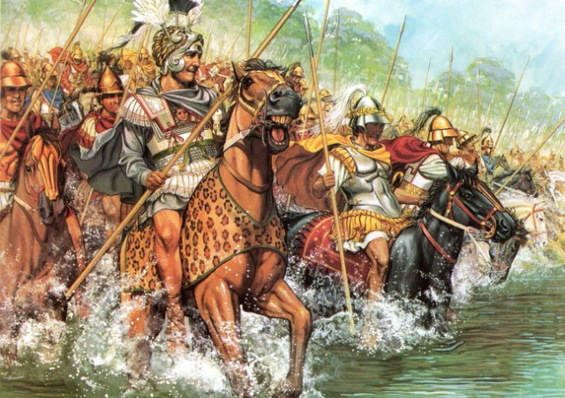

Slide 12
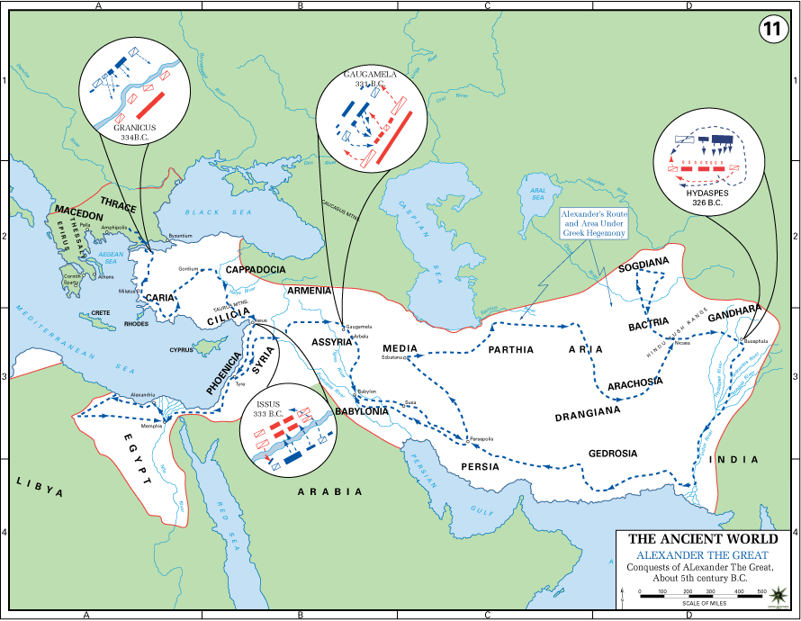

Slide 13
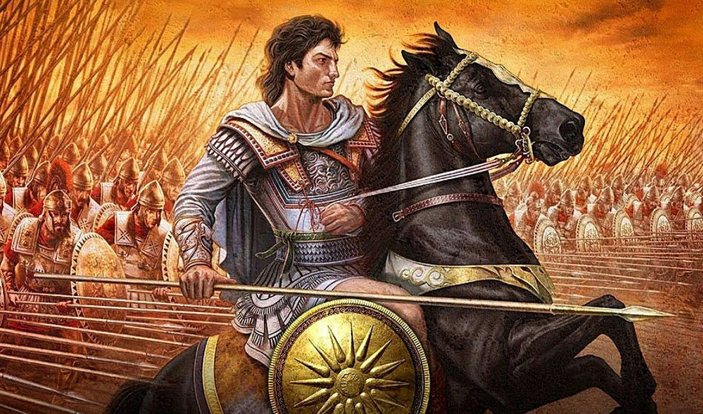

Slide 14
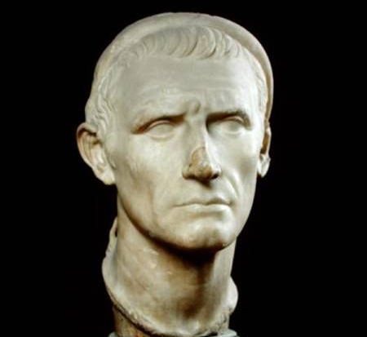
Antiochus Epiphanes

Slide 15

Antiochus IV Epiphanes (born c. 215 bce—died 164, Tabae, Iran) was the Seleucid king of the Hellenistic Syrian kingdom who reigned from 175 to 164 bce. As a ruler, he was best known for his encouragement of Greek culture and institutions. His attempts to suppress Judaism brought on the Wars of the Maccabees.

Slide 16
Daniel 8: What lessons do we learn?
Lesson 1. Recognize that Daniel shares details of present (Daniel’s present) and future history.
Lesson 2. Recognize that Antichrist(s) will come on the scene shortly before Christ returns.
Lesson 3. This prophecy (and prophecy, in general) should bring an urgency to our calling.

Slide 17
Daniel 8: A Ram, a Goat, and a Double Prophecy
Biblicaltoolbelt.com
Creative commons

