Slide 1


Slide 2
Overcoming the Deadly Trap of Offense

Slide 3
John 17:21, 23
“…that they all may be one, as You, Father, are in me, and I in You, that they also may be one in us that the world may believe that You have sent me… I in them and You in me, that they may be made perfect in one, and that the world may know that You have sent me, and have loved them, as You have loved me.”

Slide 4

“The Bait of Satan—Living Free From The Deadly Trap of Offense” by John Bevere

Slide 5

We hope our path looks like this

Slide 6

However most of the time our path looks more like this

Slide 7

And, at best, there may be sections that look like this

Slide 8
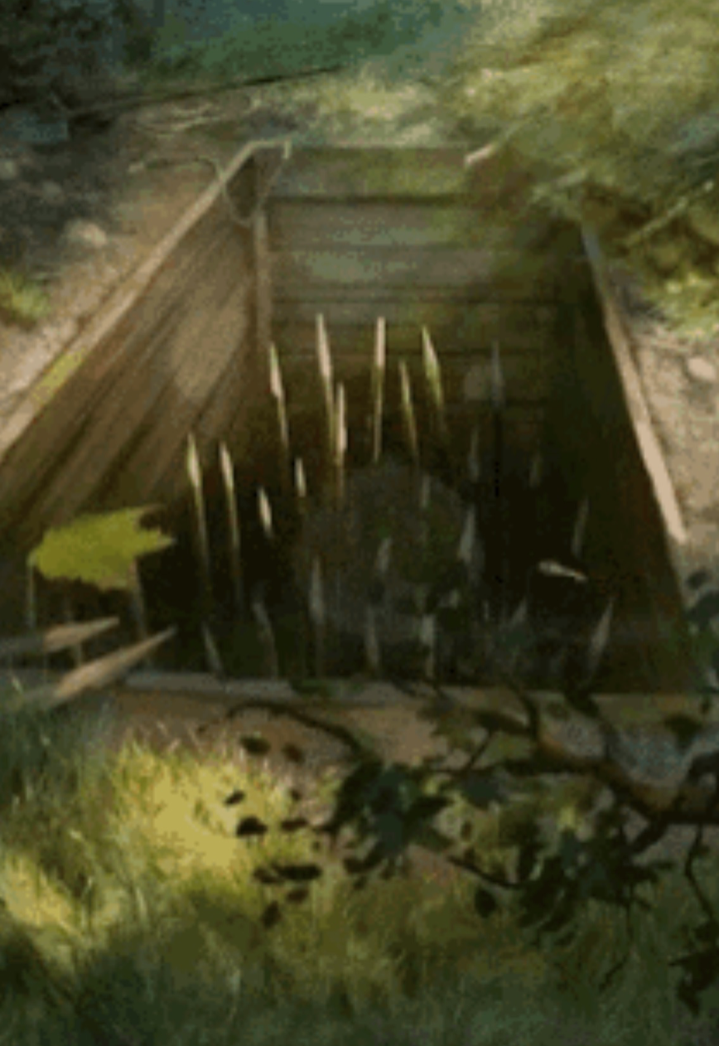
Inevitably there are going to be several pitfalls, covered over with a false, flimsy “floor” of sticks, nettles and leaves, hiding the danger beneath

Slide 9
Hazards – the “root causes of offense”
Pride (goes before a fall)
Unmet expectations
Self-righteousness
Unforgiveness

Slide 10
Root Cause #1: Pride
2 Kings 5:11–12 (NKJV) – “Naaman became furious... ‘Are not the rivers of Damascus better than all the waters of Israel?’”
Matthew 15:12 – “Then His disciples came and said to Him, ‘Do You know that the Pharisees were offended when they heard this saying?’”

Slide 11
Root Cause #2: Unrealistic or Unmet Expectations
Matthew 11:3 – “Are You the Coming One, or do we look for another?”
Matthew 11:6 – “Blessed is he who is not offended because of Me.”
John 11:21 – “Lord, if You had been here, my brother would not have died.”

Slide 12
Root Cause #3: Self-Righteousness / Entitlement
Luke 15:29–30 – “Lo, these many years I have been serving you... But as soon as this son of yours came… you killed the fatted calf for him.”
Jonah 4:1–2 – “But it displeased Jonah exceedingly, and he became angry...”
Jonah 4:9 – “Is it right for you to be angry?”

Slide 13
Root Cause #4: Unforgiveness & Bitterness
2 Samuel 13:22 – “Absalom spoke to his brother Amnon neither good nor bad; for Absalom hated Amnon...”
Hebrews 12:15–17 – “...lest any root of bitterness springing up cause trouble... Esau, who for one morsel of food sold his birthright... he was rejected...”

Slide 14
2 Tim 1:7
For God has not given us a spirit of fear, but of power and of love and of a sound mind.

Slide 15
Step 1: Recognize the Trap of Offense (Sound Mind)
Acts 24:16 (NKJV) – “I myself always strive to have a conscience without offense toward God and men.”
2 Timothy 4:14–16 – Paul acknowledges betrayal from Alexander the coppersmith and abandonment by others, but recognizes it without becoming bitter.

Slide 16
Step 2: Repent of Unforgiveness and Pride (Sound Mind)
1 Timothy 1:13–15 – “Although I was formerly a blasphemer, a persecutor, and an insolent man; but I obtained mercy… Christ Jesus came into the world to save sinners, of whom I am chief.”
Romans 7:18 – “For I know that in me (that is, in my flesh) nothing good dwells…”

Slide 17
Step 3: Forgive from the Heart (Love)
2 Timothy 4:16 – “At my first defense no one stood with me, but all forsook me. May it not be charged against them.”
Eph 4:32 – “And be you kind to one another, tenderhearted, forgiving one another, even as God in Christ forgave you.”

Slide 18
Step 4: Choose Love and Bless the Offender (Love)
Philemon 10–12, 17 – He pleads for the restoration of Onesimus (a runaway slave), calling him a “son” and asking Philemon to receive him as you would me.
Romans 12:14, 17–21 – “Bless those who persecute you… do not repay evil for evil… overcome evil with good.”

Slide 19
Step 5: Stay Rooted in the Word of God (Power)
Acts 20:32 – “I commend you to God and to the word of His grace, which is able to build you up…”
Colossians 3:16 – “Let the word of Christ dwell in you richly…”

Slide 20
Step 6: Walk Daily in the Holy Spirit (Power)
Galatians 5:16 – “Walk in the Spirit, and you shall not fulfill the lust of the flesh.”
Romans 8:13–14 – “If by the Spirit you put to death the deeds of the body, you will live… For as many as are led by the Spirit of God, these are sons of God.”
2 Corinthians 12:9–10 – “My grace is sufficient for you, for My strength is made perfect in weakness… when I am weak, then I am strong.”

Slide 21
Hazards – the “root causes of offense”
Pride (goes before a fall)
Unmet expectations
Self-righteousness
Unforgiveness

Slide 22
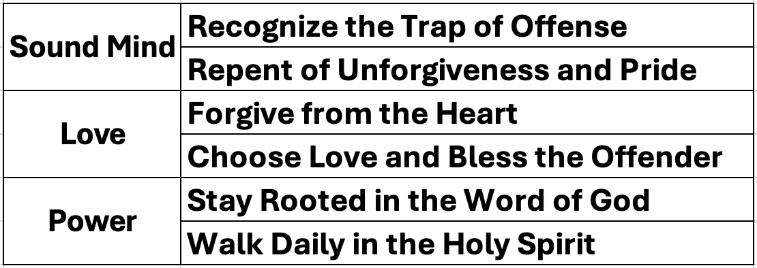
Enabled by the Holy Spirit

Slide 23
Luke 24:32
"Did not our hearts burn within us while he talked with us on the road and while he opened to us the Scriptures?".

Slide 24

The Holy Spirit provides a bridge over the roots of offense.
It enables us to overcome the the hazards, pitfalls and deadly traps/snares.

