Slide 1
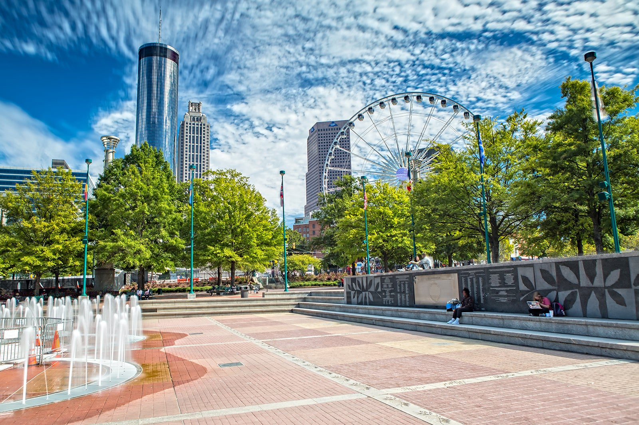

2025 Atlanta & Buford Church Survey Results

Slide 2
48
Total Responses
Date Created: Friday, April 04, 2025
Complete Responses: 48

Slide 3
Q1: This first section asks general questions about our area. Which congregation do you routinely attend?
Answered: 48 Skipped: 0

Slide 4
Q1: This first section asks general questions about our area. Which congregation do you routinely attend?
Answered: 48 Skipped: 0
ANSWER CHOICES | RESPONSES
Atlanta | 89.58% | 43
Buford | 10.42% | 5
TOTAL |  | 48

Slide 5
Q2: What is your general sense of your congregation at this time?
Answered: 47 Skipped: 1

Slide 6
Q2: What is your general sense of your congregation at this time?
Answered: 47 Skipped: 1
 | VERY POOR | POOR | FAIR | GOOD | EXCELLENT | TOTAL | WEIGHTED AVERAGE
 | 0.00% 0 | 4.26% 2 | 19.15% 9 | 53.19% 25 | 23.40% 11 | 47 | 3.96

Slide 7
Q3: In general, how do you like the Holiday Inn Express, Bethlehem as a meeting hall?
Answered: 25 Skipped: 23

Slide 8
Q3: In general, how do you like the Holiday Inn Express, Bethlehem as a meeting hall?
Answered: 25 Skipped: 23
ANSWER CHOICES | RESPONSES
Excellent | 36.00% | 9
Good | 36.00% | 9
Fair | 28.00% | 7
Poor | 0.00% | 0
Very Poor | 0.00% | 0
TOTAL |  | 25

Slide 9
Q4: In general, how do you like Unity Atlanta as a meeting hall?
Answered: 47 Skipped: 1

Slide 10
Q4: In general, how do you like Unity Atlanta as a meeting hall?
Answered: 47 Skipped: 1
ANSWER CHOICES | RESPONSES
Excellent | 51.06% | 24
Good | 17.02% | 8
Fair | 8.51% | 4
Poor | 8.51% | 4
Very Poor | 14.89% | 7
TOTAL |  | 47

Slide 11
Q8: The local church webcast is offered each week to serve those in our area who are sick and those in other areas who ask to watch our service. What is your sense of the webcast at this time?
Answered: 47 Skipped: 1

Slide 12
Q8: The local church webcast is offered each week to serve those in our area who are sick and those in other areas who ask to watch our service. What is your sense of the webcast at this time?
Answered: 47 Skipped: 1
ANSWER CHOICES | RESPONSES
Strongly Approve | 36.17% | 17
Approve | 40.43% | 19
Neutral | 21.28% | 10
Disapprove | 0.00% | 0
Strongly Disapprove | 2.13% | 1
TOTAL |  | 47

Slide 13
Q9: This section asks questions about the activities in our area. Our combined Sabbath services with covered-dish meals are scheduled every 4-6 weeks. What do you think about this frequency?
Answered: 48 Skipped: 0

Slide 14
Q9: This section asks questions about the activities in our area. Our combined Sabbath services with covered-dish meals are scheduled every 4-6 weeks. What do you think about this frequency?
Answered: 48 Skipped: 0
 | STRONGLY DISAPPROVE | DISAPPROVE | NEUTRAL | APPROVE | STRONGLY APPROVE | TOTAL | WEIGHTED AVERAGE
 | 2.08% 1 | 4.17% 2 | 33.33% 16 | 29.17% 14 | 31.25% 15 | 48 | 3.83

Slide 15
Q11: We try to have church outings (picnics, bowling, sightseeing, etc.) about 6-8 times a year. What you do think about the frequency of these outings?
Answered: 46 Skipped: 2

Slide 16
Q11: We try to have church outings (picnics, bowling, sightseeing, etc.) about 6-8 times a year. What you do think about the frequency of these outings?
Answered: 46 Skipped: 2
 | NOT AT ALL SATISFIED | SLIGHTLY SATISFIED | MODERATELY SATISFIED | VERY SATISFIED | COMPLETELY SATISFIED | TOTAL | WEIGHTED AVERAGE
 | 0.00% 0 | 4.35% 2 | 28.26% 13 | 47.83% 22 | 19.57% 9 | 46 | 3.83

Slide 17
Q14: We plan to offer a local (outreach) service committee that will help with things like visiting, sending cards, etc. Would you volunteer for that committee?
Answered: 41 Skipped: 7

Slide 18
Q14: We plan to offer a local (outreach) service committee that will help with things like visiting, sending cards, etc. Would you volunteer for that committee?
Answered: 41 Skipped: 7
ANSWER CHOICES | RESPONSES
Yes | 73.17% | 30
No | 26.83% | 11
TOTAL |  | 41

Slide 19
Q15: We had a social committee plan events during the past year. What are your thoughts regarding their work?
Answered: 47 Skipped: 1

Slide 20
Q15: We had a social committee plan events during the past year. What are your thoughts regarding their work?
Answered: 47 Skipped: 1
ANSWER CHOICES | RESPONSES
Strongly approve | 27.66% | 13
Approve | 48.94% | 23
Neutral | 17.02% | 8
Disapprove | 4.26% | 2
Strongly disapprove | 2.13% | 1
TOTAL |  | 47

Slide 21
Q17: The next section focuses on the pastor's involvement in the area. My pastor provides and over sees a balanced Spiritual diet (i.e., a good mix of Bible History, Christian Living, Doctrine, and Prophecy) for our area.
Answered: 46 Skipped: 2

Slide 22
Q17: The next section focuses on the pastor's involvement in the area. My pastor provides and over sees a balanced Spiritual diet (i.e., a good mix of Bible History, Christian Living, Doctrine, and Prophecy) for our area.
Answered: 46 Skipped: 2
 | NEVER | RARELY | SOMETIMES | OFTEN | ALWAYS | TOTAL | WEIGHTED AVERAGE
 | 0.00% 0 | 6.52% 3 | 21.74% 10 | 36.96% 17 | 34.78% 16 | 46 | 4

Slide 23
Q18: The messages in our area offer meat in due season (2 Tim 4:2).
Answered: 46 Skipped: 2

Slide 24
Q18: The messages in our area offer meat in due season (2 Tim 4:2).
Answered: 46 Skipped: 2
 | NEVER | RARELY | SOMETIMES | OFTEN | ALWAYS | TOTAL | WEIGHTED AVERAGE
 | 0.00% 0 | 10.87% 5 | 13.04% 6 | 47.83% 22 | 28.26% 13 | 46 | 3.93

Slide 25
Q19: My pastor visits with me upon request and is available for anointing.
Answered: 42 Skipped: 6

Slide 26
Q19: My pastor visits with me upon request and is available for anointing.
Answered: 42 Skipped: 6
ANSWER CHOICES | RESPONSES
Never | 2.38% | 1
Rarely | 4.76% | 2
Sometimes | 19.05% | 8
Often | 23.81% | 10
Always | 50.00% | 21
TOTAL |  | 42

Slide 27
Q20: My pastor avoids controversial topics that create strife in a congregation.
Answered: 42 Skipped: 6

Slide 28
Q20: My pastor avoids controversial topics that create strife in a congregation.
Answered: 42 Skipped: 6
ANSWER CHOICES | RESPONSES
Never | 7.14% | 3
Rarely | 7.14% | 3
Sometimes | 14.29% | 6
Often | 33.33% | 14
Always | 38.10% | 16
TOTAL |  | 42

Slide 29
Q21: My pastor maintains a close relationship with those who are ordained in the area.
Answered: 35 Skipped: 13

Slide 30
Q21: My pastor maintains a close relationship with those who are ordained in the area.
Answered: 35 Skipped: 13
 | NEVER | RARELY | SOMETIMES | OFTEN | ALWAYS | TOTAL | WEIGHTED AVERAGE
 | 0.00% 0 | 0.00% 0 | 17.14% 6 | 37.14% 13 | 45.71% 16 | 35 | 4.29

Slide 31
Q22: How accessible do you feel the pastor is to you and others by phone, email, and text?
Answered: 46 Skipped: 2

Slide 32
Q22: How accessible do you feel the pastor is to you and others by phone, email, and text?
Answered: 46 Skipped: 2
 | NEVER | RARELY | SOMETIMES | OFTEN | ALWAYS | TOTAL | WEIGHTED AVERAGE
 | 0.00% 0 | 10.87% 5 | 13.04% 6 | 23.91% 11 | 52.17% 24 | 46 | 4.17

Slide 33
Q23: Do you have someone, other than the pastor (ordained or not within the congregations), that you are can talk with concerning what you go through on a weekly basis?
Answered: 47 Skipped: 1

Slide 34
Q23: Do you have someone, other than the pastor (ordained or not within the congregations), that you are can talk with concerning what you go through on a weekly basis?
Answered: 47 Skipped: 1
 | YES | NO | TOTAL | WEIGHTED AVERAGE
 | 97.87% 46 | 2.13% 1 | 47 | 1.02

Slide 35
Q24: My pastor is hard working and diligent.
Answered: 44 Skipped: 4

Slide 36
Q24: My pastor is hard working and diligent.
Answered: 44 Skipped: 4
 | NEVER | RARELY | SOMETIMES | OFTEN | ALWAYS | TOTAL | WEIGHTED AVERAGE
 | 0.00% 0 | 6.82% 3 | 11.36% 5 | 25.00% 11 | 56.82% 25 | 44 | 4.32

Slide 37
Q25: My pastor is an effective delegator.
Answered: 45 Skipped: 3

Slide 38
Q25: My pastor is an effective delegator.
Answered: 45 Skipped: 3
 | NEVER | RARELY | SOMETIMES | OFTEN | ALWAYS | TOTAL | WEIGHTED AVERAGE
 | 0.00% 0 | 2.22% 1 | 11.11% 5 | 28.89% 13 | 57.78% 26 | 45 | 4.42

Slide 39
Q26: My pastor performs his duties in an organized and way.
Answered: 45 Skipped: 3

Slide 40
Q26: My pastor performs his duties in an organized and way.
Answered: 45 Skipped: 3
ANSWER CHOICES | RESPONSES
Never | 0.00% | 0
Rarely | 6.67% | 3
Sometimes | 8.89% | 4
Often | 33.33% | 15
Always | 51.11% | 23
TOTAL |  | 45

Slide 41
Q27: My pastor shows humility and love for the brethren.
Answered: 45 Skipped: 3

Slide 42
Q27: My pastor shows humility and love for the brethren.
Answered: 45 Skipped: 3
 | NEVER | RARELY | SOMETIMES | OFTEN | ALWAYS | TOTAL | WEIGHTED AVERAGE
 | 0.00% 0 | 6.67% 3 | 4.44% 2 | 24.44% 11 | 64.44% 29 | 45 | 4.47

Slide 43
Q28: My pastor knows when to refer members to outside professionals.
Answered: 35 Skipped: 13

Slide 44
Q28: My pastor knows when to refer members to outside professionals.
Answered: 35 Skipped: 13
 | NEVER | RARELY | SOMETIMES | OFTEN | ALWAYS | TOTAL | WEIGHTED AVERAGE
 | 0.00% 0 | 0.00% 0 | 20.00% 7 | 25.71% 9 | 54.29% 19 | 35 | 4.34

Slide 45
Q29: My pastor supports all generations in our congregations: preteens, teens, young adults, adults, and seniors.
Answered: 44 Skipped: 4

Slide 46
Q29: My pastor supports all generations in our congregations: preteens, teens, young adults, adults, and seniors.
Answered: 44 Skipped: 4
 | NEVER | RARELY | SOMETIMES | OFTEN | ALWAYS | TOTAL | WEIGHTED AVERAGE
 | 0.00% 0 | 6.82% 3 | 20.45% 9 | 27.27% 12 | 45.45% 20 | 44 | 4.11

Slide 47
Q30: I would recommend my congregation to a co-worker, friend, or family member.
Answered: 45 Skipped: 3

Slide 48
Q30: I would recommend my congregation to a co-worker, friend, or family member.
Answered: 45 Skipped: 3
 | NEVER | RARELY | SOMETIMES | OFTEN | ALWAYS | TOTAL | WEIGHTED AVERAGE
 | 0.00% 0 | 15.56% 7 | 13.33% 6 | 28.89% 13 | 42.22% 19 | 45 | 3.98

