Slide 1
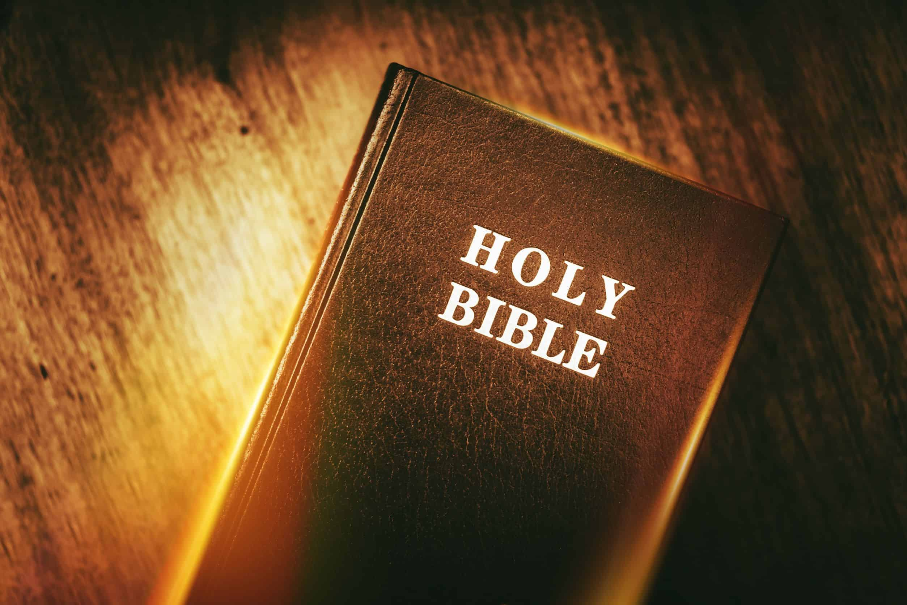
Is the Bible the Inspired
Word of God?
Isaiah 40:8 – “The grass withers, the flower fades, but the word of our God stands forever.”

Slide 2
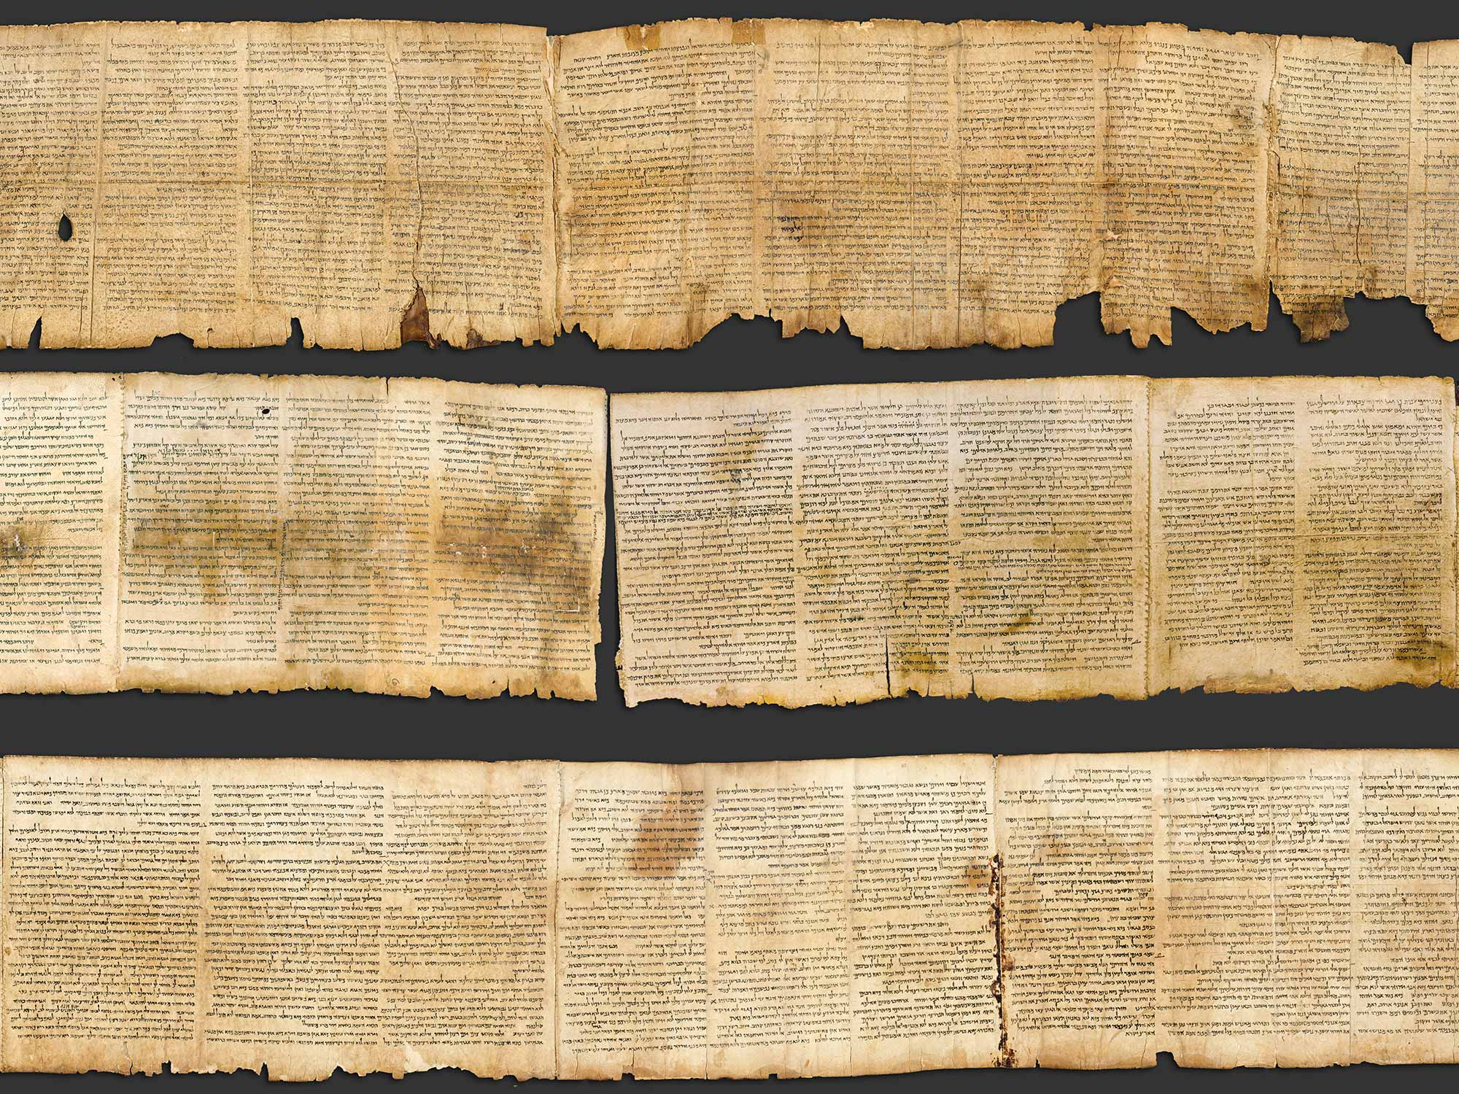
Dead Sea Scrolls

Slide 3
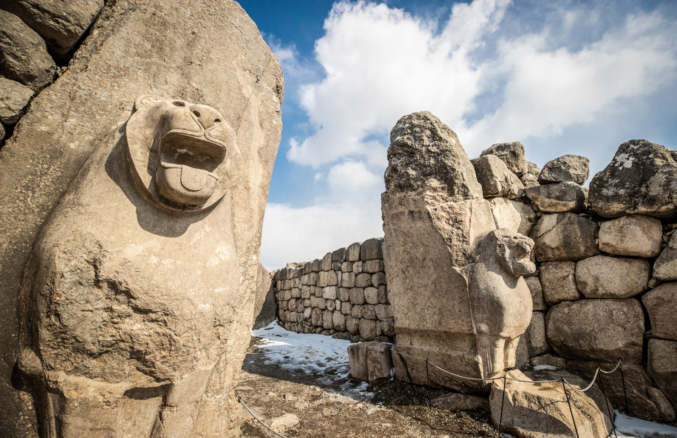
The Hittites

Slide 4
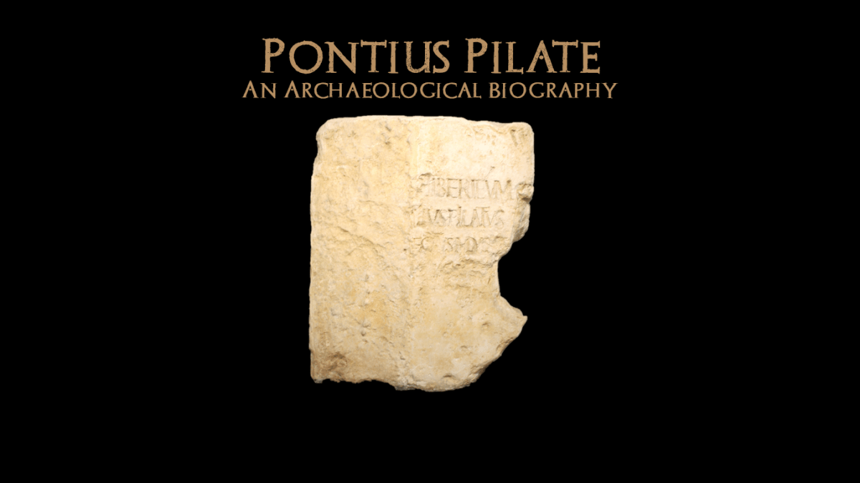

Slide 5
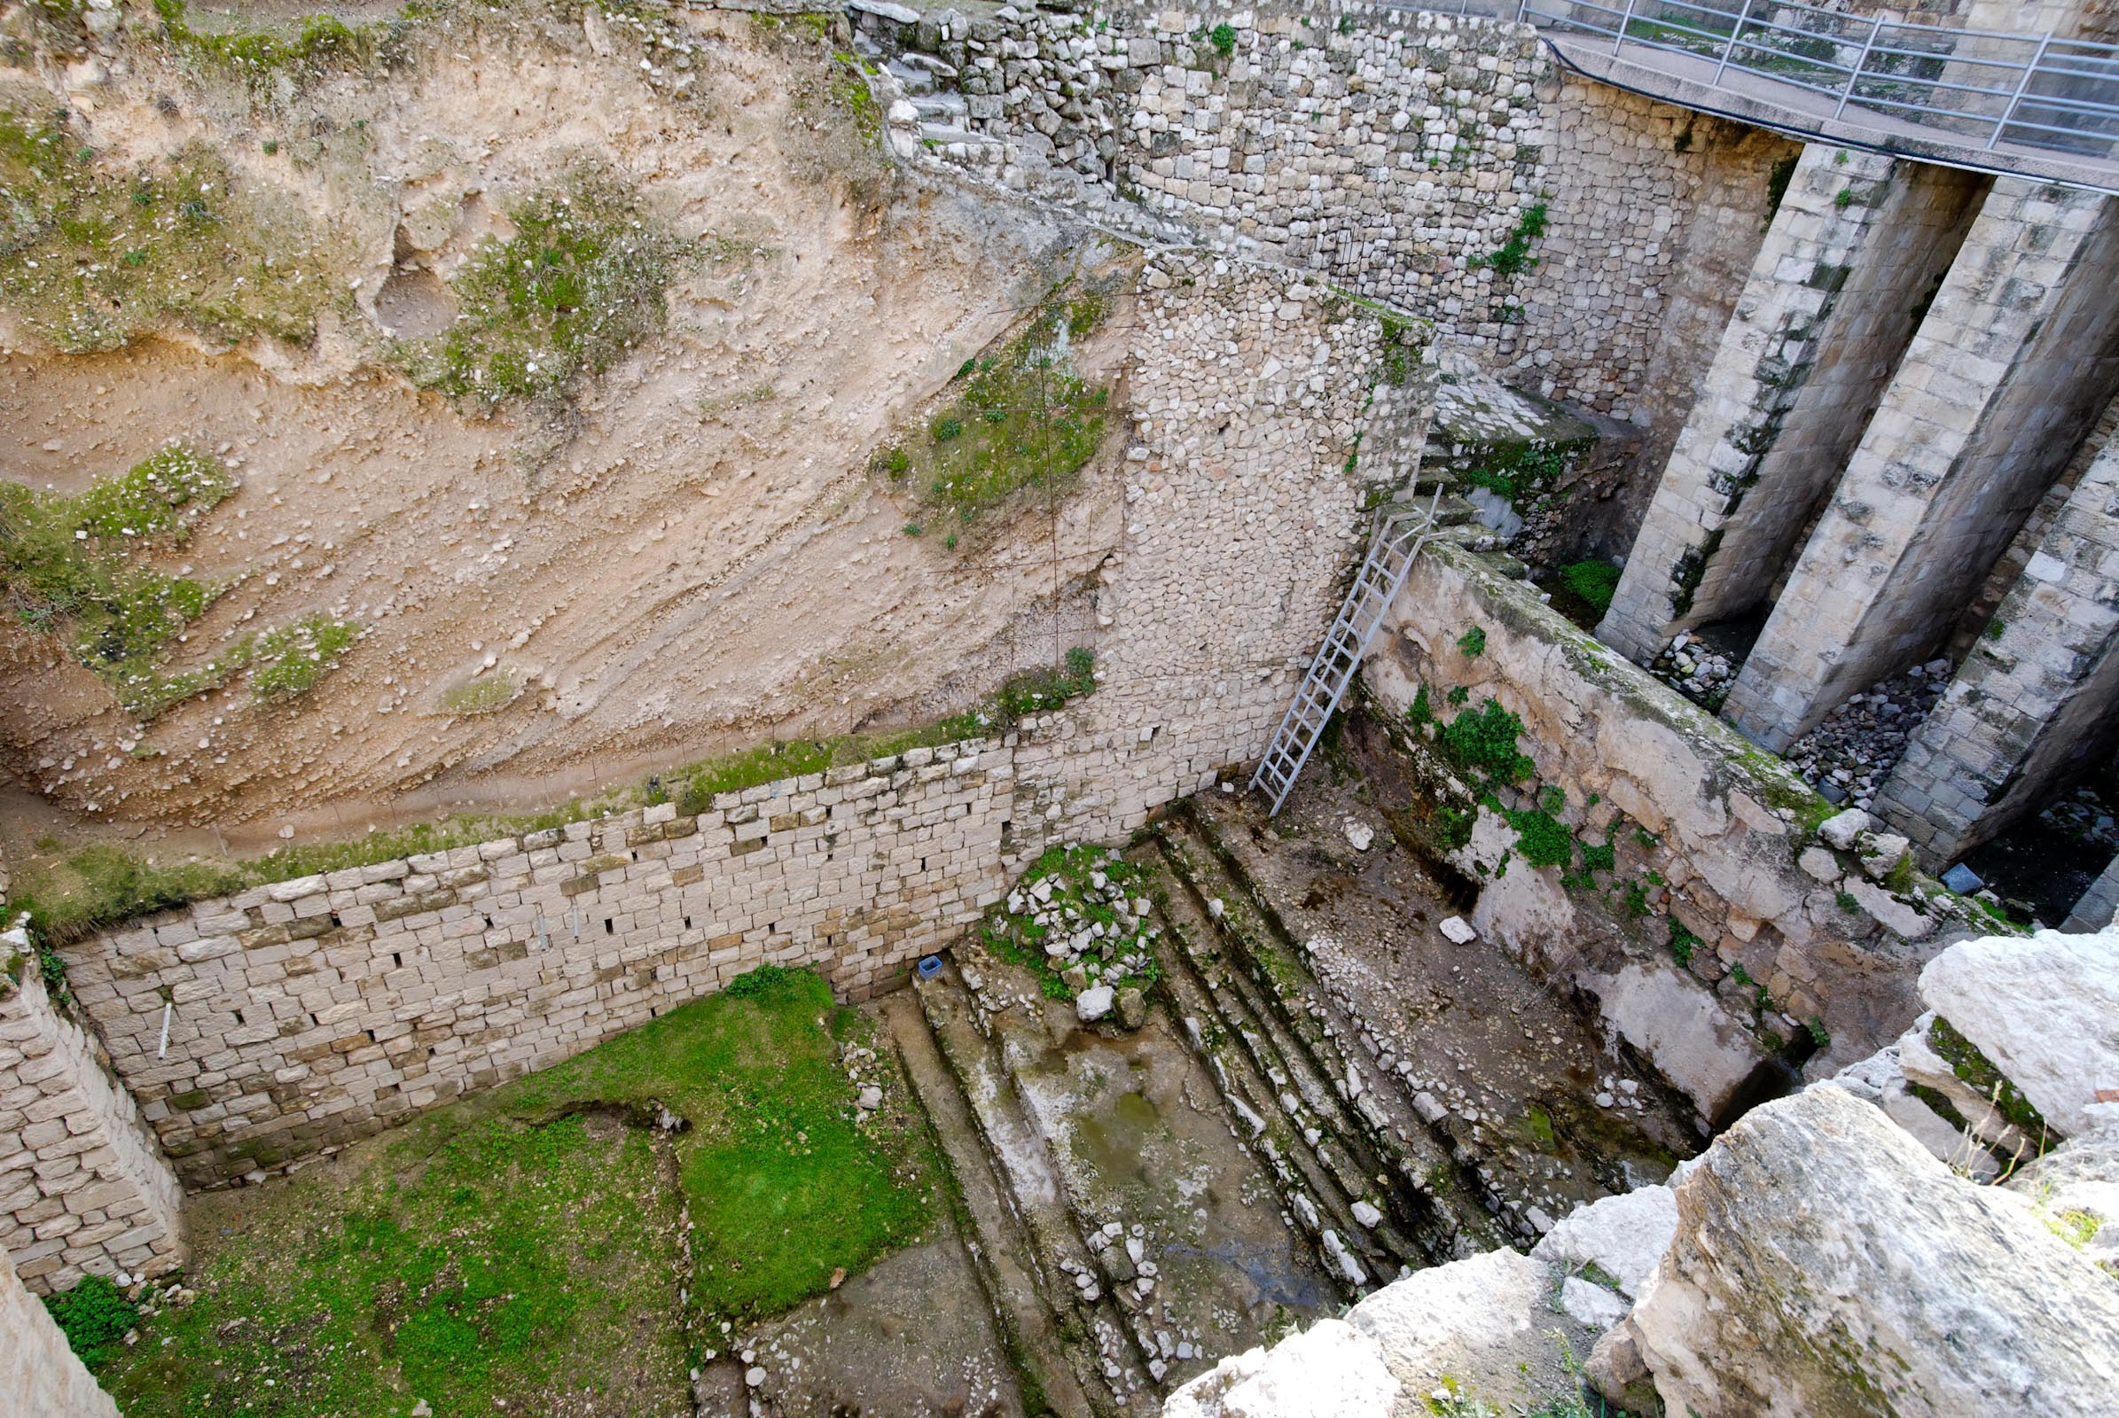
Pool of Bethesda

Slide 6
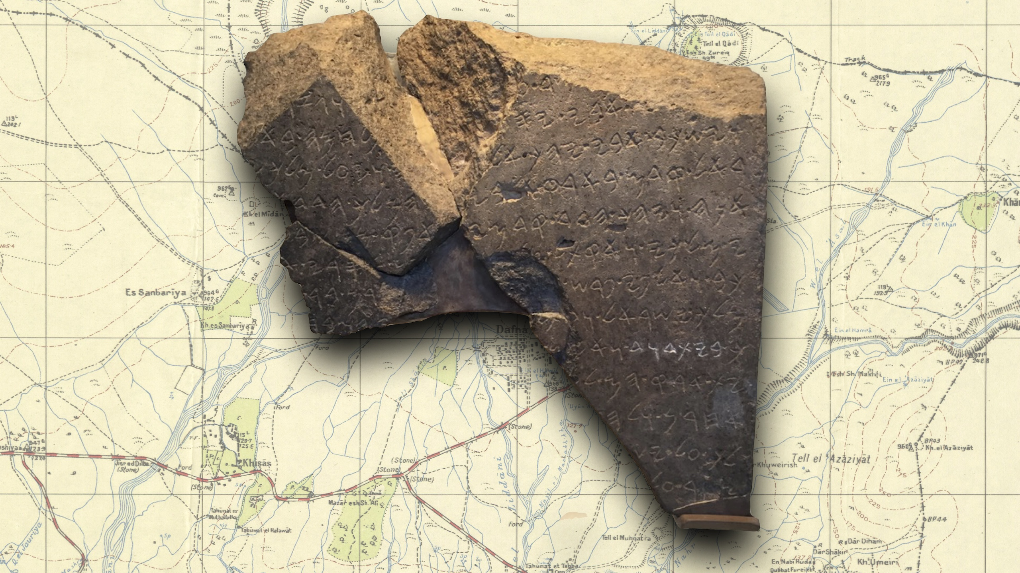
House of David

Slide 7

Edinburgh Castle
Constructed
~900 BC - 1588

Slide 8
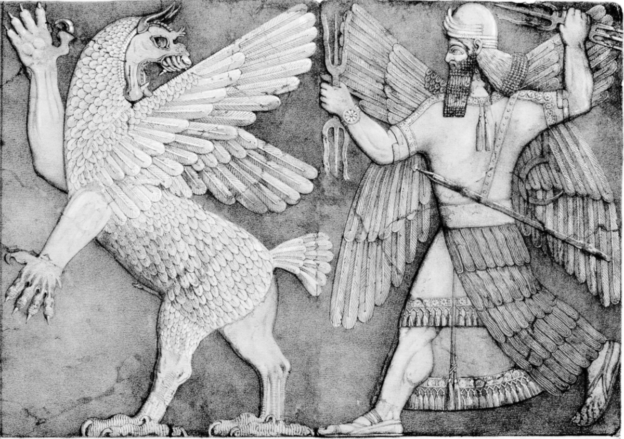
Tiamat
Babylonian Sea-Goddess

Slide 9
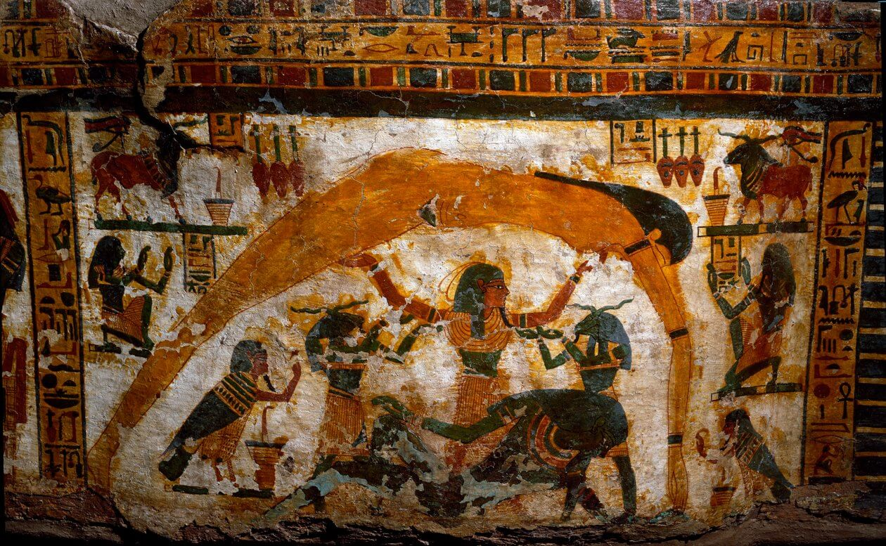
Nut and Geb
Egyptian Sky-Goddess and Earth God

Slide 10
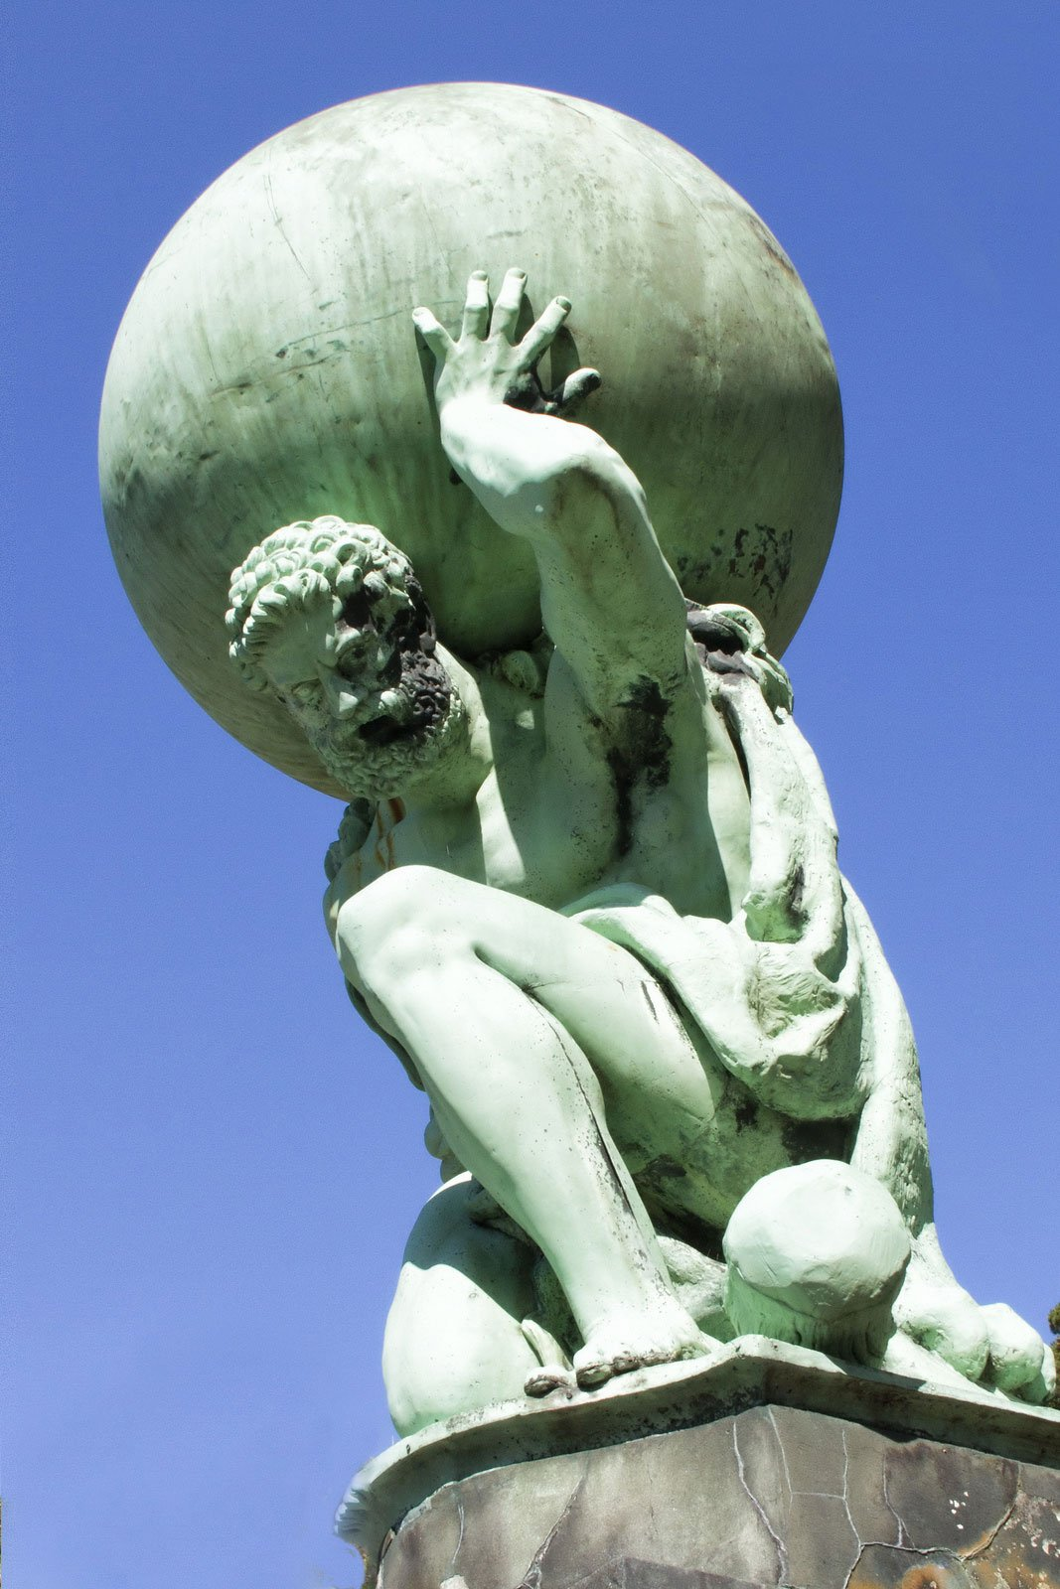
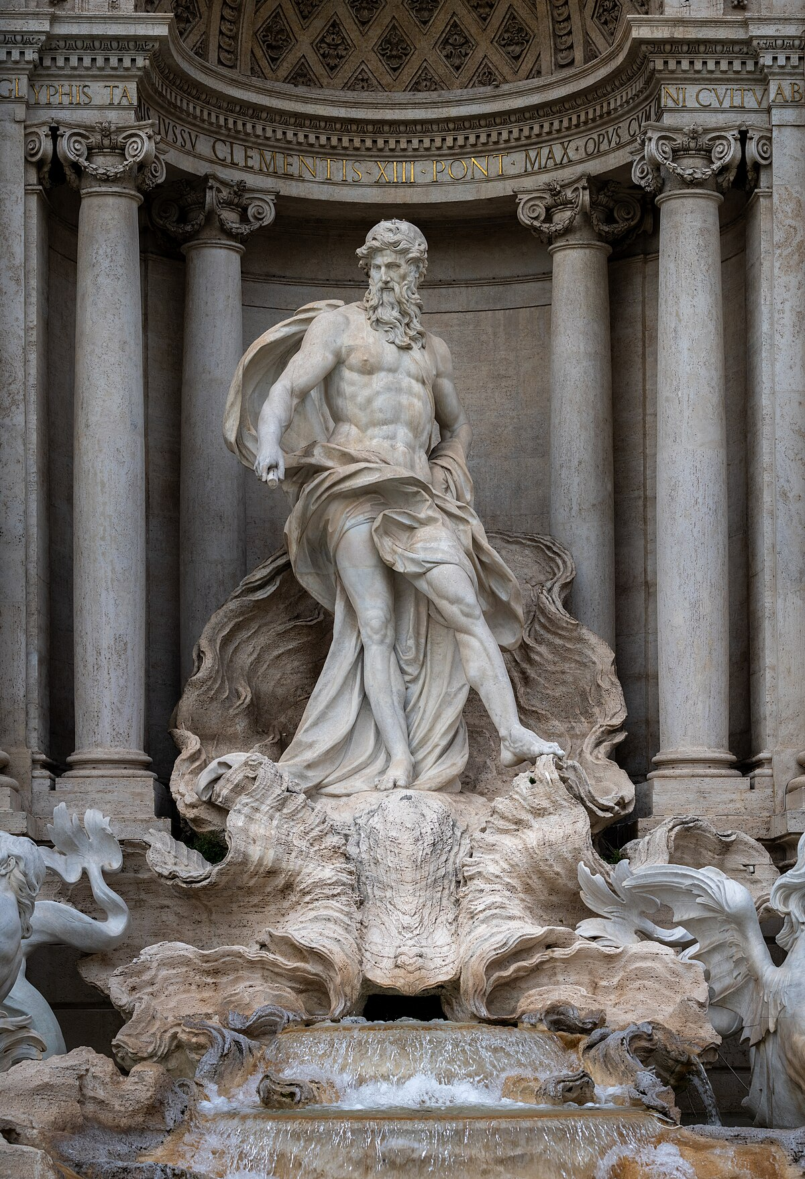
Atlas
Holding up World
Oceanus
Roman River-God

Slide 11
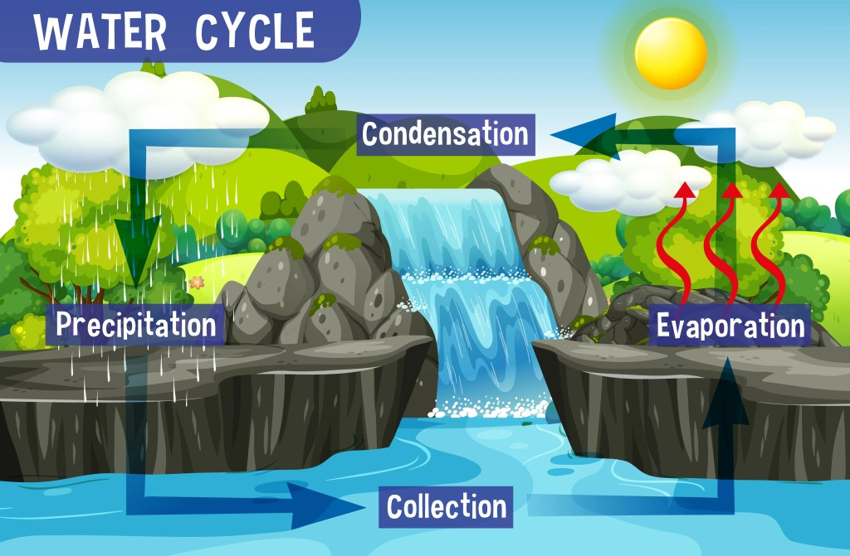

Slide 12
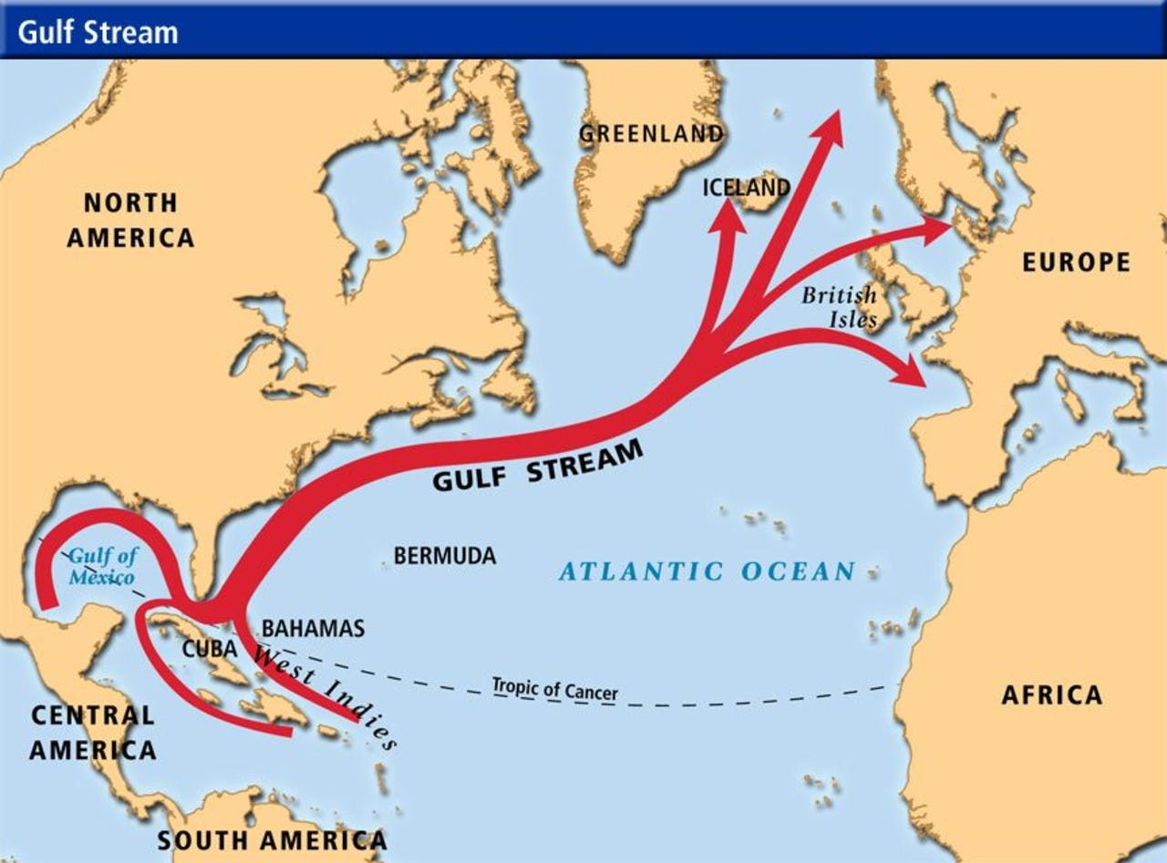

Slide 13
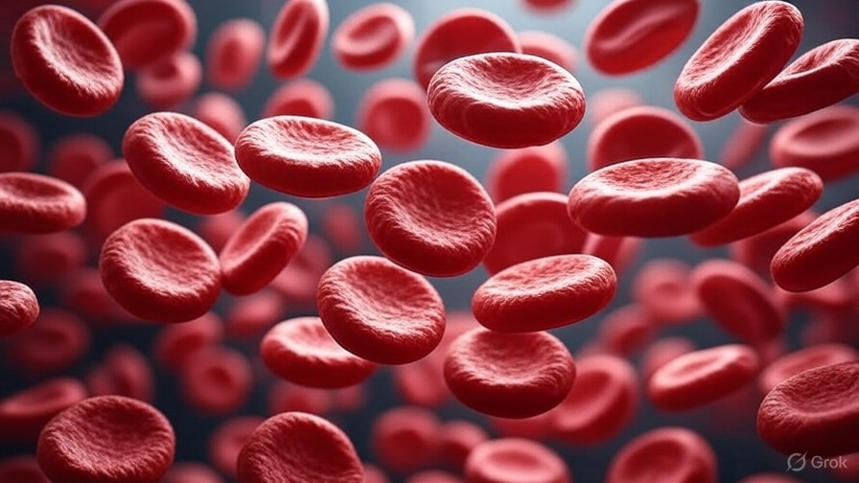
Life is in the Blood

Slide 14

Quarantine

Slide 15
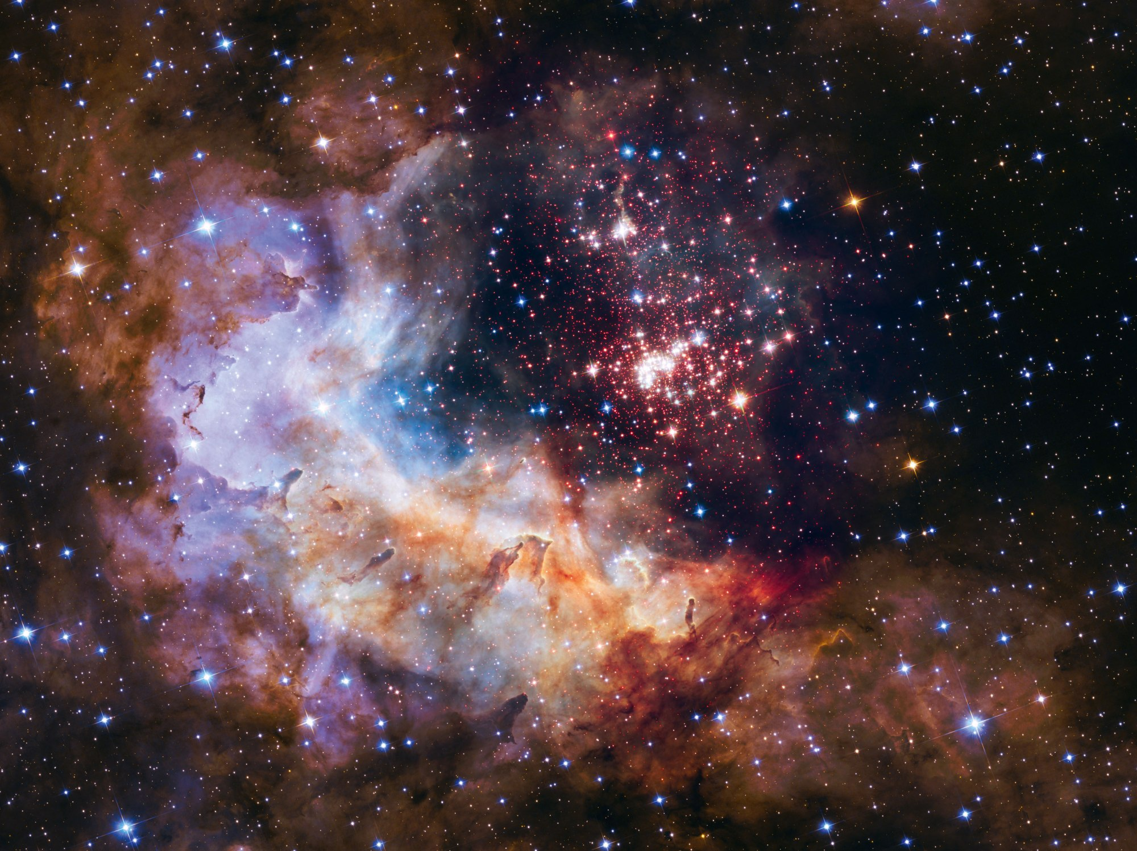
Host of Heaven

Slide 16
Micah 5:2 – “But you, Bethlehem Ephrathah… out of you shall come forth to Me the One to be Ruler in Israel.”
Matthew 2:1–6 – [Fulfilled in Jesus’ birth in Bethlehem.]
Zechariah 9:9 – “Behold, your King is coming to you… lowly and riding on a donkey.”
Matthew 21:1–7 – [Fulfilled in the Triumphal Entry.]
Zechariah 11:12–13 – “So they weighed out for my wages thirty pieces of silver… throw it to the potter.”
Matthew 27:3–10 – [Judas’ price; money thrown in the temple; used to buy the potter’s field.]
Isaiah 53:7 – “He was oppressed and He was afflicted, yet He opened not His mouth.”
Matthew 26:62–63 – [Jesus silent before accusers.]
Psalm 22:16 – “They pierced My hands and My feet.”
John 19:18, 37 – [Crucifixion; “they shall look on Him whom they pierced.”]

Slide 17
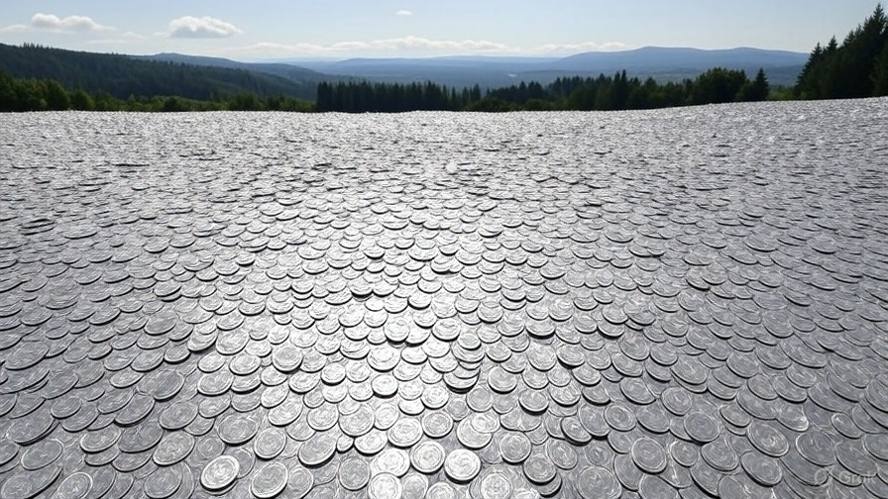
100,000,000,000,000,000
Silver Dollars
4 feet deep
Across Washington State
The WHOLE State

Slide 18
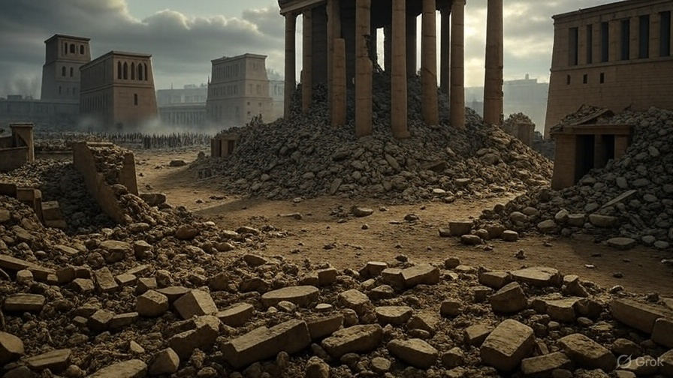
Babylon defeated by
Medo-Persia

Slide 19
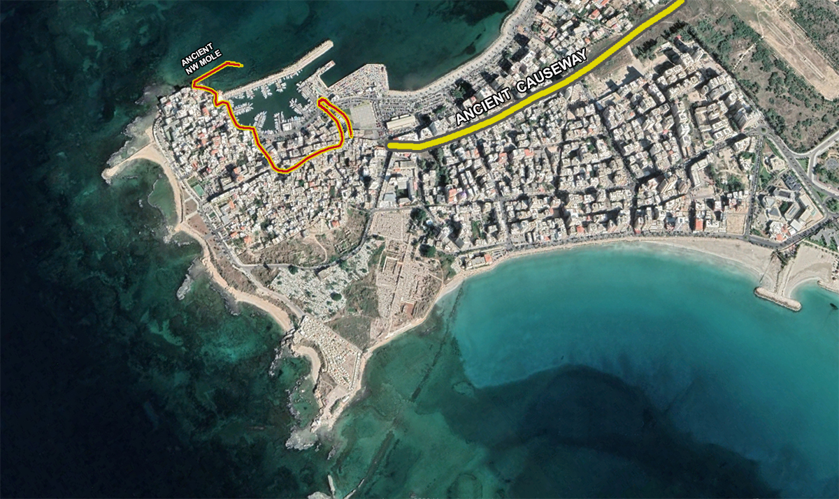
Alexander’s
Causeway

Slide 20
The Bible IS the Inspired
Word of God!
Isaiah 40:8 – “The grass withers, the flower fades, but the word of our God stands forever.”

