Slide 1
A Tale of Two Churches
The Struggle for the Faith Once Delivered

Slide 2
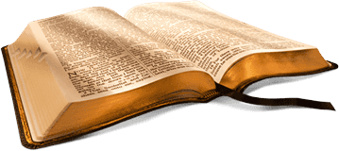
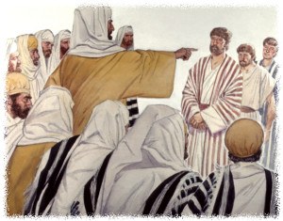
Acts 5:29

Slide 3
Acts 5:29
“We ought to serve God rather than men.”

Slide 4
Matthew 16:18
“I will build my church; and the gates of hell shall not prevail against it.”

Slide 5
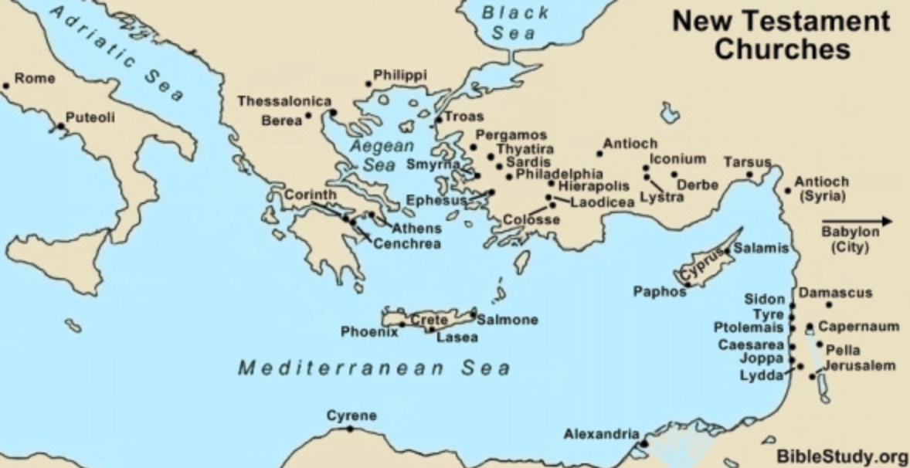
⚫
⚫
Churches of Asia
⚫ Rome
⚫
⚫
⚫
⚫
⚫
⚫
⚫
⚫
⚫
⚫
⚫
⚫
⚫
⚫
⚫
⚫
⚫
⚫
⚫
⚫
⚫
⚫
⚫
⚫
Churches of Judea
⚫
⚫
⚫
⚫Jerusalem
⚫

Slide 6
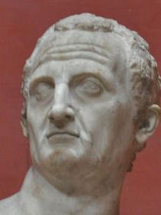
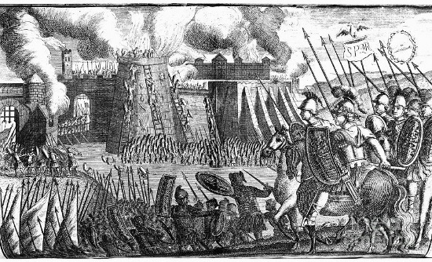
66 AD

Slide 7
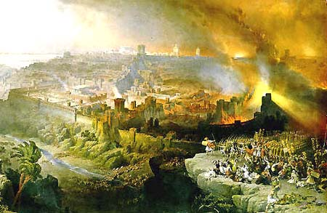
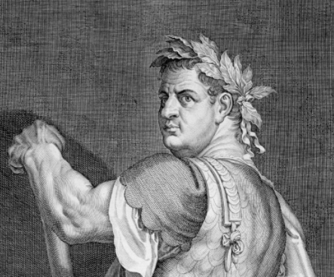
66 AD
68-70 AD

Slide 8
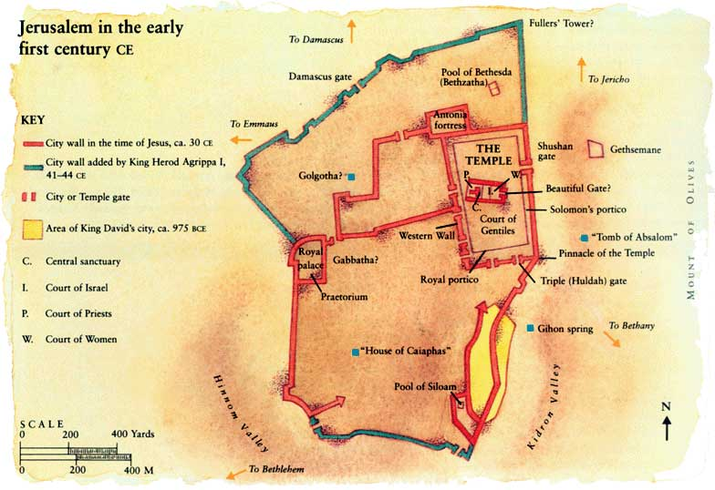
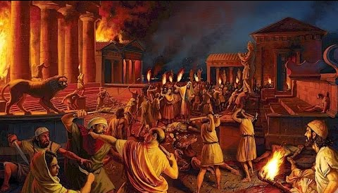

Slide 9
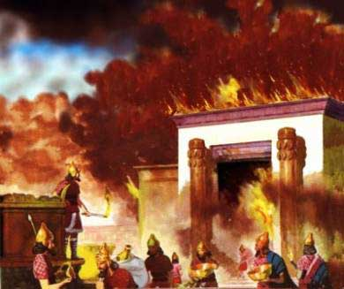
10th of AV – same day temple destroyed in 587 BC
God purifies what has been defiled by fire
Zech. 13:9 Putting people through the fire…purifying like silver and testing them like gold.
Deut. 4:24 The Lord your God is a consuming fire…
Ezek 23:38 God condemns His people for defiling the temple.

Slide 10
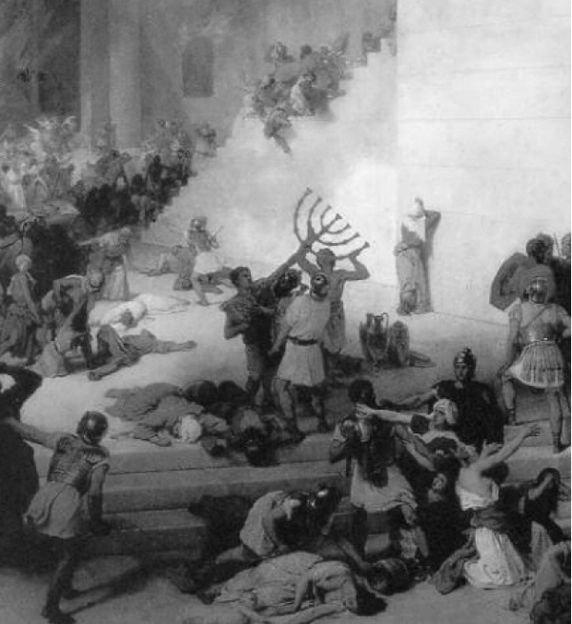
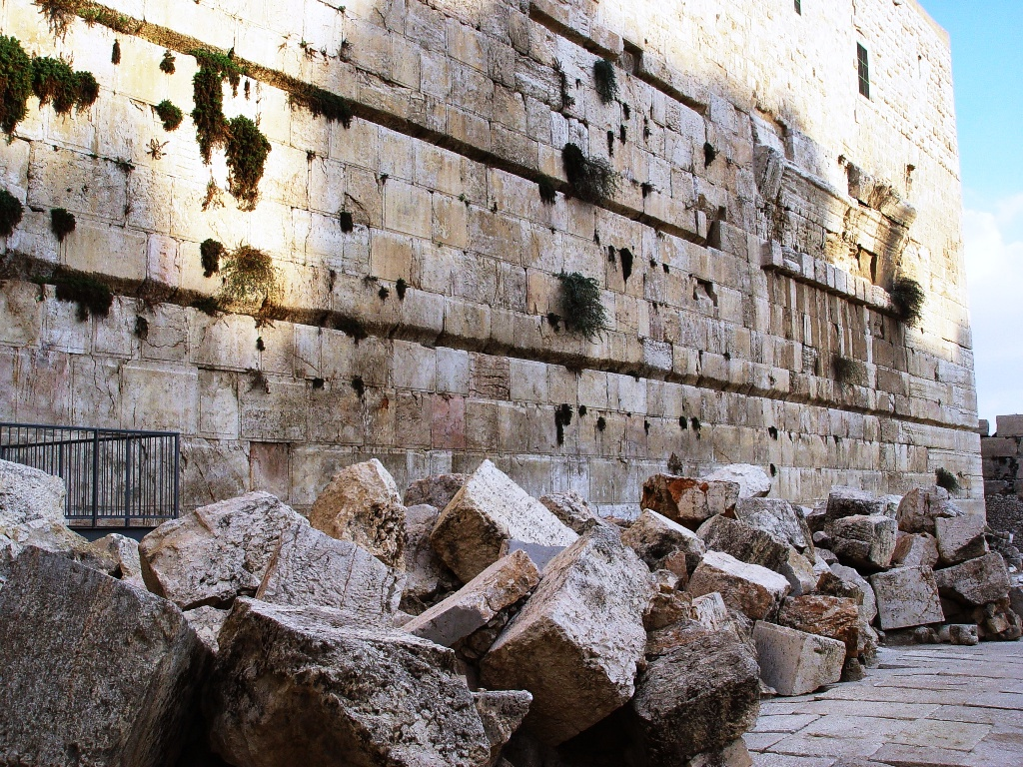
Matthew 24:1 - 2
“Then Jesus went out and departed from the temple, and His disciples came up to show Him the buildings of the temple. And Jesus said to them, ’Do you not see all these things? Assuredly, I say to you, not one stone shall be left here upon another, that shall not be thrown down.’’

Slide 11
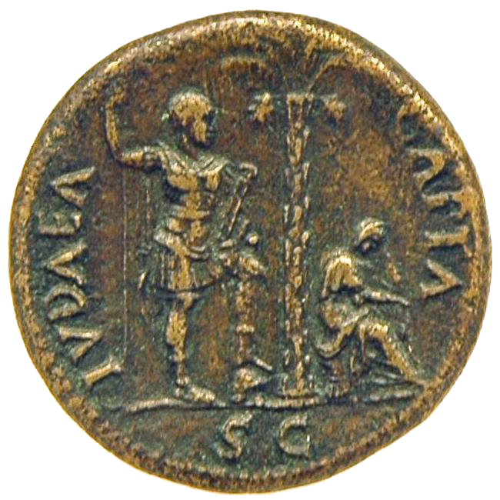
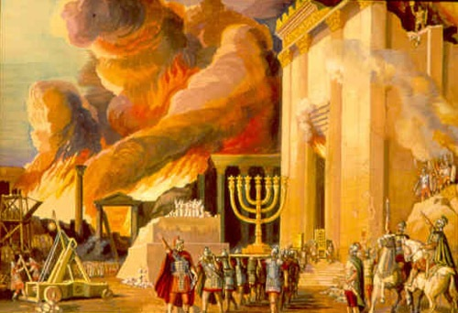
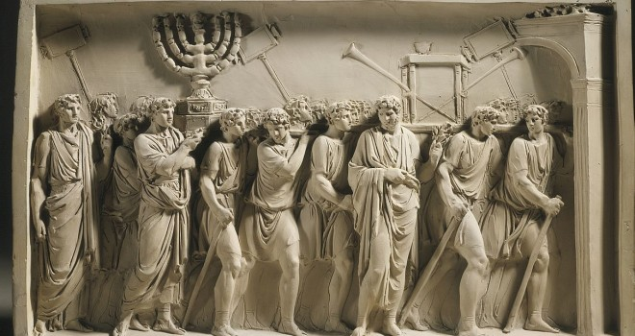

Slide 12
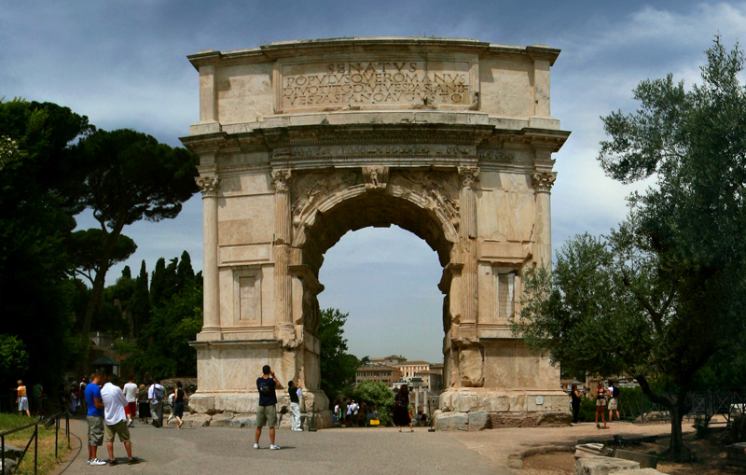
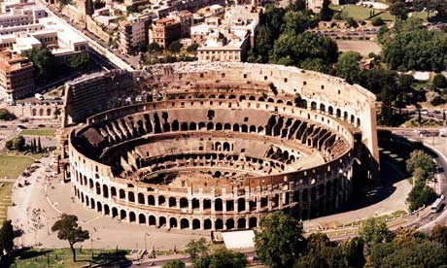
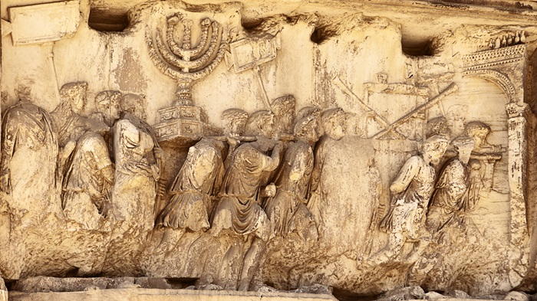

Slide 13
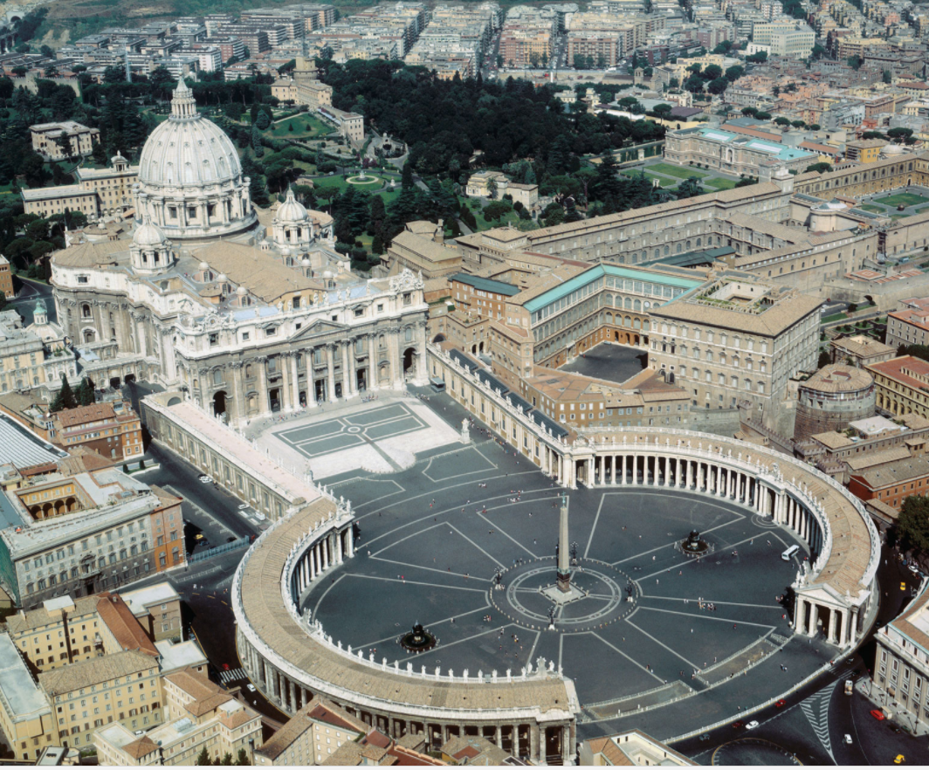
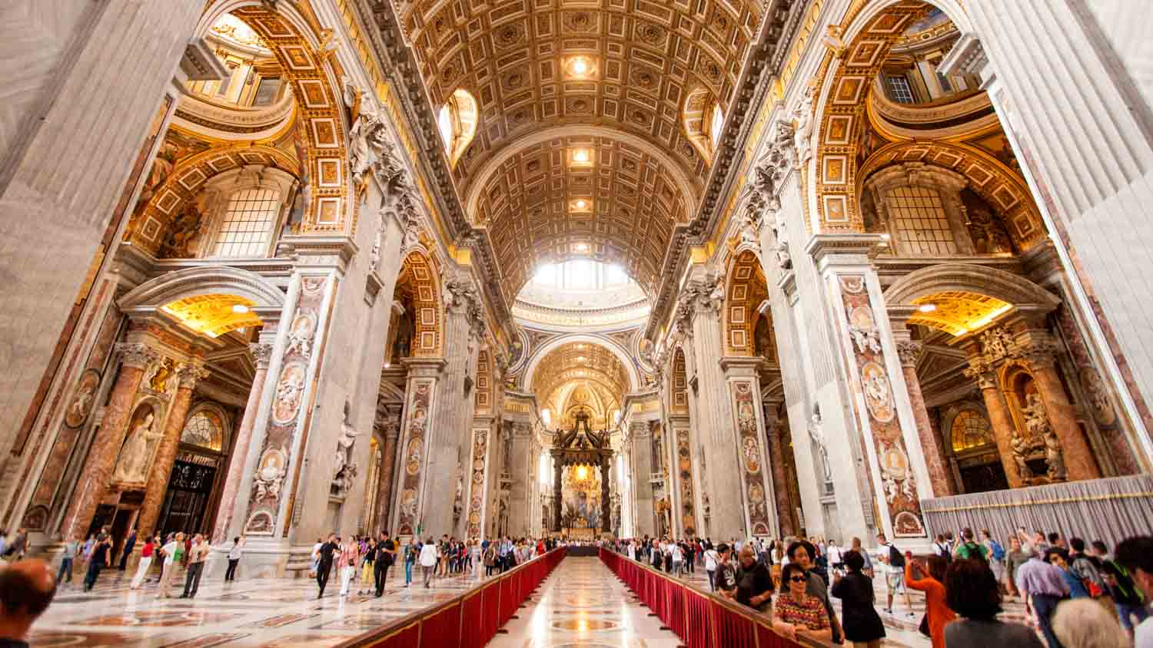

Slide 14
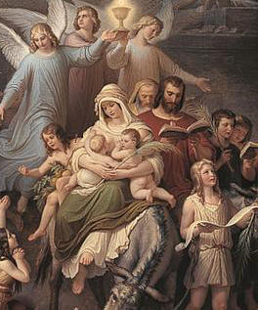
Josephus - Jewish Wars (AD 75)
"Besides these [signs], a few days after that feast, on the one- and-twentieth day of the month Artemisius, [Jyar,] a certain prodigious and incredible phenomenon appeared; I suppose the account of it would seem to be a fable, were it not related by those that saw it, and were not the events that followed it of so considerable a nature as to deserve such signals; for, before sun-setting, chariots and troops of soldiers in their armour were seen running about among the clouds, and surrounding of cities.”

Slide 15
Josephus - Jewish Wars (AD 75)
“Moreover, at that feast which we call Pentecost, as the priests were going by night into the inner [court of the] temple, as their custom was, to perform their sacred ministrations, they said that, in the first place, they felt a quaking, and heard a great noise, and after that they heard a sound as of a great multitude, saying, "Let us remove hence."

Slide 16
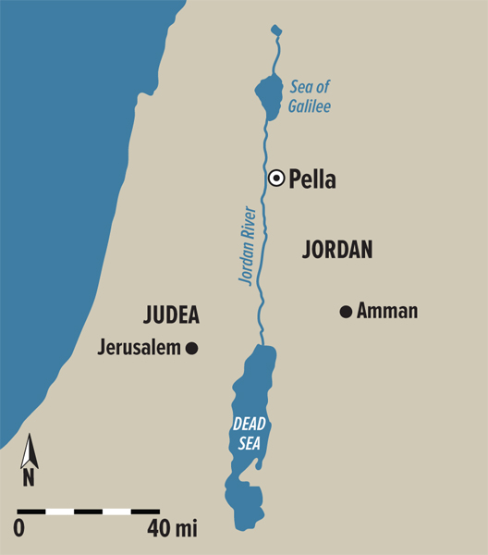

Slide 17

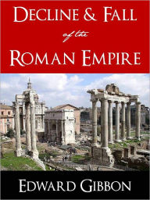
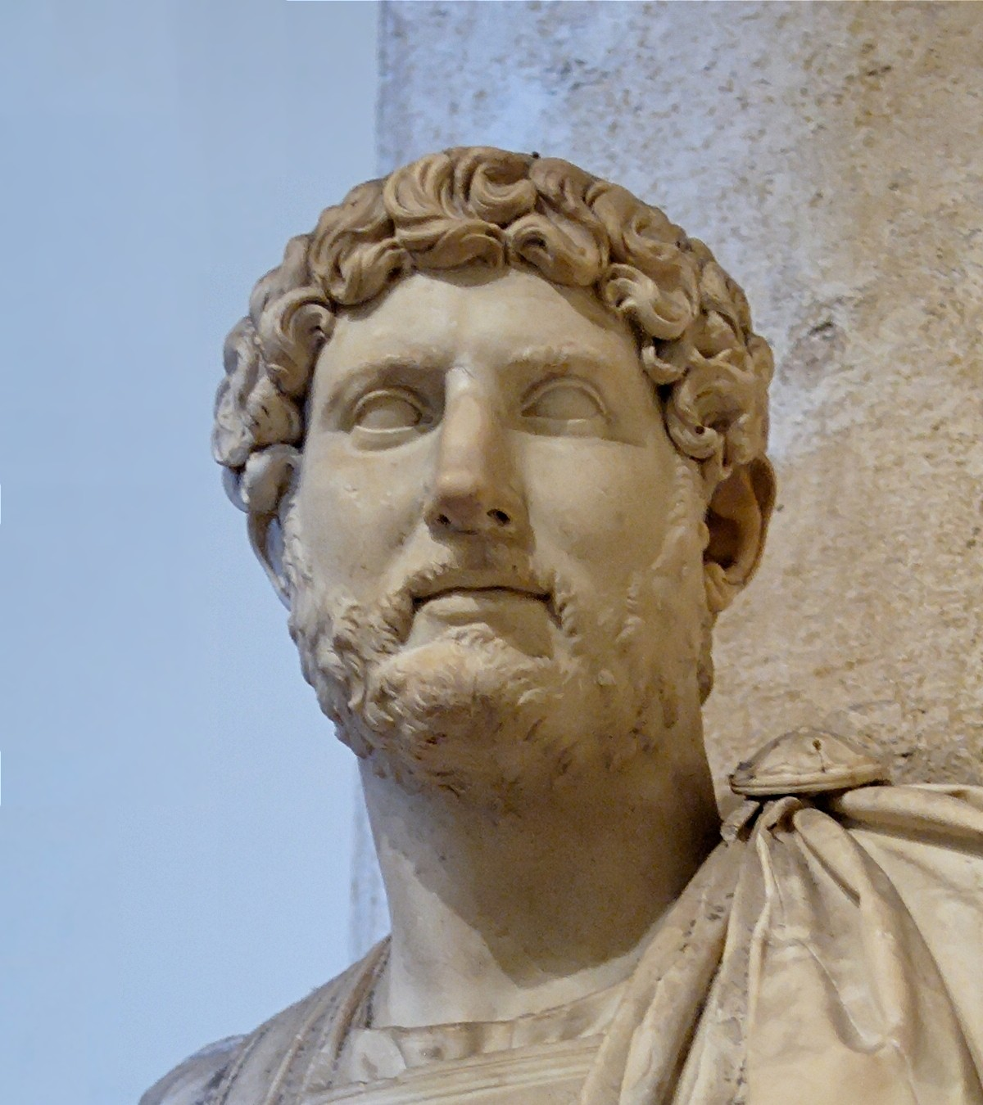

E. Gibbon - Decline and Fall of the Roman Empire
“The Nazarenes retired from the ruins of Jerusalem to the little town of Pella beyond the Jordan, where that ancient church languished above sixty years in solitude and obscurity.
They still enjoyed the comfort of making frequent and devout visits to the Holy City, and the hope of being one day restored to those seats which both nature and religion taught them to love as well as to revere.
But at length, under the reign of Hadrian, the desperate fanaticism of the Jews filled up the measure of their calamities; and the Romans, exasperated by their repeated rebellions, exercised the rights of victory with unusual rigour.”

Slide 18
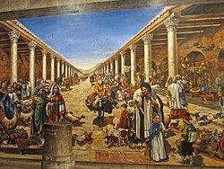
E. Gibbon - Decline and Fall of the Roman Empire
“The emperor founded, under the name of Alia Capitolina, a new city on Mount Sion, to which he gave the privileges of a colony; and denouncing the severest penalties against any of the Jewish people who should dare to approach its precincts, he fixed a vigilant garrison of a Roman cohort to enforce the execution of his orders.”
“The Nazarenes had only one way left to escape the common proscription, and the force of truth was on this occasion assisted by the influence of temporal advantages.”

Slide 19
E. Gibbon - Decline and Fall of the Roman Empire
“They elected Marcus for their bishop, a prelate of the race of the Gentiles, and most probably a native either of Italy or of some of the Latin provinces. At his persuasion the most considerable part of the congregation renounced the Mosaic law, in the practice of which they had persevered above a century. By this sacrifice of their habits and prejudices they purchased a free admission into the colony of Hadrian…”
When the name and honours of the church of Jerusalem had been restored to Mount Sion, the crimes of heresy and schism were imputed to the obscure remnant of the Nazarenes which refused to accompany their Latin bishop. They still preserved their former habitation of Pella, spread themselves into the villages adjacent to Damascus, and formed an inconsiderable church in the city of Bercea, or, as it is now called, of Aleppo, in Syria.”

Slide 20
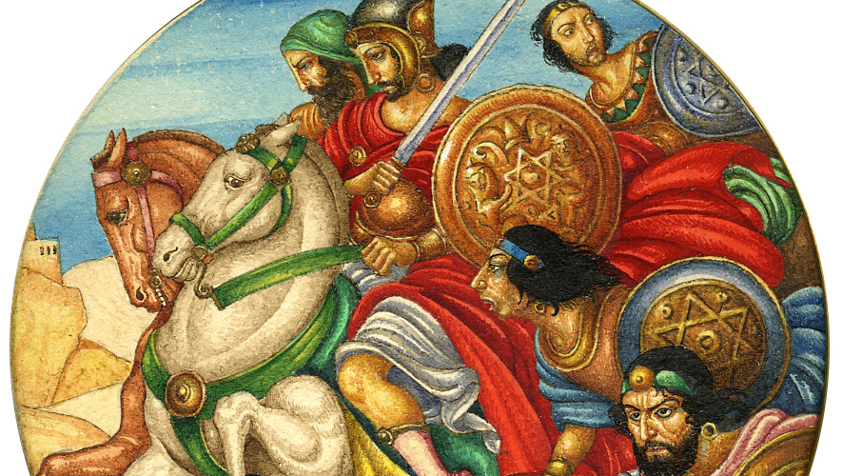
135 AD

Slide 21
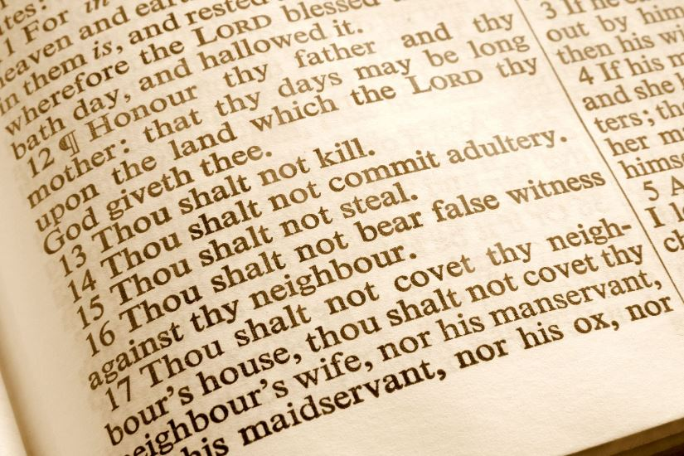
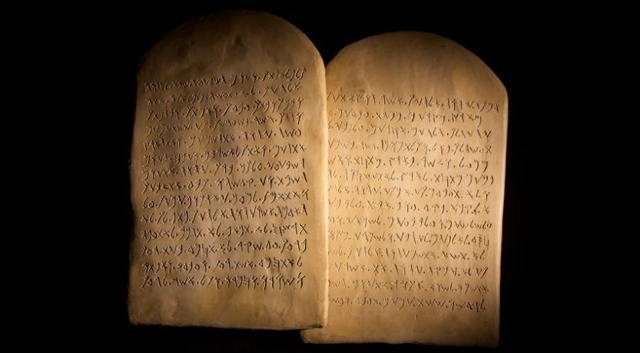

Slide 22
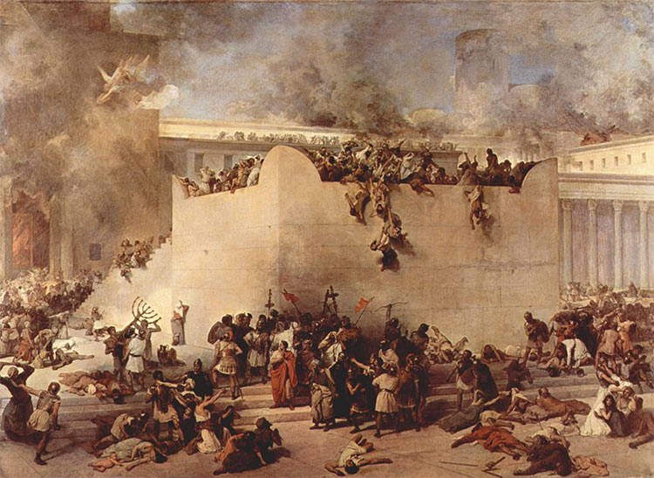
Sabbath and Sunday in Early Christianity - Robert Leo Odom 1977
“The second century opened with intense antipathy manifested throughout the Roman Empire by pagan Gentiles toward Jews as a result of Jewish uprisings against the Roman government in Palestine, Egypt, Cyprus, and Cyrene during the reign of Trajan (98-117).
It reached its climax during the Jewish revolt led by Bar Cocheba in Judea during 132-135. Emperor Hadrian (117-138) crushed the long and bloody revolt with terrible severity, razed Jerusalem, and established a heathen community there, and made it a capital crime for a Jew to set foot on its soil.”

Slide 23
Sabbath and Sunday in Early Christianity - Robert Leo Odom 1977
“Judaism was outlawed by harsh decrees of the emperor, and all of its religious practices­­­- especially Sabbath observance, Passover celebration, and circumcision- were prohibited under penalty of death.
Although the Hadrianic decrees were softened somewhat by Antonius Pius (138-161), widespread animosity toward Judaism and everything that seemed to smack of it smoldered long afterward.”
- p. 297

Slide 24
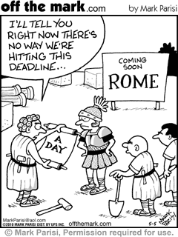

Slide 25
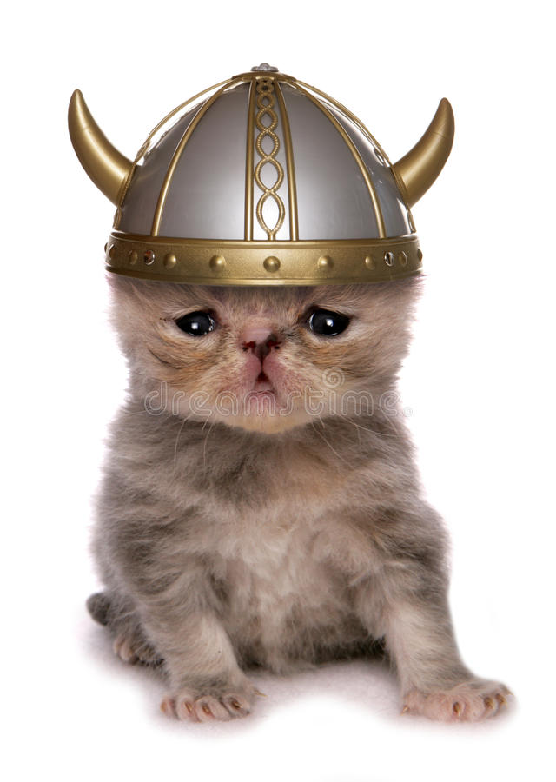

Slide 26
Matthew 16:18
“I will build my church; and the gates of hell shall not prevail against it.”

Slide 27
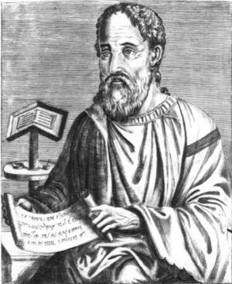
Eusebius - 4th Century Catholic church historian
“This heresy of the Nazoraeans exists in Beroea in the neighbourhood of Coele Syria and the Decapolis in the region of Pella and in Basanitis in the so-called Kokaba (Chochabe in Hebrew).
From there it took its beginning after the exodus from Jerusalem when all the disciples went to live in Pella because Christ had told them to leave Jerusalem and to go away since it would undergo a siege.”

Slide 28
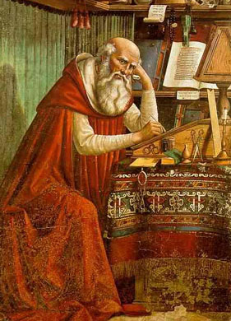
Letter of Jerome to Augustine - 5th Century Bishop of Rome
404 AD
“The matter in debate, therefore, or I should rather say your opinion regarding it, is summed up in this: that since the preaching of the gospel of Christ, the believing Jews do well in observing the precepts of the law, i.e. in offering sacrifices as Paul did, in circumcising their children, as Paul did in the case of Timothy, and keeping the Jewish Sabbath, as all the Jews have been accustomed to do.“

Slide 29
Letter of Jerome to Augustine - 5th Century Bishop of Rome
404 AD
“If this be true, we fall into the heresy of Cerinthus and Ebion, who, though believing in Christ, were anathematized by the fathers for this one error, that they mixed up the ceremonies of the law with the gospel of Christ, and professed their faith in that which was new, without letting go what was old.“

Slide 30
Letter of Jerome to Augustine - 5th Century Bishop of Rome
404 AD
“Why do I speak of the Ebionites, who make pretensions to the name of Christian? In our own day there exists a sect among the Jews throughout all the synagogues of the East, which is called the sect of the Minei, and is even now condemned by the Pharisees. The adherents to this sect are known commonly as Nazarenes; they believe in Christ the Son of God, born of the Virgin Mary; and they say that He who suffered under Pontius Pilate and rose again, is the same as the one in whom we believe. But while they desire to be both Jews and Christians...”

Slide 31
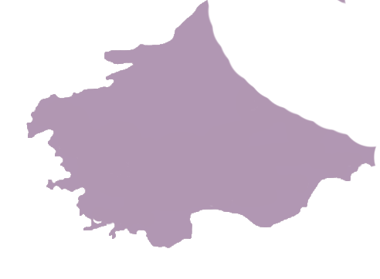

⚫
⚫
Churches of Asia
⚫ Rome
⚫
⚫
⚫
⚫
⚫
⚫
⚫
⚫
⚫
⚫
⚫
⚫
⚫
⚫
⚫
⚫
⚫
⚫
⚫
⚫
⚫
⚫
⚫
⚫
⚫
⚫
⚫
⚫Jerusalem
⚫

Slide 32
Matthew 24:4 - 5
“Take heed that no one deceives you. For many will come in My name (claiming to represent me), saying, ‘I am the Christ,’ and will deceive many.”

Slide 33
Acts 20:29 - 31
“For I know this, that after my departure savage wolves will come in among you, not sparing the flock. Also from among yourselves men will rise up, speaking perverse things,
(NIV “distorting the truth”) to draw away the disciples after themselves. Therefore watch, and remember that for three years I did not cease to warn everyone night and day with tears.”

Slide 34
II Thesallonians 2:7-15
“For the mystery of lawlessness is already at work; ...13 But we are bound to give thanks to God always for you, brethren beloved by the Lord, because God from the beginning chose you for salvation through sanctification by the Spirit and belief in the truth, 14 to which He called you by our gospel, for the obtaining of the glory of our Lord Jesus Christ. 15 Therefore, brethren, stand fast and hold the traditions which you were taught, whether by word or our epistle.”

Slide 35
II Peter 2:1 - 3
“But there were also false prophets among the people, even as there will be false teachers among you, who will secretly bring in destructive heresies, even denying the Lord who bought them, and bring on themselves swift destruction.
And many will follow their destructive ways, because of whom the way of truth will be blasphemed. By covetousness they will exploit you with deceptive words; for a long time their judgment has not been idle, and their destruction does not slumber.”

Slide 36
⚫
⚫
Churches of Asia
⚫ Rome
⚫
⚫
⚫
⚫
⚫
⚫
⚫
⚫
⚫
⚫
⚫
⚫
⚫
⚫
⚫
⚫
⚫
⚫
⚫
⚫
⚫
⚫
⚫
⚫
Churches of Judea
⚫
⚫
⚫
⚫Jerusalem
⚫

Slide 37
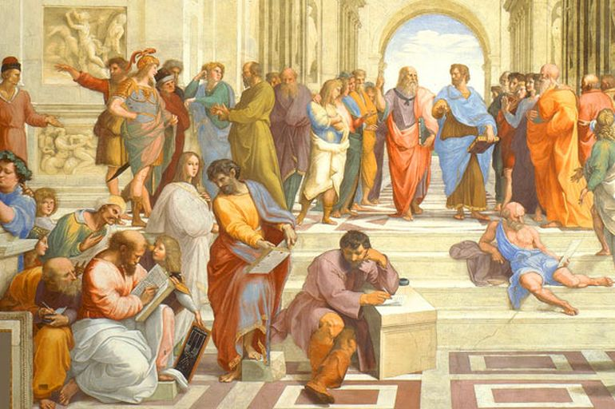

Slide 38
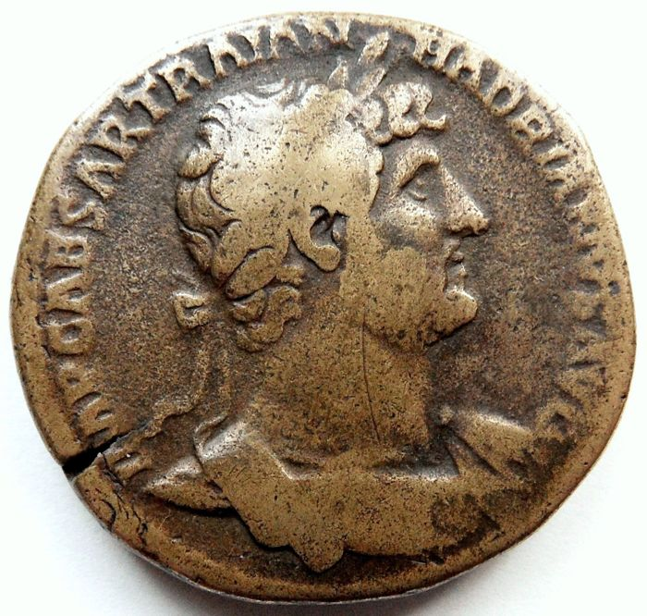

Slide 39
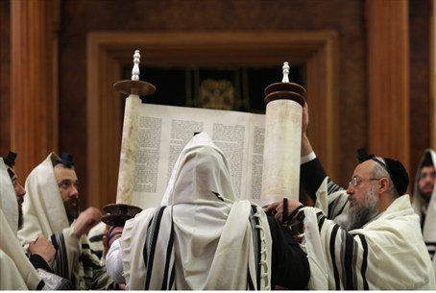

Slide 40
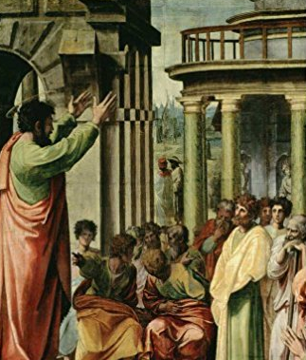

Slide 41
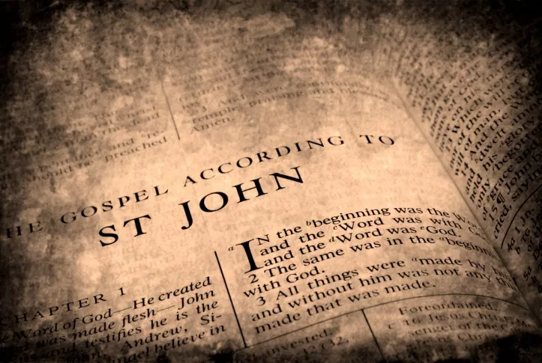
Apostle John - Only remaining disciple after 60 AD, had oversight of churches in Asia Minor

Slide 42
II John 1:4 - 8
“I rejoiced greatly that I have found some of your children walking in truth, as we received commandment from the Father. And now I plead with you, lady, not as though I wrote a new commandment to you, but that which we have had from the beginning: that we love one another. This is love, that we walk according to His commandments. This is the commandment, that as you have heard from the beginning, you should walk in it. For many deceivers have gone out into the world who do not confess Jesus Christ as coming in the flesh. This is a deceiver and an antichrist. Look to yourselves, that we do not lose those things we worked for, but that we may receive a full reward.”

Slide 43
II John 1:4 - 8
“I rejoiced greatly that I have found some of your children walking in truth, as we received commandment from the Father. And now I plead with you, lady, not as though I wrote a new commandment to you, but that which we have had from the beginning: that we love one another. This is love, that we walk according to His commandments. This is the commandment, that as you have heard from the beginning, you should walk in it. For many deceivers have gone out into the world who do not confess Jesus Christ as coming in the flesh. This is a deceiver and an antichrist. Look to yourselves, that we do not lose those things we worked for, but that we may receive a full reward.”

Slide 44
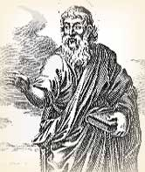

Slide 45
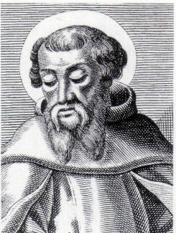
Irenaeus - Greek Cleric - 180 AD
“But Polycarp also was not only instructed by apostles, and conversed with many who had seen Christ, but was also, by apostles in Asia, appointed bishop of the Church in Smyrna…always taught the things which he had learned from the apostles, and which the Church has handed down, and which alone are true. To these things all the Asiatic Churches testify, as do also those men who have succeeded Polycarp down to the present time.”
- (Irenaeus. Adversus Haeres. Book III, Chapter 4, Verse 3 and Chapter 3, Verse 4).

Slide 46
William Cave - 17th Century Historian
“...the Sabbath or Saturday was held by them in great veneration, and especially in the Eastern parts honoured with all the public solemnities of religion...This is plain, not only from some passages in Ignatius and Clement's Constitutions, but from writers of more unquestionable credit and authority. Athanasius, bishop of Alexandria, tells us, that they assembled on Saturdays, not that they were infected with Judaism, but only to worship Jesus Christ, the Lord of the sabbath.”
- (Cave William, D.D. Primitive Christianity: or the Religion of the Ancient Christians in the First Ages of the Gospel. 1840 edition revised by H. Cary. Oxford, London, pp. 84,85).

Slide 47
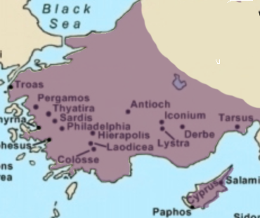
Salminius Hermias Sozomenus - Christian historian - 443 AD
Constantinople
“The people of Constantinople, and almost everywhere (in Asia Minor), assemble together on the Sabbath as well as on the first day of the week, which custom is never observed at Rome or at Alexandria.”
- (Sozomen. THE ECCLESIASTICAL HISTORY OF SOZOMEN. Comprising a History of the Church, from a.d. 323 to a.d. 425. Book VII, Chapter XIX)

Slide 48


Slide 50
Irenaeus - Greek Cleric - 180 AD
“Valentinus (a gnostic false teacher) came to Rome in the time of Hyginus (bishop of Rome between AD 136-140), flourished under Pius (bishop from 140-155), a bishop of the Roman church, and remained until Anicetus (155 - 166 AD), another bishop.
Cerdon [and] Marcion (both false gnostic teachers), then, succeeding him, flourished under Anicetus.”

Slide 51
Irenaeus - Greek Cleric - 180 AD
”But Polycarp also was not only instructed by apostles, and conversed with many who had seen Christ, but was also, by apostles in Asia, appointed bishop of the Church in Smyrna…always taught the things which he had learned from the apostles, and which the Church has handed down, and which alone are true.
To these things all the Asiatic Churches testify, as do also those men who have succeeded Polycarp down to the present time -- a man who was of much greater weight, and a more steadfast witness of truth, than Valentinus, and Marcion, and the rest of the heretics.”

Slide 52
Irenaeus - Greek Cleric - 180 AD
”He it was who, coming to Rome in the time of Anicetus caused many to turn away from the aforesaid heretics to the Church of God, proclaiming that he had received this one and sole truth from the apostles... John, the disciple of the Lord…exclaiming, ‘Let us fly, lest even the bath-house fall down, because Cerinthus, the enemy of the truth, is within.’
And Polycarp himself replied to Marcion, who met him on one occasion, and said, ‘Dost thou know me?’’I do know thee, the first-born of Satan’”
- (Irenaeus. Adversus Haeres. Book III, Chapter 4, Verse 3 and Chapter 3, Verse 4).

Slide 53




Slide 54
Irenaeus - Greek Cleric - 180 AD
”And when the blessed Polycarp was sojourning in Rome in the time of Anicetus, although a slight controversy had arisen among them as to certain other points…For neither could Anicetus persuade Polycarp to forego the observance [of Passover, in his own way], inasmuch as these things had been always observed by John the disciple of our Lord, and by other apostles with whom he had been conversant; nor, on the other hand, could Polycarp succeed in persuading Anicetus to keep [the observance in his way], for he maintained that he was bound to adhere to the usage of the presbyters who preceded him.”

Slide 55
Irenaeus - Greek Cleric - 180 AD
”And in this state of affairs they held fellowship with each other; and Anicetus conceded to Polycarp in the Church the celebration of the Eucharist, by way of showing him respect; so that they parted in peace one from the other, maintaining peace with the whole Church, both those who did observe [this custom] and those who did not Irenaeus.”
- (FRAGMENTS FROM THE LOST WRITINGS OF IRENAEUS.)

Slide 56
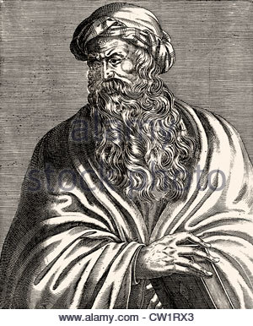
Epiphanius - Catholic Bishop - 4th Century
”For long ago, even from the earliest days, the Passover was celebrated at different times in the church…In the time of Polycarp and Victor, the east was at odds with the west and they would not accept letters of commendation from each other.”
- (Epiphanius. The Panarion of Epiphanius of Salamis, Books II and III (Sects 47-80), De Fide). Section VI, Verse 9,7.)

Slide 57


Slide 58
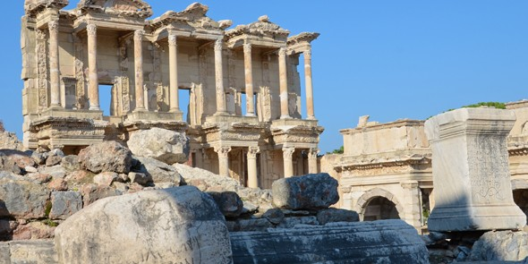
Polycrates of Ephesus

Slide 59

Eusebius - Catholic historian - 195 AD
(Quoting letter from Polycrates of Ephesus to Roman Bishop Victor)
“We observe the exact day; neither adding, nor taking away. For in Asia also great lights have fallen asleep, which shall rise again on the day of the Lord's coming, when he shall come with glory from heaven, and shall seek out all the saints. Among these are Philip, one of the twelve apostles, who fell asleep in Hierapolis; and his two aged virgin daughters, and another daughter, who lived in the Holy Spirit and now rests at Ephesus;...”

Slide 60
Eusebius - Catholic historian - 195 AD
...and, moreover, John, who was both a witness and a teacher, who reclined upon the bosom of the Lord, and, being a priest, wore the sacerdotal plate.
He fell asleep at Ephesus. And Polycarp in Smyrna, who was a bishop and martyr; and Thraseas, bishop and martyr from Eumenia, who fell asleep in Smyrna.
Why need I mention the bishop and martyr Sagaris who fell asleep in Laodicea, or the blessed Papirius, or Melito, the Eunuch who lived altogether in the Holy Spirit, and who lies in Sardis, awaiting the episcopate from heaven, when he shall rise from the dead?”

Slide 61
Eusebius - Catholic historian - 195 AD
“All these observed the fourteenth day of the passover according to the Gospel, deviating in no respect, but following the rule of faith. And I also, Polycrates, the least of you all, do according to the tradition of my relatives, some of whom I have closely followed. For seven of my relatives were bishops; and I am the eighth. And my relatives always observed the day when the people put away the leaven.”

Slide 62
Eusebius - Catholic historian - 195 AD
“I, therefore, brethren, who have lived sixty-five years in the Lord, and have met with the brethren throughout the world, and have gone through every Holy Scripture, am not affrighted by terrifying words.
For those greater than I have said ' We ought to obey God rather than man'”
- (Eusebius. Church History, Book V, Chapter 24.)

Slide 63
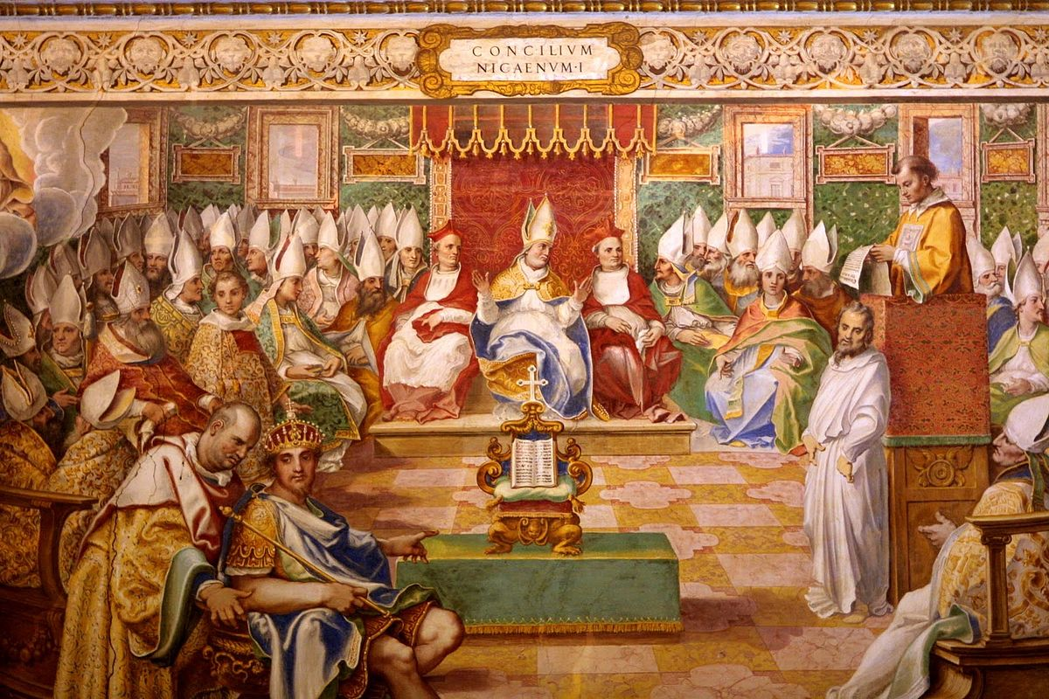
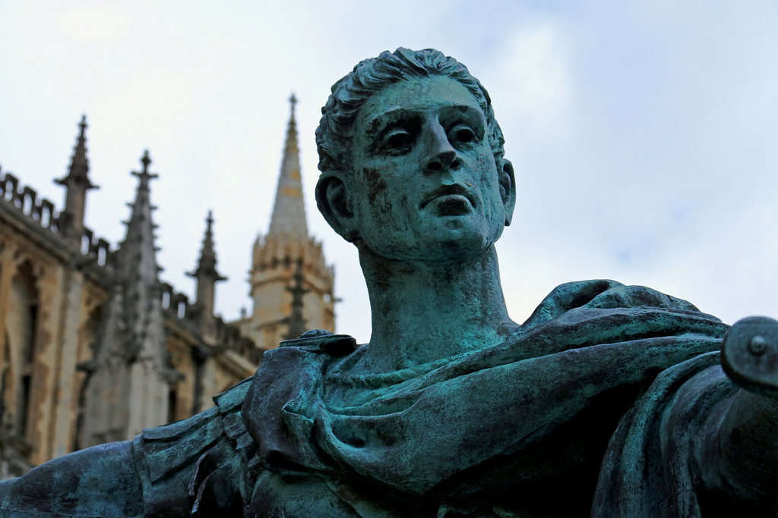
Constantine’s Council of Nicaea - 325 AD

Slide 64
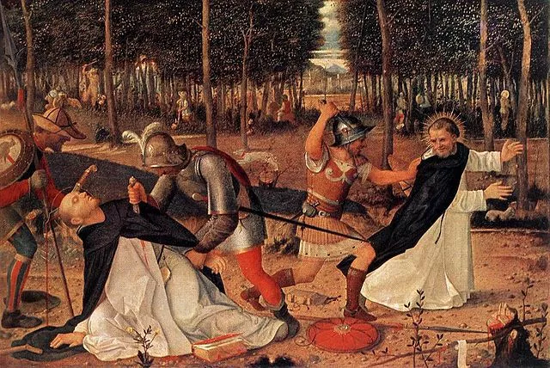
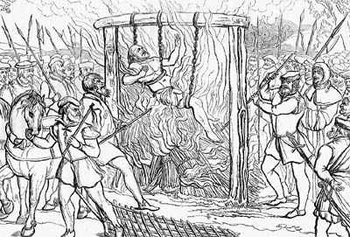

Slide 65
Matthew 5:10-12
“Blessed are those who are persecuted for righteousness’ sake,
For theirs is the kingdom of heaven. Blessed are you when they revile and persecute you, and say all kinds of evil against you falsely for My sake. Rejoice and be exceedingly glad, for great is your reward in heaven, for so they persecuted the prophets who were before you.”

Slide 66
Peter and the apostles, Polacretes...and us...
“We ought to serve God rather than men.”

