Slide 1
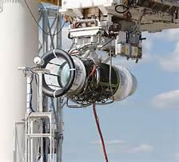
Certification Testing -- 101
Once the jet engine is designed, a series of certification tests must be successfully accomplished before proceeding to becoming a finished product…

Slide 2
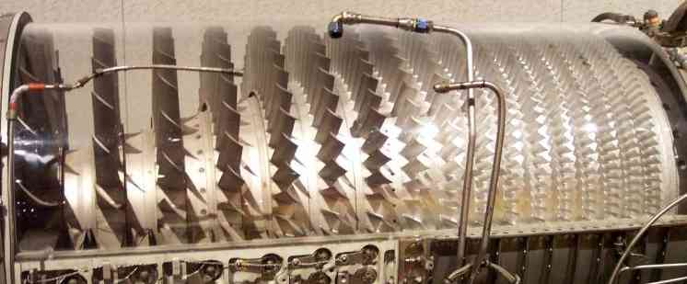
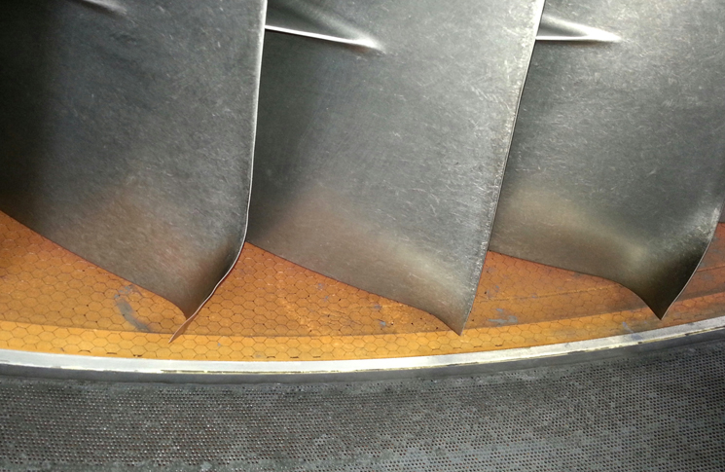
Stall Testing: 2
Relight after a Stall
Continue running

Slide 3
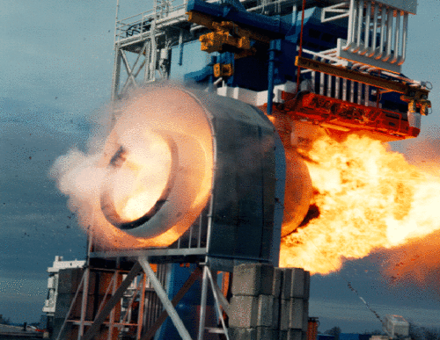
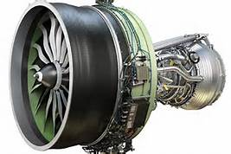
Blade-out: 3
Contain the Damage
Safety of Others

Slide 4
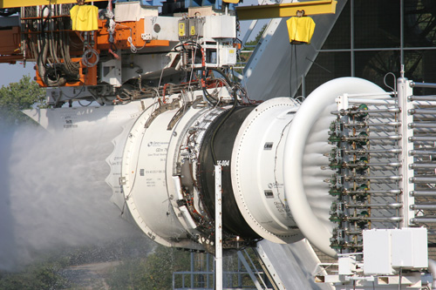
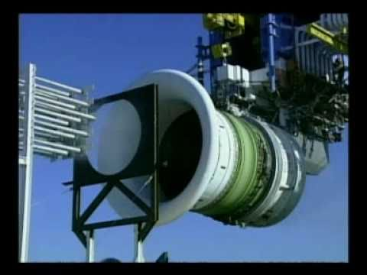
Extreme Conditions: 4
Water
Ice
Endure Spiritual Loss
Endure Physical Loss

Slide 5
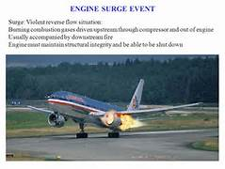
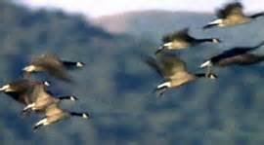
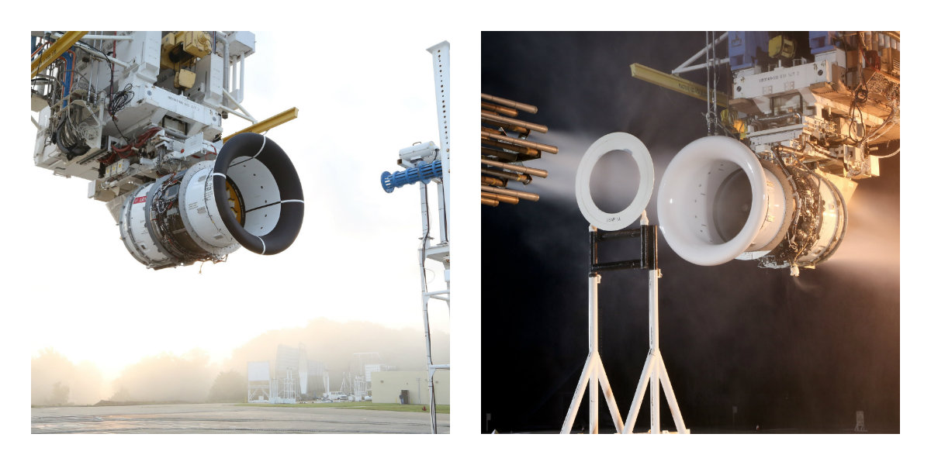
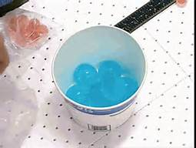
Bird Ingestion: 5
Hailstones
Ingest the birds, hailstones
Learn from it

Slide 6
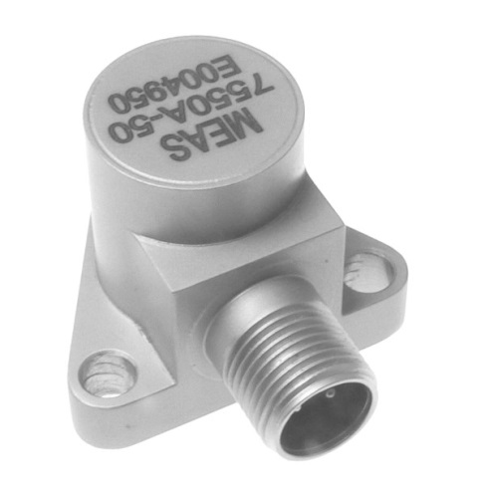
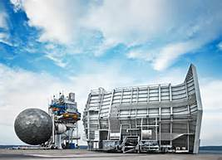
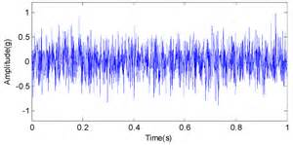
Vibration Certification: 6
Sensor
Amplitude
(Mils or IPs)
Be able to run unbalanced
Until you can become balanced

Slide 7
Life is full of Certification Tests… 7
How will you handle your certification tests?

