Slide 1
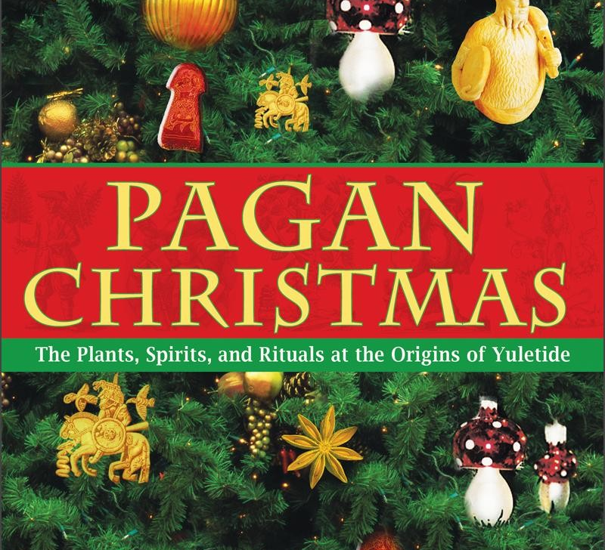
Christmas Has Pagan Origins, So What?

Slide 2
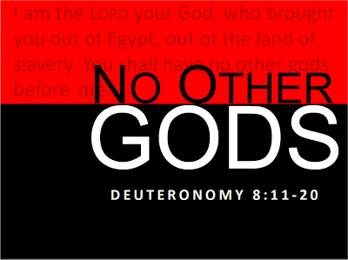
DEUTERONOMY 12:29-32

Slide 3
Power Of Traditions of Men
The easiest way to incorporate a teaching into a religious system is to surround it with tradition.
Mark 7:1-9, 13
Jude 3-4; 2 Peter 2:1-3:
“For fifty years after St. Paul’s life a curtain hangs over the church, through which we strive vainly to look; and when at last it arises, about 120 A.D. with the writings of the earliest church fathers, we find a church in many aspects very different from that in the days of St. Peter and St. Paul.” (The Story of the Christian Church, p. 44)

Slide 4
The Bible Without Tradition Is Not Enough?
“Revelation comes down to us by two means: through Holy Scripture, written down under divine inspiration, and through Tradition, handed down orally from Apostolic times.
“We read the Bible with great respect, for it is the Word of God. We treat Tradition with as great reverence, for God speaks through Tradition as well.
It is wrong to believe the Bible alone without Tradition.” (My Catholic Faith, Louis LaRavoire Morrow; p. 22 emphasis mine)

Slide 5
God is “The true worshipers shall worship the Father in spirit and in truth: for the Father is indeed seeking those who worship Him in this manner. Spirit (pneuma= mind or mental despostion), and those who worship Him must worship (prostrate oneself in homage) in spirit and in truth.” (John 4:23-24 NKJV)

Slide 6
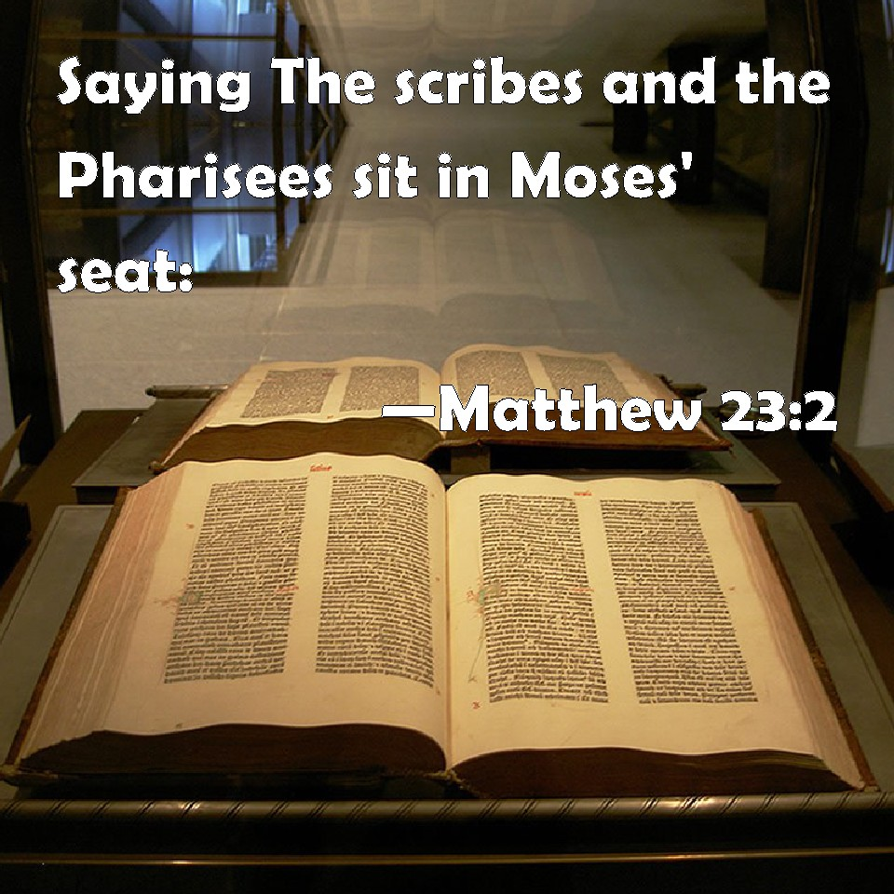

Slide 7
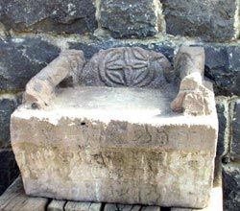
“The scribes and the Pharisees have sat down on Moses’ seat as judges;” Matthew 23:2 (The Holy Bible In It’s original Order; Second Edition)

Slide 8
“Therefore, every judgment that they tell you to observe, observe and do. But do not do according to their works.” Matthew 23:3 (The Holy Bible In It’s original Order; Second Edition)

Slide 9
“Blind guides, who filter out a gnat, but swallow a camel.” Matthew 23:24 (The Holy Bible In It’s original Order; Second Edition)

Slide 10
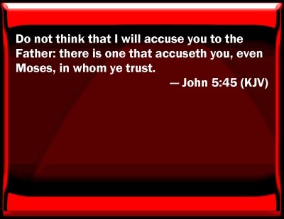
Moses Will Judge You

Slide 11
“If Christmas does not honor God, who does it honor?” Most people claim that they desire to worship the true God of creation, but they have been deluded into accepting practices that, in fact, worship false gods. So we must ask ourselves, “Do we want to worship the God of creation, or the gods which men have created for themselves? Do we want to be justified by God, or do we want to justify our own human ways, and thoughts?”
Christmas—the Greatest Story Never Told

Slide 12
Deuteronomy 12:30
“Take heed to yourself that you do not become ensnared by following them, after they are destroyed from before you, and that you do not ask about their gods, saying, ‘How did these nations serve their gods that I may also do likewise?’”

Slide 13
Deuteronomy 12:31
“You shall not do so to the LORD your God, for every abomination to the LORD, which He hates, they have done to their gods; even their sons and their daughters they have burned in the fire to their gods.”

Slide 14
Jeremiah 10:2-5 Matthew 15:9 John 4:24 II Corinthians 11:13-15

Slide 15
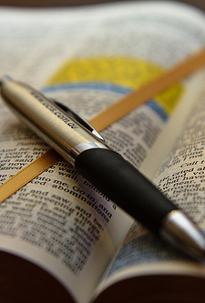
Bible Only Basis For Sound Doctrine
2 Timothy 2:15-19
2 Timothy 3:14-17
2 Timothy 4:1-4
1 Peter 1:18-22;
2 Peter 1:12, then verse’s 15-21
This Photo by Unknown Author is licensed under CC BY

Slide 16
Exodus 20:1-3
Deuteronomy 11:1-4

Slide 17
Stand Firm And Keep A Strong Grip
“With all these things in mind, dear brothers and sisters, stand firm and keep a strong grip on the teaching we passed on to you both in person and by letter.”
(2Thessalonians 2:15 NLT)

Slide 18
We Don’t Observe Christmas Because It Does Not Honor God.

Slide 19
Stand Firm And Keep A Strong Grip
“Keep careful guard to observe His customs, and His Divine Ordinances.”
(Paraphrase of Deuteronomy 11:1)

