Slide 1
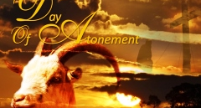
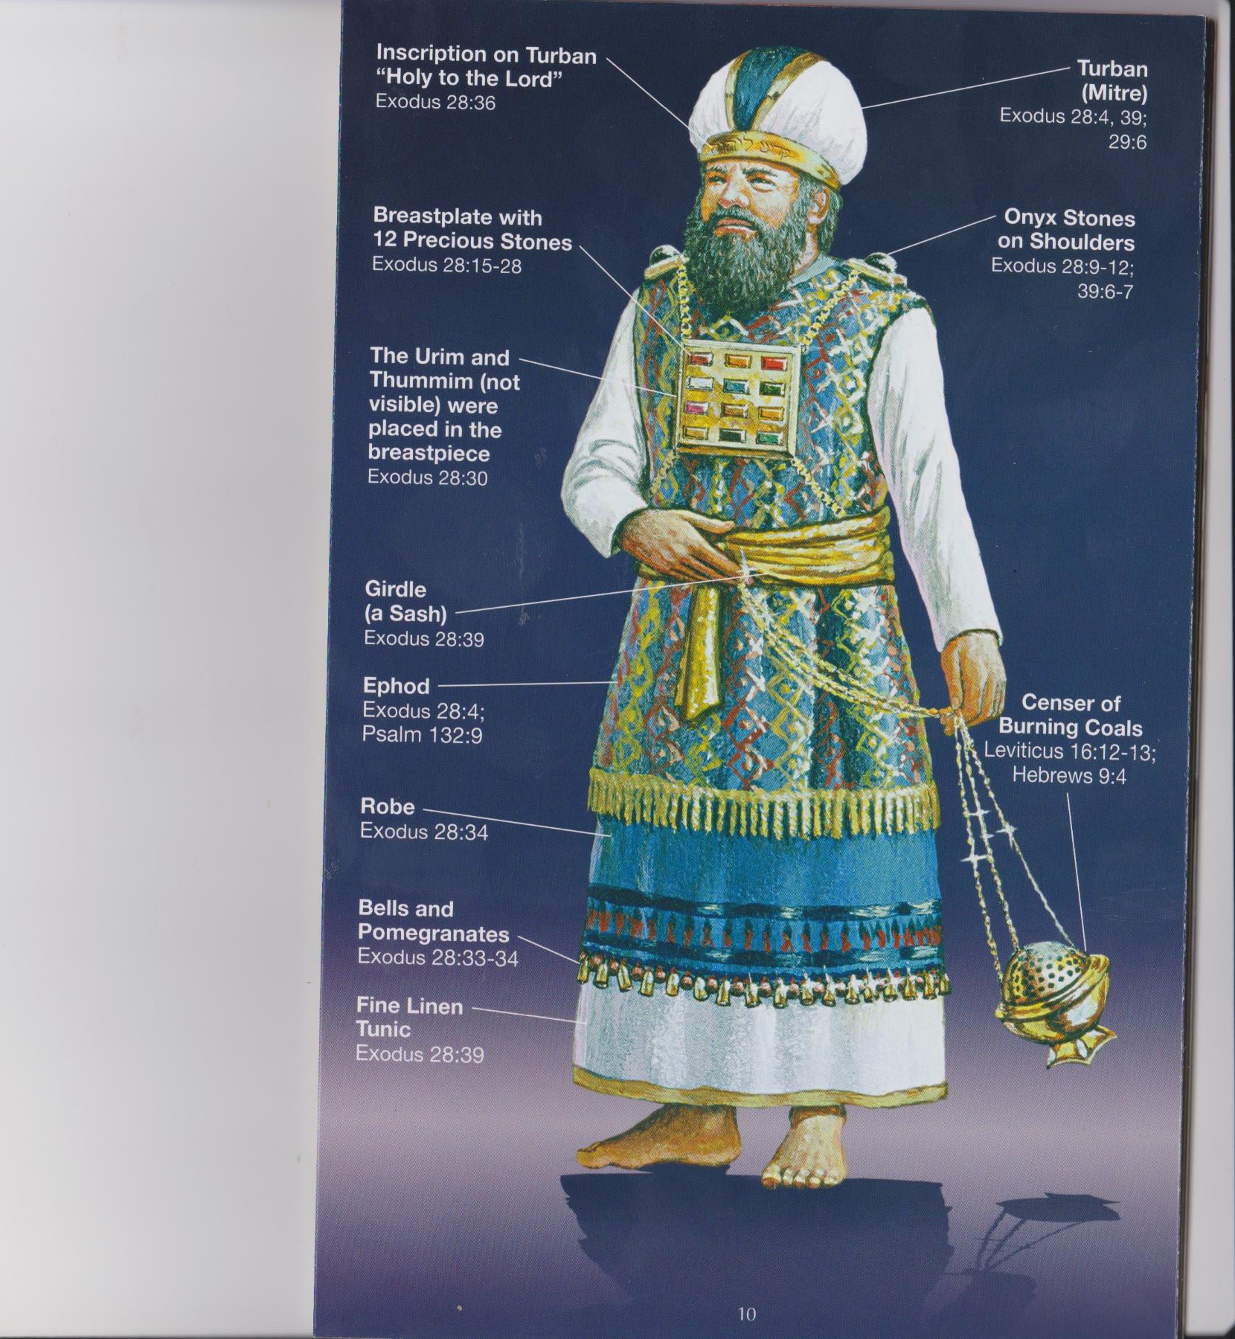
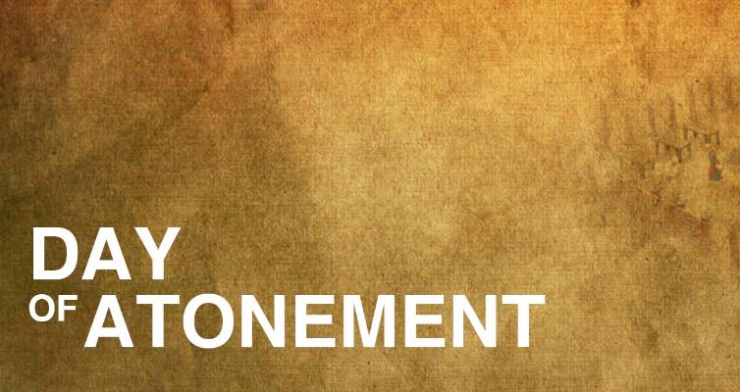

Slide 2
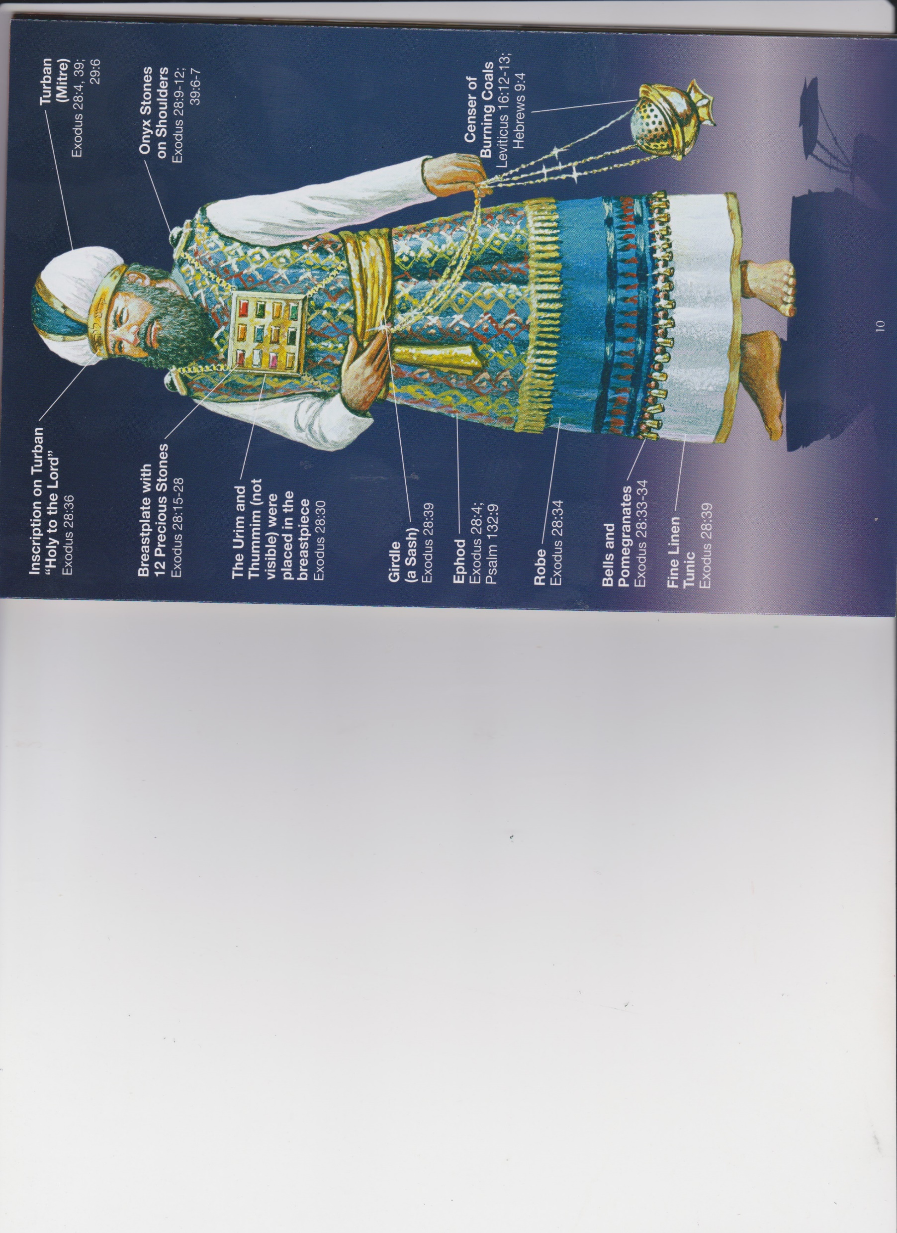
Ex. 29:20-21
High Priest Garments had symbolic meaning as to what the High Priest function was.

Slide 3
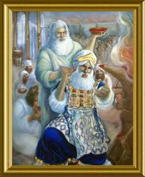
Moses Anoints Aaron As High Priest
This Photo by Unknown Author is licensed under CC BY-NC-SA

Slide 4
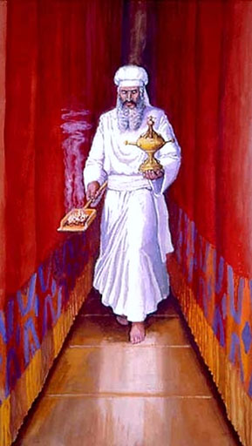
High Priest Enters Holy Of Holies
Lev. 16: 29-30;
and
vv. 32-34
T
This Photo by Unknown Author is licensed under CC BY-NC-SA
This Photo by Unknown Author is licensed under CC BY-SA

Slide 5
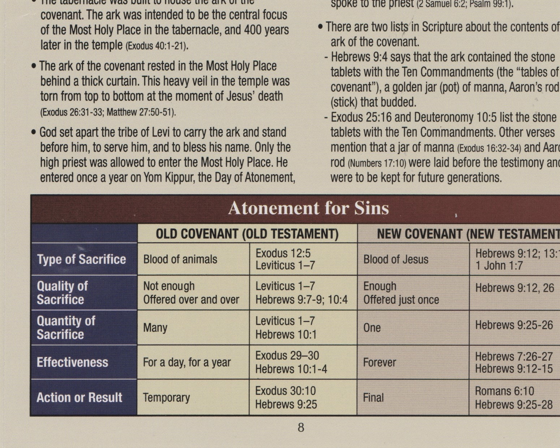
Compare and Contrast Old Testament and New Testament Atonement

Slide 6
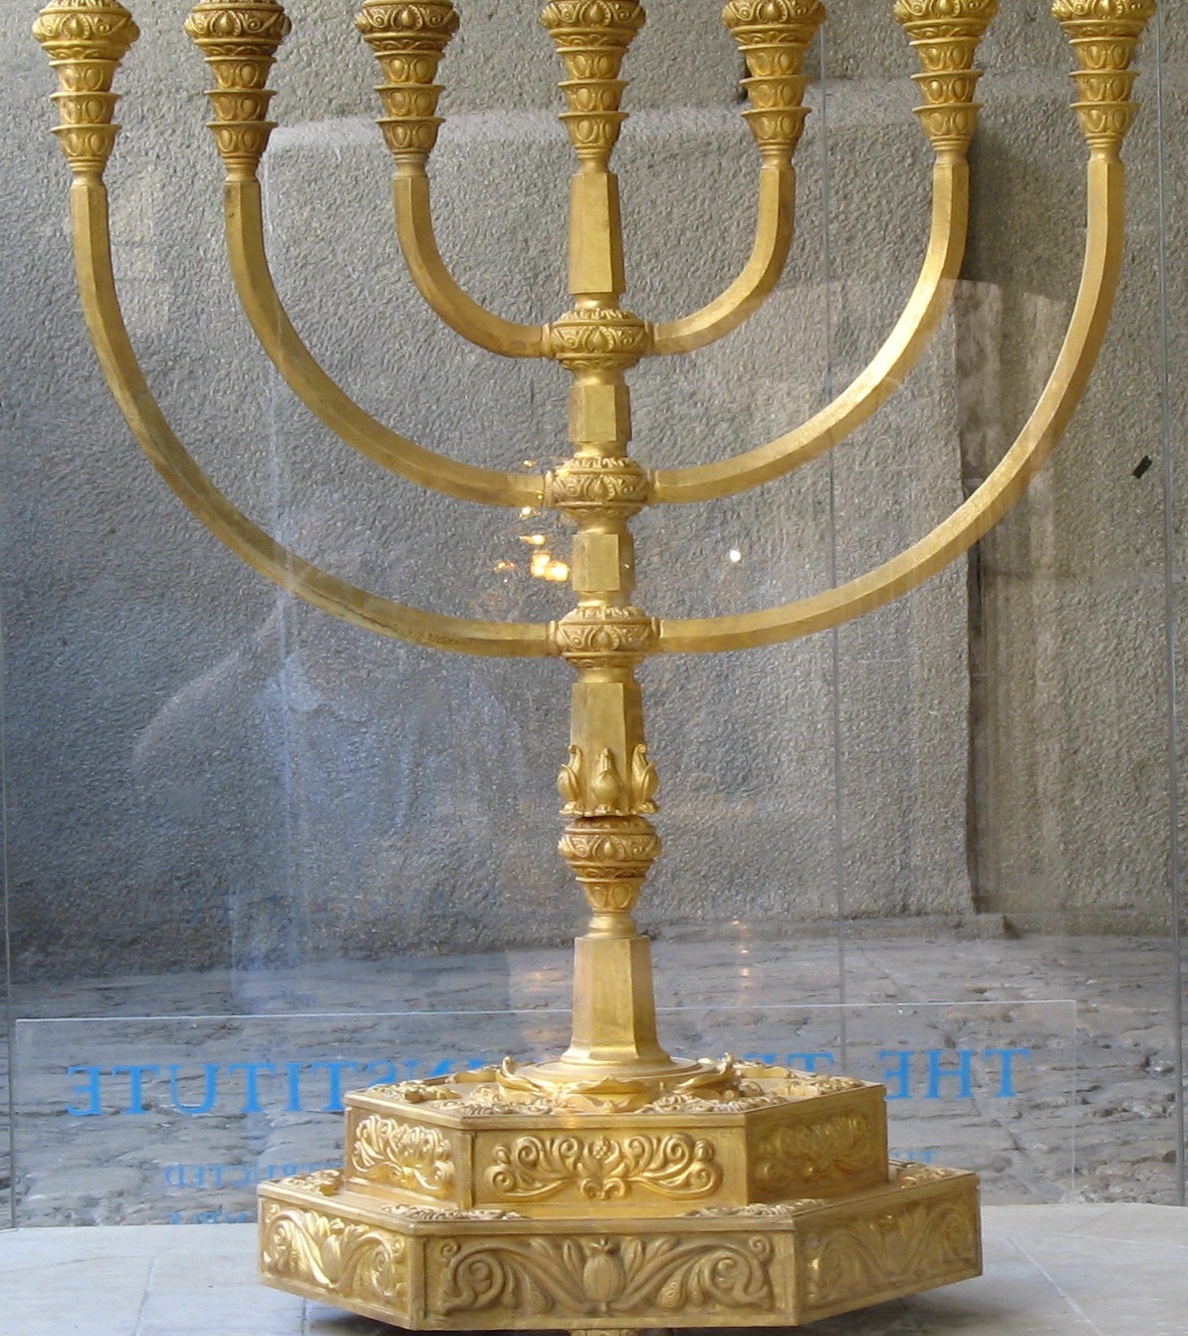
Golden Lampstand Heb. 9:2
This Photo by Unknown Author is licensed under CC BY-SA

Slide 7
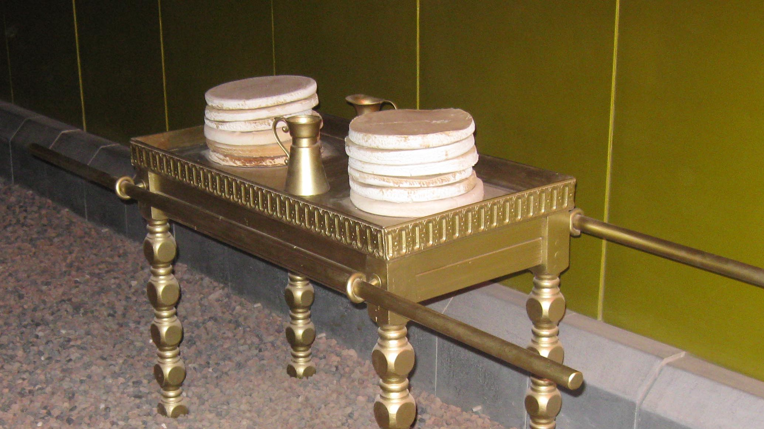
Table of Showbread (Heb. 9:2)
This Photo by Unknown Author is licensed under CC BY-SA

Slide 8
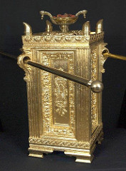
Alter of Incense Just in front of the curtain to The Holy of Holies
This Photo by Unknown Author is licensed under CC BY-SA

Slide 9
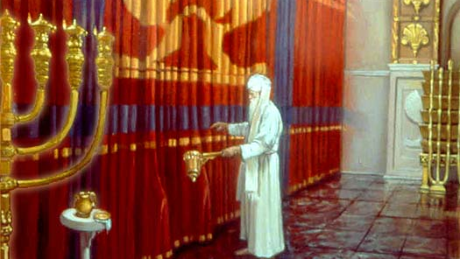
High Priest Going Into The Holy of Holies
This Photo by Unknown Author is licensed under CC BY-NC-ND

Slide 10
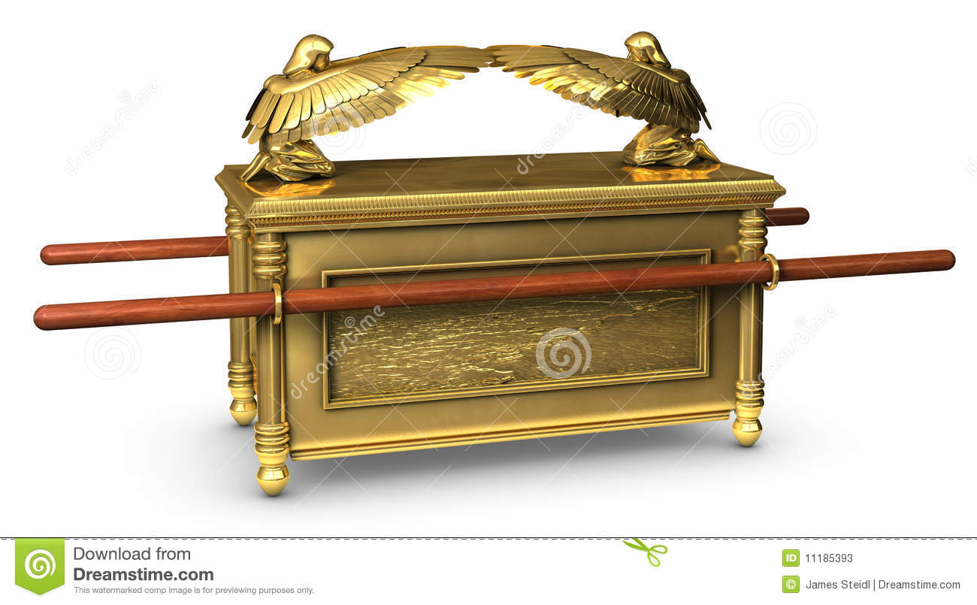
Ark of the Covenant (Heb. 9:4-28)

Slide 11
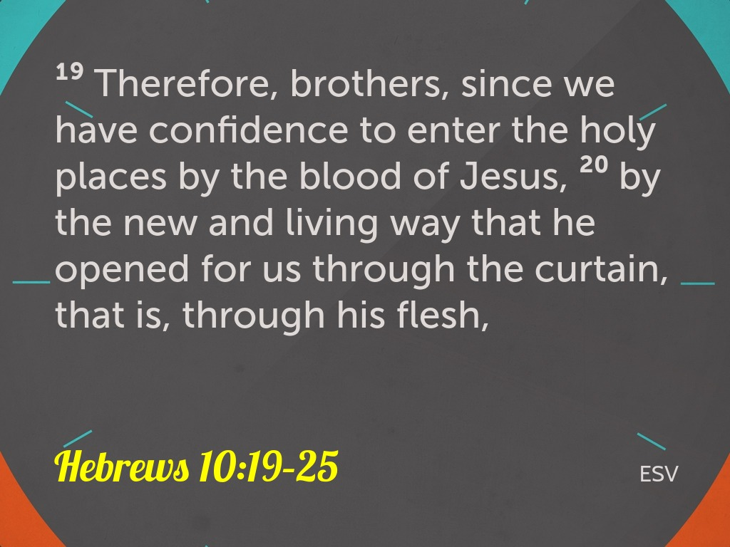

Slide 12
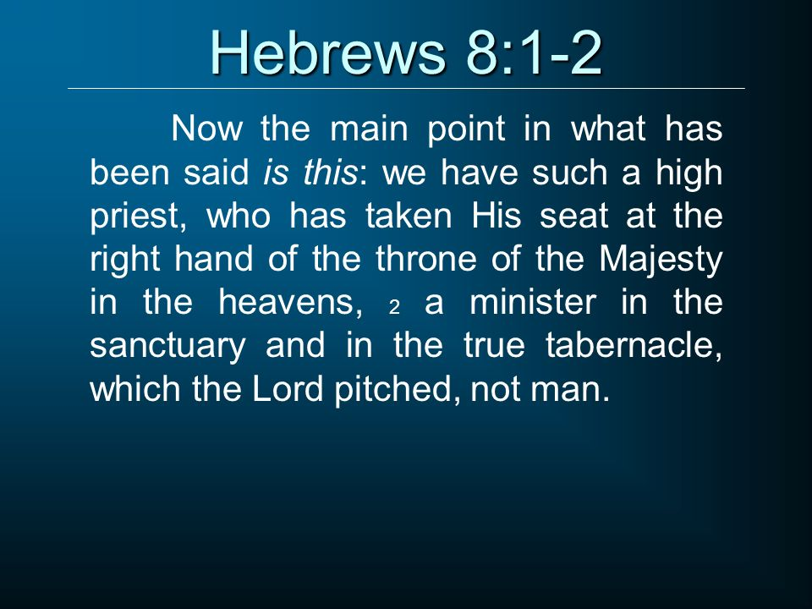

Slide 13
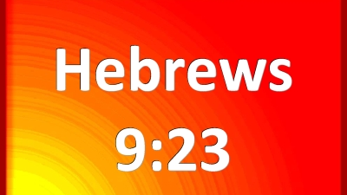

Slide 14
