Slide 1
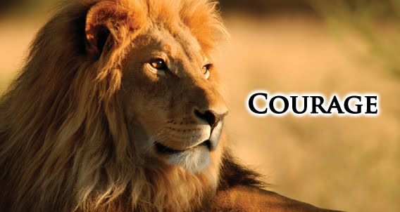

Slide 2
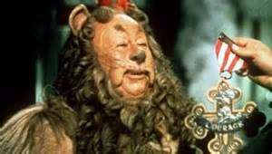
Is This The Courage God Had In Mind?

Slide 3
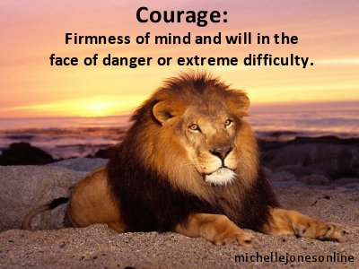
( 1 Kings 16:29-33)

Slide 4
Courage Is Summoned When There Is A Great Need
Ahab was evil and married Jezebel who was from a severely pagan background. She was the daughter of Ethbaal. Great evil existed from the union of Ahab, who reigned over the ten tribes for 22 years, and his wife Jezebel.
(1 Kings 16:31)

Slide 5
Courage To Stand Against Evil
“Ahab son of mri began to rule over Israel in the thirty-eighth year of “King Asa’s reign in Judah. He reigned in Samaria twenty-two years.
But Ahab son of Omri did what was evil in the LORD’s sight, even more than any of the kings before him.
And as though it were not enough to follow the sinful example of Jeroboam, he married Jezebel, the daughter of King Ethbaal of the Sidonians, and he began to bow down in worship of Baal.
First Ahab built a temple and an altar for Baal in Samaria.”
(1 Kings 16:29-32 NLT)

Slide 6

Our focus will be on Elijah, a prophet of God and one of the most courageous examples in all of Scripture. The reasons for his great courage will be revealed as we read the narrative. his life.

Slide 7
Our Working definition of courage is as follows; ‘walking towards what you’d rather run away from.”

Slide 8
The Canaanites worshiped Baal as the sun god and as the storm god — he is usually depicted holding a lightning bolt — who defeated enemies and produced crops. They also worshiped him as a fertility god who provided children. (Baal became a centerpiece in ancient history for people to worship.)

Slide 9
Baal worship was rooted in sensuality and involved ritualistic prostitution in the temples. At times, appeasing Baal required human sacrifice, usually the firstborn of the one making the sacrifice
(Jeremiah 19:5).
The priests of Baal appealed to their god in rites of wild abandon, which included loud, ecstatic cries and self inflicted injury
(1 Kings 18:28).

Slide 10
What Is Courage?
“Courage is perhaps the most underrated, under-appreciated and invisible virtue of our time. We are so busy complying with the status quo, with watching our words and with following what others say and do on social media that we seem to have forgotten the simple yet powerful virtue of courage.”

Slide 11
What Is Courage?
Courage is stepping up, stepping out and standing against the tide of darkness. Courage is being what you know you should be when it is unpopular with others. Courage is having the guts to listen when others only want to argue”; Christian Questions; 2017

Slide 12
What Is Courage?
…it is reaching out to give when others are focused on taking and courage is leading by example when following in anonymity would be so much easier. ” Christian Questions; 2017

Slide 13
Evil King Asa
“1 Kings 16:29-33: (NRSV) 29 In the thirty-eighth year of King Asa of Judah, (the two tribe Kingdom of Israel) Ahab son of Omri began to reign over Israel (the ten tribe Kingdom of Israel); Ahab…reigned over Israel in Samaria twenty-two years. 30Ahab…did evil in the sight of the LORD more than all who were before him. 31And as if it had been a light thing for him to walk in the sins of Jeroboam son of Nebat, he took as his wife Jezebel daughter of King Ethbaal of the Sidonians, and went and served Baal, and worshiped him;”

Slide 14
Evil King Asa
“Ahab was evil and married Jezebel who was from a severely pagan background. She was the daughter of Ethbaal. Great evil existed from the union of Ahab, who reigned over the ten tribes for twenty-two years, and his wife Jezebel.”
(Source: Biblical commentary by J. Vernon McGee)

Slide 15

Without Courage You Can’t Show What You Stand For
“Without courage, all the other virtues will go unpracticed. Unless you stand, you cannot show what it is you stand for. It was courageous for Elijah to stand and hide. That was God’s will at the time.”
“Elijah - The Power of Courage!” Christian Questions January 23, 2017

Slide 16
“…Ahab called Obadiah who was over the household. Now Obadiah feared the LORD greatly;
for when Jezebel destroyed the prophets of the LORD, Obadiah took a hundred prophets and hid them by fifties in a cave, and provided them with bread and water.”
1Kings 18:3-4: (NASB)

Slide 17
“… Then Ahab said to Obadiah, go through the land to all the springs of water and to all the valleys; perhaps we will find grass and keep the horses and mules alive, and not have to kill some of the cattle.
So they divided the land between them to survey it; Ahab went one way by himself and Obadiah went another way by himself.”
1 Kings 18:5-6: (NASB)

Slide 18
Exceptional Courage
Obadiah was a trusted servant of King Ahab and his courage was to fly under the deadly radar of Ahab and Jezebel. Searching for Elijah distracted Ahab and Jezebel.
This covert operation of Obadiah’s required exceptional courage, planning, secrecy, energy, wisdom and perseverance. He was driven by his loyalty to God and the sacredness of life.

Slide 19
