Slide 1
Pentecost and The Covenants
Of God
Notes:
Greetings and Happy Sabbath. With Pentecost coming up I thought it would be good to review the covenants of the Bible. There are lessons from Bible covenants that we need in our lives today. We will discuss these lessons and see how important the New Covenant is for us.

Slide 2


Is it a Duck?
Quack, Quack, Quack!
Notes:
Back on the farm where I grew up (Explain living between 3 farms). We had a common sense type saying.
{Click} If it looks like a duck {Click} If it performs like a duck {Click} If it sounds like a duck

Slide 3
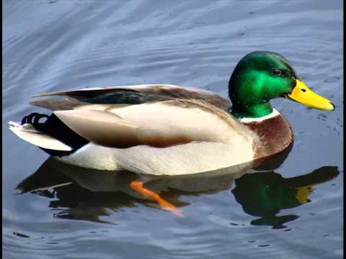
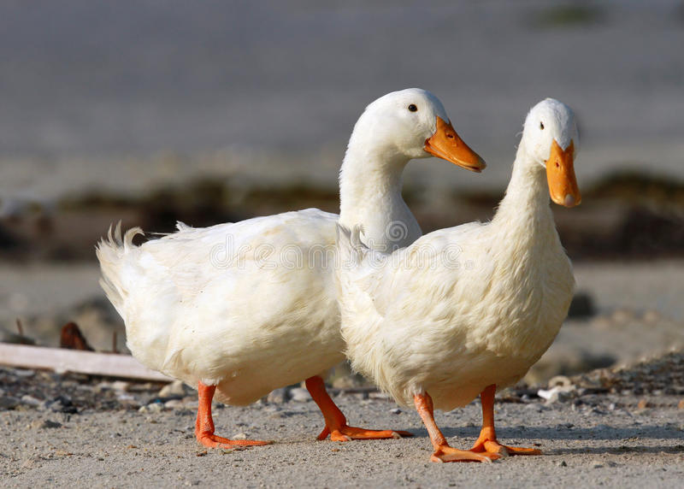
It is a Duck
Notes:
Then it is a duck!!!

Slide 4
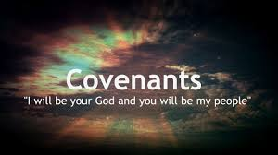
Is it a Covenant?
If it looks like a covenant
If it performs like a covenant
If it reads like a covenant
It must be a covenant
Notes:
{Click} If it looks like a covenant
{Click} If it performs like a covenant
{Click} If it reads like a covenant
{Click} It must be a covenant

Slide 5
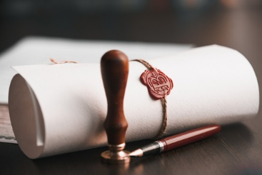
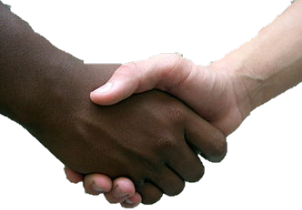
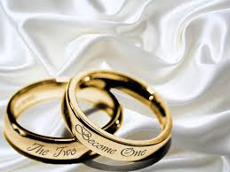
What is a Covenant?
Long term agreement
Forms a binding relationship
Defines obligations & commitments
Ratified/bind with a sign or ritual
Notes:
1.noun an agreement.
synonyms: contract, agreement, undertaking, commitment, guarantee, warrant, pledge, promise, bond, indenture; More
2.verb agree, especially by lease, deed, or other legal contract.
synonyms: undertake, contract, guarantee, pledge, promise, agree, engage, warrant, commit oneself, bind oneself
3 Biblical definition of agreement could be understanding

Slide 6
What is a Covenant?
Notes:
There is a summary statement that I will read in the UCG book the “New Covenant, Does it Abolish God’s Law”
Inherent in any covenant is the concept of a lasting commitment to a clearly defined relationship. Generally speaking, a covenant is a long term agreement between two or more parties that formalizes a binding relationship between them. It defines their essential obligations and commitments to each other.
In ancient times, major covenants were ratified and kept alive through symbolic rituals that reflected each party’s commitment to, and acceptance of, the covenant’s binding requirements. However, covenant rituals are not the same as covenant commitments and obligations. Rituals in divine covenants serve primarily as symbolic reminders and are intentionally given only a figurative value. The real value is in the substance of the commitments made! Through the substance of His covenants—His divine commitments—God binds Himself to perform all of the promises He makes. In a divine covenant, God defines the basic obligations that He imposes on Himself and, usually, on the other participants. Thus a dominant feature of a covenant is a list of blessings that God promises to give to those who honor their covenant commitments. A divine covenant can be compared to a sacred constitution established to regulate human relationships with God. It is a formal declaration of God’s will and purpose. It typically expresses His deep love for humanity and reveals one or more major aspects of His plan for humanity’s salvation.

Slide 7
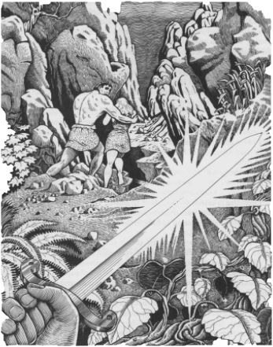
Covenant w/ Adam and Eve
Gen 3:9-19
God and Adam, Eve, descendants
Curses, pain, toil
Death return to dust
Notes:
Let’s review the covenants from the Bible and the lessons they teach us. Let’s first start with the covenant with Adam and Eve.
Gen 3:9-19
Genesis 3:9-19 New King James Version (NKJV)
⁹ Then the Lord God called to Adam and said to him, “Where are you?”
¹⁰ So he said, “I heard Your voice in the garden, and I was afraid because I was naked; and I hid myself.”
¹¹ And He said, “Who told you that you were naked? Have you eaten from the tree of which I commanded you that you should not eat?”
¹² Then the man said, “The woman whom You gave to be with me, she gave me of the tree, and I ate.”
¹³ And the Lord God said to the woman, “What is this you have done?”
The woman said, “The serpent deceived me, and I ate.”
¹⁴ So the Lord God said to the serpent:
“Because you have done this, You are cursed more than all cattle, And more than every beast of the field;
On your belly you shall go, And you shall eat dust All the days of your life.
¹⁵ And I will put enmity Between you and the woman, And between your seed and her Seed;
He shall bruise your head, And you shall bruise His heel.”
¹⁶ To the woman He said: “I will greatly multiply your sorrow and your conception;
In pain you shall bring forth children; Your desire shall be for your husband,
And he shall rule over you.”
¹⁷ Then to Adam He said, “Because you have heeded the voice of your wife, and have eaten from the tree of which I commanded you, saying, ‘You shall not eat of it’:
“Cursed is the ground for your sake; In toil you shall eat of it All the days of your life.
¹⁸ Both thorns and thistles it shall bring forth for you, And you shall eat the herb of the field.
¹⁹ In the sweat of your face you shall eat bread Till you return to the ground,
For out of it you were taken; For dust you are, And to dust you shall return.”
{Click}
The Agreement was between God + Adam + Eve + their Descendants. {Click}
The Obligation and Commitment – God was going bring curses & Adam would “toil the ground and eat food after sweating to grow it”. Eve would have sorry in conception and pain in child birth. {Click}
The Sign of this Covenant – At death Man and Woman would return to the dust they came from.

Slide 8
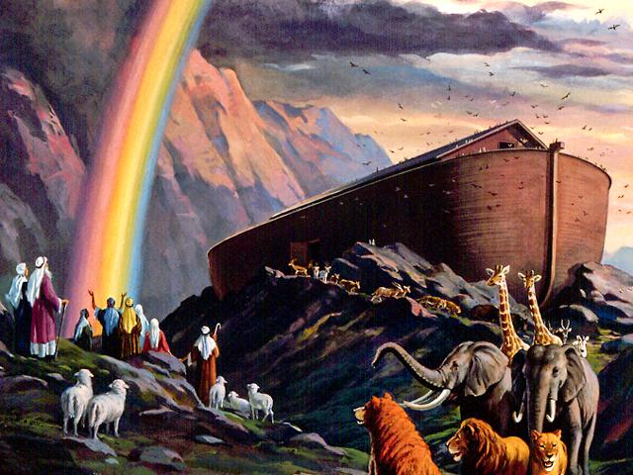
Covenant with Noah
Gen 8:20-22,
9:8-17
God and Noah, descendants
Never again to be a worldwide flood
Rainbow sign
Notes:
Next covenant is the covenant with Noah.
Gen 8:20-22
God’s covenant with creation
²⁰ Then Noah built an altar to the Lord, and took of every clean animal and of every clean bird, and offered burnt offerings on the altar. ²¹ And the Lord smelled a soothing aroma. Then the Lord said in His heart, “I will never again curse the ground for man’s sake, although the imagination of man’s heart is evil from his youth; nor will I again destroy every living thing as I have done.
²² “While the earth remains, Seedtime and harvest, Cold and heat, Winter and summer, And day and night Shall not cease.”
Genesis 9:8-17 New King James Version (NKJV)
⁸ Then God spoke to Noah and to his sons with him, saying: ⁹ “And as for Me, behold, I establish My covenant with you and with your descendants after you, ¹⁰ and with every living creature that is with you: the birds, the cattle, and every beast of the earth with you, of all that go out of the ark, every beast of the earth. ¹¹ Thus I establish My covenant with you: Never again shall all flesh be cut off by the waters of the flood; never again shall there be a flood to destroy the earth.”
¹² And God said: “This is the sign of the covenant which I make between Me and you, and every living creature that is with you, for perpetual generations: ¹³ I set My rainbow in the cloud, and it shall be for the sign of the covenant between Me and the earth. ¹⁴ It shall be, when I bring a cloud over the earth, that the rainbow shall be seen in the cloud; ¹⁵ and I will remember My covenant which is between Me and you and every living creature of all flesh; the waters shall never again become a flood to destroy all flesh. ¹⁶ The rainbow shall be in the cloud, and I will look on it to remember the everlasting covenant between God and every living creature of all flesh that is on the earth.” ¹⁷ And God said to Noah, “This is the sign of the covenant which I have established between Me and all flesh that is on the earth.”
The agreement / understanding was between God – Noah and Noah’s descendants.
The obligation and commitment – Never be a worldwide flood
The sign of this covenant – rainbow.
Also, under this Covenant God did remove some of the curses from the Adam/Eve Covenant.

Slide 9

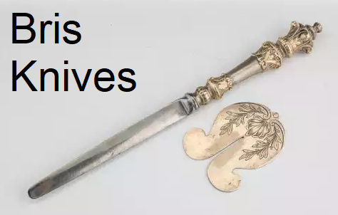
Covenant w/ Abraham
Gen 17:1-11
God and Abraham, descendants
God: Many nations, World is blessed, Abraham: Keep My covenant
Circumcision sign
Notes:
Covenant with Abraham.
Genesis 17:1-11 New King James Version (NKJV)
The sign of the covenant
17 When Abram was ninety-nine years old, the Lord appeared to Abram and said to him, “I am Almighty God; walk before Me and be blameless. ² And I will make My covenant between Me and you, and will multiply you exceedingly.” ³ Then Abram fell on his face, and God talked with him, saying: ⁴ “As for Me, behold, My covenant is with you, and you shall be a father of many nations. ⁵ No longer shall your name be called Abram, but your name shall be Abraham; for I have made you a father of many nations. ⁶ I will make you exceedingly fruitful; and I will make nations of you, and kings shall come from you. ⁷ And I will establish My covenant between Me and you and your descendants after you in their generations, for an everlasting covenant, to be God to you and your descendants after you. ⁸ Also I give to you and your descendants after you the land in which you are a stranger, all the land of Canaan, as an everlasting possession; and I will be their God.”
⁹ And God said to Abraham: “As for you, you shall keep My covenant, you and your descendants after you throughout their generations. ¹⁰ This is My covenant which you shall keep, between Me and you and your descendants after you: Every male child among you shall be circumcised; ¹¹ and you shall be circumcised in the flesh of your foreskins, and it shall be a sign of the covenant between Me and you.
The agreement / understanding was between God – Abraham and Abraham’s descendants.
The obligation and commitment – Father of many nations. Whole world would be blessed
The sign of this covenant – circumcision
Opinion: Verse 9 is translated is some translations “Obey Me”. I believe this refers to the 10 commandments which Abraham kept. The 10 commandments were known long before Mt. Sinai.

Slide 10
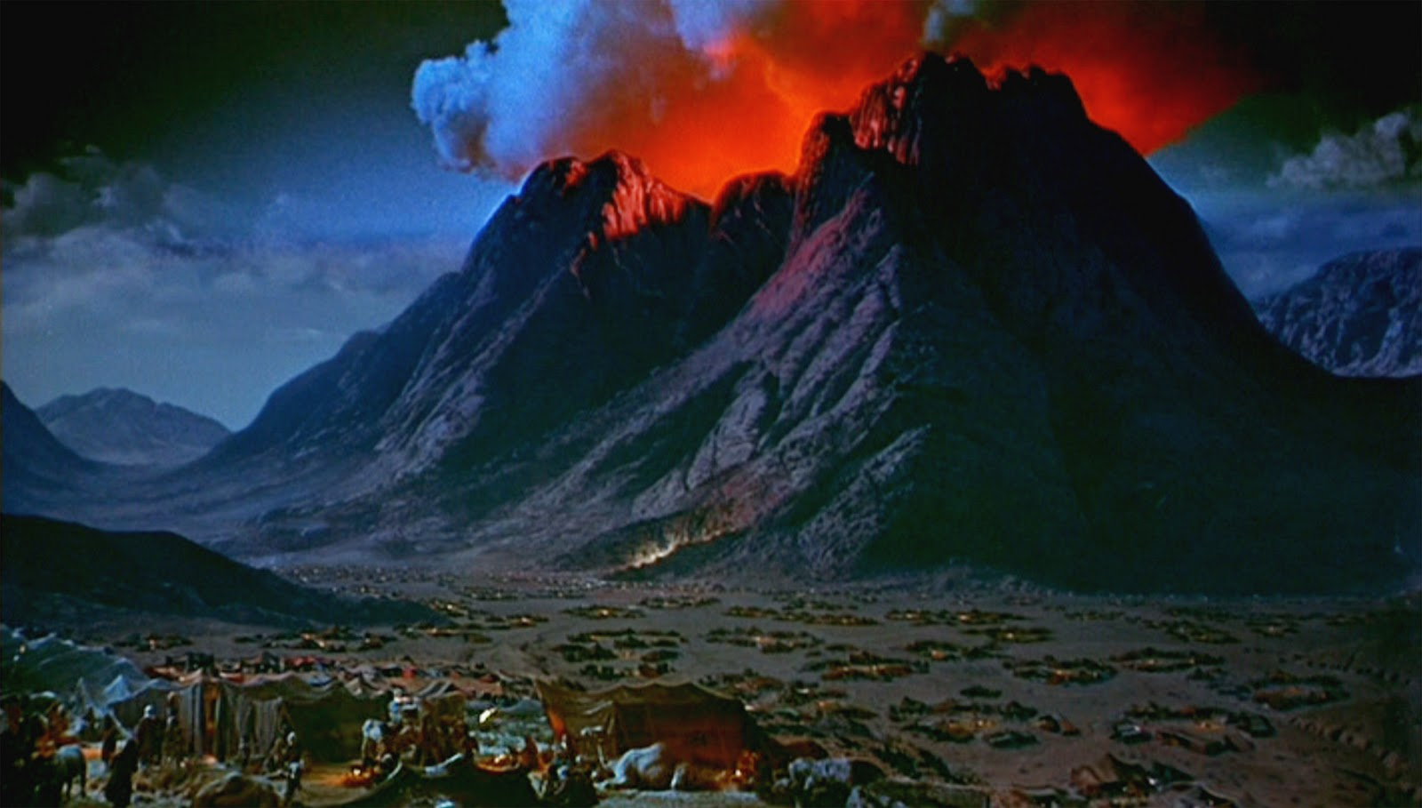
Covenant w/ Israel
(Old or Sinai Covenant)
Exodus 19:3-8, 20-31
God and children of Israel
God’s special treasure, Obey God’s law and voice
Notes:
Covenant with Israel, Also known as the Old Covenant.
Exodus 19:3-8 New King James Version (NKJV)
³ And Moses went up to God, and the Lord called to him from the mountain, saying, “Thus you shall say to the house of Jacob, and tell the children of Israel: ⁴ ‘You have seen what I did to the Egyptians, and how I bore you on eagles’ wings and brought you to Myself. ⁵ Now therefore, if you will indeed obey My voice and keep My covenant, then you shall be a special treasure to Me above all people; for all the earth is Mine. ⁶ And you shall be to Me a kingdom of priests and a holy nation.’ These are the words which you shall speak to the children of Israel.”
⁷ So Moses came and called for the elders of the people, and laid before them all these words which the Lord commanded him. ⁸ Then all the people answered together and said, “All that the Lord has spoken we will do.” So Moses brought back the words of the people to the Lord.
The agreement / understanding was between God – Children of Israel or the nation of Israel
The obligation and commitment – Special treasure to God (many blessing). Keep God’s law and God’s voice, All that God said (Chapters 20-31)

Slide 11
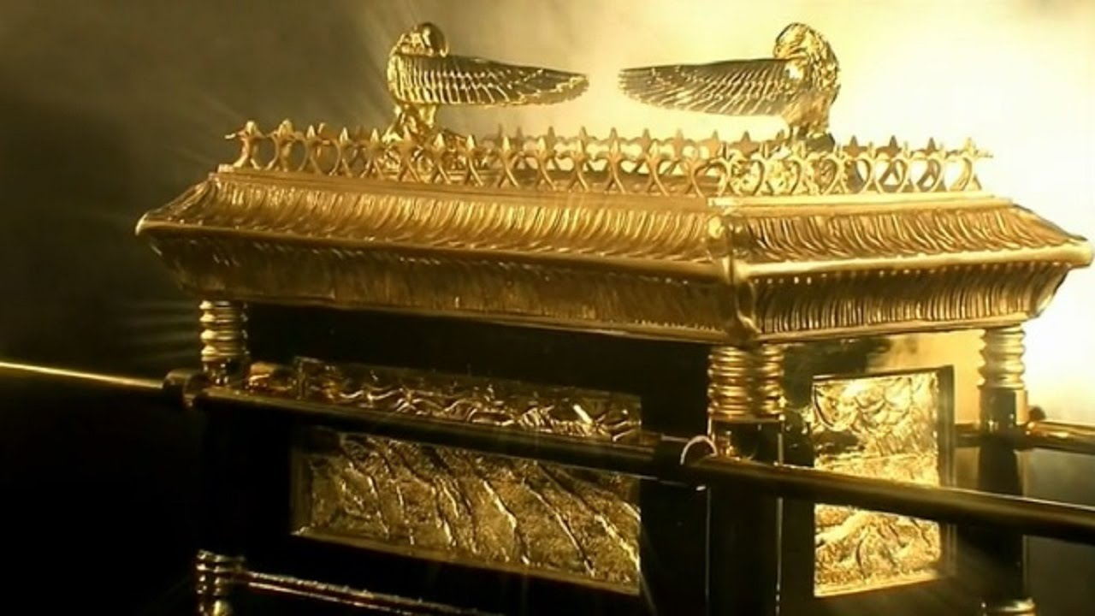
Covenant w/ Israel
(Old or Sinai Covenant)
Ark of the Covenant
Exo 25,
1 Chron 16:4,
15-17
Notes:
The Sign of this Covenant – I could not find a definitive answer, but it seems logical that is was the Ark of the Covenant (with the Ten Commandments inside) It could also have been the Children of Israel obeying God. I think is was the Ark of Covenant. I also want to point out that the Children of Israel were to never see the Ark as pictured. It was covered in many layers of badger and beaver skins and special cloth. The image or sign to take away is of a private place for God’s law.

Slide 12
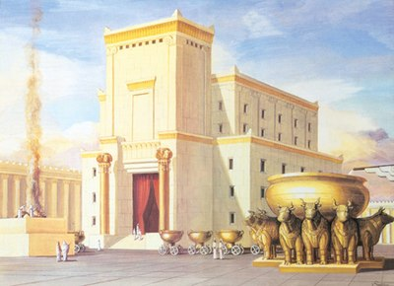
Covenant w/ David
Psa 89:3-4, 2 Sam 7:12-16
God and King David and his seed
Establish the throne forever, build the first temple
Notes:
Covenant with David.
Psalms 89:3-4
“I have made a covenant with My chosen, I have sworn to My servant David:
⁴ ‘Your seed I will establish forever, And build up your throne to all generations.’”
2 Samuel 7:12-16 New King James Version (NKJV)
¹² “When your days are fulfilled and you rest with your fathers, I will set up your seed after you, who will come from your body, and I will establish his kingdom. ¹³ He shall build a house for My name, and I will establish the throne of his kingdom forever. ¹⁴ I will be his Father, and he shall be My son. If he commits iniquity, I will chasten him with the rod of men and with the blows of the sons of men. ¹⁵ But My mercy shall not depart from him, as I took it from Saul, whom I removed from before you. ¹⁶ And your house and your kingdom shall be established forever before you.^{[a]} Your throne shall be established forever.”’”
The agreement / understanding was between God – King David and his seed
The obligation and commitment – Establish King David’s throne forever through Jesus Christ. Build the first Temple to God.

Slide 13
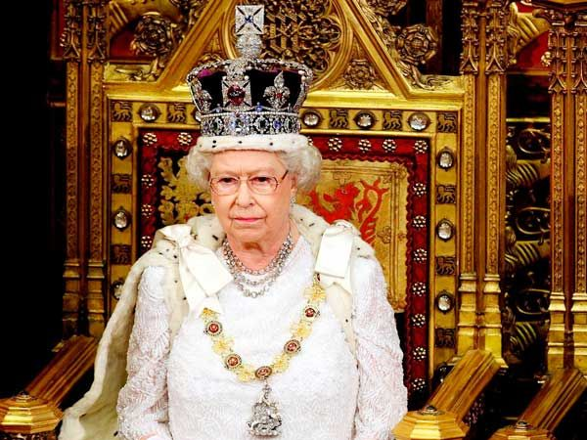
Covenant w/ David
Jer 33:17
United Kingdom line of Kings and Queens
Notes:
Covenant with David.
Jeremiah 33:17 New Living Translation (NLT)
¹⁷ For this is what the Lord says: David will have a descendant sitting on the throne of Israel forever.
The Sign of this covenant – United Kingdom Line of Kings and Queens from Israel. There may be some debate on this, but I think it is the Line of Kings and Queens.

Slide 14
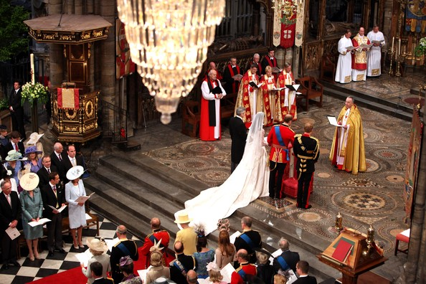
Covenant of Marriage
Mark 10:6-8, Jer 3:14, Eph 5:25-33
God + husband + wife
Remain faithful, Love the wife, Respect the husband
Multiple blessings from God, Understand God is a family
Notes:
Covenant of marriage.
Mark 10:6-8 New King James Version (NKJV)
⁶ But from the beginning of the creation, God ‘made them male and female.’^{[a]} ⁷ ‘For this reason a man shall leave his father and mother and be joined to his wife, ⁸ and the two shall become one flesh’; ^{[b]} so then they are no longer two, but one flesh.
Jeremiah 3:14 New King James Version (NKJV)
¹⁴ “Return, O backsliding children,” says the Lord; “for I am married to you. I will take you, one from a city and two from a family, and I will bring you to Zion.
Ephesians 5:25-33 New King James Version (NKJV)
²⁵ Husbands, love your wives, just as Christ also loved the church and gave Himself for her, ²⁶ that He might sanctify and cleanse her with the washing of water by the word, ²⁷ that He might present her to Himself a glorious church, not having spot or wrinkle or any such thing, but that she should be holy and without blemish. ²⁸ So husbands ought to love their own wives as their own bodies; he who loves his wife loves himself. ²⁹ For no one ever hated his own flesh, but nourishes and cherishes it, just as the Lord does the church. ³⁰ For we are members of His body, of His flesh and of His bones. ³¹ “For this reason a man shall leave his father and mother and be joined to his wife, and the two shall become one flesh.” ³² This is a great mystery, but I speak concerning Christ and the church. ³³ Nevertheless let each one of you in particular so love his own wife as himself, and let the wife see that she respects her husband.
{Click}
The Agreement / Understanding was between God + Husband + Wife {Click}
The Obligations and Commitments – Husbands/Wives were to remain Faithful, Love and Respect, {Clicl} God would provide Multiple Blessing, such as Answered Prayer, Children, Favor from God, Understanding God is a family and much more.

Slide 15
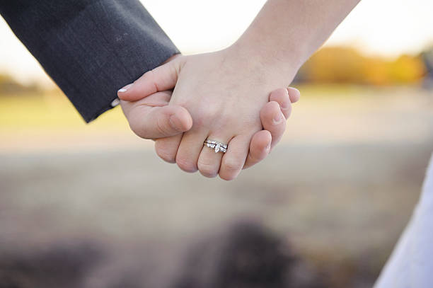
Covenant of Marriage
Mark 10:8
Becoming one, in mind body and spirit with God
Notes:
Covenant of Marriage.
⁸ and the two shall become one flesh’; so then they are no longer two, but one flesh.
The sign of this covenant – Consummation or “one flesh”

Slide 16
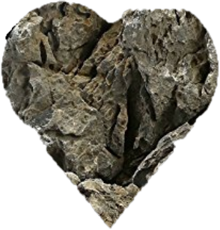

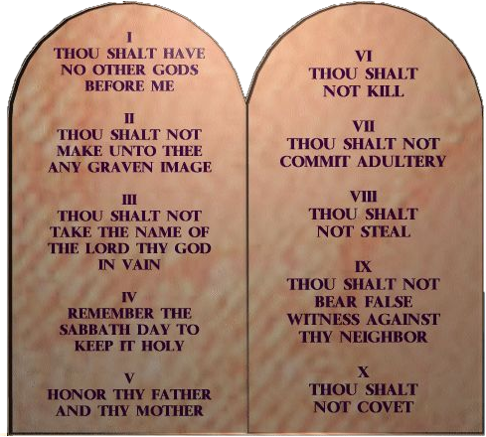
New Covenant
Hebrews 8:7-13
God and everyone
Salvation, blessings, obey God in all things
Our hearts will turn from stone to flesh and have God’s law written .
Notes:
New Covenant
Hebrews 8:7-13 New King James Version (NKJV)
A New Covenant
⁷ For if that first covenant had been faultless, then no place would have been sought for a second. ⁸ Because finding fault with them, He says: “Behold, the days are coming, says the Lord, when I will make a new covenant with the house of Israel and with the house of Judah— ⁹ not according to the covenant that I made with their fathers in the day when I took them by the hand to lead them out of the land of Egypt; because they did not continue in My covenant, and I disregarded them, says the Lord. ¹⁰ For this is the covenant that I will make with the house of Israel after those days, says the Lord: I will put My laws in their mind and write them on their hearts; and I will be their God, and they shall be My people. ¹¹ None of them shall teach his neighbor, and none his brother, saying, ‘Know the Lord,’ for all shall know Me, from the least of them to the greatest of them. ¹² For I will be merciful to their unrighteousness, and their sins and their lawless deeds^{[a]} I will remember no more.”^{[b]}
¹³ In that He says, “A new covenant,” He has made the first obsolete. Now what is becoming obsolete and growing old is ready to vanish away.
The agreement / understanding was between - God & everyone
The obligations and commitments – God’s promise of salvation, blessings. We must obey God in all things.
The sign of this covenant - Our Hearts will be turned from stone into flesh and have God’s law written on them
We will cover John 14 later.

Slide 17
Similar & Different
Expected to obey God
Build a relationship with God
God always kept his promises
Private Signs / Intimate
The New Covenant makes some of the past covenants obsolete
The New Covenant will eventually consolidate all the past covenants
Notes:
Explain – Similar and Difference between some or all the covenants.
All covenants had the following in common
{Click}Expected to obey God
{Click}Build a relationship with God
{Click}God always kept his promises
{Click}Abraham, Marriage, Old Covenant and New Covenant signs of Circumcision, Consummation, Ark of the Covenant and Writing the law on our Hearts are private signs. They are not outward signs. They are between God and covenant participants in a private / intimate way.
{Click}The New Covenant was needed because the fault was with us. The people not God.
The New Covenant makes some of the past covenants obsolete. (The word obsolete can be confusing. God’s obligations and Promises will never go away) Our requirement has turned from a physical to a spiritual. I like to say it this way. {Click}
The New Covenant will eventually consolidate all the past covenants.
Even the Earth will be replaced with a New Heaven and New Earth.
What changes in the New Covenant is our Obligation and Commitments change from Physical to Spiritual

Slide 18
Covenants + Pentecost
Feast of Pentecost is all about covenants
DoUB – What we need to do
Pentecost – God’s promises and the wonderment He is doing with us
What do covenants teach us on Pentecost?
Notes:
The Feast of Pentecost is all about covenants. In big picture concepts The Days of Unleavened Bread teach us what we need to do. Pentecost is about what God is going to do. What He is going to do for us. During the Days of Unleavened Bread we did learn that God will help us, but Pentecost is about something far more wonderful. What do covenants teach us on Pentecost? {Repeat} What is all this for.

Slide 19
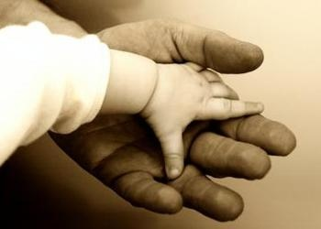
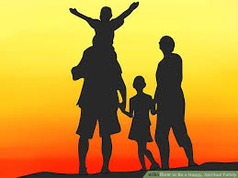
Covenant Relationship
God the Father wants us in His family
Notes:
God wants a covenant relationship with us. Both God beings, God the Father and His Majesty King and Savior Jesus Christ, want a special type of covenant relationship with us.
{Click} God the Father wants us in His family

Slide 20
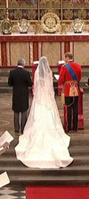
Covenant Relationship
Our King and Savior Jesus Christ will be married to us
Notes:
And our King & Savior Jesus Christ will be married to us.

Slide 21
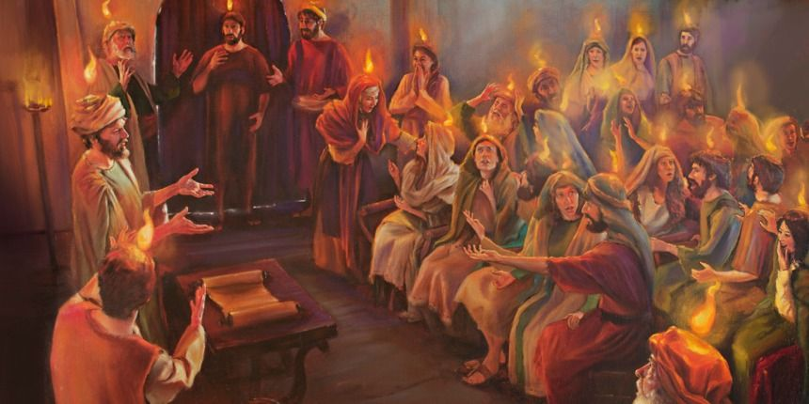
Covenant Relationship
Baptize with Holy Spirit
Acts
2
Notes:
For us to have this covenant relationship with God, God had to give us a helper. Something that would allow us to communicate directly with God. A power that would change ours hearts from stone to flesh and write His law on them. We had to be baptized with Holy Spirit. BUT we will learn about that on Pentecost. For this message I need to ask you one question, and that question is.

Slide 22


Best Pentecost Ever
How can we have the best Feast of Pentecost ever?
Prepare, Study, Review
Notes:
So how can we have the best Feast of Pentecost ever? Feast of Pentecost is about 5 weeks away. What can we do to make this Feast of Pentecost the best ever{Click}
Prepare, Study, Review{Click} Is this how you study? This is not how to prepare for Pentecost.

Slide 23
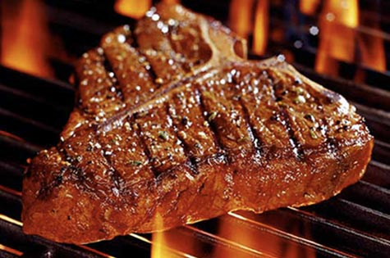
Best Pentecost Ever
Full of spiritual meat
Review the covenants
Notes:
The Feast of Pentecost is full of Spiritual meat. There are many themes for us to review. {Click} This message is to highlight the need to review the covenants and especially the New Covenant. What do we need to do the keep the New Covenant? Many Biblical historical events happened on this Holy Day. My suggestion for you to help you prepare for Pentecost is to study the Covenants.

Slide 24
Covenants | Feast of Harvest | Feast of First Fruits | Feast of Weeks | Pentecost
Adam/Eve | X | X
Noah/Creation | X | X
Abraham |  | X
Old/Sinai/Israel |  |  | X | X
David |  |  | X | X
Marriage |  | X
New | X | X | X | X
Lessons or future events we need to learn. | God and Jesus Christ are the creators and we have to obey God | Our Savior Jesus Christ is the first and we will be another first and have a marriage type covenant with Him | You can always count on God. God keeps His promises. | We must watch and count the days until our King Jesus Christ returns
Notes:
To get this process started I have a little interesting table about the Feast of Pentecost Holy Day. Have you wonder why the Feast of Pentecost has so many names. There are many different views on this, but I personally think it is to help us remember past covenants and to picture future events. I created this table to show what each could represent past and future. It my opinion, so if you don’t agree you can make your own. Let’s review. (Read slide)

Slide 25
New Covenant
Notes:
One way to review and prepare for the Feast of Pentecost is to read the United Church of God book the New Covenant. I think this is one of the best books United Church of God has produced. It is packed with information that will help make the Feast of Pentecost the best.

Slide 26
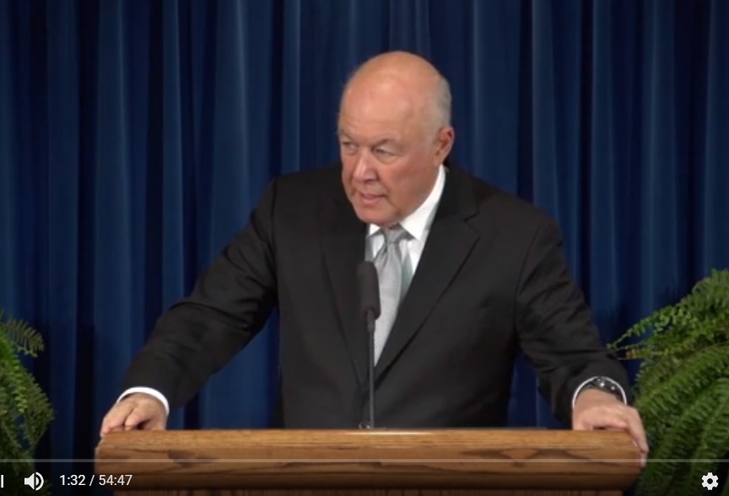
Covenant Relationship
The Covenant Relationship with God
Notes:
I found a sermon by Mr. Bill Bradford on the covenant relationship with God. This is another excellent source of information that will help make this Feast of Pentecost the best. I have the url (link) for anyone who needs it.
https://www.youtube.com/watch?v=W43Murfujko&index=4&list=PLD7B0xf2qkmhUIci-NuFeB1p7jDkQpMd2

Slide 27
Covenant Relationship
John 14,15,16 Acts 1:4
God and everyone
Salvation, blessings, obey God in all things
Our Hearts will turn from stone to flesh and have God’s law written .
Notes:
I want to give you a taste of how the New Covenant help us have this Covenant Relationship with God. This is found in John 14
The Father revealed
⁷ Philip said to Him, “Lord, show us the Father, and it is sufficient for us.”
⁹ Jesus said to him, “Have I been with you so long, and yet you have not known Me, Philip? He who has seen Me has seen the Father;
….Skipping to verse 12
¹² “Most assuredly, I say to you, he who believes in Me, the works that I do he will do also; and greater works than these he will do, because I go to My Father. ¹³ And whatever you ask in My name, that I will do, that the Father may be glorified in the Son. ¹⁴ If you ask^{[c]} anything in My name, I will do it.
Jesus Promises Another Helper
¹⁵ “If you love Me, keep^{[d]} My commandments. ¹⁶ And I will pray the Father, and He will give you another Helper, that this power may abide with you forever— ¹⁷ the Spirit of truth, whom the world cannot receive, because it neither sees this power nor knows this power; but you know this power, for this power dwells with you and will be in you.
….Skipping to verse 21
²¹ He who has My commandments and keeps them, it is he who loves Me. And he who loves Me will be loved by My Father, and I will love him and manifest Myself to him.”
²² Judas (not Iscariot) said to Him, “Lord, how is it that You will manifest Yourself to us, and not to the world?”
²³ Jesus answered and said to him, “If anyone loves Me, he will keep My word; and My Father will love him, and We will come to him and make Our home with him.
….Skipping to verse 26
The Gift of His Peace
²⁶ But the Helper, the Holy Spirit, whom the Father will send in My name, Through this power God will teach you all things, and bring to your remembrance all things that I said to you. ²⁷ Peace I leave with you, My peace I give to you; not as the world gives do I give to you. Let not your heart be troubled, neither let it be afraid. ²⁸ You have heard Me say to you, ‘I am going away and coming back to you.’ If you loved Me, you would rejoice because I said,^{[e]} ‘I am going to the Father,’ for My Father is greater than I.
….Skipping to John 15:9
⁹ “As the Father loved Me, I also have loved you; abide in My love. ¹⁰ If you keep My commandments, you will abide in My love, just as I have kept My Father’s commandments and abide in His love.
Another great way to prepare Pentecost is to review John 14,15,16.
I will read Acts 1:4 Acts 1:4 New King James Version (NKJV)
The Holy Spirit Promised
⁴ And being assembled together with them, He commanded them not to depart from Jerusalem, but to wait for the Promise of the Father, “which,” He said, “you have heard from Me;
Just as our Lord and Savior Jesus Christ left the congregation waiting for Pentecost. I will leave you waiting for Pentecost, but while you wait prepare to make this the best Feast of Pentecost ever.

