Slide 1
Exodus 18-20
Bible Study

Slide 2
Review
Chapter 15
Moses and the Israelites sang a song of praise to God for their deliverance
They go from singing to complaining, when they came to Marah with it’s bitter water
God by miracle made the waters sweet [as Moses cast a tree into the waters]
Chapter 16
Description of Israel’s journey into the wilderness
They complain for a lack of food
God tests them by the gathering of Manna
The Preparation day established to gather twice as much for the Sabbath
Chapter 17
Came to the oasis at Rephidim, where there is no water [they complain]
God provides water for them by means of another miracle (Moses strikes the rock)
Amalekites attack them (their rear flanks)
Joshua leads Israel in victory with God’s help

Slide 3
Chapter 18
The wisdom of Jethro
Of the Midianite tribe of ‘Kenites’ [Ex. 3:1; Judges 1:16]
¹And Jethro, the priest of Midian, Moses’ father-in-law, heard of all that God had done for Moses and for Israel His people—that the Lord had brought Israel out of Egypt.
“Jethro” (Companion) “Probably a descendent of Abraham through Keturah, and not, therefore, an idolater. Compare v. 12 and context”
(The Bible is history, Ian Wilson)
“According to the ancient Egyptians, it [Midian] was inhabited by tribes they described as Shosu, or foot-slogging pastoralists.
This is consistent with the occupation the Bible itself ascribes to the Midianites.”
“Moreover, directly, contemporary Egyptian sources specifically name the God of these peoples as Yhw, i.e. Yahweh.”
“Scholars increasingly accept the reference as the earliest extra-Biblical occurrence in ancient documents of this God name.”

Slide 4
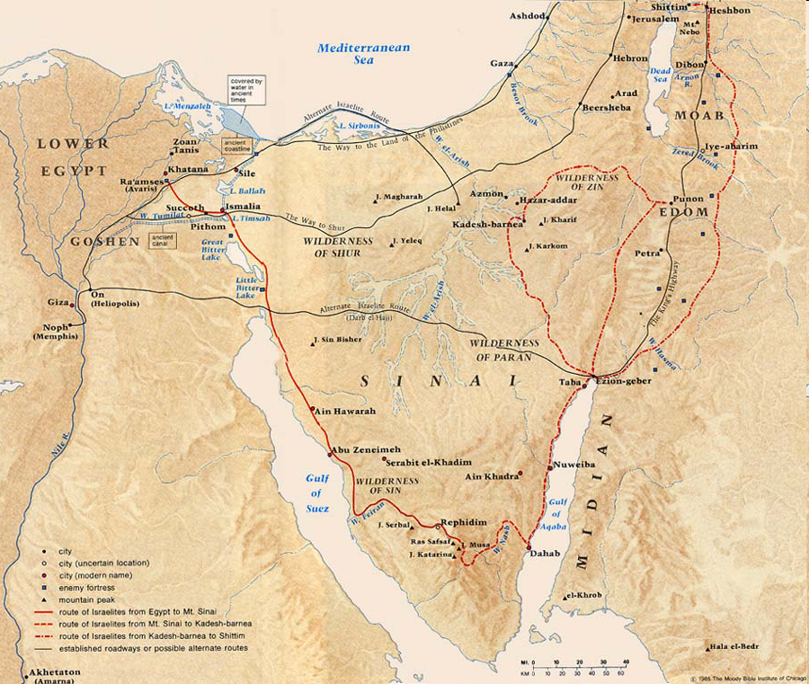
“Land of Midian”
“Midianites”
(Aid to Bible Understanding)
“The extent of their landholdings is uncertain and must have varied in the course of their history”
At the time of Ch. 18 Jethro must have been in this general area
Rephidim
Where Moses and Jethro meet

Slide 5
¹And Jethro, the priest of Midian, Moses’ father-in-law, heard of all that God had done for Moses and for Israel His people—that the Lord had brought Israel out of Egypt.
“heard of all that God had done”
(NSB) “Word of God’s deliverance of the Israelites had reached the remote dwelling place of Jethro, priest of Midian”
(Old Testament Times, R.K.Harrison)
“Jethro (Reuel), the shepherd-priest of the Midianite tribe of Kenites…
The name ‘Kenites’ means ‘belonging to the copper-smiths’ and is probable that they were attracted to the Sinai peninsula by the renowned copper mines at Serabit el Khadem, a site some fifty miles from the traditional location of Mount Sinai”
“The Kenites belonged to the Midianite peoples, who were among the first of the nomadic Bedouins to domesticate the camel”

Slide 6
²Then Jethro, Moses’ father-in-law, took Zipporah, Moses’ wife, after he had sent her back,
³with her two sons, of whom the name of one was Gershom (for he said, “I have been a stranger in a foreign land”)£
⁴and the name of the other was £Eliezer (for he said, “The God of my father was my help, and delivered me from the sword of Pharaoh”);
v. 2 ‘after he had sent her back’
Apparently Zipporah had returned to her father in Midian after the circumcision event of Moses’ sons [4:24]…(It is not recorded that the entire family came out of Egypt)
v. 3 “Gershom” means ‘expulsion’
(BKC) “It is probably related to the Hebrew verb garas, ‘to drive out or banish’. He was a child of Moses’ banishment, that is, a child born while Moses was an alien in a foreign land” [Midian]
v. 4 “Eliezer” means ‘God is [my] helper’
(Aid to Bible Understanding) “The younger of Moses’ two sons, so named by Moses because God had been his helper in delivering Moses from Pharaoh’s sword”
⁵and Jethro, Moses’ father-in-law, came with his sons and his wife to Moses in the wilderness, where he was encamped at the mountain of God.

Slide 7
⁶Now he had said to Moses, “I, your father-in-law Jethro, am coming to you with your wife and her two sons with her.”
Better translation: (NIV) “Jethro had sent word to him…”
(Expositors) “Jethro announced his arrival by means of a messenger”
⁷So Moses went out to meet his father-in-law, bowed down, and kissed him. And they asked each other about their well-being, and they went into the tent.
(JFB) “Their salutations would be marked by all the warm and social greeting of Oriental friends”
⁸And Moses told his father-in-law all that the Lord had done to Pharaoh and to the Egyptians for Israel’s sake, all the hardship that had come upon them on the way, and how the Lord had delivered them.
⁹Then Jethro rejoiced for all the good which the Lord had done for Israel, whom He had delivered out of the hand of the Egyptians.

Slide 8
¹⁰And Jethro said, “Blessed be the Lord, who has delivered you out of the hand of the Egyptians and out of the hand of Pharaoh, and who has delivered the people from under the hand of the Egyptians.
¹¹Now I know that the Lord is greater than all the gods; for in the very thing in which they behaved proudly, He was above them.”
v. 11 “greater than all the gods”—referring to the ‘gods’ of Egypt
(Expositors) “It is a clear statement to Yahweh’s incomparable greatness above all the gods of Egypt (not necessarily Jethro’s past or present penchant for polytheism)”
¹²Then Jethro, Moses’ father-in-law, £took a burnt offering and other sacrifices to offer to God. And Aaron came with all the elders of Israel to eat bread with Moses’ father-in-law before God.
(JFB) “This friendly interview was terminated by a solemn religious service—the burnt offerings were consumed on the altar, and the sacrifices were offerings, used in a feast of joy and gratitude,
at which Jethro, a priest of the true God, seems to have presided, and to which the chiefs of Israel were invited”

Slide 9
¹³And so it was, on the next day, that Moses sat to judge the people; and the people stood before Moses from morning until evening.
v. 13 (NSB) “Judge here means ‘to render decisions’”
¹⁴So when Moses’ father-in-law saw all that he did for the people, he said, “What is this thing that you are doing for the people? Why do you alone sit, and all the people stand before you from morning until evening?”
Jethro noticed that too much of Moses’ time was taken up as judge answering disputes and inquiries and he was doing it alone

Slide 10
¹⁵And Moses said to his father-in-law, “Because the people come to me to inquire of God.
¹⁶When they have a difficulty, they come to me, and I judge between one and another; and I make known the statutes of God and His laws.”
v. 15 “the people come to me to inquire of God”
The people came to Moses with disputes and to seek God’s will in these matters
v. 16 “I make known the statutes of God and His laws”
God’s laws and statutes being expounded and taught before being formally declared at Sinai
¹⁷So Moses’ father-in-law said to him, “The thing that you do is not good.
¹⁸Both you and these people who are with you will surely wear yourselves out. For this thing is too much for you; you are not able to perform it by yourself.
¹⁹Listen now to my voice; I will give you counsel, and God will be with you: Stand before God for the people, so that you may bring the difficulties to God.
v. 19“Listen now….I will give you counsel”
Jethro recognized that Moses was wearing himself down and gives advice on carrying out the responsibilities
v. 19 ‘Stand before God’
Standing between the people and God, both as His minister or representative, and as representative of the people

Slide 11
²⁰And you shall teach them the statutes and the laws, and show them the way in which they must walk and the work they must do.
“teach them”
(Barnes) “The word is emphatic, and signifies ‘enlightenment.’ The text gives four distinct points: statutes, laws, show them the way [course of duty], the work they must do”
²¹Moreover you shall select from all the people able men, such as fear God, men of truth, hating covetousness; and place such over them to be rulers of thousands, rulers of hundreds, rulers of fifties, and rulers of tens.
²²And let them judge the people at all times. Then it will be that every great matter they shall bring to you, but every small matter they themselves shall judge. So it will be easier for you, for they will bear the burden with you.
v. 21 “you shall select”
(Expositors) “While it may seem from this passage that Moses autocratically chose his own staff, the actual election was the work of all the people as Deut. 1:9, 13 affirms”
Deuteronomy 1: 13
“Choose wise, understanding and knowledgeable men from among your tribes, and I will make them heads over you”

Slide 12
²³If you do this thing, and God so commands you, then you will be able to endure, and all this people will also go to their place in peace.”
(Expositors) “Jethro warned that his plan needed to be executed only if God was pleased with this advise”
²⁴So Moses heeded the voice of his father-in-law and did all that he had said.
(Word) “Moses response to Jethro’s counsel is a further indication of its significance and originality”
²⁵And Moses chose able men out of all Israel, and made them heads over the people: rulers of thousands, rulers of hundreds, rulers of fifties, and rulers of tens.
²⁶So they judged the people at all times; the hard cases they brought to Moses, but they judged every small case themselves.
(Zondervan Bible Backgrounds Commentary)
“Well-ordered societies require a mechanism for resolving disputes. Exodus 18 describes the establishment of a fledgling judicial system of Israel, and the text presents a hierarchically organized system”
²⁷Then Moses let his father-in-law depart, and he went his way to his own land.

Slide 13
Chapter 19
‘wilderness of Sinai’—used for the 1st time here
Where they stayed almost a year
¹In the third month after the children of Israel had gone out of the land of Egypt, on the same day, they came to the Wilderness of Sinai.
²For they had departed from Rephidim, had come to the Wilderness of Sinai, and camped in the wilderness. So Israel camped there before the mountain.
(Aid to Bible Understanding)
“The exact geographical limits of the wilderness of Sinai cannot be determined from the Bible record. It was apparently near Rephidim”
v. 2(last part) “before the mountain”
Mt.Sinai/ Horeb?

Slide 14
Which mountain? Where is it located?
(Old Testament Times, R.K. Harrison)
“The mountain from which God revealed the Law was named Horeb in the book of Deuteronomy, though the other books of the Pentateuch referred to it as Sinai.”
(Old Testament Times)
“The identification of the site is by no means certain, but the great weight of tradition indicates Jebel Musa, the ‘mountain of Moses’, a prominent peak in a rugged range of granite hills, as the original Mount Sinai.”
(Zondervan Bible Backgrounds Commentary)
“Older traditions actually point to an entirely different location for Mount Sinai…..there is no clear evidence on which mountain is the right one.”

Slide 15
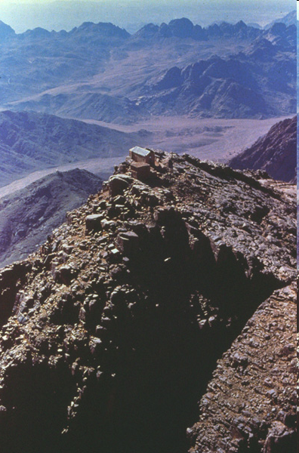
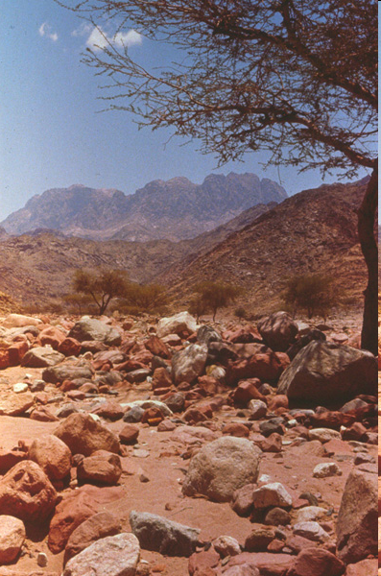
Jebel Musa
Jebel Serbal

Slide 16
Jewish tradition says the law was given on Pentecost
¹In the third month after the children of Israel had gone out of the land of Egypt, on the same day, they came to the Wilderness of Sinai.
(Matthew Poole) “Third new moon [month], called Sivan, including the latter part of May, and the former part of June”
“on the same day”
(Word) “on the [same] day is sometimes understood in reference to ‘in the month’ as so to specify that Israel reached the Sinai wilderness on the very first day of the third lunar month [Sivan] from the departure from Egypt”
(Matthew Poole) “The same day, (Heb.)I n that day, to wit, when the month or new moon began, and when they departed from Rephidim…
This is set down thus accurately, because it gives us an account of the original feast of Pentecost, because the giving of the law, which was three or four days after this time, was fifty days after the Passover, whereof forty-six or forty-seven were past at their first coming to Sinai, reckoning from the fifteenth day of the first month, when they came out of Egypt, to this time”

Slide 17
²For they had departed from Rephidim, had come to the Wilderness of Sinai, and camped in the wilderness. So Israel camped there before the mountain.
Exodus 3:12 (fulfillment)
¹²So He said, “I will certainly be with you. And this shall be a sign to you that I have sent you: When you have brought the people out of Egypt, you shall serve God on this mountain.”
³And Moses went up to God, and the Lord called to him from the mountain, saying, “Thus you shall say to the house of Jacob, and tell the children of Israel:
‘Lord called’
(Companion) (Heb.) Jehovah called—only occurrence of this expression in Exodus [here and v. 20]
‘house of Jacob’—only time used in the Pentateuch
(Barnes) “it has a peculiar fitness here, referring doubtless to the special promises made to the Patriarch”

Slide 18
The basic form of the covenant between God and Israel verses 4-6:
⁴‘You have seen what I did to the Egyptians, and how I bore you on eagles’ wings and brought you to Myself.
⁵Now therefore, if you will indeed obey My voice and keep My covenant, then you shall be a special treasure to Me above all people; for all the earth is Mine.
⁶And you shall be to Me a kingdom of priests and a holy nation.’ These are the words which you shall speak to the children of Israel.”
(BKC) “The proposal made by God (My covenant) would give Israel an exalted position among the nations in view of their acceptance of God’s righteous standards”
(Zondervan Bible Backgrounds commentary)
“The Hebrew word for covenant essentially means a binding legal agreement..”

Slide 19
⁷So Moses came and called for the elders of the people, and laid before them all these words which the Lord commanded him.
Moses called for the elders and gave them God’s words, and then they repeated them to the people
Helps us understand the way the instructions were given to such a mass of people [2 million]
⁸Then all the people answered together and said, “All that the Lord has spoken we will do.” So Moses brought back the words of the people to the Lord.
“all the people answered together”
(Paraphrase) “they responded in unison…”
(NIV) “the people all responded together..”
“All that the Lord has spoken we will do”
(Keil and Delitzch) “they promised unanimously”
All the people of Israel agreed to obey God

Slide 20
(Expositors) “To forestall all future pretext for saying that the law Moses was about to give to Israel was of his own devising, God conferred on Moses the highest possible honor and deference ever given to mortal man”
⁹And the Lord said to Moses, “Behold, I come to you in the thick cloud, that the people may hear when I speak with you, and believe you forever.” So Moses told the words of the people to the Lord.
(Expositors) “Ordinarily God dwelt with his people in a pillar of cloud and fire; but here it turned dense and pitch black, perhaps with a roar of thunder and the flash of lightning as God’s voice pierced his creation.
The voice of God speaking to Moses would be audible in the camp so that Israel and all her true descendents would trust in Moses’ words both then and for all time”

Slide 21
Special instructions are given to the people in order to approach the vicinity of God’s holy presence
¹⁰Then the Lord said to Moses, “Go to the people and consecrate them today and tomorrow, and let them wash their clothes.
¹¹And let them be ready for the third day. For on the third day the Lord will come down upon Mount Sinai in the sight of all the people.
(Expositors) “The theology of this passage, then, is fitness for meeting with God and preparation for the worship of God”
¹²You shall set bounds for the people all around, saying, ‘Take heed to yourselves that you do not go up to the mountain or touch its base. Whoever touches the mountain shall surely be put to death.
¹³Not a hand shall touch him, but he shall surely be stoned or shot with an arrow; whether man or beast, he shall not live.’ When the trumpet sounds long, they shall come near the mountain.”
v. 12 Not touching the mountain taught them a sense of awe and respect towards God
v. 13 (last part) (Paraphrase)
“Stay away from the mountain entirely until you hear the trumpet sounding one long blast; then gather at the foot of the mountain”

Slide 22
¹⁴So Moses went down from the mountain to the people and sanctified the people, and they washed their clothes.
¹⁵And he said to the people, “Be ready for the third day; do not come near your wives.”
Wearing clean clothes and abstaining form sexual relations were outward acts to signify that they had sanctified themselves before God would speak to them
¹⁶Then it came to pass on the third day, in the morning, that there were thunderings and lightnings, and a thick cloud on the mountain; and the sound of the trumpet was very loud, so that all the people who were in the camp trembled.
¹⁷And Moses brought the people out of the camp to meet with God, and they stood at the foot of the mountain.
¹⁸Now Mount Sinai was completely in smoke, because the Lord descended upon it in fire. Its smoke ascended like the smoke of a furnace, and £the whole mountain quaked greatly.
(Expositors) “A deep moral impression was made on the people, for they were in the presence of the glorious majesty of the Holy God who was about to reveal his person and character in his law”

Slide 23
¹⁹And when the blast of the trumpet sounded long and became louder and louder, Moses spoke, and God answered him by voice.
²⁰Then the Lord came down upon Mount Sinai, on the top of the mountain. And the Lord called Moses to the top of the mountain, and Moses went up.
v. 19 ‘and God answered him by a voice’
(Companion) “Heb. denotes continued speaking, and thus tells us how the next and following chapters were given to Moses”
²¹And the Lord said to Moses, “Go down and warn the people, lest they break through to gaze at the Lord, and many of them perish.
²²Also let the priests who come near the Lord consecrate themselves, lest the Lord break out against them.”
v. 22 the “priests” had to consecrate themselves as well
(Expositors) “Certainly this was not the Aaronic priesthood which had not been established yet. It must be a reference to the ‘firstborn’ of every family who were dedicated and consecrated to God [13:2]
Only later was the tribe of Levi substituted for each firstborn male [Num. 3:45]”

Slide 24
²³But Moses said to the Lord, “The people cannot come up to Mount Sinai; for You warned us, saying, ‘Set bounds around the mountain and consecrate it.’”
²⁴Then the Lord said to him, “Away! Get down and then come up, you and Aaron with you. But do not let the priests and the people break through to come up to the Lord, lest He break out against them.”
²⁵So Moses went down to the people and spoke to them.
v. 24 “then come up, you and Aaron with you”
(Keil and Delitzch) “The promulgation of the ten words [commandments] of God…took place before Moses ascended the mountain again with Aaron”

