Slide 1
Happy Sabbath
United Church of God
San Francisco Bay Area
October 26, 2019

Slide 2
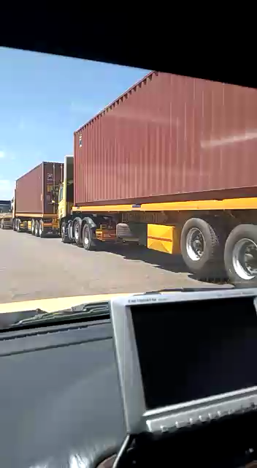
Video from Pastor Moise Mabout
Trucks lined-up to cross the border from the Democratic Republic of the Congo into Zambia

Slide 3
The size of the Democratic Republic of the Congo compared to the U.S.
Graphics credit – endingextremepoverty.org, nationsencyclopedia.com, globaldashboard.org.

Slide 4
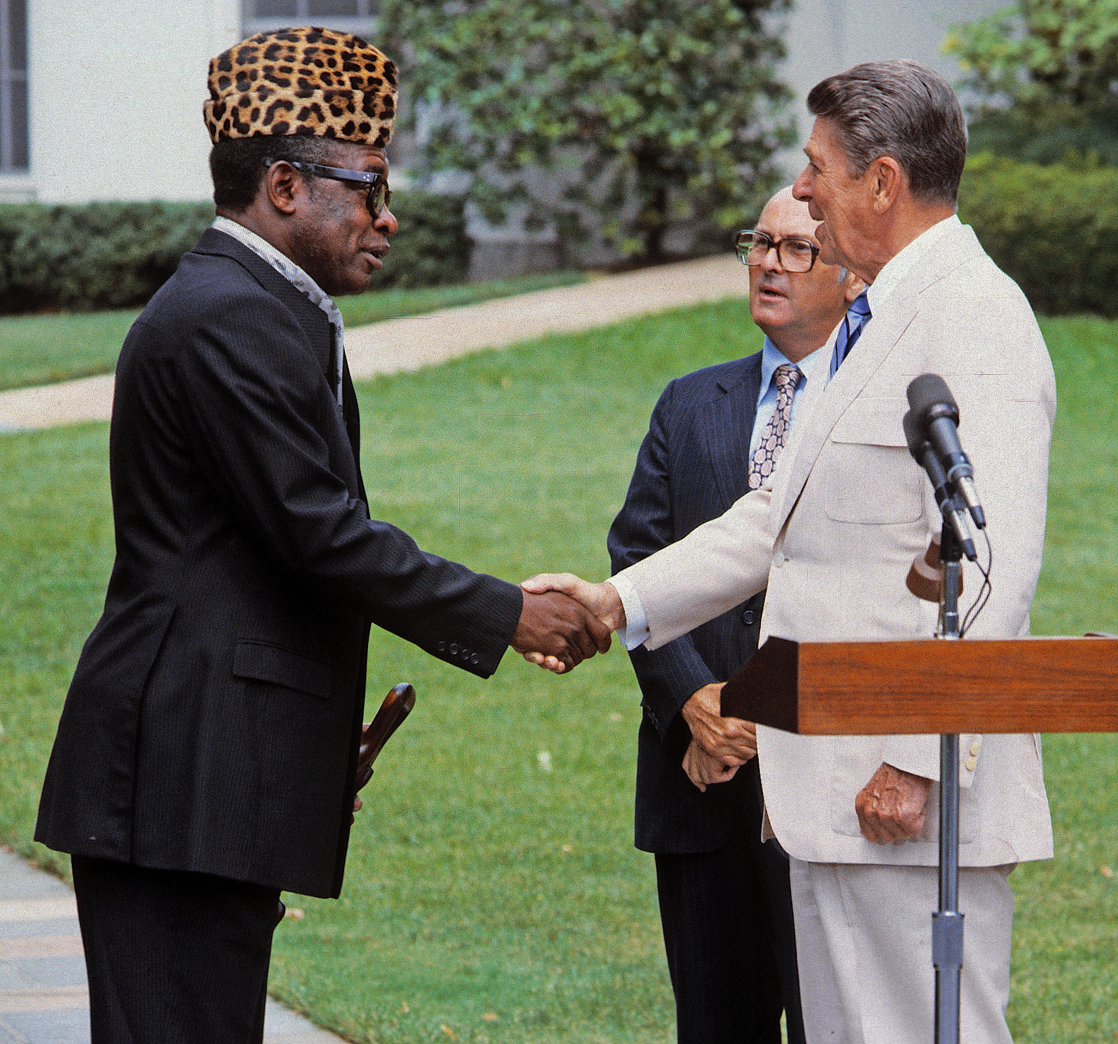
MediaPunch Inc / Alamy Stock Photo, used with permission
President Mobuto Sese Seko meets President Ronald Reagan in 1984

Slide 5
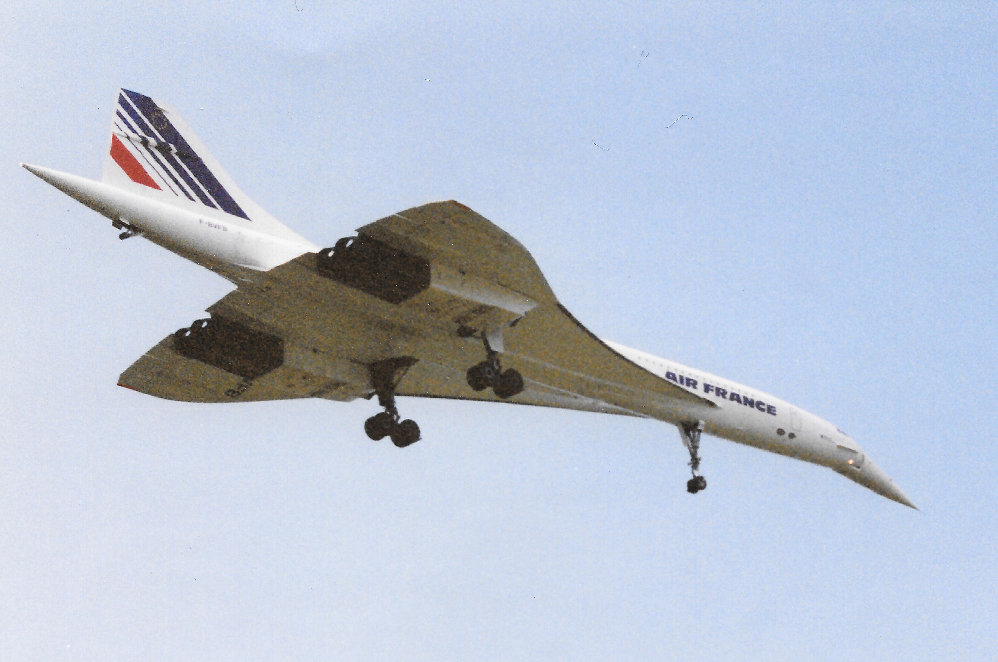
The African Versailles
Photo by RTBF.be, “dans le palais de Mobutu, à Gbadolite, en 1988”
Photo by Eric Salard, F-BVFB last commercial flight 5-31-2003, Licensed from Creative Commons, unmodified, Attribution-ShareAlike 2.0 Generic

Slide 6
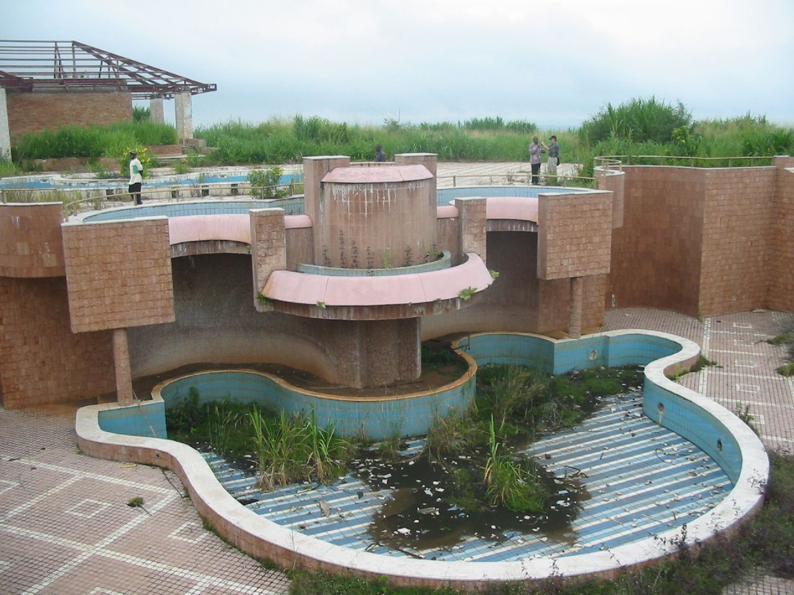
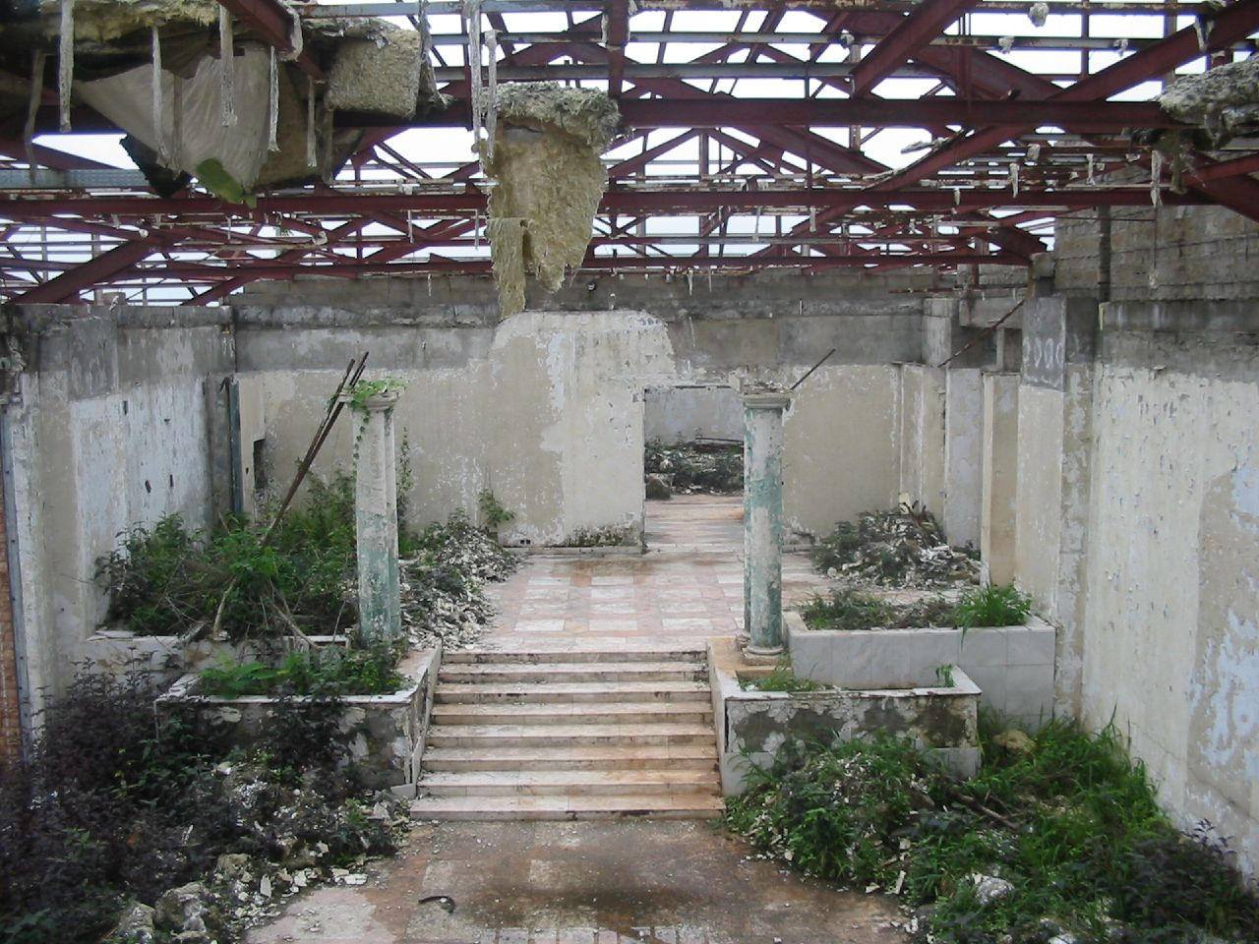
Photos by Clement Bourse, Licensed from Creative Commons, unmodified, Attribution-ShareAlike 2.0 Generic

Slide 7
I Corinthians 15:50
Robert Lukeman - Unsplash
Olivier de Sadeleer - Unsplash

Slide 8
Moving from Corruption to Convesion
What is corruption?
How does it affect us in the Church of God?
How do we move from Corruption to Conversion?
Olivier de Sadeleer - Unsplash

Slide 9
I Corinthians 15:50
Joshua Hoehn - unsplash
Corruption = « phthora »

Slide 10
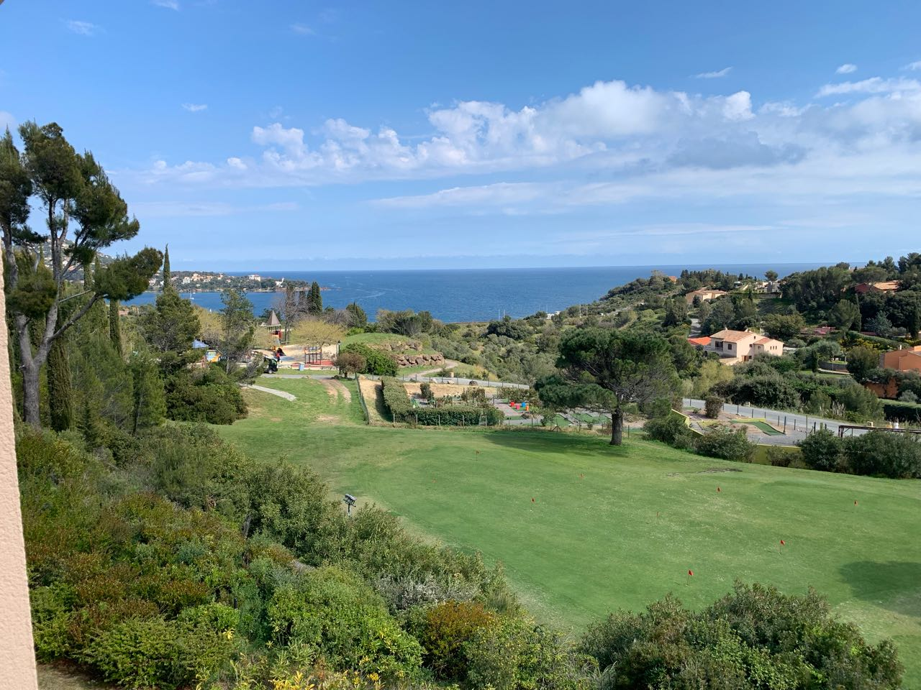
Happy Sabbath
Photo by Tim Pebworth

