Slide 2
After This MANNER
Prayer Foundations

Slide 3

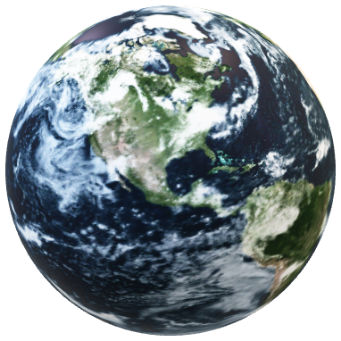
Prayer is one of the most valuable ways to develop THE Relationship with God.

Slide 4

God Speaks to us with His Word
He Guides us with His Holy Spirit
Conversation With God - PRAYER
We Consider - How to Move Forward – Meditating

Slide 5
Isaiah 55:8-9 (NKJV) ⁸ "For My thoughts are not your thoughts, Nor are your ways My ways," says the LORD. ⁹ "For as the heavens are higher than the earth, So are My ways higher than
your ways, And My thoughts than your thoughts.

Slide 6
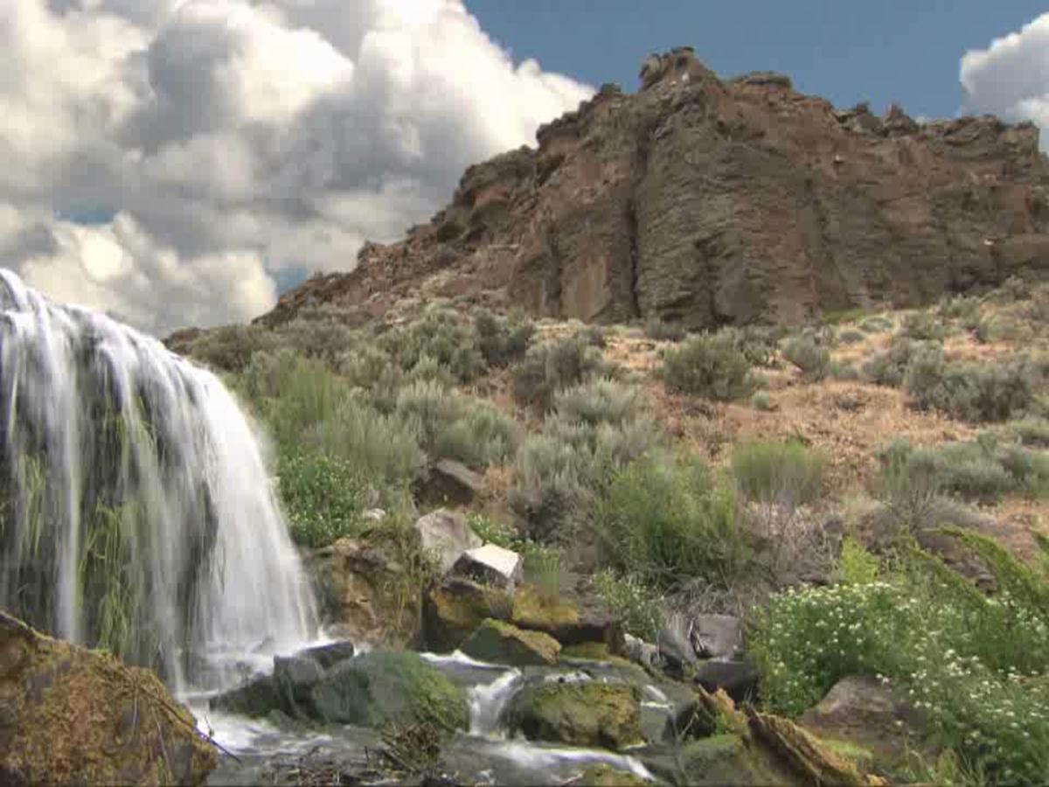
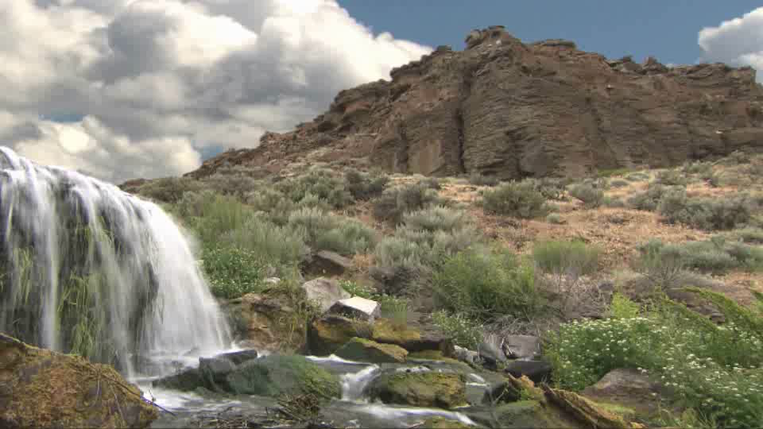
Matthew 6:9-13 (NKJV) ⁹ In this manner, therefore, pray:
Our Father in heaven, Hallowed be Your name.
¹⁰ Your kingdom come. Your will be done On earth as it is in heaven.
¹¹ Give us this day our daily bread.
¹² And forgive us our debts, As we forgive our debtors.
¹³ And do not lead us into temptation, But deliver us from the evil one.
For Yours is the kingdom and the power and the glory forever. Amen.
Notes:
Faded picture background with full-color video overlay (Intermediate) To reproduce the background effects on this slide, do the following:
On the Home tab, in the Slides group, click Layout, and then click Blank.
On the Insert tab, in the Media group, click Video, and then click Video from File.
In the left pane of the Insert Video dialog box, click the drive or library that contains the video. In the right pane of the dialog box, click the video that you want and then click Insert.
Under Video Tools, on the Format tab, in the Sizing group, click the arrow to the right of Size to launch the Format Video dialog box.
In the Format Video dialog box, select Size from the left pane, under Scale in the right pane clear the Lock Aspect Ratio box.
In the Format Video dialog box, select Size from the left pane, under Size and Rotate in the right pane, set the Height to 7.5” and set the Width to 10”.
On the Home tab, in the Drawing group, click Arrange, point to Align, and then do the following:
Click Align Center.
Click Align Middle.
Select the video. On the Home tab, in the Clipboard group, click Copy.
Also on the Home tab, in the Clipboard group, click the arrow below Paste, and select Paste Special. In the Paste Special dialog box, select Paste, and then under As, select Picture (JPEG).
Select the (JPEG) image. On the Home tab, in the Drawing group, click Arrange, point to Align, and then do the following:
Click Align Top.
Click Align Left.
Under Picture Tools, on the Format tab, in the Adjust group, click the arrow under Color, and then under Recolor select Tan, Background color 2 Light (third row, first option from the left).
On the Home tab, in the Drawing group, click the arrow below Arrange, and select Send to Back.
Select the video. Under Video Tools on the Format tab, in the Size group, click the arrow at the bottom right corner to launch the Format Video dialog box, and then select Crop in the left pane. In the Crop pane, under Crop Position do the following:
In the Width box, enter 3.17”.
In the Height box, enter 7.5”.
Also in the Format Video dialog box, select Glow and Soft Edges in the left pane. Under Soft Edges in the right pane, click the arrow next to Presets and select 25 Point.
On the Animations tab, in the Animation group, select Play.
Also on the Animations tab, in the Timing group, click the arrow to the right of Start and select With Previous.
Select the video. Under Video Tools, on the Playback tab, in the Video Options group, select Loop until Stopped.
To reproduce the text effects on this slide, do the following:
On the Insert tab, in the Text group, click Text Box, and then on the slide drag to draw your text box.
With the text box selected type in desired title text (“Title”).
Select the text. On the Home tab, in the Font group, click the arrow at the bottom corner to launch the Font dialog box, then on the Font tab do the following:
In the Text Font box, select Calibri from the Font list.
In the Font Style box, select Bold.
In the Size box, enter 36 pt, and then click OK.
Also on the Home tab, in the Paragraph group, select the Center Text icon.
Under Drawing Tools, on the Format tab, in the WordArt Styles group, click the arrow at the bottom right corner to launch the Format Text Effects box, and then select Reflection in the left pane and in the Reflection pane click the arrow to the right of Presets and under Reflection Variations select Half Reflection 4 pt Offset (second row, second option from left).
Also on the Format tab, in the Size group, click the arrow at the bottom right corner to launch the Format Shape dialog box, select Position in the left pane, and in the Position pane do the following:
In the Horizontal box, enter 3.16” from Top Left Corner.
In the Vertical box, enter 0.5” from Top Left Corner.
On the Insert tab, in the Text group, click Text Box, and then on the slide drag to draw your text box.
With the text box selected, type in desired body copy text.
Select the text. On the Home tab, in the Font group, select Calibri from the Font list, and then select 28 pt from the Font Size list.
Under Drawing Tools, on the Format tab, in the Size group, click the arrow at the bottom right corner to launch the Format Shape dialog box, select Position in the left pane, and in the Position pane do the following:
In the Horizontal box, enter 3.6” from Top Left Corner.
In the Vertical box, enter 2.25” from Top Left Corner.
Close the Format Shape dialog.

Slide 7
Psalm 145
More Detail
As we examine Psalm 145 in light of Matthew 6, we’ll see God’s Approach to our Relationship with Him more clearly.
David was inspired to write a prayer which parallels the sample Prayer given by Jesus Christ in Matthew 6
Very Important to Orthodox Jewish Faith.
Psalm 145 is recited three times a day by Orthodox Jews …as they believe it guides their humility and praise of God.
Very poetic and artfully composed.
It is an acrostic, and obviously inspired for those who read Hebrew.

Slide 8
BOTH Matthew 6 and Psalms 145 Combine to Create an Overall More Detailed Model Prayer
Intention
To develop a more complete guide for our Daily prayer, therefore enhancing our Relationship with Our Father and Jesus Christ
!
Our Daily Relationship with Our Father and Jesus Christ are Guided and even Jump-Started by the inspired Guides God has provided for us.

Slide 9
Matthew 6:9 (NKJV)
⁹ In this manner, therefore, pray: Our Father in heaven, Hallowed be Your name.

Slide 10
Psalm 145:1-2
Psalm 145:1-2 (NKJV) ¹ I will extol You, my God, O King; And I will bless Your name forever and ever.
² Every day I will bless You, And I will praise Your name forever and ever.
Granting us even more rich detail

Slide 11
COMPARISON
Side By Side Matthew 6:9 With Psalm 145:1-2
Matthew 6:9
Psalm 145:1-2
In this manner, therefore, pray: Our Father in heaven, Hallowed be Your name.
I will extol You, my God, O King; And I will bless Your name forever and ever.
² Every day I will bless You, And I will praise Your name forever and ever.

Slide 12
God and You
His Desire - To Lead You to
HIS Priorities and HIS Ways.
1 Thessalonians 5:17-18 (NKJV) ¹⁷ pray without ceasing, ¹⁸ in everything give thanks; for this is the will of God in Christ Jesus for you.
Romans 11:33-36 (NKJV) ³³ Oh, the depth of the riches both of the wisdom and knowledge of God! How unsearchable are His judgments and His ways past finding out! ³⁴ "For who has known the mind of the LORD? Or who has become His counselor?" ³⁵ "Or who has first given to Him And it shall be repaid to him?" ³⁶ For of Him and through Him and to Him are all things, to whom be glory forever. Amen.

Slide 13
God and You
His Desire - To Lead You to
HIS Priorities and HIS Ways.
Job 42:1-6 (NKJV) ¹ Then Job answered the LORD and said: ² "I know that You can do everything, And that no purpose of Yours can be withheld from You. ³ You asked, 'Who is this who hides counsel without knowledge?' Therefore I have uttered what I did not understand, Things too wonderful for me, which I did not know. ⁴ Listen, please, and let me speak; You said, 'I will question you, and you shall answer Me.' ⁵ "I have heard of You by the hearing of the ear, But now my eye sees You. ⁶ Therefore I abhor myself, And repent in dust and ashes.“
1 Timothy 6:15-16 (NKJV) ¹⁵ which He will manifest in His own time, He who is the blessed and only Potentate, the King of kings and Lord of lords, ¹⁶ who alone has immortality, dwelling in unapproachable light, whom no man has seen or can see, to whom be honor and everlasting power. Amen.

Slide 14
Psalm 145:3-4
Great is the LORD, and greatly to be praised; And His greatness is unsearchable.
⁴ One generation shall praise Your works to another, And shall declare Your mighty acts.
Continuing with Orientation –
GOD Praised - in ALL Generations.

Slide 15
COMPARISON
Side By Side Matthew 6:9 With Psalm 145:3-4
Matthew 6:9
Psalm 145:3-4
In this manner, therefore, pray: Our Father in heaven, Hallowed be Your name.
Great is the LORD, and greatly to be praised; And His greatness is unsearchable.
⁴ One generation shall praise Your works to another, And shall declare Your mighty acts.

Slide 16
God and You
His Desire - To Instruct ALL Families
In Praising His WAYS and PLANS.
Genesis 18:19 (NKJV) ¹⁹ For I have known him, in order that he may command his children and his household after him, that they keep the way of the LORD, to do righteousness and justice, that the LORD may bring to Abraham what He has spoken to him."

Slide 17
Psalm 145:5
⁵ I will meditate on the glorious splendor of Your majesty, And on Your wondrous works.
Continuing with Godly Orientation –
Inspiring Our Thoughts.

Slide 18
COMPARISON
Side By Side Matthew 6:9 With Psalm 145:5
Matthew 6:9
Psalm 145:5
In this manner, therefore, pray: Our Father in heaven, Hallowed be Your name.
⁵ I will meditate on the glorious splendor of Your majesty, And on Your wondrous works.

Slide 19
God and You
His Desire – SEE Our Relationship
WE are Praise of HIM in US.
1 Chronicles 29:11-15 (NKJV) ¹¹ Yours, O LORD, is the greatness, The power and the glory, The victory and the majesty; For all that is in heaven and in earth is Yours; Yours is the kingdom, O LORD, And You are exalted as head over all. ¹² Both riches and honor come from You, And You reign over all. In Your hand is power and might; In Your hand it is to make great And to give strength to all. ¹³ "Now therefore, our God, We thank You And praise Your glorious name. ¹⁴ But who am I, and who are my people, That we should be able to offer so willingly as this? For all things come from You, And of Your own we have given You. ¹⁵ For we are aliens and pilgrims before You, As were all our fathers; Our days on earth are as a shadow, And without hope..

Slide 20
God and You
His Desire – To Bring Many To Glory In His Kingdom as His “Offspring”
Acts 17:24-28 (NKJV) ²⁴ God, who made the world and everything in it, since He is Lord of heaven and earth, ... ²⁵ Nor is He worshiped with men's hands, as though He needed anything, since He gives to all life, breath, and all things. ²⁶ And He has made from one blood every nation of men to dwell on all the face of the earth, and has determined their preappointed times and the boundaries of their dwellings, ²⁷ so that they should seek the Lord, in the hope that they might grope for Him and find Him, though He is not far from each one of us; ²⁸ for in Him we live and move and have our being, as also some of your own poets have said, 'For we are also His offspring.'

Slide 21
God and You
His Desire – To Bring Many To Glory In His Kingdom as His Children & Heirs with Christ
Romans 8:14-17 (NKJV) ¹⁴ For as many as are led by the Spirit of God, these are sons of God. ¹⁵ For you did not receive the spirit of bondage again to fear, but you received the Spirit of adoption by whom we cry out, "Abba, Father." ¹⁶ The Spirit Himself bears witness with our spirit that we are children of God, ¹⁷ and if children, then heirs--heirs of God and joint heirs with Christ, if indeed we suffer with Him, that we may also be glorified together.

Slide 22
Psalm 145:6-10
⁶ Men shall speak of the might of Your awesome acts, And I will declare Your greatness. ⁷ They shall utter the memory of Your great goodness, And shall sing of Your righteousness.
⁸ The LORD is gracious and full of compassion, Slow to anger and great in mercy. ⁹ The LORD is good to all, And His tender mercies are over all His works. ¹⁰ All Your works shall praise You, O LORD, And Your saints shall bless You.
Continuing with Godly Orientation –
WE “Hallow” HIM by God IN Us.

Slide 23
COMPARISON
Side By Side Matthew 6:9 With Psalm 145:6-10
Matthew 6:9
Psalm 145:6-10
In this manner, therefore, pray: Our Father in heaven, Hallowed be Your name.
⁶ Men shall speak of the might of Your awesome acts, And I will declare Your greatness. ⁷ They shall utter the memory of Your great goodness, And shall sing of Your righteousness.
⁸ The LORD is gracious and full of compassion, Slow to anger and great in mercy. ⁹ The LORD is good to all, And His tender mercies are over all His works. ¹⁰ All Your works shall praise You, O LORD, And Your saints shall bless You.

Slide 24
Matthew 6:10 (NKJV)
¹⁰ Your kingdom come. Your will be done On earth as it is in heaven..

Slide 25
COMPARISON
Side By Side Matthew 6:10 With Psalm 145:11-13
Matthew 6:10
Psalm 145:11-13
Your kingdom come. Your will be done On earth as it is in heaven.
¹¹ They shall speak of the glory of Your kingdom, And talk of Your power,
¹² To make known to the sons of men His mighty acts, And the glorious majesty of His kingdom.
¹³ Your kingdom is an everlasting kingdom, And Your dominion endures throughout all generations.

Slide 26
God and You
His Desire – To Give You
A Future and a Hope.
Hebrews 2:10-11 (NKJV) ¹⁰ For it was fitting for Him, for whom are all things and by whom are all things, in bringing many sons to glory, to make the captain of their salvation perfect through sufferings. ¹¹ For both He who sanctifies and those who are being sanctified are all of one, for which reason He is not ashamed to call them brethren,
Revelation 2:7 (NKJV) ⁷ He who has an ear, let him hear what the Spirit says to the churches. To him who overcomes I will give to eat from the tree of life, which is in the midst of the Paradise of God." '

Slide 27
Matthew 6:11 (NKJV)
Give us this day our daily bread.

Slide 28
COMPARISON
Side By Side Matthew 6:11 With Psalm 145:14-16
Matthew 6:11
Psalm 145:14-16
Give us this day our daily bread.
¹⁴ The LORD upholds all who fall, And raises up all who are bowed down.
¹⁵ The eyes of all look expectantly to You, And You give them their food in due season.
¹⁶ You open Your hand And satisfy the desire of every living thing.

Slide 29
Matthew 6:12-13a (NKJV)
And forgive us our debts, As we forgive our debtors. ¹³ And do not lead us into temptation, But deliver us from the evil one…

Slide 30
COMPARISON
Side By Side Matthew 6:12-13a With Psalm 145:17-20
Matthew 6:12-13a
Psalm 145:17-20
And forgive us our debts, As we forgive our debtors.
¹³ And do not lead us into temptation, But deliver us from the evil one…
¹⁷ The LORD is righteous in all His ways, Gracious in all His works.
¹⁸ The LORD is near to all who call upon Him, To all who call upon Him in truth.
¹⁹ He will fulfill the desire of those who fear Him; He also will hear their cry and save them.
²⁰ The LORD preserves all who love Him, But all the wicked He will destroy.

Slide 31
God and You
His Desire for You – Have HIS Approach
Call On the One Who Cares for ALL
Isaiah 55:6 (NKJV) ⁶ Seek the LORD while He may be found, Call upon Him while He is near.
Romans 10:12-13 (NKJV) ¹² For there is no distinction between Jew and Greek, for the same Lord over all is rich to all who call upon Him. ¹³ For "whoever calls on the name of the LORD shall be saved."
1 Timothy 2:3-4 (NKJV) ³ For this is good and acceptable in the sight of God our Savior, ⁴ who desires all men to be saved and to come to the knowledge of the truth.

Slide 32
The POINT of Human Life
Matthew 6: ^{13b} …For Yours is the kingdom and the power and the glory forever. Amen.

Slide 33
COMPARISON
Side By Side Matthew 6:13b With Psalm 145:21
Matthew 6:13b
Psalm 145:21
^{13b} …For Yours is the kingdom and the power and the glory forever. Amen.
²¹ My mouth shall speak the praise of the LORD, And all flesh shall bless His holy name Forever and ever.

Slide 34
The Old and New Testament Model Prayers are Not for Rote Repetition
They Are Templates for Discussion of Your Relationship with God
Pray that God Would Help Us to Pray and Know Him as He Knows Us
Our Prayers are Precious To God …as Incense on the Altar Before Him

Slide 35

Psalm 141:2-5 (NKJV) ² Let my prayer be set before You as incense, The lifting up of my hands as the evening sacrifice. ³ Set a guard, O LORD, over my mouth; Keep watch over the door of my lips.
Revelation 8:3-4 (NKJV) ³ Then another angel, having a golden censer, came and stood at the altar. He was given much incense, that he should offer it with the prayers of all the saints upon the golden altar which was before the throne. ⁴ And the smoke of the incense, with the prayers of the saints, ascended before God from the angel’s hand.

Slide 36
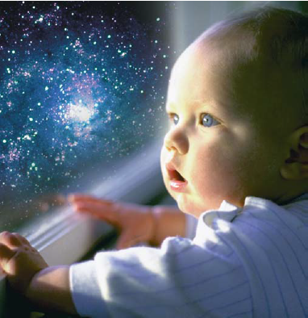

Slide 37
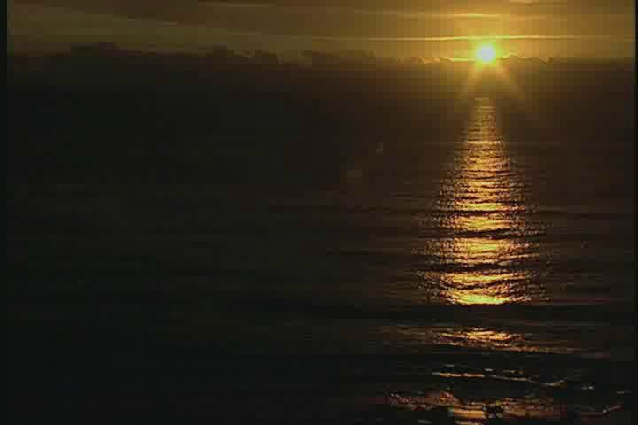
John 17:8-10 (NKJV) ⁸ For I have given to them the words which You have given Me; and they have received them, and have known surely that I came forth from You; and they have believed that You sent Me. ⁹ I pray for them. I do not pray for the world but for those whom You have given Me, for they are Yours. ¹⁰ And all Mine are Yours, and Yours are Mine, and I am glorified in them.

