Slide 1
Noah, the ark & the flood
Lessons from “noah’s” flood

Slide 2
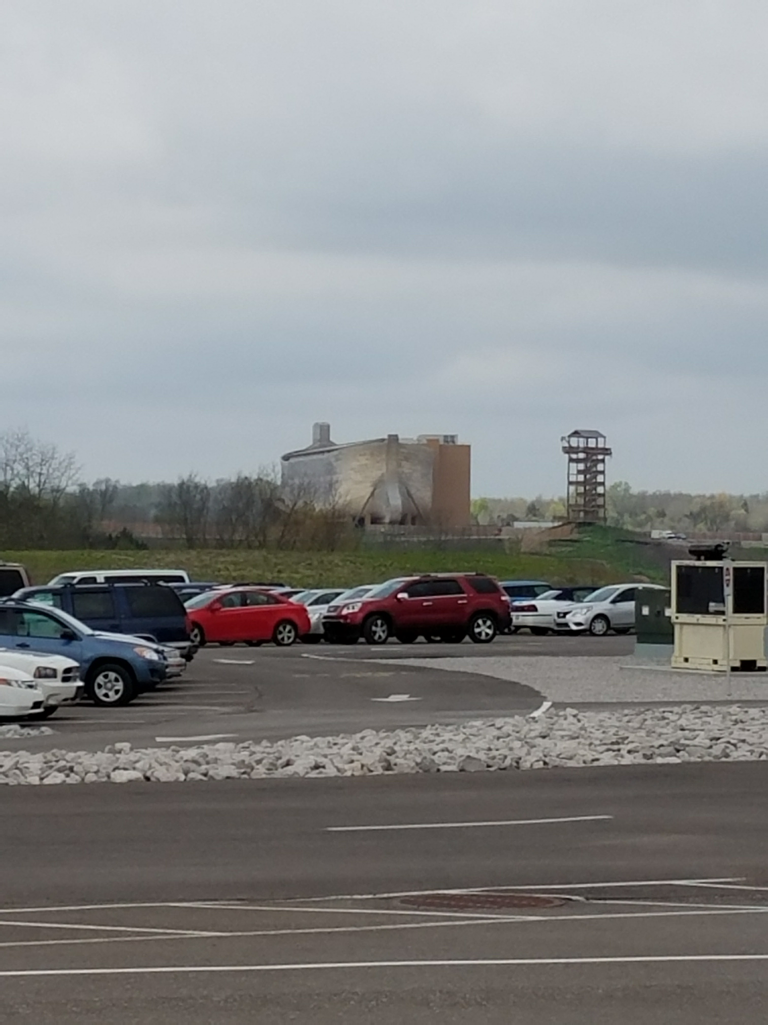


Ark encounter
First arrival

Slide 3
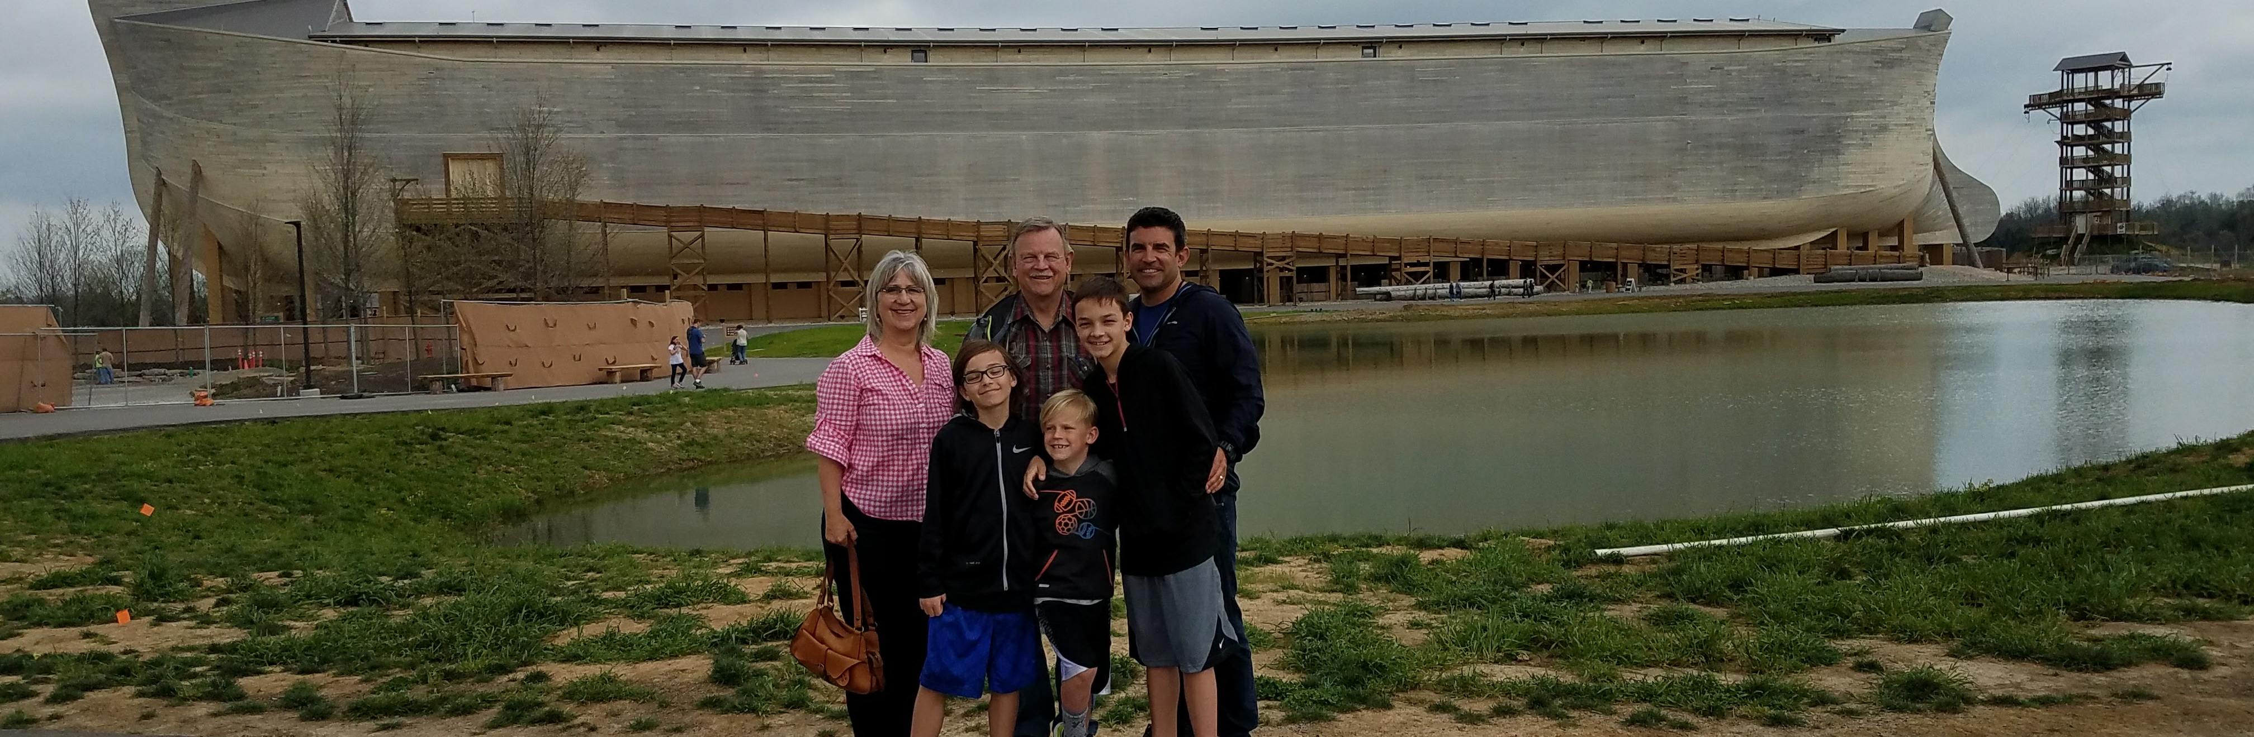
Hill family
Ark entrance

Slide 4
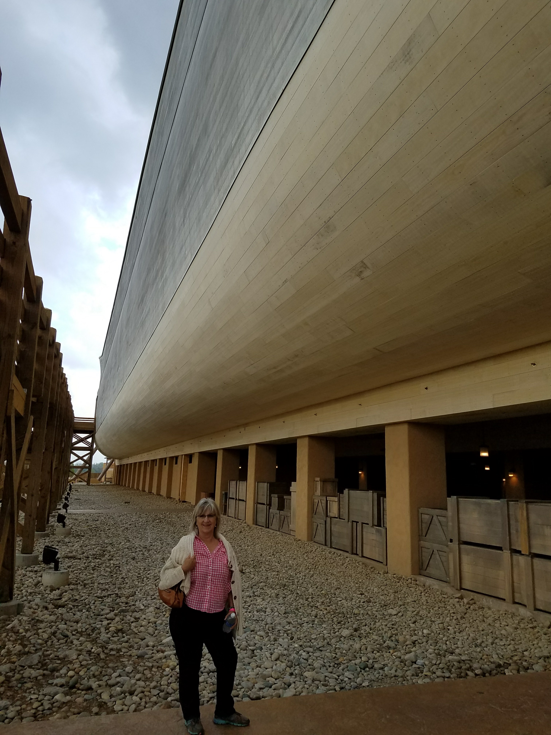
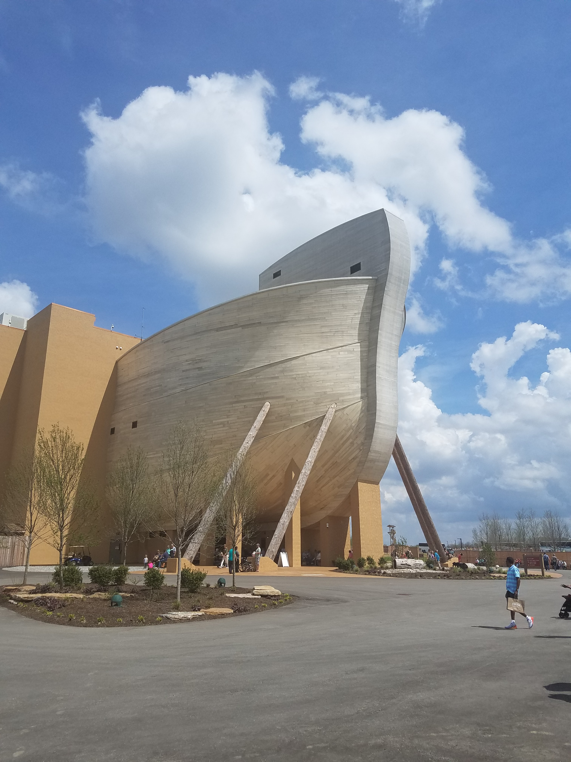
Close ups
Ark’s hull
Ark’s bow

Slide 5

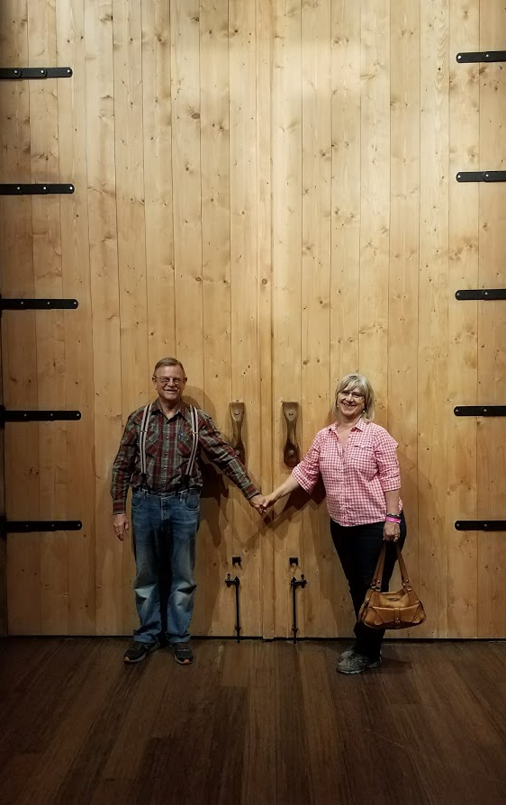
The Door
(Gen 6:16) You shall make a window for the ark, and you shall finish it to a cubit from above; and set the door of the ark in its side. You shall make it with lower, second, and third decks.

Slide 6

Scoffers and Mockers
2 Peter 3:3-6

Slide 7

Beware
Exhort one another daily
Watch out
Hold on to your confidence
Listen up!
Hebrews 3:7-15

Slide 8
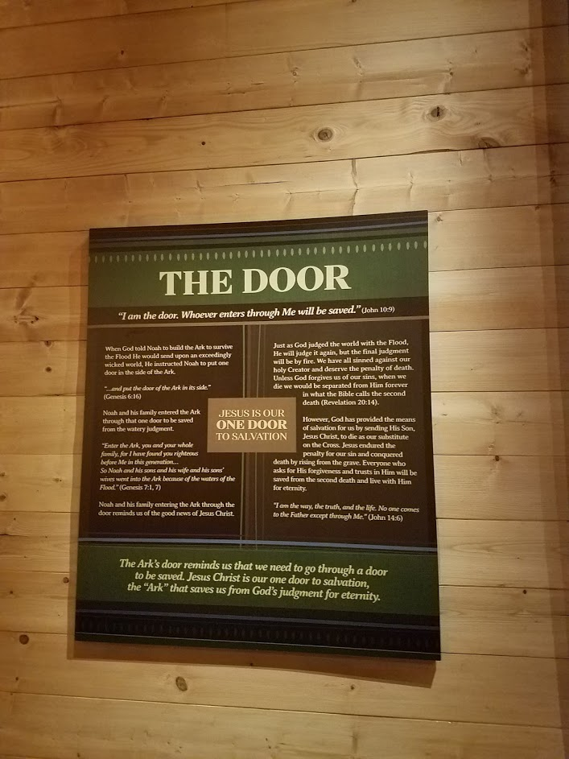

Slide 9
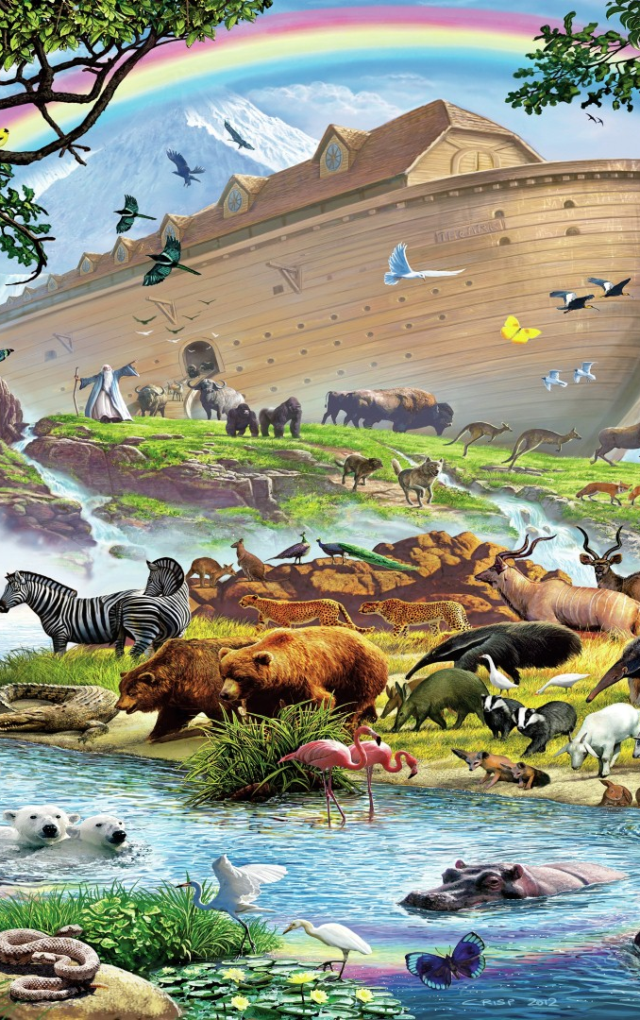
Our heritage
It’s worth enduring to the end.
(1Pe 5:4) and when the Chief Shepherd appears, you will receive the crown of glory that does not fade away.

