Slide 1
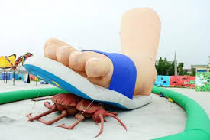
God’s Will
God
You
Notes:
Greetings. How would you define God’s Will? Not examples of God’s Will but a dictionary definition. Is the topic a little confusing to you or are you confident in understanding. {CLICK}. When some of you think of God’s Will do you picture a mean God ready to squash us for any reason. Is this a representation of what you believe God’s will is? {CLICK} Today we are going to talk about the definition of God’s Will. The goal at the end of this message is for all of us to be on the same page. We will either all have a good understanding of the definition of God’s Will or we will all be confused.

Slide 2
What is the definition of God’s will?
A) What God wants
– The gifts and accomplishments for us
B) What God allows
– God is in control, everything that happens is His will
C) What God does or reveals
– Gods direct involvement shows us His will
D) All of the above
E) None of the above
Notes:
What is the definition of God’s Will. Let’s take a test
{CLICK} A) What God Wants.
{CLICK} – The gifts and accomplishments for us
{CLICK} B) What God Allows.
{CLICK} – God is in control, Everything that happens is His Will
{CLICK} C) What God Does or Reveals.
{CLICK} – Gods direct involvement shows us His Will
{CLICK} D) All of the above
{CLICK} E) None of the above

Slide 3

What is the definition of God’s will?
What God wants
What God allows
C) What God does or reveals
“A”
Isaiah 55:8 / Psalm 143:10
We rarely know what God wants
James William Chance Jr.
Notes:
What is the definition of God’s Will.
{CLICK} What God Wants.
{CLICK} What God Allows.
{CLICK} What God Does or Reveals.
I believe The short answer is “A” “What God wants” We understand this from a Legal process known as “Will in Testament” When we die we are asked to have a “Will” so that we can tell people what we want done with our estates.
{CLICK}
This answer is close but it may not be complete.
Our mind is not God’s mind.
Isaiah 55:8 says Isaiah 55:8-9 New King James Version (NKJV)
⁸ “For My thoughts are not your thoughts, Nor are your ways My ways,” says the Lord. ⁹ “For as the heavens are higher than the earth, So are My ways higher than your ways, And My thoughts than your thoughts.
Psalm 143:10 (NKJV)
¹⁰ Teach me to do Your will, For You are my God; Your Spirit is good. Lead me in the land of uprightness.
God’s Thoughts are not our thoughts. His ways are not our ways.
Many times we are confused about God’s Will because we do not understand What God’s wants.
We need to be taught God’s Will.
Also if anyone wants to put me in their Will here is my legal name. {CLICK}

Slide 4

What is the definition of God’s will?
Is God’s Will a form of predestination?
Does God cause tragedy?
Is God in control or is Satan in control?
Does God give blessings?
Can God’s will change?
Answers Please!!
ME
Notes:
To help us deeper define God’s Will let explore some basic questions
{Click} Is God’s Will a form of predestination?
{Click} Does God cause tragedy?
{Click} Is God in control or is Satan in control?
{Click} Does God give blessings?
{Click} Can God’s Will Change?
These questions are not the complete list. But with {CLICK} theses answer we can gain a better understanding of the definition of “God’s Will”
By the way – You know you are getting old when the Clip art man looks better than you ☺

Slide 5

Is God’s will a form of predestination?
Isaiah 46:9-10
…God’s does His pleasure
Rom 8:28-30
…whom He predestined
Eph 1:4-5,11
…being predestined
Is your part in the bride of Christ a “fait accompli” or done deal
“Has fate has already determined your future?”
Notes:
Isaiah 46:9-10 New King James Version (NKJV) ⁹ Remember the former things of old, For I am God, and there is no other; I am God, and there is none like Me, ¹⁰ Declaring the end from the beginning, And from ancient times things that are not yet done, Saying, ‘My counsel shall stand, And I will do all My pleasure,’
Are we like puppets on a string. The end for us is already set. We have no choice. Some of us will make it and some of us will not.
Romans 8:28-30 New King James Version (NKJV)
²⁸ And we know that all things work together for good to those who love God, to those who are the called according to His purpose. ²⁹ For whom He foreknew, He also predestined to be conformed to the image of His Son, that He might be the firstborn among many brethren. ³⁰ Moreover whom He predestined, these He also called; whom He called, these He also justified; and whom He justified, these He also glorified.
Let’s read another example is Eph 1
Ephesians 1:4-5 New King James Version (NKJV)
⁴ just as He chose us in Him before the foundation of the world, that we should be holy and without blame before Him in love, ⁵ having predestined us to adoption as sons by Jesus Christ to Himself, according to the good pleasure of His will,
¹¹ In Him also we have obtained an inheritance, being predestined according to the purpose of Him who works all things according to the counsel of His will,
{Read}

Slide 6
Is God’s Will a form of predestination?
ME
FREE WILL FREE WILL FREE WILL FREE WILL FREE WILL FREE WILL
Blessing
Cursing
Deuteronomy 30:19... We choose
Revelation 13:8 … The savior was decide
before the earth was made
Notes:
Turn to Deuteronomy 30:19
I am going to try something different today. We are going to build a visual diagram to dig deeper into the definition of God’s Will. If our future has been determined by “Fate” why do we have Free Will. When God’s created mankind (you and me) he created us with Free Will. Free Will is the ability or the capacity to make our own choices. Free will allows us to choose what we do each day. For example:
Do I get out of bed?
Do I eat more than I should?
Will I be nice to my dog or spouse?
Do I pray today?
Do I study/read the bible today?
Click - We find scriptures where our future is determined by our choices.
Deut 30:19 I call heaven and earth as witnesses today I have set before you life and death, blessing and cursing; therefore choose life…
To answer the question Is God’s Will a form of predestination? God’s wants us to choose life to choose blessing, but we are not robots. Our future has not be chosen by God or anyone else. Our future is our choice. God’s Will is not a form of predestination. God’s wants us to choose His way so he can bless us. He wants us to receive salvation, but it is our choice our Free Will.
Unfortunately when God gave us “Free Will” it came with a cost or price. When God gave us “Free Will” He knew we would Sin and make bad choices.
For us to have “Free Will” we needed a Savior.
Revelation 13:8 New King James Version (NKJV)
⁸ All who dwell on the earth will worship him, whose names have not been written in the Book of Life of the Lamb slain from the foundation of the world
This is part of the reason why Jesus Christ was slain from the foundation of the earth.
Knowing what future choices mankind will make and creating a plan to save mankind may seem like predestination but is not.
This is like a Parent knowing what a child will do and preparing a way to rescue them.
God’s Will is not a predestination. God’s has a plan and it is God’s Will that we use our Free Will to choice God’s to be part of His Plan
God’s Will is not a predestination. God’s has a plan and it is God’s Will that we use our Free Will to choice God’s to be part of His Plan

Slide 7

God’s Will is not a predestination.
God’s has a plan and it is
God’s Will
that we use our Free Will to choose God’s to be part of His Plan
Notes:
{Read}
God’s Will is not a predestination. God’s has a plan and it is God’s Will that we use our Free Will to choice God’s to be part of His Plan
God’s Will is not a predestination. God’s has a plan and it is God’s Will that we use our Free Will to choice God’s to be part of His Plan

Slide 8
Free Will
Given to us by God
Comes with a “horrific” price/cost
Can be used to choose life and blessings
Can be used to choose death and cursings
Choosing sin is why Jesus Christ had to died
God’s will is for free will to choose salvation
Joshua 24:16
…choose for yourselves this day whom you will serve…
2 Pet 3:9
…not willing that any should perish….
Notes:
Free Will helps us to understanding definition of God’s Will – what God wants.
To Recap. Free Will is
Given to us by God
Comes with a “horrific” price/cost.
Can be used to choose life and blessings.
Can be used to choose death and cursings.
Choosing sin is why Jesus Christ had to died
God’s Will is for Free Will to receive Salvation
One of the best versus to support Free Will is
Joshua 24:15 New King James Version (NKJV)
¹⁵ And if it seems evil to you to serve the Lord, choose for yourselves this day whom you will serve, whether the gods which your fathers served that were on the other side of ^{[a]}the River, or the gods of the Amorites, in whose land you dwell. But as for me and my house, we will serve the Lord.”
None should persih
2 Peter 3:9 New King James Version (NKJV)
⁹ The Lord is not slack concerning His promise, as some count slackness, but is longsuffering toward ^{[a]}us, not willing that any should perish but that all should come to repentance.

Slide 9
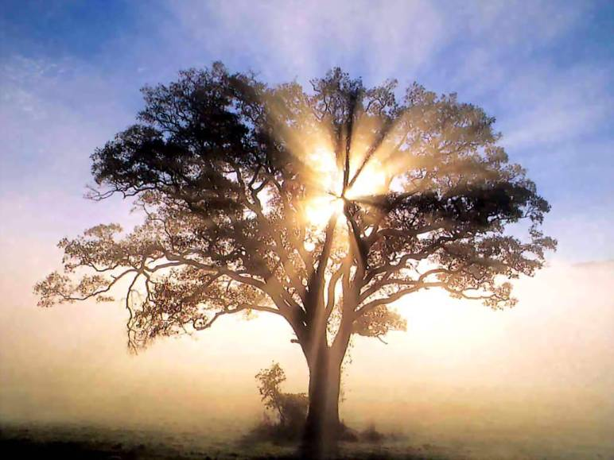
God’s Predestination
God’s plan for us.
Tree of ifle
Life everlasting
Bride of Christ
Better words for predestination
Determine
Appointed
Planned
Notes:
God’s Predestination is God’s plan for us. God has determine a wonderful outcome, but we have to choose. He has appointed everyone to choose the Tree of Life. To choose Life Everlasting and for the elect to be in the Bride of Christ. But we have to choose. Many times in scripture Will should be translated as plan or decide. I have an example of that for later.

Slide 10
Does God cause tragedy?
ME
Satan’s
will
Deception
FREE WILL FREE WILL FREE WILL FREE WILL FREE WILL FREE WILL
Blessings
Cursings
Acts 3:21 ..times of restoration..
1 Peter 5:8 ..Satan wants to destroy us…
Notes:
Does God cause tragedy?
Next we need to understand that Satan does exists and Satan has a Will. This is called Satan’s Will. When tragedy or horrific events occur is it easy to blame God. We ask the question why? Why did this happen. Why do bad things happen to good people? But 99% of time these tragedies are the result of Satan’s Will and our Free Will not God’s Will
But let’s look at the future. In the end God will restore all things
We find this fact in Acts 3:21. I will read Acts 3:21
²¹ whom heaven must receive until the times of restoration of all things, which God has spoken by the mouth of all His holy prophets since the world began.
So no matter what tragedy comes upon us it is only temporary from God’s perspective. All things we be restored. We will be healed of sickness. We will be raised from the dead. But as comforting as Act 3:21 is
Did or does God cause temporary tragedy? The simple answer is no.
To be complete God’s has harden the hearts of leaders, Pharaoh. God’s has killed humans and God has cause destruction.
But in these cases this was done for His (God’s) specific purpose. {Explain} In the future we know God’s wrath will be poured out on this earth to bring mankind to repentance.
What God does in the past and future that we may consider a tragedy will be restored by God.
On the other hand Satan wants to destroy us. Satan cannot wait to bring tragedy upon us. Satan will use deception and any means he is allowed to destroy us.
The good news is that Satan cannot directly bring tragedy upon us w/o God or us allowing it. We have this understanding from Job.
Most of the time God is holding Satan at bay.
All the tragedy in my life was caused either by me or I listening to Satan’s deception and allowing Satan to bring tragedy in my life.
1 Peter 5:8 Be sober, be vigilant; because your adversary the devil walks about like a roaring lion, seeking whom he may devour.

Slide 11
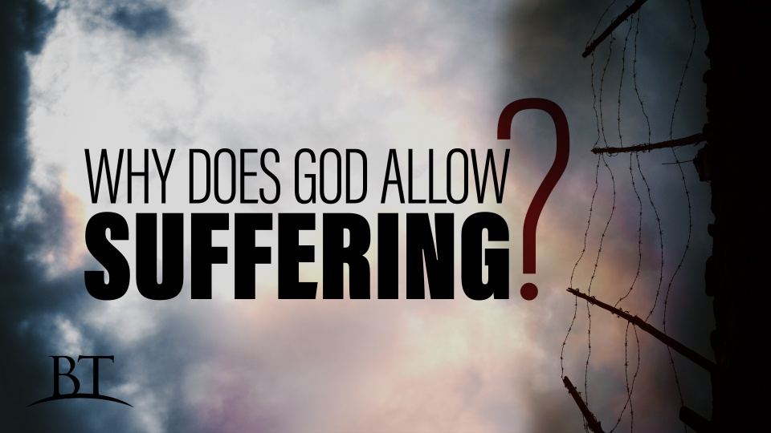
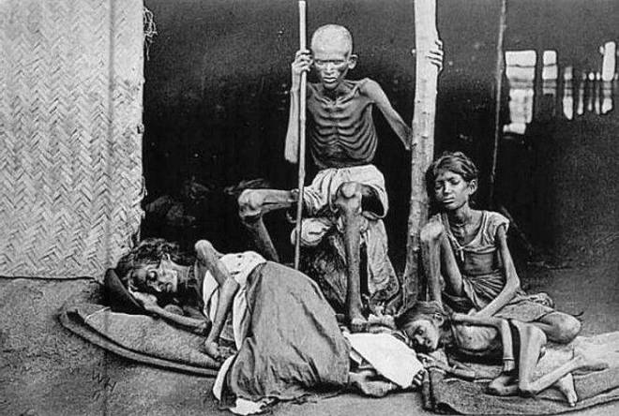
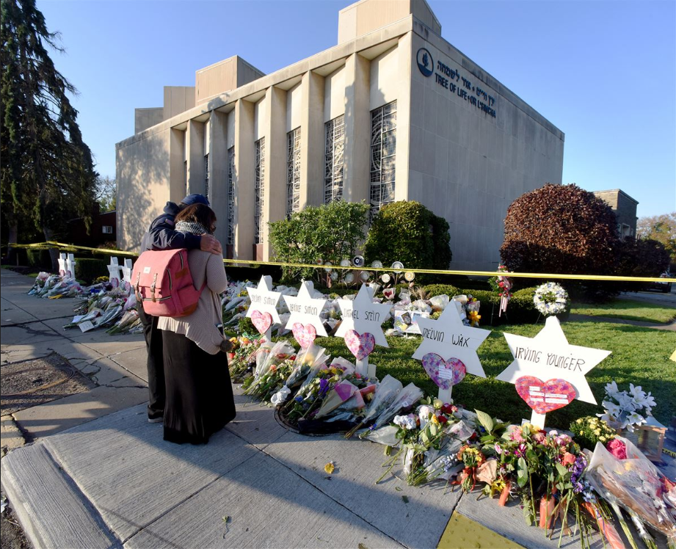
Why Does God Allow Suffering?
James 4:1-2
Suffering comes from our Free will
Notes:
Why does God Allow Suffering? There is a good Beyond Today program on this topic. {Talk} Tree of Life. Etc. James 4 has the answer
James 4:1-2 New King James Version (NKJV)
4 Where do ^{[a]}wars and fights come from among you? Do they not come from your desires for pleasure that war in your members? ² You lust and do not have. You murder and covet and cannot obtain. You fight and ^{[b]}war. ^{[c]}Yet you do not have because you do not ask.
For us to understand that consequences of our Free Will. Our deciding what is Good and Evil or Our choosing the follow Satan way. God must allow to see and experience our choices. We must understand the consequences of not choosing God. If God forced us to make good choices so there would be no more suffering we would be robots. W/O a will. God’s wants beings of Free Will in His family.

Slide 12
Is God in control or is Satan in control?
God’s
Will
ME
Prayer, Bible Study, Fasting
Satan’s
will
Deception
FREE WILL FREE WILL FREE WILL FREE WILL FREE WILL FREE WILL
Blessings
Cursings
Mat 19:26 …but with God all things are possible.”
Jam 4:7 …Resist the devil and he will flee from you.
Notes:
With God allowing Satan to bring all this tragedy and destruction one may ask the Question. Is God in control or is Satan in control? {CLICK} Clearly God is in control, but currently Satan is the “God of this world” All the tragedy that Satan is allowed to bring in only temporary to God. It is not what God wants. It is not His Will.
Matthew 19:26 New King James Version (NKJV)
²⁶ But Jesus looked at them and said to them, “With men this is impossible, but with God all things are possible.”
James 4:7
⁷ Therefore submit to God. Resist the devil and he will flee from you.
With all the suffering it is hard to understand that God has a plan. God will restore all things. God gives us tools to help our understanding. We need to use our Free Will to Pray, Study and/or Fast so that our confidence that God is in control is strengthened.
God’s Will or what God wants will ultimately prevail.

Slide 13
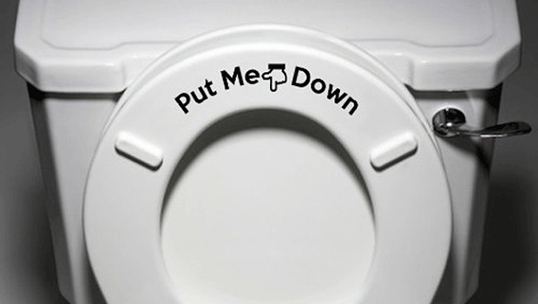
God’s predestination is God’s Plan
God is in control of His plan, but God is not controlling
Notes:
{Read}
God’s Will is not a predestination. God’s has a plan and it is God’s Will that we use our Free Will to choice God’s to be part of His Plan
God’s Will is not a predestination. God’s has a plan and it is God’s Will that we use our Free Will to choice God’s to be part of His Plan
God’s has a plan and God is in control of His plan, but God is not controlling
But God is not controlling us. We are not Robots. Sometimes I think it would be nice to be a Robot controlled by God. I would not make any mistakes. Nothing would be my fault. {Click}
When my wife say’s “You left the toilet seat up”. Not My Fault – I do not have Free Will.

Slide 14
Does God give blessings?
God’s
Will
Holy Spirit
ME
Prayer, Bible Study, Fasting
Satan’s
will
Deception
FREE WILL FREE WILL FREE WILL FREE WILL FREE WILL FREE WILL
Blessings
Cursings
Absolutely Yes!!!
Notes:
Does God want to give us blessings? Does God want us to overcome Satan.? {CLICK} Yes
One of God’s greatest blessings is the give us the Holy Spirit which helps us to choose God.
But God does not make us choose Him. We have to freely choose to obey him we have to choose blessings. Referring back to Deu 30.
God wants the best for us and God knows what is best for us. Unfortunately what we think is best for us is usually not best for us.
I need Chocolate – I need expensive French Chocolate. God I need to be in charge. If I was in charge all would be good. {Sarcasm}
We need to understand that we rarely know what God’s wants, but we must have confidence that God’s wants what is best for us in Hs Plan.
Also, many times we do not know how much God has blessed us. In the future when God restores all things we can learn how blessed we were.

Slide 15
Can God’s Will Change?
God’s
Will
Holy Spirit
ME
Prayer, Bible Study, Fasting
Satan’s
will
Deception
FREE WILL FREE WILL FREE WILL FREE WILL FREE WILL FREE WILL
Blessings
Cursings
2 Kings 20:1-6 …Hezekiah is healed…
Maybe, but it depends on us
Notes:
Can God’s Will Change? To ask the question differently, Can we change what God Wants? God will not change His plan, but there are examples of “Short term adjustments”.
Let’s read 2 Kings 20:1-6
2 Kings 20:1-6 New King James Version (NKJV)
Hezekiah’s Life Extended
20 In those days Hezekiah was sick and near death. And Isaiah the prophet, the son of Amoz, went to him and said to him, “Thus says the Lord: ‘Set your house in order, for you shall die, and not live.’ ”
² Then he turned his face toward the wall, and prayed to the Lord, saying, ³ “Remember now, O Lord, I pray, how I have walked before You in truth and with a loyal heart, and have done what was good in Your sight.” And Hezekiah wept bitterly.
⁴ And it happened, before Isaiah had gone out into the middle court, that the word of the Lord came to him, saying, ⁵ “Return and tell Hezekiah the leader of My people, ‘Thus says the Lord, the God of David your father: “I have heard your prayer, I have seen your tears; surely I will heal you. On the third day you shall go up to the house of the Lord. ⁶ And I will add to your days fifteen years…..
God was going to let Hezekiah died, but after Hezekiah beseeched God, God gave Hezekiah another 15 years.
God’s knows what is best for us and in the future God will restore all things. God’s would rather give us salvation than 15 additional years of life.
Over the past year or more several people we love deeply have died. Some un-expectantly , Was this God’s Will? Did God want them to die? The answer is we do not believe it was God’s Will that they die, but God Wants to give them a crown and salvation. God’s priorities are not our priorities. Could God have save their human life – Yes. But God’s priority is in the spiritual life to come. We can be given short term blessings, but God knows best.

Slide 16
Translations are problematic
Isaiah 53:10
(NIV) ¹⁰ Yet it was the Lord’s will to crush him and cause him to suffer,
(NKJV) ¹⁰ Yet it pleased the Lord to ^{[a]}bruise Him; He has put Him to grief.
(CEV) ¹⁰ The Lord decided his servant would suffer as a sacrifice to take away the sin and guilt of others.
(NLT) ¹⁰ But it was the Lord’s good plan to crush him and cause him grief. Yet when his life is made an offering for sin,
Notes:
Here is an example of how translations call God’ Plan or God Decision God’s Will
{Read do not tell answer}

Slide 17
Final Exam
Was it God’s will for Jesus Christ to die to pay the penalty for our sins?
Yes
No
I am so confused ☹
“No”
No Father wants His son to suffer a horrific death.
If there was another choice God would have:
“Taken the cup from His son”
Notes:
Final Exam time. Let’s see if we understand the definition of God’s Will
{CLICK} Was it God’s Will for Jesus Christ to die to pay the penalty for our sins?
{CLICK} Yes
{CLICK} No
{CLICK} I am so confused
{CLICK} “No”
{CLICK} No Father wants His son to suffer a horrific death.
If there was another choice God would have”
“Taken the cup from His son”

Slide 18
Translations are problematic
Isaiah 53:10
(NLT) ¹⁰ But it was the Lord’s good plan to crush him and cause him grief. Yet when his life is made an offering for sin,
Notes:
The better translation {Read}

Slide 19
Final Exam
God wants to give us salvation
Free will brings sin
Sin requires payment of death from Jesus Christ
God did not want Jesus Christ murdered but this was required for us
But God wanted the world to know this greatest of gifts (All the Prophesies)
God’s Will is What God Wants
Notes:
God Wants to give us Salvation
Free Will brings Sin
Sin requires payment of death from Jesus Christ
God did not want Jesus Christ murdered but this was required for us.
But God Wanted the world to know this greatest of gifts. (All the Prophesies)
God’s Will is What God Wants

Slide 20
Conclusion
God’s created a plan so that even God cannot have it all.
For God’s Plan to work as God’ wants his cannot always have His (God’s) Will.
For God’s Plan to work as God’ wants his cannot always have His (God’s) Will.
Notes:
Conclusion
{Read}

Slide 21
Conclusion
God’s will is what God wants
We do not always know what God Wants
Is God’s will a form of predestination?
God has a plan; Free will to choose God’s will
Does God cause tragedy?
+99% by free will yielding to Satan’s will
Is God in control or is Satan in control?
God is in control of His plan
But God is not controlling
Notes:
Conclusion
God’s Will is What God Wants – but We do not always know what God Wants and this can cause us to be confused unless we use the knowledge and wisdom God’s gives us.
Is God’s Will a form of predestination? – No God gave us Free Will so we could freely choose to follow God’s and what God wants or “God’s Will”
Does God cause tragedy? – Rarely, but to fulfill His plan God will cause perceived “tragedy” but over 99% of the worlds tragedy is caused by Satan’s and his Will. Satan is currently the god of this world
Is God in control or is Satan in control? - God is absolutely in control of His plan. His plan will ultimately prevail. But God is not controlling us like robots. We have Free Will to choose.

Slide 22
Conclusion
Does God give blessings?
- Yes but God’s knows what is best
Can God’s will change?
- Yes but it depends on us
Acts 3:21.
²¹ whom heaven must receive until the times of restoration of all things, which God has spoken by the mouth of all His holy prophets since the world began
Notes:
Does God give blessings? - Yes but God’s knows what is best. God’s knows what we need before we need it and God’s priorities are not our priorities.
Can God’s Will Change? - Yes but it depends on us. We can beseech God and ask, but we must except God’s answer.
God Wants us to be in his family. God Wants what is best for us.
No matter what happens in the life, in the future “It is God ‘s Will to restore all things”

Slide 23
Conclusion
God’s will - What God wants
God wants the best for us. i.e. salvation
Satan’s will - God allowed
To destroy us, god of this world
Bad choice for free will
Fee will – blessing/life cursing/death
Blames God for its “tragedy”
Free will came with a horrific cost
Notes:
God’s Will - What God wants.
God wants the best for us. i.e. Salvation
Satan’s Will - God Allows Tragedy
To destroy us, god of this world
Bad choice for Free Will
Fee Will – Blessing/Life Cursing/Death
Blames God for its “Tragedy”
Free Will came with a horrific cost

Slide 24

Conclusion
God’s will is wonderful toward us.
Psalm 40:5
…Cannot be recounted
Life Everlasting
God’s will is for us to have Life Everlasting
John 6:40 ...Believe in Jesus Christ…
Notes:
{Read} Psalm 40:5 New King James Version (NKJV)
⁵ Many, O Lord my God, are Your wonderful works Which You have done; And Your thoughts toward us Cannot be recounted to You in order; If I would declare and speak of them, They are more than can be numbered.
John 6:40 New King James Version (NKJV)
⁴⁰ And this is the will of Him who sent Me, that everyone who sees the Son and believes in Him may have everlasting life; and I will raise him up at the last day.”
God will is for us to have Life Everlasting.

