Slide 1
How Dark is Your Light 2.0
(Part II)
What is the Composition
of Your Light?

Slide 2
If Darkness is the Absence of Light
It Begs the Question
What Color is Light?
Stated Another Way
What is the Composition of Light?

Slide 3
In 1672 Sir Isaac Newton Discovered
That “White Light” Was Composed
Of Different Colors

Slide 4
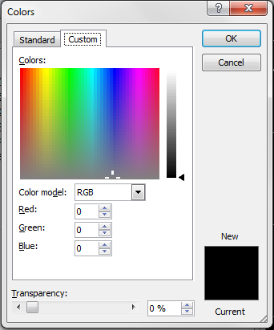
Black

Slide 5
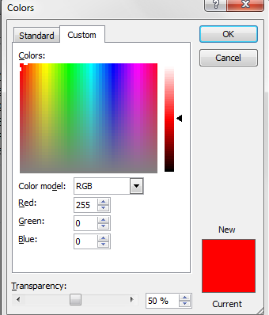
Red

Slide 6
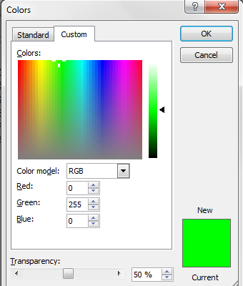
Green

Slide 7
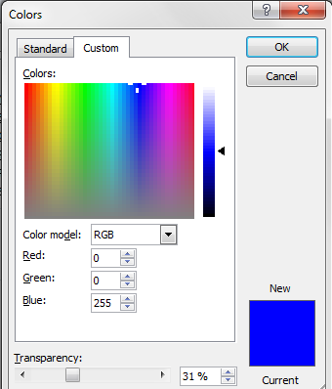
Blue

Slide 8
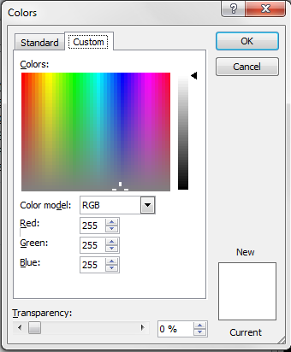
Light

Slide 9
Stop
Justice
[Matthew 23:23 NKJV]
"Woe to you, scribes and Pharisees, hypocrites! For you pay tithe of mint and anise and cummin, and have neglected the weightier [matters] of the law: justice and mercy and faith. These you ought to have done, without leaving the others undone.
Go
Mercy
Trust
Faith

Slide 10
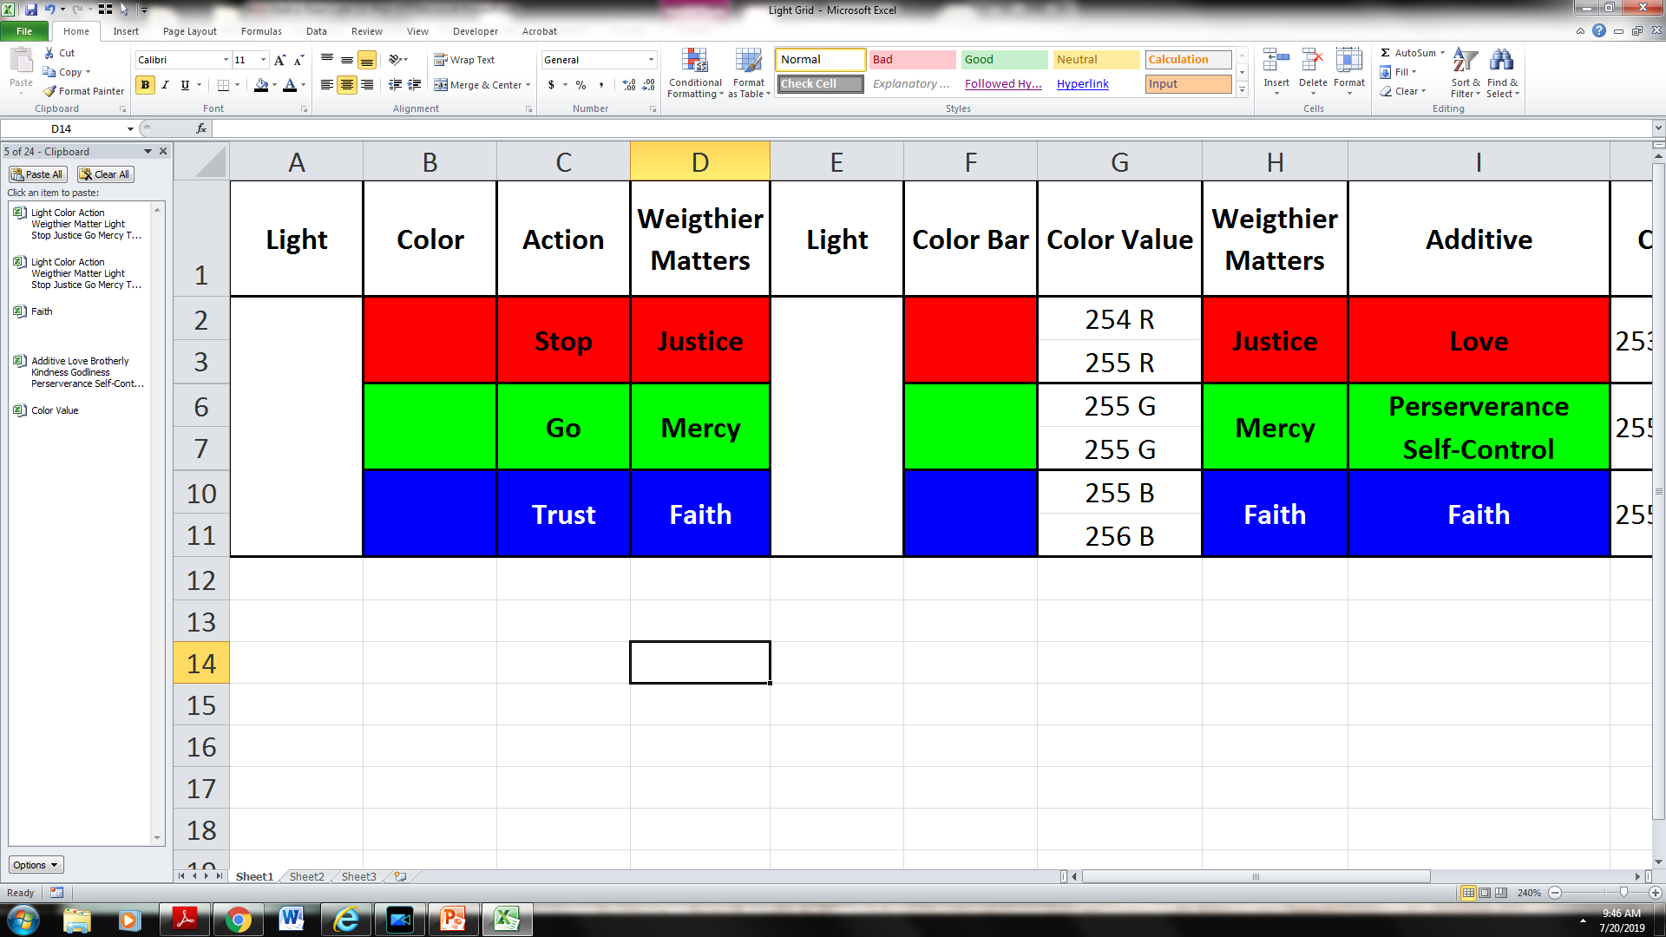

Slide 14
[Matthew 23:23 NKJV]
"Woe to you, scribes and Pharisees, hypocrites! For you pay tithe of mint and anise and cummin, and have neglected the weightier [matters] of the law: justice and mercy and faith. These you ought to have done, without leaving the others undone.

Slide 15
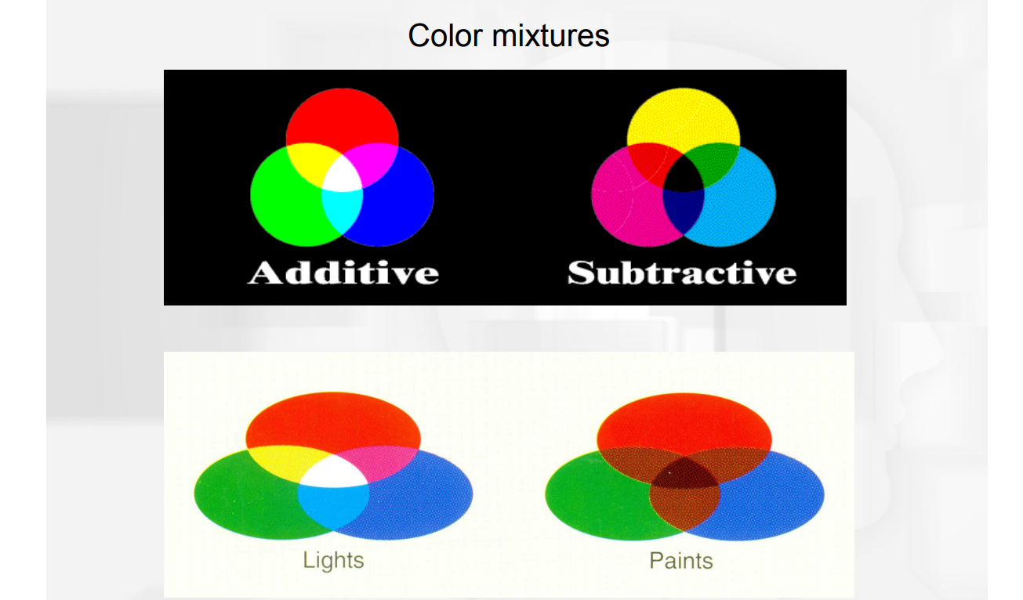

Slide 16
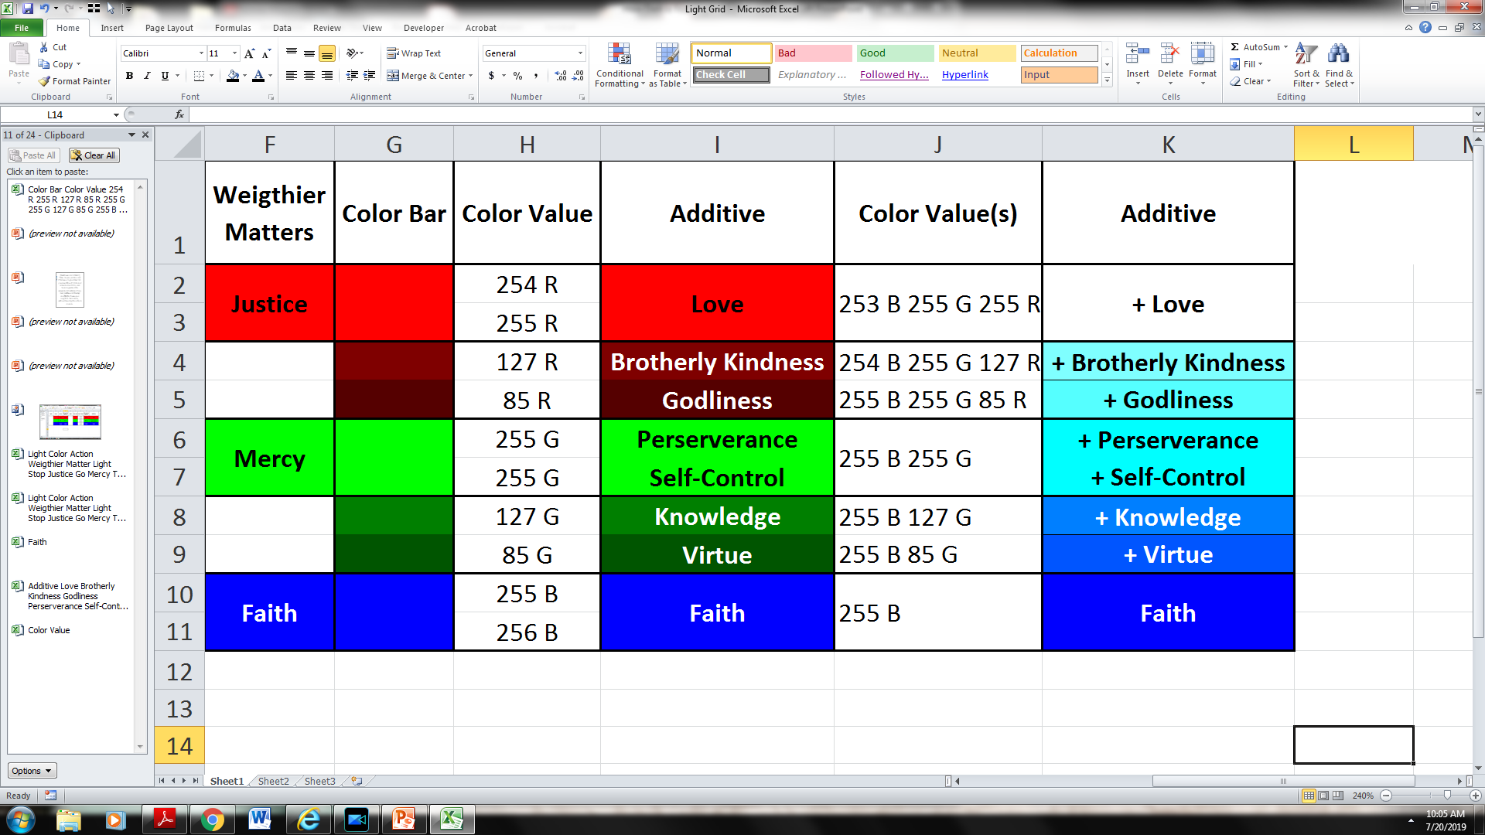

Slide 18
[2 Peter 1:5-7 NKJV]
But also for this very reason, giving all diligence,
1) add to your faith virtue,
2) to virtue knowledge,
3) to knowledge self-control,
4) to self-control perseverance,
5) to perseverance godliness,
6) to godliness brotherly kindness,
7)and to brotherly kindness love.

Slide 19
[2 Peter 1:5-7 NKJV]
But also for this very reason, giving all diligence,
1) add to your faith virtue,

Slide 20
[2 Peter 1:5-7 NKJV]
But also for this very reason, giving all diligence,
1) add to your faith virtue,

Slide 21
[2 Peter 1:5-7 NKJV]
But also for this very reason, giving all diligence,
2) to virtue knowledge,

Slide 22
[2 Peter 1:5-7 NKJV]
But also for this very reason, giving all diligence,
3) to knowledge self-control,
1.79

Slide 23
[2 Peter 1:5-7 NKJV]
But also for this very reason, giving all diligence,
4) to self-control perseverance,

Slide 24
[2 Peter 1:5-7 NKJV]
But also for this very reason, giving all diligence,
5) to perseverance godliness,

Slide 25
[2 Peter 1:5-7 NKJV]
But also for this very reason, giving all diligence,
6) to godliness brotherly kindness,

Slide 26
[2 Peter 1:5-7 NKJV]
But also for this very reason, giving all diligence,
7)and to brotherly kindness love.
[1 John 5:3]
For this is the love of God, that we keep His commandments. And His commandments are not burdensome.

Slide 28
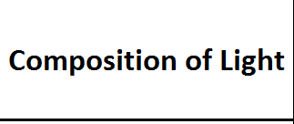

Slide 36
Go
Mercy without Justice
Trust
Faith

Slide 37
Stop
Justice Without Mercy
Trust
Faith

Slide 38
Stop
Justice Without Faith
Go
Mercy

Slide 39
Stop
Justice
[Matthew 23:23 NKJV]
"Woe to you, scribes and Pharisees, hypocrites! For you pay tithe of mint and anise and cummin, and have neglected the weightier [matters] of the law: justice and mercy and faith. These you ought to have done, without leaving the others undone.
Go
Mercy
Trust
Faith

Slide 40
Mat 5:14, 16 NKJV
"You are the light of the world. A city that is set on a hill cannot be hidden… Let your light so shine before men, that they may see your good works and glorify your Father in heaven.”

Slide 41
Mat 6:22 NKJV
"The lamp of the body is the eye. If therefore your eye is good, your whole body will be full of light.

Slide 42
Matthew 6:23 NKJV
But if your eye is bad, your whole body will be full of darkness. If therefore the light that is in you is darkness, how great [is] that darkness!

Slide 43
Mat 6:22 NKJV
"The lamp of the body is the eye. If therefore your eye is good, your whole body will be full of light.

Slide 44
Genesis 1:3
Then God said,
"Let there be light"; and there was light.
Rev 22:5 NKJV
There shall be no night there: They need no lamp nor light of the sun, for the Lord God gives them light.

