Slide 1
How The Holy Spirit Works

Slide 2


Slide 3

Proverbs 20:27

Slide 4

How Does God Convert The Mind?

Slide 5

Bible Speaks of Three Spirits
Holy Spirit
1 Cor. 2:11
Spirit in man
1 Cor. 2:11

Slide 6
Bible Speaks of Three Spirits
The Holy Spirit
1 Cor. 2:11;
Spirit in man
1 Cor. 2:11
spirit of the god of this world

Slide 7
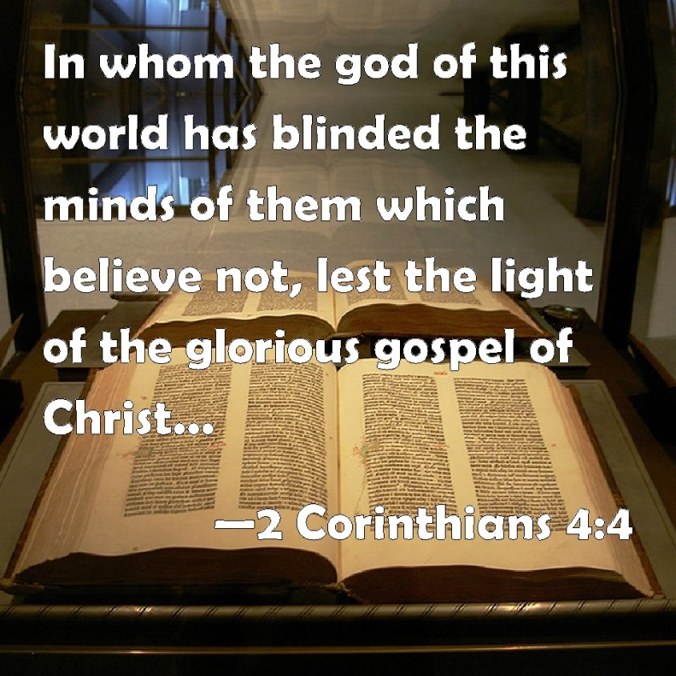
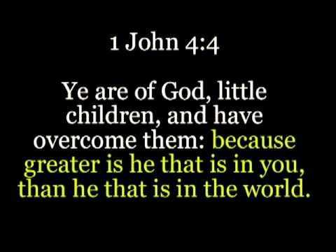
…he that is in you?

Slide 8
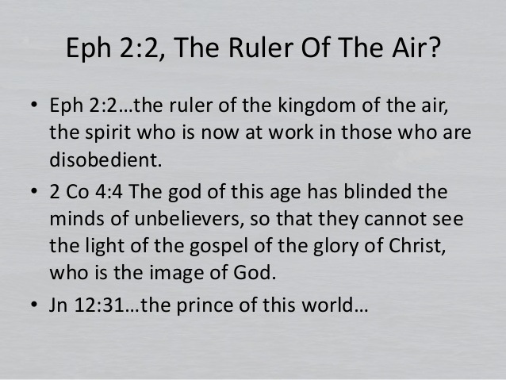
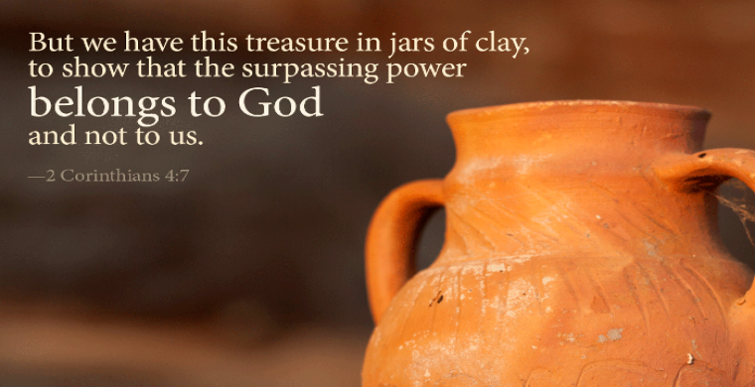
…he that is in you?

Slide 9
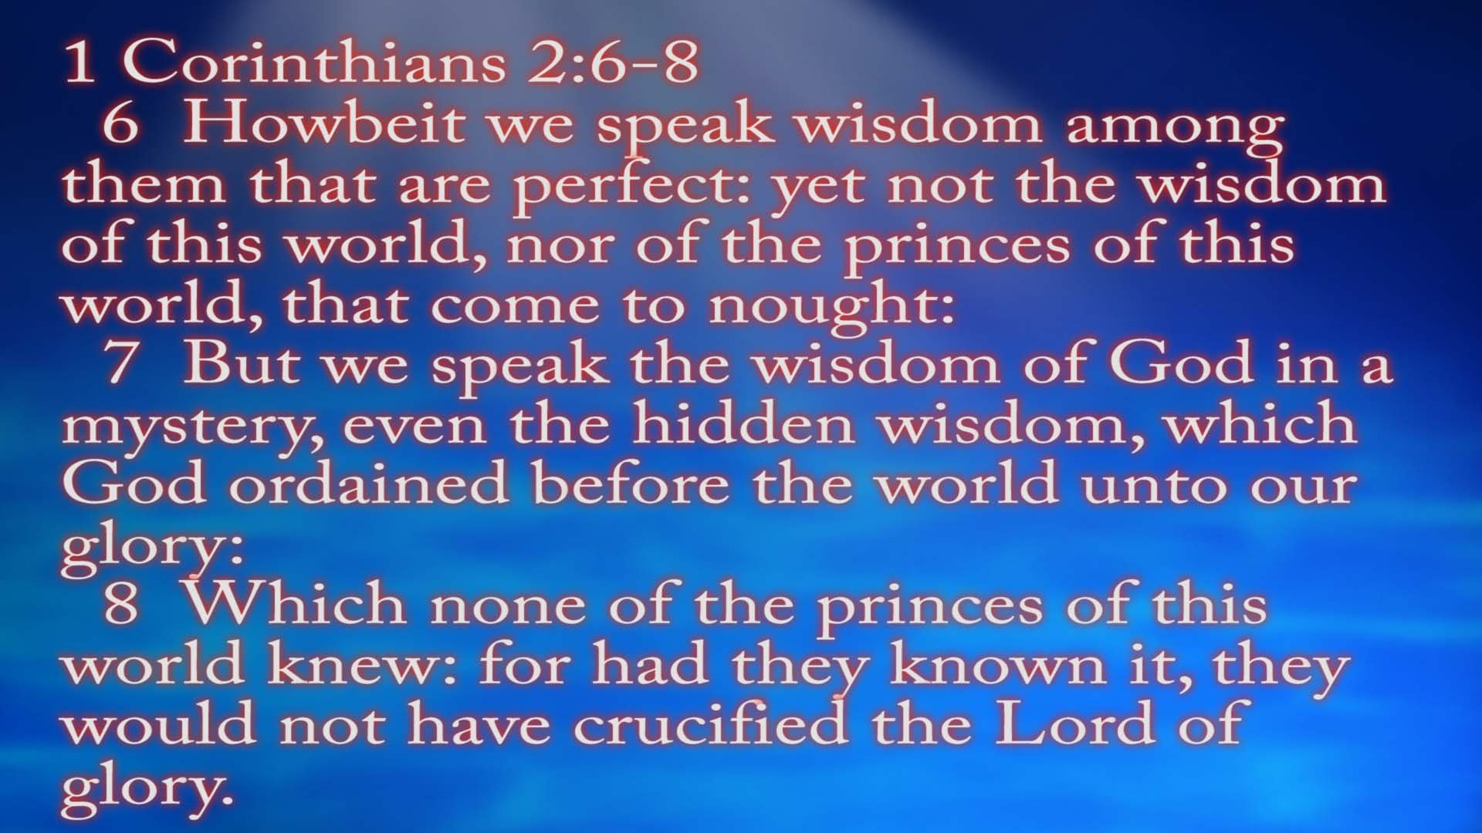

Slide 10


Slide 11
1 Corinthians 2:10 ERV
“But God has shown us these things through the Spirit. The Spirit knows all things. The Spirit even knows the deep secrets of God.

Slide 12
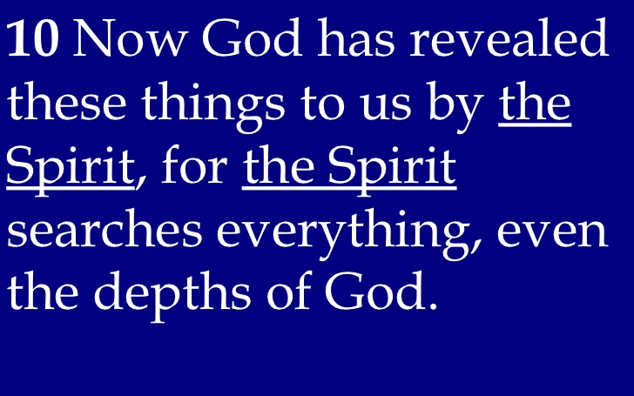

1 Corinthians 2:10 ESV

Slide 13
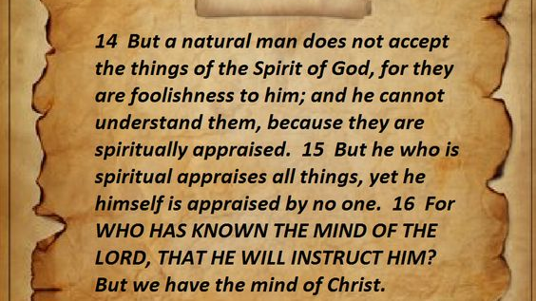
1 Corinthians 2:14-16

Slide 14


Unconverted Have Two Spirits

Slide 15

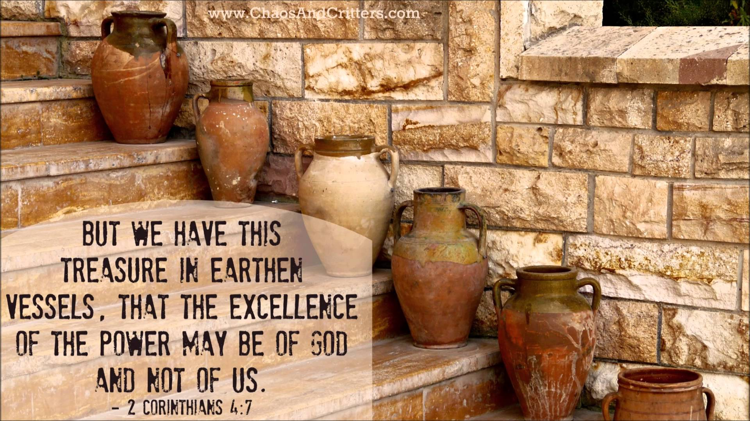
Converted Have two +/- Spirits
James 1:5-8

Slide 16
...These Things I Speak…
Matt. 15:3, 8-9
John 15:10
John 8:29
Luke 2:46-47
John 3:34; 7:15

Slide 17
“{He} Who sent me is true, and what I have heard from Him, these things I speak to the world… I do nothing of Myself. But as the Father taught Me, these things I speak” (John 8:26,28)

Slide 18

ASV

