Slide 1
Humanity
The Good, The Bad and The Best
Slide 1 of 1,356
☺
Notes:
Greetings. The message today will be an overview of the United Church of God’s Fundamental belief on Humanity. I encourage everyone to periodically read the Fundamental Beliefs.
{Click} We will cover Humanity {Read Slide} Somewhere in my past I read or heard a statistic that ½ of everyone that ever lived is alive today. I think that statistic is post-flood but I actually don’t know.
{Click} For those of you that are alive at beginning of the message let’s hope you are still alive at the end of the message. {Click} {Wait}

Slide 2
Humanity
UCG Fundamental Beliefs
Summary Statement
(Genesis 1:26; 2 Peter 1:4; Hebrews 9:27; 1 Corinthians 15:22; Romans 5:12; 6:23).
Notes:
Turn to 2 Peter 1
Let’s first read the {Read Slide} - We believe that humanity was created in the image of God with the potential to become children of God, partakers of the divine nature. God formed humanity of flesh, which is material substance. Human beings live by the breath of life, are mortal, subject to corruption and decay, without eternal life, except as the gift of God under God’s terms and conditions as expressed in the Bible. We believe that God placed before Adam and Eve the choice of eternal life through obedience to God or death through sin. Adam and Eve yielded to temptation and disobeyed God. As a result, sin entered the world and, through sin, death. Death now reigns over all humanity because all have sinned
2 Peter 1:4 New King James Version (NKJV)
⁴ by which have been given to us exceedingly great and precious promises, that through these you may be partakers of the divine nature, having escaped the ^{[a]}corruption that is in the world through lust.
Hebrews 9:27 New King James Version (NKJV)
²⁷ And as it is appointed for men to die once, but after this the judgment,
Romans 5:12 New King James Version (NKJV)
Death in Adam, Life in Christ
¹² Therefore, just as through one man sin entered the world, and death through sin, and thus death spread to all men, because all sinned—

Slide 3
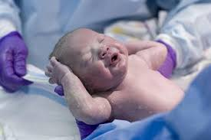
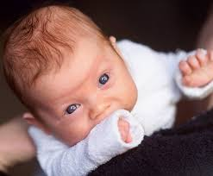
Humanity
Humanity’s awesome potential
“Why were you conceived?”
Notes:
Today we are going to explain Humanity’s awesome potential or to use some updated Church speak {Click}“Why were you conceived”

Slide 4
Areas to Review
God’s human creation physical and spirit
God’s plan(s) for humanity
Crimes against humanity
Our role in humanity
Notes:
We will review theses areas:
{Click} God’s Human Creation Physical and Spirit – The details of what and how leading to why.
{Click} God’s Plan(s) for Humanity – I say plans because there are 3 out comes or potential for humans
{Click} Crimes Against Humanity – I am borrowing a 20th century term, but we need to understand who and what is against humanity
{Click} Our Role in Humanity – What part does God want us to fulfill as it pertains to humanity?
Turn to Gen 1

Slide 5
God’s Human Creation Physical and Spirit
Notes:
The first area to review is
God’s Human Creation Physical and Spirit

Slide 6
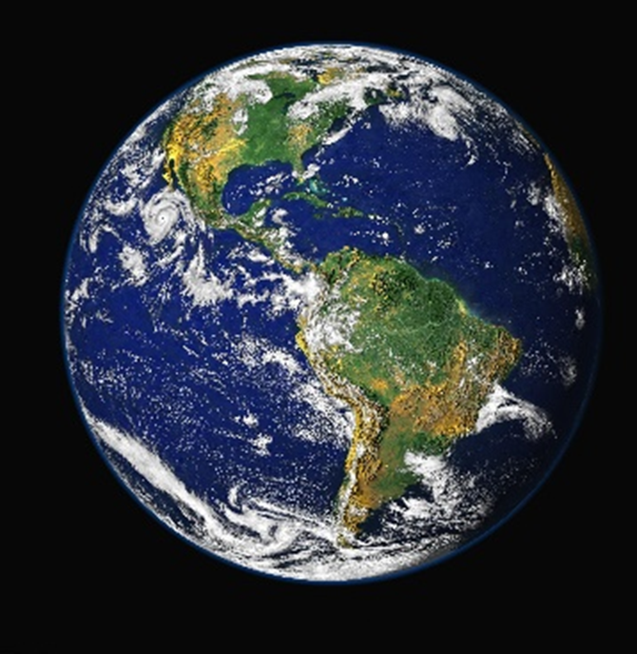
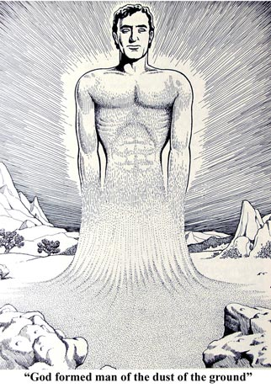
Human Creation Physical and Spirit
Gen
1:25-27
God prepared earth for humanity in 6 days
God created man and woman in His likeness/image
Notes:
Turn to Gen 1.
{Click} God created the earth and then something happened and earth had to be recreated or prepared for human habitation. It took 6 days to prepare the earth for humanity.
{Click} Then God created man from the ground and then God created woman from man.
Let’s read Gen 1:25-27
Genesis 1:25-27 (NKJV)
²⁵ And God made the beast of the earth according to its kind, cattle according to its kind, and everything that creeps on the earth according to its kind. And God saw that it was good.
²⁶ Then God said, “Let Us make man in Our image, according to Our likeness; let them have dominion over the fish of the sea, over the birds of the air, and over the cattle, over all the earth and over every creeping thing that creeps on the earth.” ²⁷ So God created man in His own image; in the image of God He created him; male and female He created them.

Slide 7
Human Creation Physical and Spirit
Vegetation is to reproduce according to its kind
Animals are to reproduce according its kind
Man and woman are to reproduce according to their kind (Gen 5:1-3)
God created humanity because He is reproducing His kind
Notes:
Turn to Gen 5
{Click} {Read Slide}
{Click} {Read Slide}
{Click} {Read Slide}
Genesis 5:1-3 (NKJV)
5 This is the book of the genealogy of Adam. In the day that God created man, He made him in the likeness of God. ² He created them male and female, and blessed them and called them mankind in the day they were created. ³ And Adam lived one hundred and thirty years, and begot a son in his own likeness, after his image, and named him Seth.
{Click} {Read Slide}

Slide 8

Human Creation Physical and Spirit
Spirit in man Type of power from God
Job 32:8
Think / reason
Feelings
Learn / design
Free will
Much lower than God
Inferior to God
Humanity is MORTAL 1 Cor 15:22
Notes:
Turn to Job 32:8
{Click}
God created humanity physical - flesh and blood, but God also gave us a spirit or a power.
{Read Slide} We find this Job 32:8
But there is a spirit in man
And the breath of the Almighty gives him understanding.
For your notes this is also found in
This is also called the human spirit
{Click} With this spirit this power we receive the ability {Read Slide}
Turn to 1 Cor 15
{Click} But even with this power we are {Read Slide}
1 Corinthians 15:22 New King James Version (NKJV)
²² For as in Adam all die, even so in Christ all shall be made alive.

Slide 9
Human Creation Physical and Spirit
The combination of physical flesh and blood plus the spirit in man makes a:
Being (living), living being
Nephesh (Hebrew) Strong's H5315
Soul, self, life, creature, person, appetite, mind, desire, emotion
Ezekiel 18:20, Rom 6:23
This Nephesh or Soul can die
We are NOT IMMORTAL
Notes:
Turn to Ezekiel 18
{Click} {Read Slide}
{Click} {Read Slide}
{Click} {Read Slide}
{Click} {Read Slide}
{Click} {Read Slide}
Ezekiel 18:20 (NKJV)
²⁰ The soul who sins shall die. {Read Slide}
Turn to
Romans 6:23 New King James Version (NKJV)
²³ For the wages of sin is death, but the ^{[a]}gift of God is eternal life in Christ Jesus our Lord.

Slide 10
Human Creation Physical and Spirit
How are we made in God’s Image
Form resembles God
Think/Reason/Learn
Feelings
Psalm 8:3-8
Not in God’s Image
Character – God is perfect
God has unlimited power
Spirit immortal – Physical die
Notes:
Psalm 8:3-8
How are we made in God’s Image
{Click} {Read Slide}
{Click} {Read Slide}
{Click} {Read Slide}
Psalm 8:3-8 New King James Version (NKJV) ³ When I consider Your heavens, the work of Your fingers, The moon and the stars, which You have ordained, ⁴ What is man that You are mindful of him, And the son of man that You visit^{[a]} him? ⁵ For You have made him a little lower than ^{[b]}the angels, And You have crowned him with glory and honor. ⁶ You have made him to have dominion over the works of Your hands; You have put all things under his feet, ⁷ All sheep and oxen—
Even the beasts of the field, ⁸ The birds of the air, And the fish of the sea That pass through the paths of the seas.
How are we inferior to God
{Click} {Read Slide}
{Click} {Read Slide}
{Click} {Read Slide}

Slide 11

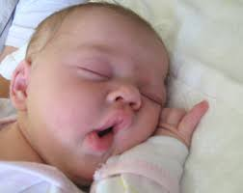

Human Creation Physical and Spirit
Death
Like sleep John 11:11-14
No consciousness Ecc 9:10
Physically decay Gen 3:19
Mankind’s spirit returns to God
Eccles 12:7
Notes:
Turn to John 11
{Click}
Humanity does die. Death is described as
{Read Slide}
John 11:11-14 (NKJV) ¹¹ These things He said, and after that He said to them, “Our friend Lazarus sleeps, but I go that I may wake him up.” ¹² Then His disciples said, “Lord, if he sleeps he will get well.” ¹³ However, Jesus spoke of his death, but they thought that He was speaking about taking rest in sleep.¹⁴ Then Jesus said to them plainly, “Lazarus is dead.
{Click} {Read Slide}
Ecclesiastes 9:10 New King James Version (NKJV)
¹⁰ Whatever your hand finds to do, do it with your might; for there is no work or device or knowledge or wisdom in the grave where you are going.
{Click} {Read Slide}
Genesis 3:19 New King James Version (NKJV)
¹⁹ In the sweat of your face you shall eat bread Till you return to the ground, For out of it you were taken; For dust you are, And to dust you shall return.”
{Click} {Read Slide}
Ecclesiastes 12:7 Then the dust will return to the earth as it was,
And the spirit will return to God who gave it.

Slide 12
God’s Plan(s) for Humanity
Notes:
We just learned about God’s Human creation and that humanity is appointed to die.
Humanity is not immortal. So that leads to the question why?
Why did God create humanity or humans?
Let’s cover the second area to review.
God’s Plan for Humanity

Slide 13
God’s Plan(s) for Humanity
Remember God is reproducing His kind
When does the plan of God begin for a human? A.K.A. LIFE.
Conception?
Breath of life?
Brain activity?
Mother can feel the baby?
20 weeks – Legal term
Notes:
As we learned in the previous slides God is reproducing His kind.
God has a plan for humanity.
So to start at the beginning
{Click} {Read Slide}
The term “Life” has been confused by Humanity. I prefer the use, “When does the plan of God begin for a human?” So does life begin at:
{Click} {Read Slide}
{Click} {Read Slide}
{Click} {Read Slide}
{Click} {Read Slide}
{Click} {Read Slide}

Slide 14
God’s Plan(s) for Humanity
When does the plan of God begin?
Judges 13:5 conceive from the womb
Job 31:15 God makes man in the womb
Luke 1:31-35 Jesus conceived in a womb
Lev 17:11,14 Life in is the blood
Exo 21:22-23 The unborn is life
Parallel:
Spiritually begotten =
Physical pregnancy to birth
Notes:
Turn to Judges 13 {Wait} {Explain}
{Click} {Read Slide} Judges 13:5 (NKJV) ⁵ For behold, you shall conceive and bear a son. And no razor shall come upon his head, for the child shall be a Nazirite to God from the womb;
Turn to Judges 13 {Wait} {Explain}
{Click} {Read Slide} Job 31:15 (NKJV) ¹⁵ Did not He who made me in the womb make them? Did not the same One fashion us in the womb?
Turn to Luke 1 {Wait} {Explain}
{Click} {Read Slide} Luke 1:31-35 "(NKJV) And behold, you will conceive in your womb and bear a son, and you shall name Him Jesus.
Turn to Lev 17 {Wait} {Explain}
{Click} {Read Slide} Leviticus 17:11 (NIV) 11 For the life of a creature is in the blood
14 because the life of every creature is its blood.
Turn to Exo 21 {Wait} {Explain}
{Click} {Read Slide} Exodus 21:22-23 (NIV) ²² “If people are fighting and hit a pregnant woman and she gives birth prematurely but there is no serious injury, the offender must be fined whatever the woman’s husband demands and the court allows. ²³ But if there is serious injury, you are to take life for life,
{Click} {Read Slide} Mr. Herbert W. Armstrong taught that there was a parallel between Spiritually begotten and Physical pregnancy to birth.

Slide 15
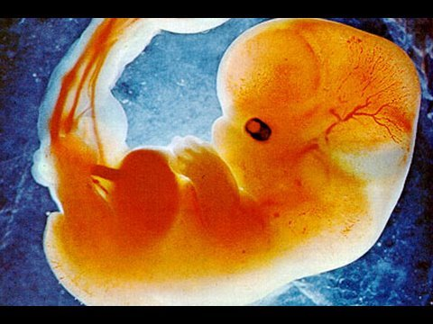
God’s Plan(s) for Humanity
Biblical definition of Conception is:
    Conceive (fertilized egg)
    In the womb
    With blood (Life)
Fetus (Baby) 3-4 Weeks in the womb
Notes:
{Click} {Read Slide}
{Click} {Read Slide}
{Click} {Read Slide}

Slide 16
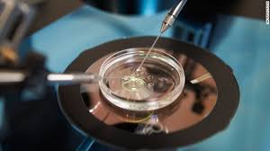
God’s Plan(s) for Humanity
When does the
plan of God begin?
Beyond Today – The Abortion Quagmire
If life begins at conception and gestation is the method by which God begins the process of creating…
My Conclusion: Conception in the womb
Notes:
Technology has made tremendous advances. When many of the church papers were written the concept that fertilization could occur outside the mother womb did not exists. I encourage everyone to do your own personal study. In looking on the ucg.org website this is what I found.
{Click} {Read} {Slide}
It is my personal conclusion from my own bible study that the plan of God begins at conception in the womb with blood.

Slide 17
God’s Plan(s) for Humanity
**Begins at conception in the womb**
All abortions are murder
Majority of miscarriages are life and are part of God’s plan(s) Acts 3:21
Medical advances to have children may be acceptable
** My personal conclusion please do your own Bible study Phil 2:12
Notes:
So if the plan of God begins at conception in the womb, what are some take aways?
{Click} {Read} {Slide}
{Click} {Read} {Slide}
For seven years Suzette and I could not have any children. During that trial we had 4 or 5 miscarriages. I believe, God willing after we reign with our Lord and Savior Jesus Christ for 1000 years. Suzette and I will become parents again with 4 or 5 babies. I wonder if I can change a diaper better when I am spirit??
{Click} {Read} {Slide}
It is very heart breaking to be barren and for anyone who has or is going through that my prayers are with you. From my personal bible study I have concluded that there is a Godly approach to the medical advances we have today. But again this is from my own bible study and encourage you to do your own study and make your own personal choice.

Slide 18
God’s Plan(s) for Humanity
What is the end of God Plan(s) for humanity?
Reign a 1000 years with His Majesty Jesus Christ as His bride ?
Eternal life in the family of God?
Destroyed in a lake of fire forever?
A & B
Notes:
{Read} {Slide}
{Click} {Read} {Slide}
{Click} {Read} {Slide}
{Click} {Read} {Slide}
Or the one I prefer
{Click} {Read} {Slide} Of course if you receive A you get B.

Slide 19
God’s Plan(s) for Humanity
Resurrection(s)
Three resurrections Dan 12:1-3, Rev 20:4-15
It was revealed the resurrections are sequential 1st 2nd and 3rd John 5:29
Eternal life in the family of God is also called salvation
Bride / Ruling with Jesus Christ Heb 11:35
Notes:
Turn to Dan 12
{Read} {Slide} The bible calls the End(s) of God’s Plan “Resurrection(s)”
When we are resurrected from the dead we are given a body and our conscious is returned to us. Some of Humanity will raise to a spiritual body and some to a physical body.
{Click} {Read} {Slide}
Daniel 12:1-3 (NKJV) 12 “At that time Michael shall stand up, The great prince who stands watch over the sons of your people; And there shall be a time of trouble, such as never was since there was a nation, even to that time. And at that time your people shall be delivered, every one who is found written in the book. ² And many of those who sleep in the dust of the earth shall awake, Some to everlasting life, some to shame and everlasting contempt. ³ Those who are wise shall shine like the brightness of the firmament, And those who turn many to righteousness Like the stars forever and ever.
Turn to Rev 20:4-5
Revelation 20:4-15 New King James Version (NKJV)
The Saints Reign with Christ 1,000 Years
⁴ And I saw thrones, and they sat on them, and judgment was committed to them. Then I saw the souls of those who had been beheaded for their witness to Jesus and for the word of God, who had not worshiped the beast or his image, and had not received his mark on their foreheads or on their hands. And they lived and reigned with Christ for ^{[a]}a thousand years. ⁵ But the rest of the dead did not live again until the thousand years were finished. This is the first resurrection. ⁶ Blessed and holy is he who has part in the first resurrection. Over such the second death has no power, but they shall be priests of God and of Christ, and shall reign with Him a thousand years.
Satanic Rebellion Crushed
⁷ Now when the thousand years have expired, Satan will be released from his prison ⁸ and will go out to deceive the nations which are in the four corners of the earth, Gog and Magog, to gather them together to battle, whose number is as the sand of the sea. ⁹ They went up on the breadth of the earth and surrounded the camp of the saints and the beloved city. And fire came down from God out of heaven and devoured them. ¹⁰ The devil, who deceived them, was cast into the lake of fire and brimstone where^{[b]} the beast and the false prophet are. And they will be tormented day and night forever and ever.
The Great White Throne Judgment
¹¹ Then I saw a great white throne and Him who sat on it, from whose face the earth and the heaven fled away. And there was found no place for them. ¹² And I saw the dead, small and great, standing before ^{[c]}God, and books were opened. And another book was opened, which is the Book of Life. And the dead were judged according to their works, by the things which were written in the books. ¹³ The sea gave up the dead who were in it, and Death and Hades delivered up the dead who were in them. And they were judged, each one according to his works. ¹⁴ Then Death and Hades were cast into the lake of fire. This is the second ^{[d]}death. ¹⁵ And anyone not found written in the Book of Life was cast into the lake of fire.
{Click} {Read} {Slide}
There are 3 resurrections as the final plan(s) for Humanity. Scripture is very clear that the 2nd and 3rd resurrections follows the 1st resurrection.
The bible does not use the term “2nd Resurrection” It is called the Resurrection of the Dead or Resurrection to Judgement. This is the resurrection of those that have not known God or were not called. They will be given the chance to learn and qualify to receive salvation. The dead will be resurrected to a physical body and have their conscious returned. There are no specific biblical details on the age of the physical body. In Ezekiel 37:1-14 dry bones came back to life and the multitude was great.
Turn to John 5
The Bible also does not use the term “3rd Resurrection” but called this the “Resurrection of Condemnation” The reason we believe in 3 sequential resurrections is “3” is God’s number of finality. The is the resurrection to the lake of fire and brimstone.
John 5:29 New King James Version (NKJV)
²⁹ and come forth—those who have done good, to the resurrection of life, and those who have done evil, to the resurrection of condemnation.
{Click} {Read} {Slide}
{Click} {Read} {Slide}
Turn to Heb 11:35 {Wait}
In the 1st resurrection we are resurrected or changed to spiritual body.
Hebrews 11:35 New King James Version (NKJV) ³⁵ Women received their dead raised to life again.
Others were tortured, not accepting deliverance, that they might obtain a better resurrection.
Heb 11:35 says the 1st resurrection is the better resurrection. In the first resurrection if we qualify we can be part of the bride of Christ and rule with our Majesty Lord and Savior Jesus Christ.

Slide 20
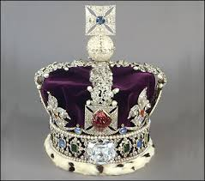
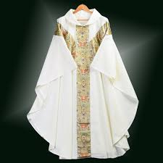
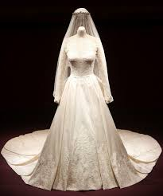
God’s Plan(s) for Humanity
How do we qualify to be the bride of Christ and receive salvation?
Holy spirit - Romans 8:11-16
Notes:
Turn to Rom 8
{Read} {Slide}
{Click} {Read} {Slide}
As initially formed, human beings are incomplete creations. God wants to share with them His very nature and enable them to become His literal spiritual children. This is only possible by His Holy Spirit joining with each person’s human spirit. This gives higher, Godly understanding and imparts God’s character of love It is through the Holy Spirit that God will transform us into beings who will, when resurrected or changed at Christ’s return, live with Him forever.
Romans 8:11-16 Contemporary English Version (CEV)
¹¹ Yet God raised Jesus to life! God’s Spirit now lives in you, and he will raise you to life by his Spirit.
¹² My dear friends, we must not live to satisfy our desires. ¹³ If you do, you will die. But you will live, if by the help of God’s Spirit you say “No” to your desires. ¹⁴ Only those people who are led by God’s Spirit are his children. ¹⁵ God’s Spirit doesn’t make us slaves who are afraid of him. Instead, we become his children and call him our Father. ¹⁶ God’s Spirit makes us sure that we are his children

Slide 21
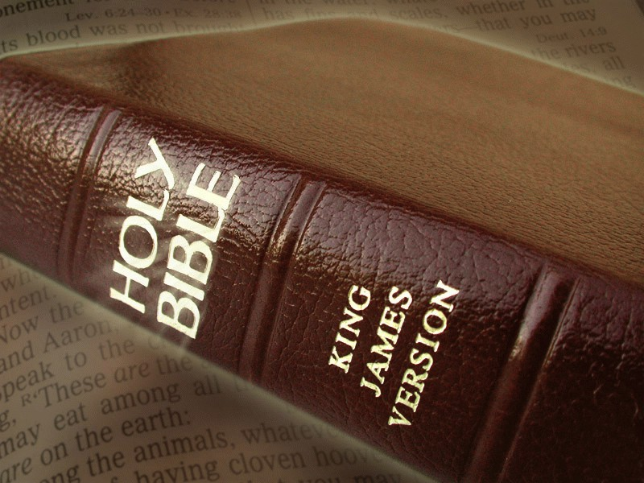
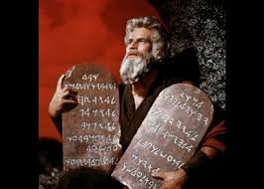
God’s Plan(s) for Humanity
Keep the commandments – obey God (I Cor 6:9-10, Rev 22:14)
Grow in grace and knowledge of our Lord and Savior Jesus Christ (2 Peter 3:18)
Notes:
Turn to 2 Peter 3
How do we qualify to be in the Bride of Christ and receive Salvation?
{Click} {Read} {Slide}
We must obey God’s Law. Keep the commandments.
How many remember Charlton Heston carrying the 10 Commandments.
I could be wrong but it my understanding that when Moses is resurrected he wants to look like Mr. Heston.
1 Corinthians 6:9-10 (NKJV) ⁹ Do you not know that the unrighteous will not inherit the kingdom of God? Do not be deceived. Neither fornicators, nor idolaters, nor adulterers, nor homosexuals, nor sodomites, ¹⁰ nor thieves, nor covetous, nor drunkards, nor revilers, nor extortioners will inherit the kingdom of God.
Revelation 22:14 (NKJV)
¹⁴ Blessed are those who do His commandments, that they may have the right to the tree of life, and may enter through the gates into the city.
{Click} {Read} {Slide}
2 Peter 3:18 New King James Version (NKJV)
¹⁸ but grow in the grace and knowledge of our Lord and Savior Jesus Christ.
To Him be the glory both now and forever. Amen.

Slide 22
God’s Plan(s) for Humanity
A small part of Humanity has been invited and will be chosen to qualify to receive Salvation and rule with our Majesty Lord and Savior Jesus Christ.
This is 1st Resurrection or Plan A & B
This group will be Resurrected or changed to Spirit
Notes:
{Read} {Slide}
{Click}
A- Reign a 1000 years with His Majesty Jesus Christ as His bride ?
B - Eternal life in the family of God?

Slide 23
God’s Plan(s) for Humanity
The rest of humanity will be in the resurrection of the dead. They will be resurrected to a physical body and will be invited to receive the Holy Spirit and learn to follow God.
This is 2nd resurrection or Plan B
Notes:
{Read} {Slide}
{Click}
B - Eternal life in the family of God?

Slide 24
God’s Plan(s) for Humanity
Humanity that objects God, blasphemes the Holy Spirit will be in the resurrection of condemnation. They will be resurrected to a physical body and will be thrown in a lake of fire and brimstone
This is 3nd resurrection or Plan C
DO NOT CHOOSE THIS PLAN
Notes:
{Read} {Slide}
{Click}
C - Destroyed in a lake of fire forever?
{Click}
My recommendation is to not choose plan C

Slide 25
God’s Plan(s) for Humanity
God loves Humanity
John 3:16-17 (NKJV)
¹⁶ For God so loved the world that He gave His only begotten Son, that whoever believes in Him should not perish but have everlasting life.¹⁷ For God did not send His Son into the world to condemn the world, but that the world through Him might be saved.
Notes:
The reason God is doing all of this is because God loves us more than any other being.
{Read} {Slide}

Slide 26
Crimes Against Humanity
Notes:
We have learn about God’s human creation - humanity.
God has a plan for humanity.
Humanity will be given the opportunity to receive salvation.
Salvation is eternal life or life everlasting with God in his family.
So is there a being or group of beings try to cause humanity to fail?
A being or group of beings that want Humanity to choose the “Resurrection of Condemnation”?

Slide 27
Crimes Against Humanity
Satan the Devil
and
His Demons
Notes:
{Read} {Slide}

Slide 28
Crimes Against Humanity
Devil is the enemy of all humanity
Devil lied and deceived Eve (Gen 3:2-4)
Devil seeks whom he may devour (I Peter 5:8)
Father of lies (John 8:44)
Deceives the whole world (Rev 12:9)
Devil constantly influences Humanity to sin (Eph 2:2)
Devil (Satan) is currently the god of this world
Notes:
Turn to Gen 3
{Click} {Read} {Slide}
{Click} {Read} {Slide}
Genesis 3:2-4 (NKJV) ² And the woman said to the serpent, “We may eat the fruit of the trees of the garden; ³ but of the fruit of the tree which is in the midst of the garden, God has said, ‘You shall not eat it, nor shall you touch it, lest you die.’” ⁴ Then the serpent said to the woman, “You will not surely die.
Turn to 1 Pet 5:8 {Maybe} {Check time}
{Click} {Read} {Slide}
1 Peter 5:8 (NKJV) ⁸ Be sober, be vigilant; because[ your adversary the devil walks about like a roaring lion, seeking whom he may devour.
Turn to John 8:44 {Maybe} {Check time}
{Click} {Read} {Slide}
John 8:44 New King James Version (NKJV)
⁴⁴ You are of your father the devil, and the desires of your father you want to do. He was a murderer from the beginning, and does not stand in the truth, because there is no truth in him. When he speaks a lie, he speaks from his own resources, for he is a liar and the father of it.
Turn to Rev 12:9 {Maybe} {Check time}
{Click} {Read} {Slide}
Revelation 12:9 (NKJV) ⁹ So the great dragon was cast out, that serpent of old, called the Devil and Satan, who deceives the whole world;
Turn to Eph 2:2 {Maybe} {Check time}
{Click} {Read} {Slide}
Ephesians 2:2 (NKJV) ² in which you once walked according to the course of this world, according to the prince of the power of the air, the spirit who now works in the sons of disobedience,
{Click} {Read} {Slide}

Slide 29
Crimes against Humanity
How to Overcome the Devil?
Obey, submit and worship only God (Luke 4:8)
Resist the devil (James 4:7)
Repent of you sins; Pray and fast
Put on the whole armor of God (Eph 6:11)
Notes:
Turn to Luke 4:8 {Maybe} {Check time}
{Click} {Read} {Slide}
Luke 4:8 (NKJV) ⁸ And Jesus answered and said to him, “Get behind Me, Satan! For it is written, ‘You shall worship the Lord your God, and Him only you shall serve
Turn to James 4:7 {Maybe} {Check time}
{Click} {Read} {Slide}
James 4:7 (NKJV) ⁷ Therefore submit to God. Resist the devil and he will flee from you.
Turn to Eph 6
{Click} {Read} {Slide}
{Click} {Read} {Slide}
Ephesians 6:11 (NKJV) ¹¹ Put on the whole armor of God, that you may be able to stand against the wiles of the devil.

Slide 30
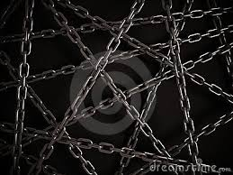
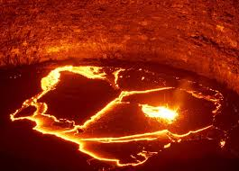
Crimes against Humanity
God’s Plan for the Devil and his Demons?
They will held in chains of darkness until judgment (2 Pet 2:4)
Cast in the lake of fire (Rev 20:10)
Notes:
Turn to 2 Pet 2:4
{Click} {Read Slide}
2 Peter 2:4 (NKJV) ⁴ For if God did not spare the angels who sinned, but cast them down to hell and delivered them into chains of darkness, to be reserved for judgment;
Turn to Rev 20:10
{Click} {Read Slide}
Revelation 20:10 (NKJV) ¹⁰ The devil, who deceived them, was cast into the lake of fire and brimstone where the beast and the false prophet are. And they will be tormented day and night forever and ever.

Slide 31
Our Role in Humanity
Notes:
So what is our role in humanity today?
What does God want us to do?

Slide 32
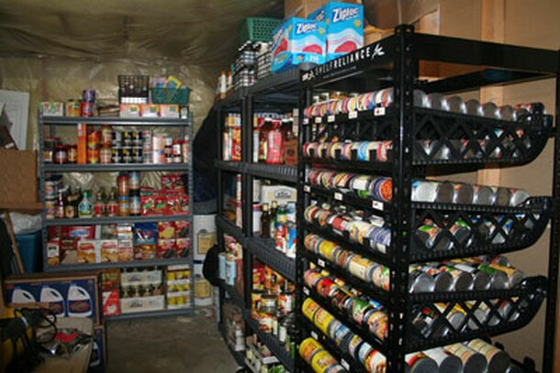
Our Role in Humanity
Hide ourselves away from humanity?
NO
Notes:
{Read Slide}
{Click} {Read Slide}

Slide 33
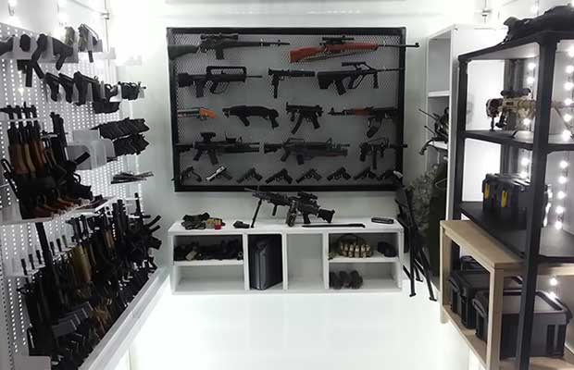
Our Role in Humanity
Prepare to protect/fight humanity?
NO
Notes:
{Read Slide}
{Click} {Read Slide}

Slide 34
Our Role in Humanity
Build harmonious relationships
Be in the world not of the world (John 17:15-16)
Be a light to the world (Matt 5:14-16)
Our Marriages
Conduct at work and home
Keeping our word – honesty
Humility – Christ like leadership
Listen more; Uplifting conversation
Notes:
Turn to Matt 5
Here is some of what God want our role to be in Humanity?
{Click} {Read Slide}
{Click} {Read Slide}
Matthew 5:14-16 (NKJV) ¹⁴ “You are the light of the world. A city that is set on a hill cannot be hidden. ¹⁵ Nor do they light a lamp and put it under a basket, but on a lampstand, and it gives light to all who are in the house. ¹⁶ Let your light so shine before men, that they may see your good works and glorify your Father in heaven.
Here are few things we need to be a light in….
{Click} {Read Slide}
{Click} {Read Slide}
{Click} {Read Slide}
{Click} {Read Slide}
{Click} {Read Slide}

Slide 35
Our Role in Humanity
Save humanity from utter destruction (Matt 24:22)
Qualify to be in the Bride of Christ
God the Father and Jesus Christ are looking for a few good people to help humanity qualify for salvation
Notes:
Turn to Matt 24
Here is some more of what God want our role to be in Humanity?
{Click} {Read Slide}
Matthew 24:22 (NKJV) ²² And unless those days were shortened, no flesh would be saved; but for the elect’s sake those days will be shortened.
{Click} {Read Slide}
{Click} {Read Slide}

Slide 36
Humanity Review
God’s human creation physical and spirit
  We are a Nephesh (Soul) created in the image of God and we have been given the ability to reproduce ourselves (kind), but we our mortal and will die.
Notes:
Humanity Review
{Read}

Slide 37
Humanity Review
God’s plan(s) for humanity
A select few will be given a opportunity to qualify to govern with His Majesty Jesus Christ to provide an opportunity for all who were conceived (biblically) to have life everlasting in God’s family.
Notes:
{Read}

Slide 38
Humanity Review
Crimes against humanity
We have an adversary, Satan and his demons, deceiving humanity into choosing eternal death. They have cause great suffering, but by choosing God and His truth, Humanity is able to defeat Satan, overcome sin and receive the gift of life everlasting.
Notes:
{Read}

Slide 39
Areas to Review
Our role in humanity
We have been give a opportunity to choose to follow God and be a light to Humanity. By being a light we can save Humanity from total destruction and rule under His Majesty Jesus Christ so that all of Humanity will come to repentance and receive life everlasting
Notes:
{Click} {Read}

Slide 40
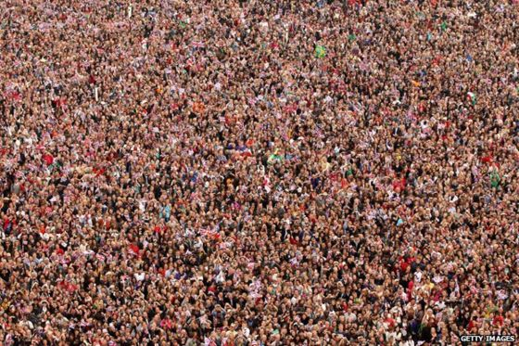
Humanity
WILL YOUR LIGHT HELP SAVE THEM?
Notes:
Humanity, The question is – {Read}

