Slide 1


Is the Earth 6000 years OLD?
Sermon: Ken Loucks
Portland, OR

Slide 2

September 2017
Notes:
In Sept. of 2017, while attending the UCG Annual Leadership Conference in Cincinnati, Becca and I took some time off to see the sites. One we had been wanting to see was the ARK Encounter in Kentucky, about 40 minutes south of Cincinnati. The Ark is a dramatization of the biblical account.

Slide 3
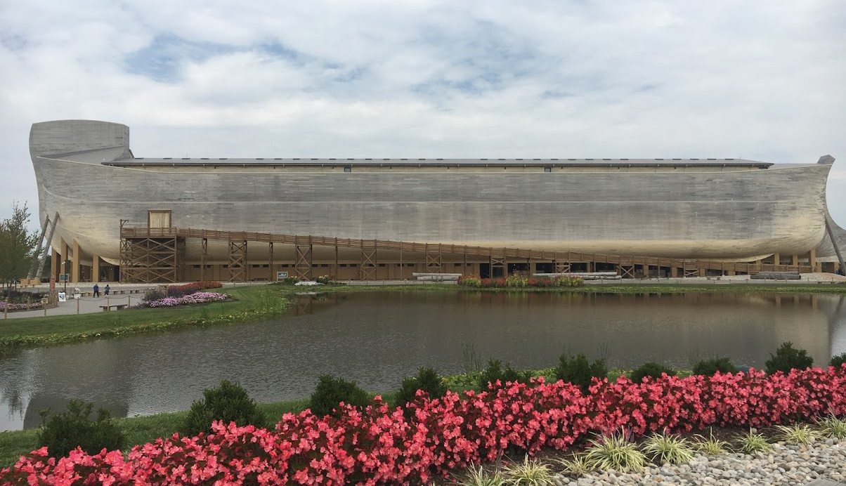
Gen 6:13 And God said to Noah, "The end of all flesh has come before Me, for the earth is filled with violence through them; and behold, I will destroy them with the earth.
Gen 6:14 Make yourself an ark of gopherwood; make rooms in the ark, and cover it inside and outside with pitch.
Gen 6:15 And this is how you shall make it: The length of the ark shall be three hundred cubits, its width fifty cubits, and its height thirty cubits.
Notes:
It is built to a realistic scale with the length of a Cubit being set at 20.4 inches, the higher end of the spectrum, which has a range of 17.6 to 20.6 inches. It is 510 feet long, 85 feet wide and 51 feet tall.

Slide 4
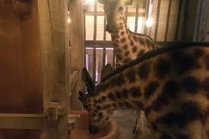
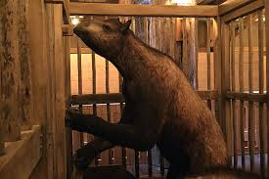
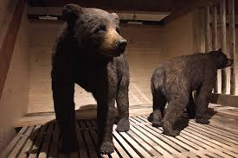
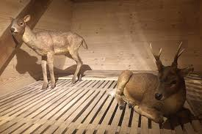
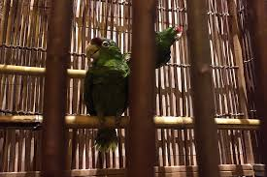
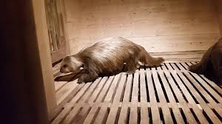
Gen 6:19 And of every living thing of all flesh you shall bring two of every sort into the ark, to keep them alive with you; they shall be male and female.
Gen 6:20 Of the birds after their kind, of animals after their kind, and of every creeping thing of the earth after its kind, two of every kind will come to you to keep them alive.
Notes:
Of course we know that there were going to be animals we would recognize by KIND on board the replica. We saw giraffes, different types of bears, Deer, Fowl, even a SLOTH. Nothing surprising there.

Slide 5
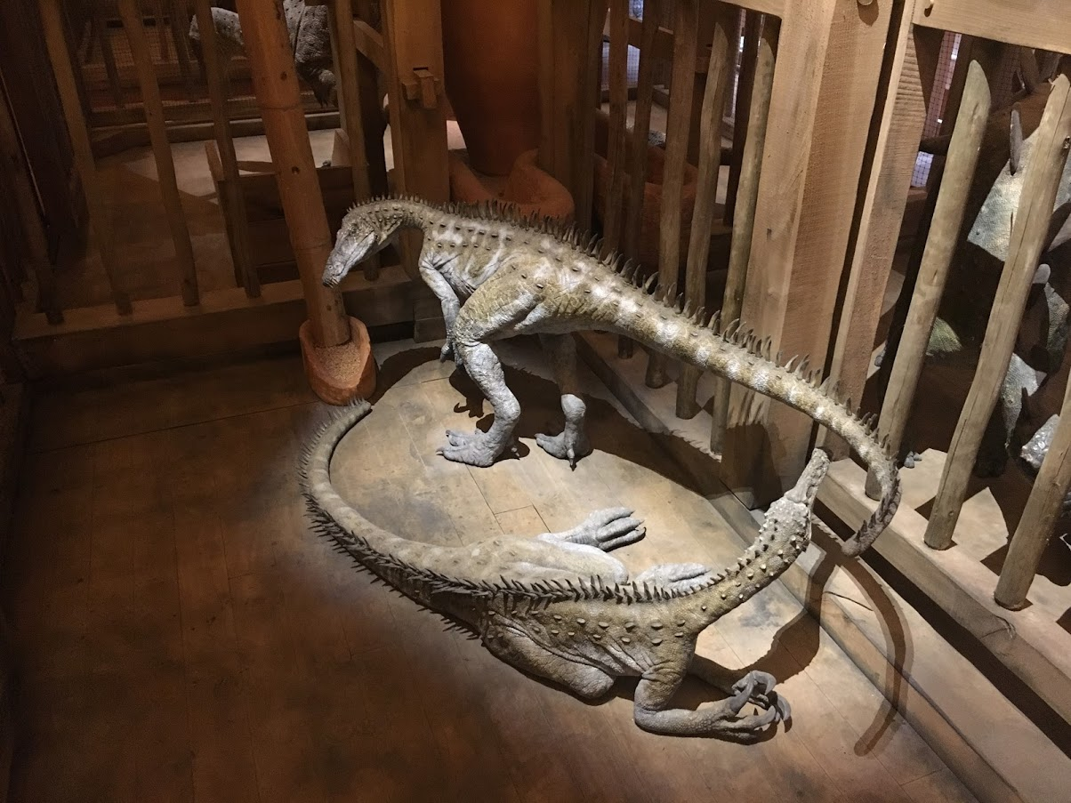
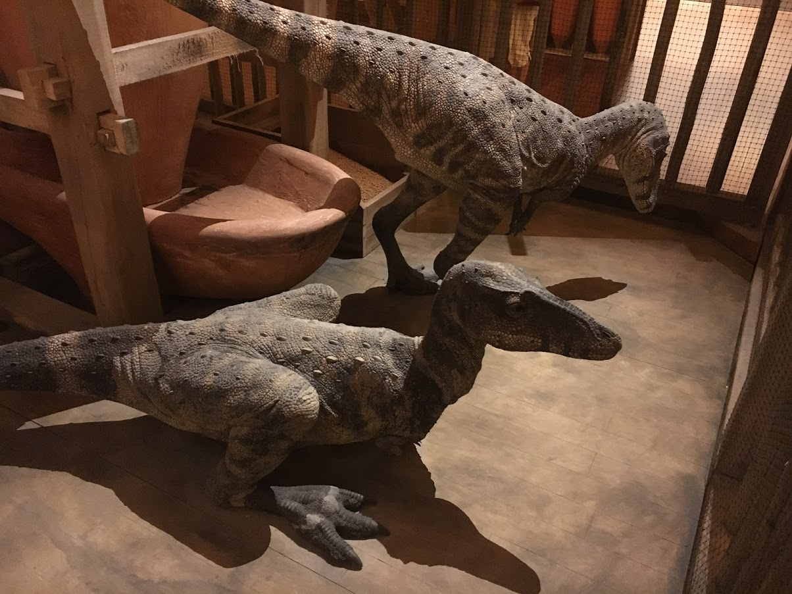
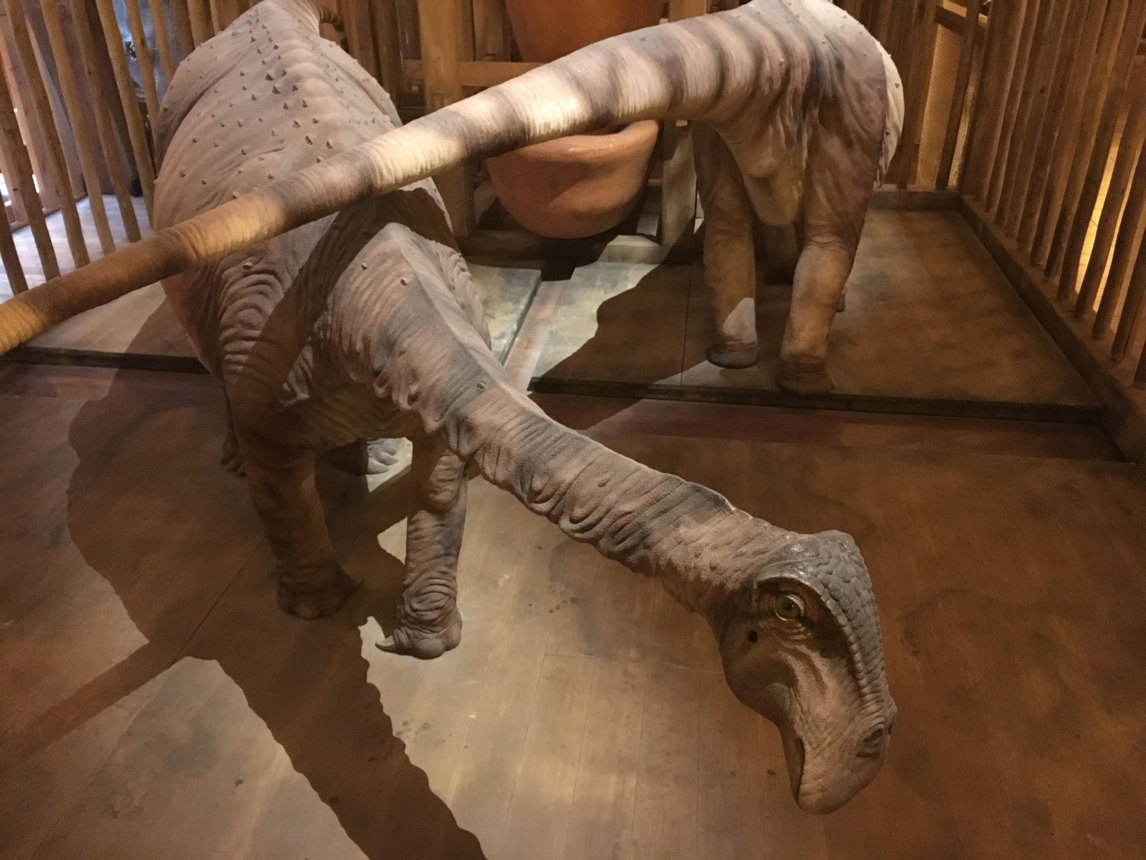
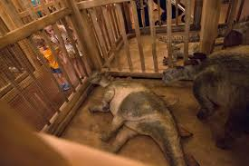
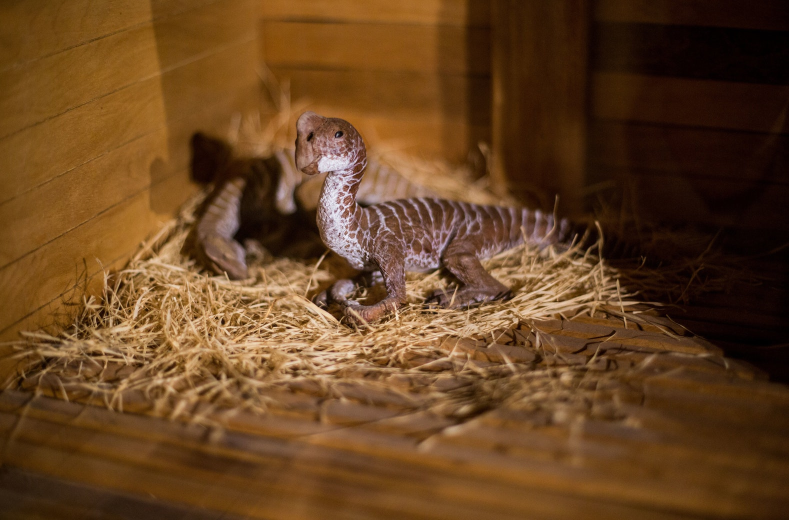
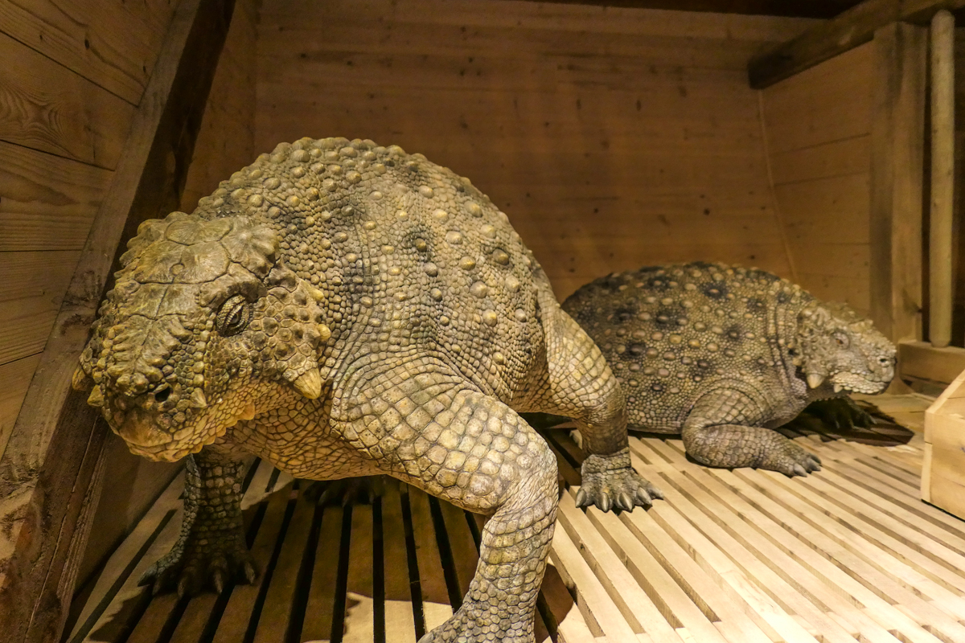
?
?
?
?
?
?
Notes:
But, WHAT is this? Dinosaurs! Yes, dinosaurs on the ARK. We didn’t get a picture, because they only had a sign that said that even the Tyrannosaurus REX was onboard, though as babies. Most of the animals on board were portrayed as very young – having higher reproductive value. The dinosaurs were predominantly portrayed as BABIES. When you consider the size of the dinosaurs as mature adults, I suppose I can understand what they were REASONING.

Slide 6
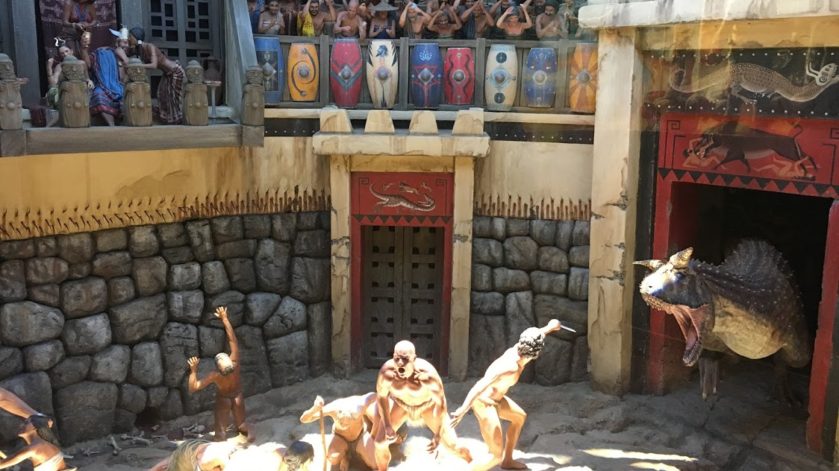
Notes:
They even had this PICTOGRAM showing a preflood ARENA where men and women had been cast as FODDER for a terrifying man-eating dinosaur, while crowds looked on and cheered. This is reminiscent of Christians being thrown to the lions in ancient Roman

Slide 7
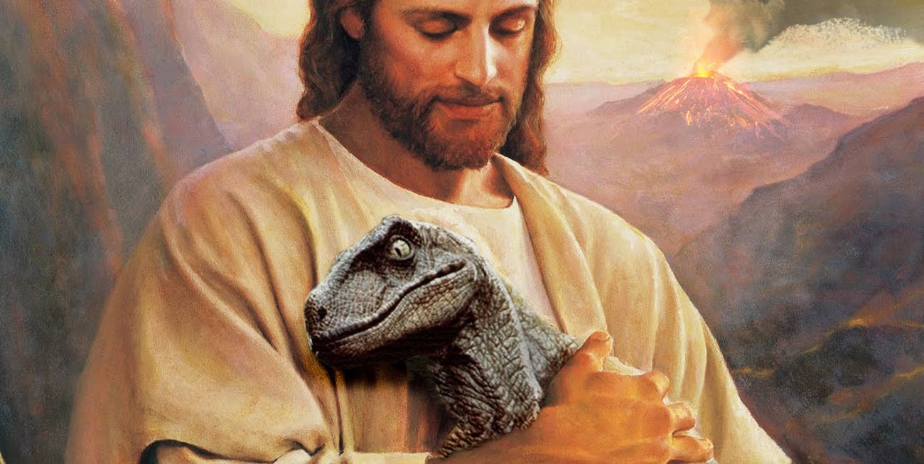
Museum of the Bible, Washington DC
Notes:
What’s behind the idea that Dinosaurs and Man could have dwelt together? Are you familiar with the 6000 year creation theology? Those who hold this belief are known more broadly as the Young-Earth Creationists. They believe that the earth and the whole universe was made 6000 years ago. Is it true? Could the earth and the universe REALLY be only 6000 years old?

Slide 8

Is there a GAP?
Gen 1:1 In the beginning God created the heavens and the earth.
Gen 1:2 The earth was without form, and void; and darkness was on the face of the deep. And the Spirit of God was hovering over the face of the waters.
Notes:
Fundamentally, it boils down to the first two scriptures in Genesis. Young-Earth Creationists take these scriptures to be summarizing ONE event. The UCG understands that there is actually a gap between the two scriptures. Those who hold that belief are referred to as Old-Earth Creationists. Both argue for CREATION and REJECT evolution. The difference is that the Young-earth creationist attempts to explain the scientific, geologic and fossil record in terms of everything fitting within just 6000 years. It seems to me that this is an over-reaction to evolution – their effort to undermine the evolutionists primary argument – that evolution requires billions of years – which would be impossible if the earth is only 6000 years old. Let’s review both scriptures to see if we can find harmony between them that fits with a ONE TIME creation event that includes BOTH scriptures.

Slide 9
Gen 1:1 In the beginning God created the heavens and the earth.
create: BARA = give existence to something new
Gen 1:21 So God created great sea creatures and every living thing that moves, with which the waters abounded, according to their kind, and every winged bird according to its kind. And God saw that it was good.
Gen 1:27 So God created man in His own image; in the image of God He created him; male and female He created them.
Notes:
Verse 1 is the recorded beginning of the PHYSICAL creation. Before anything existed was NOTHING. Out of NOTHING God CREATED Earth and the Universe. In each of these cases, there was nothing and then there was something created from NOTHING. But in what condition was the earth and the universe created?

Slide 10
Gen 1:2 The earth was without form, and void; and darkness was on the face of the deep. And the Spirit of God was hovering over the face of the waters.
Was: HAYAH = is used 1047 times in the bible to mean Came to be, Came to pass, became, had become or variations of these.
Without form: TOHU = ruin, waste, confusion or empty
Void: BOHU = empty, desolate or vacant
Notes:
The young-earthers believe the word should be correctly rendered WAS as in that this it EXISTED so. But, the overwhelming USEAGE of the word is not in the sense of as CREATED, but the sense is that the EARTH having been formerly created, HAD BECOME a WASTE – it could no longer support life – it was EMPTY and VACANT. Either the Earth was CREATED in TOHU and BOHU or it BECAME that way. Which is it?

Slide 11
Isa 45:18 For thus says the LORD, Who created the heavens, Who is God, Who formed the earth and made it, Who has established it, Who did not create it in vain, Who formed it to be inhabited: "I am the LORD, and there is no other.
Create: BARA
Vain: TOHU
Notes:
The word Created is BARA, the same as in Genesis 1:1 for created. The word VAIN is TOHU, which makes this a VERY important scripture. Here’s why. (1) We clearly see the same word for CREATED here as in Genesis 1:1, giving us NO DOUBT about the TIME of creating being discussed. (2) the word VAIN is the same word TOHU as in Gen. 1:2 clearly distinguishing HOW the earth was or was NOT created. (3) THIS scripture makes it clear that God did NOT create the earth TOHU - ruin, waste, confusion or empty. If the earth was NOT made TOHU, then it HAD TO BECOME TOHU.

Slide 12
If the Earth was NOT created in RUIN…
WHAT HAPPENED?
WE DON’T KNOW for sure!
Notes:
HOW did the earth BECOME Tohu? The truth of the matter is, we simply DO NOT know what happened…not with certainty. The arguments from the Young-earthers amount to assumptions about things they cannot PROVE. I have presented what the Bible clearly says about the condition of the earth when it was created and what it had BECOME after that. WE DO NOT know what happened, because the scripture DOES NOT SAY.

Slide 13
What can we REASONABLY conclude?
Notes:
Since we don’t know what actually happened that CAUSED the earth to become TOHU, do we have a scriptural record that would allow us to draw conclusions about what MOST LIKELY happened? Keep this in mind, nowhere in the Bible does it say WHAT happened to the earth to make it TOHU. What we do have is a record of certain events that APPEAR to have played a part in what happened – BUT to be clear we are still drawing inference where no CLEAR statement exists.

Slide 14

Job 38:4 "Where were you when I laid the foundations of the earth? Tell Me, if you have understanding.
Job 38:5 Who determined its measurements? Surely you know! Or who stretched the line upon it?
Job 38:6 To what were its foundations fastened? Or who laid its cornerstone,
Job 38:7 When the morning stars sang together, And all the sons of God shouted for joy?
All = WHOLE – the entire amount
Notes:
In this passage in Job, we see the context of the ORIGINAL creation. The morning stars and son’s of God are ANGELS, which clearly were in existence BEFORE the universe was created. It says ALL, the whole amount of Angels sang. This could ONLY have happened at the ORIGINAL creation as the context demonstrates. Corroboration as to the timing is the laying of the FOUNDATION and in particular the CORNERSTONE, which is always the FIRST stone laid in a foundation. When we combine this with Isa. 45:18, which clearly says that God did NOT create the earth in RUIN, we can understand the JOY expressed by the Angels at the BEAUTIFUL creation of GOD.

Slide 15
Heb 1:13 But to which of the angels has He ever said: "SIT AT MY RIGHT HAND, TILL I MAKE YOUR ENEMIES YOUR FOOTSTOOL"?
Heb 1:14 Are they not all ministering spirits sent forth to minister for those who will inherit salvation?
Notes:
The earth was created in perfection, according to the Plan of God. The Angels were already in existence during the creation of the universe. We see here that the Angels were created with a PURPOSE and that purpose was NOT to become actual SON’s of God. The Angels were created to be MINISTERING spirits for the purpose of HELPING mankind – THOSE who will inherit salvation. ALL Angels – no exceptions.

Slide 16
Isa 14:12 "How you are fallen from heaven, O Lucifer, son of the morning! How you are cut down to the ground, You who weakened the nations!
Isa 14:13 For you have said in your heart: 'I will ascend into heaven, I will exalt my throne above the stars of God; I will also sit on the mount of the congregation On the farthest sides of the north;
Isa 14:14 I will ascend above the heights of the clouds, I will be like the Most High.’
Notes:
Of all of the Angels, ONE is singled out, LUCIFER. We see that this being ATTEMPTED to ascend to HEAVEN (we understand that to be the THIRD heaven) to OVERTHROW the government of GOD! The scripture often refers to ANGELS as STARS – we saw that in the Book of Job in the passage we read earlier, “when the MORNING STARS sang together…” We also see here in THIS passage that LUCIFER was on EARTH ministering for GOD, preparing it for MANKIND, from where he LEFT to ASSAULT the throne of GOD.

Slide 17
Eze 28:12 "Son of man, take up a lamentation for the king of Tyre, and say to him, 'Thus says the Lord GOD: "You were the seal of perfection, Full of wisdom and perfect in beauty.
Eze 28:13 You were in Eden, the garden of God; Every precious stone was your covering: The sardius, topaz, and diamond, Beryl, onyx, and jasper, Sapphire, turquoise, and emerald with gold. The workmanship of your timbrels and pipes Was prepared for you on the day you were created.
Eze 28:14 "You were the anointed cherub who covers; I established you; You were on the holy mountain of God; You walked back and forth in the midst of fiery stones.
Notes:
This chapter of Ezekiel picks up the story and gives more background on what happened when Lucifer REBELLED. While the passage begins by talking about the king of Tyre, it becomes clear very quickly that the focus of this passage is NOT the earthly king but rather on the POWER behind that king – Satan. We see LUCIFER as HE WAS first created and HOW he was created. Perfect in BEAUTY. He was PLACED in the very THRONE ROOM of God as a COVERING Cherub before the PHYSICAL creation came to be.

Slide 18
Exo 25:16 And you shall put into the ark the Testimony which I will give you.
Exo 25:17 "You shall make a mercy seat of pure gold; two and a half cubits shall be its length and a cubit and a half its width.
Exo 25:18 And you shall make two cherubim of gold; of hammered work you shall make them at the two ends of the mercy seat.
Exo 25:19 Make one cherub at one end, and the other cherub at the other end; you shall make the cherubim at the two ends of it of one piece with the mercy seat.
Exo 25:20 And the cherubim shall stretch out their wings above, covering the mercy seat with their wings, and they shall face one another; the faces of the cherubim shall be toward the mercy seat.
Exo 25:21 You shall put the mercy seat on top of the ark, and in the ark you shall put the Testimony that I will give you.
Exo 25:22 And there I will meet with you, and I will speak with you from above the mercy seat, from between the two cherubim which are on the ark of the Testimony, about everything which I will give you in commandment to the children of Israel.
Notes:
Here in Exodus we see the REPLICA of the throne of God, called the MERCY seat, or seat of MERCY. Two CHERUB’s are fashioned to spread their wings OVER the mercy seat. This was inspired by GOD as a PHYSICAL representation of the SPIRITUAL role and responsibility of TWO CHERUBs. We know from the passage in EZEKIEL that LUCIFER was ONE of those Cherubs.

Slide 19
Eze 28:15 You were perfect in your ways from the day you were created, Till iniquity was found in you.
Eze 28:16 "By the abundance of your trading You became filled with violence within, And you sinned; Therefore I cast you as a profane thing Out of the mountain of God; And I destroyed you, O covering cherub, From the midst of the fiery stones.
Notes:
It’s hard to imagine but LUCIFER was PERFECT from the day he was CREATED. Yet, he became filled PRIDE and ENVY. This kind of pride is called HUBRIS – it DECIEVES the individual – it is SELF DECEIVEING. Lucifer came to believe that he could RULE above the STARS – over all of the angelic realm as GOD. ENVY is the DESIRE to DEPRIVE someone else of THEIR POSSESSION of what the individual DESIRES TO POSSESS. Out of PRIDE and ENVY, Lucifer attempted to DENY God his ROLE as Supreme RULER by overthrowing the GOD HEAD to rule in his stead!

Slide 20
Rev 12:3 And another sign appeared in heaven: behold, a great, fiery red dragon…
Rev 12:4 His tail drew a third of the stars of heaven and threw them to the earth.
Rev 12:7 And war broke out in heaven: Michael and his angels fought with the dragon; and the dragon and his angels fought,
Rev 12:8 but they did not prevail, nor was a place found for them in heaven any longer.
Rev 12:9 So the great dragon was cast out, that serpent of old, called the Devil and Satan, who deceives the whole world; he was cast to the earth, and his angels were cast out with him.
Luk 10:18 And He said to them, "I saw Satan fall like lightning from heaven.
Notes:
We see that SATAN apparently PURSUADED 1/3 of the Angelic realm to follow HIM. We understand this passage in Revelation to have DUAL meaning – it certainly give the picture of what happened when Satan tried and failed the first time to overthrow God’s government and seize the throne for himself. Christ confirms by his own testimony that he was THERE and WITNESSED what happened to Satan when his ATTEMPTED Coup FAILED. Satan was CAST back down to earth. In the context in Revelation we understand that Satan will try again in the future.

Slide 21
2Pe 2:4 For if God did not spare the angels who sinned, but cast them down to hell and delivered them into chains of darkness, to be reserved for judgment;
Jud 1:6 And the angels who did not keep their proper domain, but left their own abode, He has reserved in everlasting chains under darkness for the judgment of the great day;
Notes:
These passages confirm the role the angels had on EARTH and that they LEFT their PLACE and JOINED Satan in his COUP. Failing in their COUP they were cast back DOWN to earth and placed HERE in RESTRAINT – Hades = a place of restraint – to await judgment.

Slide 22
The Earth RENEWED
Gen 1:2 And the earth was without form, and void; and darkness was upon the face of the deep. And the Spirit of God moved upon the face of the waters.
Psa 104:30 Thou sendest forth thy spirit, they are created: and thou renewest the face of the earth.
Renew: CHADASH = renew or repair
Notes:
It was AFTER the rebellion, after the earth was in RUIN, that the EARTH is then RESTORED or REPAIRED or RECREATED.

Slide 23
THIS is what we KNOW!
God created the Angelic realm and established his Government
God created (BARA) the Heavens and the Earth (BARA = from nothing)
The Earth was NOT created a ruin (TOHU)
Lucifer with 1/3 of the Angels was given responsibility to minister on Earth
Lucifer became filled with Pride and Envy
Lucifer and his angelic army ascended to heaven to overthrow God and his government
War broke out in Heaven
The Earth BECAME without FORM and VOID – an Empty Wasteland (TOHU and BOHU)
Satan, the Adversary of God was cast down to earth where he and his Demons are being held in restraint until Judgement
God RE-created or REPAIRED the Earth and placed Mankind on it
Notes:
We know that LUCIFER rebelled against God, ascended into the heavens to OVERTHROW God and His government. We know the Earth was NOT MADE a ruined Wasteland and therefore it BECAME that way. We know that Satan’s attempted COUP led to WAR in heaven. We have NO IDEA what that would have been like. We have NO IDEA what could or would happen to the PHYSICAL universe as a RESULT of war in heaven. YET, if you look at what we can SEE from the planets and moons in our SOLAR system – there appears to be DAMAGE – the moon is POCMARKED across its surface. Mars looks to have similar damage to it – utterly incapable of sustaining life of any kind. It APPEARS that the war in heaven did cause damage to the physical universe. We DON’T know for sure but it is reasonable to conclude that is what happened.

Slide 24
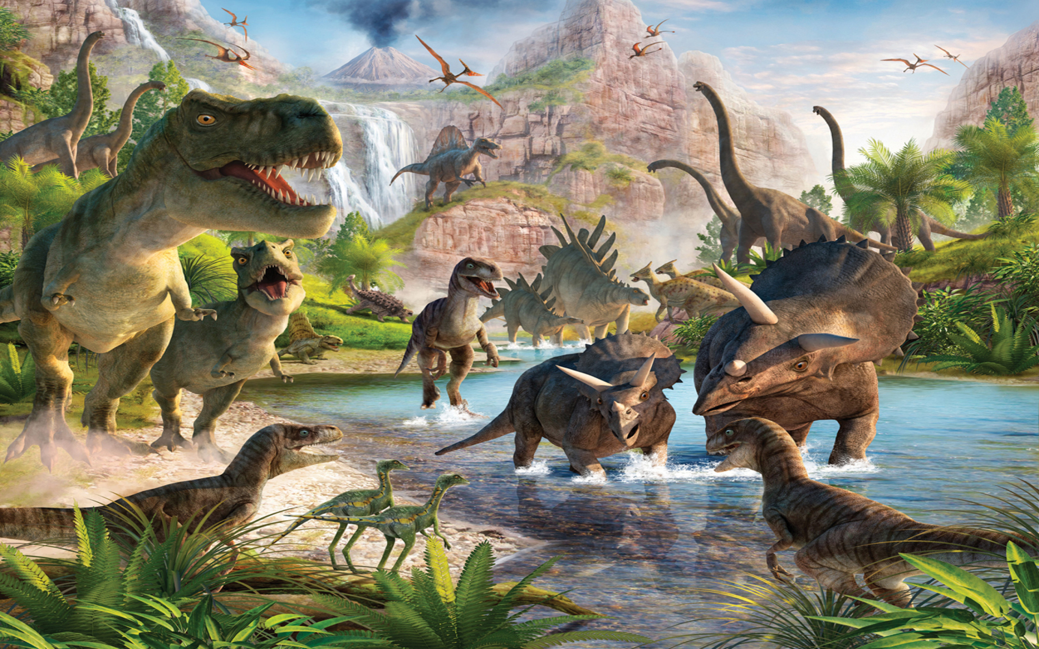
What about the Dinosaurs?
Notes:
What about the Dinosaurs? Is there any evidence that these CREATURES lived at the same time as MAN? Young-earthers believe that the dinosaurs were CREATED at the same time as all OTHER animals and that their EXTINCTION must have been caused by Noah’s Flood. There are two main problems with that theory.

Slide 25

Gen 6:19 And of every living thing of all flesh you shall bring two of every sort into the ark, to keep them alive with you; they shall be male and female.
Gen 6:20 Of the birds after their kind, of animals after their kind, and of every creeping thing of the earth after its kind, two of every kind will come to you to keep them alive.
Notes:
1. There is NO evidence that any Dinosaurs were SAVED on the Ark. There is GREAT difficulty in PROVING that dinosaurs were created at the same time as man. If that were the case then they existed at the time of the FLOOD. Young-earthers argue that this was the case. But if that’s true then the land based dinosaurs would have been present on the ark. Following that logic we SHOULD expect SOME of them to have survived even until today BECAUSE God put the animals on the ARK to KEEP THEM ALIVE. Sea based dinosaurs would SURELY have survived the flood as did other sea based creatures that are indeed with us still today – but no dinosaurs have survived. No explanation offered by Young-earthers is satisfactory to explain WHY there are NO dinosaurs today if they were SAVED on the ark.

Slide 26
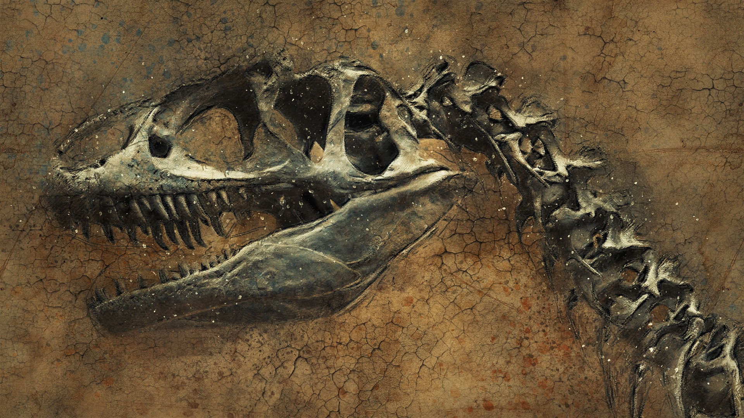
Notes:
2. Dinosaur fossils have NEVER been found with modern animals or humans. The cataclysmic events in earths history are recorded in layers we call STRATA. As we explore different strata we find an amazing record of DIFFERENT time periods. The deeper the Strata the farther back in time we go. Dinosaurs are found EXCLUSIVELY in the Mesozoic strata and NEVER after. They were here and then they were GONE! Long before modern animals and humans walked the earth. If Dinosaurs and Man coexisted then whatever happened to the Dinosaurs MUST also have happened to man and we SHOULD find the fossils of both in the same strata. But we DON’T. There are NO satisfactory answers from the Young-earthers that adequately address this dilemma.

Slide 27
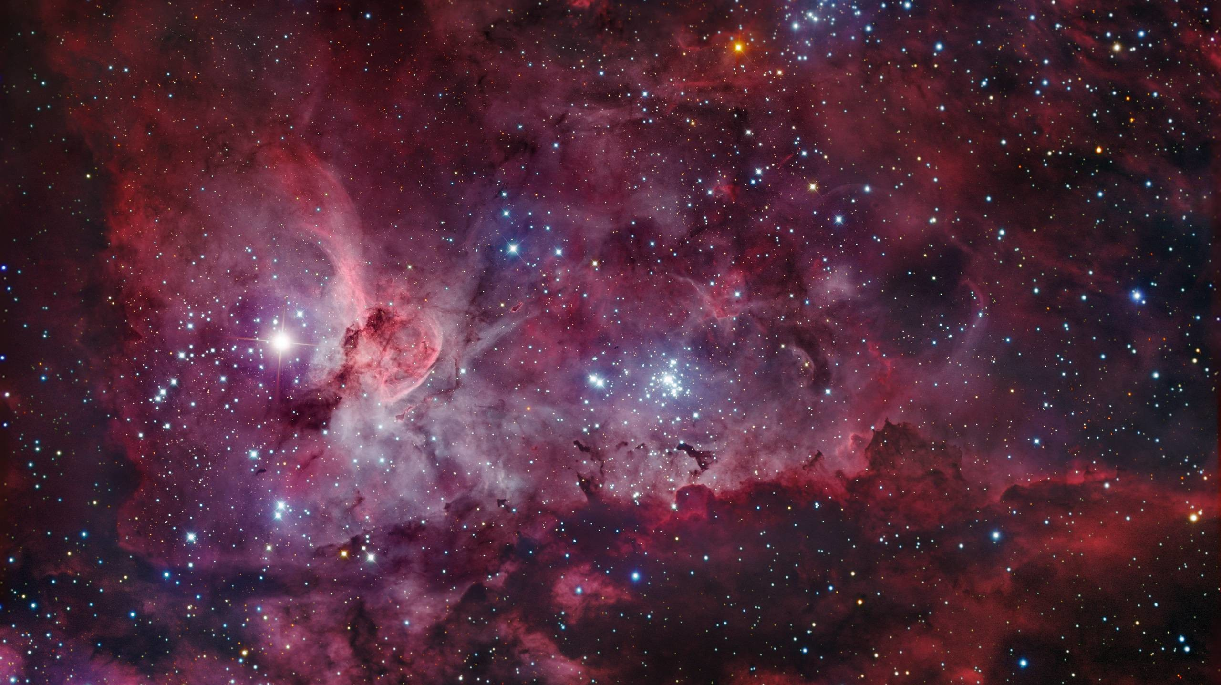
What about the LIGHT from distant Stars?
Notes:
The last area of DIFFICULTY for the Young-earthers is the problem of LIGHT from distant stars. The Distances between the Galaxies and stars in the UNIVERSE is IMMENSE. Modern Physics is based on the understanding that LIGHT travels at a CONSTANT speed (186,000 miles per second). Some theorize today that the speed of light “may” not be constant, but they have not been able to PROVE this. Young-earthers may be praying for substantiation of this theory because it would give them a WAY to explain how we can see the light today from stars that are MILLIONS of light years away from earth. If the UNIVERSE was created at the same time as earth ONLY 6000 years ago, then HOW do we see the light from STARS that are MILLIONS of light years AWAY? There are NO satisfactory explanations from Young-earthers that adequately deal with this dilemma.

Slide 28

We DON’T know
what we DON’T know!
Pro 25:2 It is the glory of God to conceal a matter, But the glory of kings is to search out a matter.
Notes:
I often wonder why a RERUN of some old BELIEF through the church causes SOME to stumble? Do you know what this passage in Proverbs is saying? It says that the GOD who CREATED all things HAS ALL KNOWLEDGE. We, whom God created, DO NOT have ALL knowledge. To US the knowledge of GOD is HIDDEN. It is a MYSTERY – there is NO MYSTERY to God. ONLY the ONE who KNOWS can CONCEAL and ONLY the ONE who KNOWS can REVEAL.

Slide 29
Job 38:1 Then the LORD answered Job out of the whirlwind, and said:
Job 38:2 "Who is this who darkens counsel By words without knowledge?
Job 38:3 Now prepare yourself like a man; I will question you, and you shall answer Me.
Job 38:4 "Where were you when I laid the foundations of the earth? Tell Me, if you have understanding.
Job 38:5 Who determined its measurements? Surely you know! Or who stretched the line upon it?
Job 38:6 To what were its foundations fastened? Or who laid its cornerstone,
Job 38:7 When the morning stars sang together, And all the sons of God shouted for joy?
Job 38:8 "Or who shut in the sea with doors, When it burst forth and issued from the womb;
Job 38:9 When I made the clouds its garment, And thick darkness its swaddling band;
Job 38:10 When I fixed My limit for it, And set bars and doors;
Job 38:11 When I said, 'This far you may come, but no farther, And here your proud waves must stop!'
Notes:
Let’s go back to the book of JOB. God is making it PLAIN to Job that HE has NOT revealed EVERYTHING that HE knows to MAN. We don’t know what we don’t know because GOD, who knows, HAS NOT REVEALED IT.

Slide 30
2Pe 1:2 Grace and peace be multiplied to you in the knowledge of God and of Jesus our Lord,
2Pe 1:3 as His divine power has given to us all things that pertain to life and godliness…
1Co 13:9 For we know in part and we prophesy in part.
1Co 13:10 But when that which is perfect has come, then that which is in part will be done away.
1Co 13:11 When I was a child, I spoke as a child, I understood as a child, I thought as a child; but when I became a man, I put away childish things.
1Co 13:12 For now we see in a mirror, dimly, but then face to face. Now I know in part, but then I shall know just as I also am known.
Notes:
The question is, WHAT is important for SALVATION? Is it having ALL KNOWLEDGE? Peter tells us that the GOD of ALL KNOWLEDGE has GIVEN us ALL WE NEED for SALVATION. Paul encourages us to know that OUR LACK OF KNOWLEDGE is temporary. DARBY paraphrases Verse 12, “For we see now through a dim window obscurely, but then face to face; now I know partially, but then I shall know according as I also have been known.” We don’t know what we don’t know and THAT’s OKAY! One day we will know and we WILL have ALL Knowledge. For now it is ENOUGH to know that God has REVEALED ALL we need to know for Salvation – One day, HE will REVEAL the rest.

Slide 31
Is the Earth 6000 years OLD?
Sermon: Ken Loucks
Portland, OR

