Slide 1

LEARN FROM GOD

Slide 2
Why should we learn from God?

Slide 3
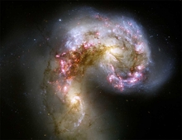
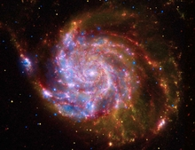
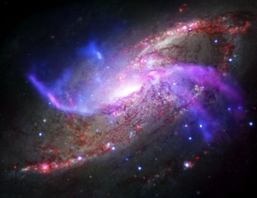


Slide 4
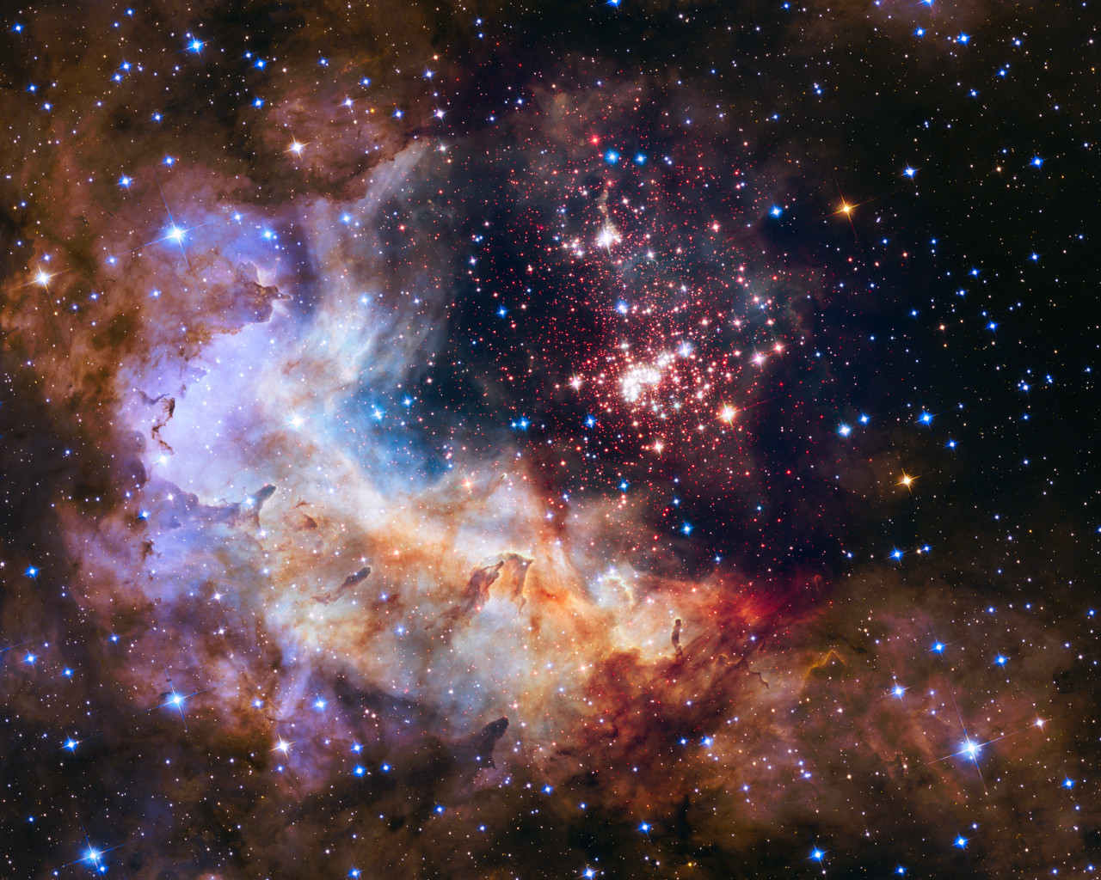

Slide 5
John 1:12
¹² But as many as received Him, to them He gave the right (power / authority) to become children of God, to those who believe in His name:

Slide 6
What does it mean to become a child of God?

Slide 7
God wants to add you and me to His Divine family.

Slide 8
Romans 8: 13-14
¹³ For if you live according to the flesh you will die; but if by the Spirit you put to death the deeds of the body, you will live. ¹⁴ For as many as are led by the Spirit of God, these are sons of God.

Slide 9
What does it mean to be led by God’s spirit?

Slide 10
How many decisions do we make every day?

Slide 11
Various internet sources estimate that an adult makes about 35,000 remotely conscious decisions each day.

Slide 12
How does God’s word help with those decisions?

Slide 13
Psalms 119: 105
¹⁰⁵ Your word is a lamp to my feet And a light to my path.

Slide 14
Romans 8: 28
²⁸ And we know that all things work together for good to those who love God, to those who are the called according to His purpose.

Slide 15
How do all things work together for good?

Slide 16
How does truth set us apart from the world?

Slide 17
John 17: 17
¹⁷ Sanctify them (set them apart)by Your truth. Your word is truth.

Slide 18
So how do we learn from God?

Slide 19
What are 3 ways to learn from God?

Slide 20
Luke 6: 47-48
⁴⁷ Whoever comes to Me, and hears My sayings and does them, I will show you whom he is like: ⁴⁸ He is like a man building a house, who dug deep and laid the foundation on the rock.

Slide 21
What is the difference between hearing and doing?

Slide 22
Can Bible study be fun? Can you learn new things?

Slide 23
^{Learn it}
^{Live It}
^{Love it}

Slide 24
Psalms 119: 18
¹⁸ Open my eyes, that I may see Wondrous things from Your law.

Slide 25
What are some creative ways to read or listen to your Bible?

Slide 26
What are some good things to remember when attending Sabbath Services?

Slide 27
You are preparing to be a leader in the Church in coming years. What does God require of a leader?

Slide 28
Joshua 1: 8
⁸ This Book of the Law shall not depart from your mouth, but you shall meditate in it day and night, that you may observe to do according to all that is written in it. For then you will make your way prosperous, and then you will have good success.

Slide 29


Slide 30
1 Peter 3: 15
¹⁵ But sanctify the Lord God^{[a]} in your hearts, and always be ready to give a defense to everyone who asks you a reason for the hope that is in you, with meekness and fear;

Slide 31
Luke 21: 15
¹⁵ for I will give you a mouth and wisdom which all your adversaries will not be able to contradict or resist.

Slide 32
Deut. 31: 6
⁶ Be strong and of good courage, do not fear nor be afraid of them; for the Lord your God, He is the One who goes with you. He will not leave you nor forsake you.”

Slide 33


