Slide 1
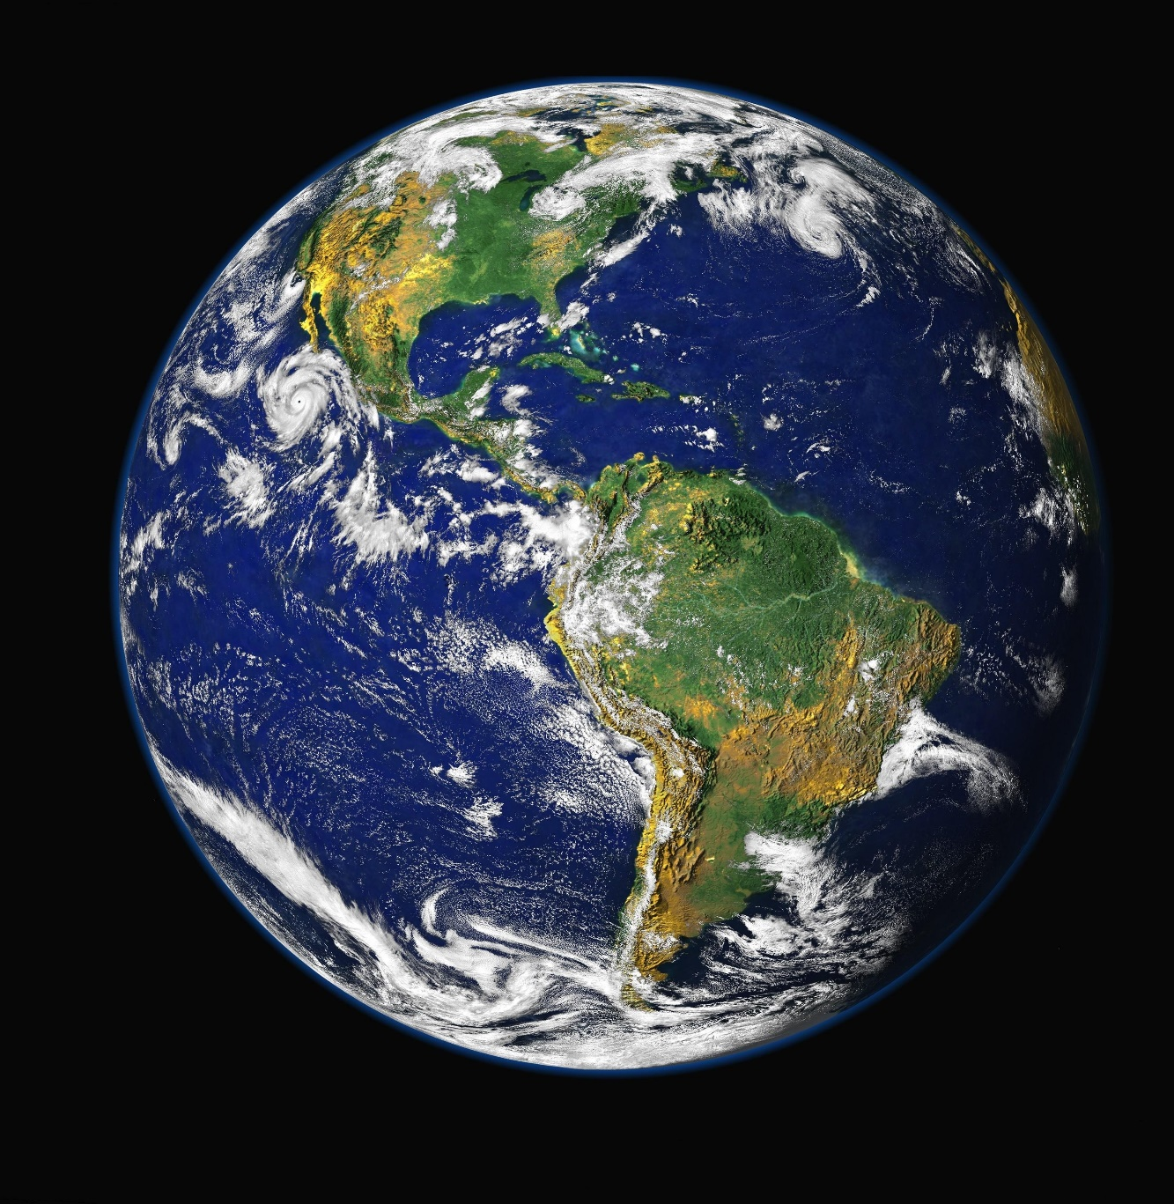
Lessons from Creation
Gen 1 –
Gen 2:1-2
NIV
Notes:
Genesis 1 New International Version (NIV)
The Beginning
1 In the beginning God created the heavens and the earth.² Now the earth was formless and empty, darkness was over the surface of the deep, and the Spirit of God was hovering over the waters.
³ And God said, “Let there be light,” and there was light.⁴ God saw that the light was good, and he separated the light from the darkness. ⁵ God called the light “day,” and the darkness he called “night.” And there was evening, and there was morning—the first day.
⁶ And God said, “Let there be a vault between the waters to separate water from water.” ⁷ So God made the vault and separated the water under the vault from the water above it. And it was so. ⁸ God called the vault “sky.” And there was evening, and there was morning—the second day.
⁹ And God said, “Let the water under the sky be gathered to one place, and let dry ground appear.” And it was so.¹⁰ God called the dry ground “land,” and the gathered waters he called “seas.” And God saw that it was good.
¹¹ Then God said, “Let the land produce vegetation seed-bearing plants and trees on the land that bear fruit with seed in it, according to their various kinds.” And it was so. ¹² The land produced vegetation: plants bearing seed according to their kinds and trees bearing fruit with seed in it according to their kinds. And God saw that it was good. ¹³ And there was evening, and there was morning—the third day.
¹⁴ And God said, “Let there be lights in the vault of the sky to separate the day from the night, and let them serve as signs to mark sacred times, and days and years, ¹⁵ and let them be lights in the vault of the sky to give light on the earth.” And it was so. ¹⁶ God made two great lights—the greater light to govern the day and the lesser light to govern the night. He also made the stars. ¹⁷ God set them in the vault of the sky to give light on the earth,¹⁸ to govern the day and the night, and to separate light from darkness. And God saw that it was good. ¹⁹ And there was evening, and there was morning—the fourth day.
²⁰ And God said, “Let the water teem with living creatures, and let birds fly above the earth across the vault of the sky.” ²¹ So God created the great creatures of the sea and every living thing with which the water teems and that moves about in it, according to their kinds, and every winged bird according to its kind. And God saw that it was good. ²² God blessed them and said, “Be fruitful and increase in number and fill the water in the seas, and let the birds increase on the earth.” ²³ And there was evening, and there was morning—the fifth day.
²⁴ And God said, “Let the land produce living creatures according to their kinds: the livestock, the creatures that move along the ground, and the wild animals, each according to its kind.” And it was so. ²⁵ God made the wild animals according to their kinds, the livestock according to their kinds, and all the creatures that move along the ground according to their kinds. And God saw that it was good.
²⁶ Then God said, “Let us make mankind in our image, in our likeness, so that they may rule over the fish in the sea and the birds in the sky, over the livestock and all the wild animals,^{[a]} and over all the creatures that move along the ground.”
²⁷ So God created mankind in his own image,
in the image of God he created them;
male and female he created them.
²⁸ God blessed them and said to them, “Be fruitful and increase in number; fill the earth and subdue it. Rule over the fish in the sea and the birds in the sky and over every living creature that moves on the ground.”
²⁹ Then God said, “I give you every seed-bearing plant on the face of the whole earth and every tree that has fruit with seed in it. They will be yours for food. ³⁰ And to all the beasts of the earth and all the birds in the sky and all the creatures that move along the ground—everything that has the breath of life in it—I give every green plant for food.” And it was so.
³¹ God saw all that he had made, and it was very good.And there was evening, and there was morning—the sixth day.
Genesis 2:1-2 (NIV)
Thus the heavens and the earth were completed in all their vast array.
² By the seventh day God had finished the work he had been doing; so on the seventh day he rested from all his work.

Slide 2

Creation Beliefs
Young Earth Creationism (YEC)
Bible is the infallible word of God
Earth is only ~6,000 Years Old
Creation was 6 x 24-hour days.
The flood explains scientific error
Notes:
Young Earth creationism (YEC) is the belief that our planet and universe were created, from nothing, in six days, approximately 6,000 years ago, by the God of the Abrahamic religions. Adherents of young Earth creationism are known as “Young Earth Creationists," or simply YECs.
Their belief is derived from a literal interpretation of the two creation beliefs in the Biblical book of Genesis. This means young Earth creationists believe the six days described in Genesis were standard 24-hour days and use a suitable chronology to date the Earth's creation to only a few thousand years ago. YEC’s believe science claims are the work of fallible humans while the Bible is the infallible word of God. This must be true because the Bible says so. Young earth creationists reject scientific claims that the earth is millions of billions of years old. Young Earth Creationists believe the worldwide flood (the story of Noah) can explain almost all observations that scientists have interpreted as pointing to a significantly older Earth.

Slide 3
Creation Beliefs
Old Earth Creationism (OEC)
Gap Creationism
Progressive Creationism
Day-age Creationism
Theistic Evolution
Notes:
Old Earth Creationism is a form of creationism which includes Gap Creationism, Progressive Creationism, theistic evolution, Day-age creationism and more. Old Earth Creationism is typically more compatible with the scientific evidence on the issues of physics, chemistry, geology, and the age of the Earth, in contrast to Young Earth Creationism.

Slide 4
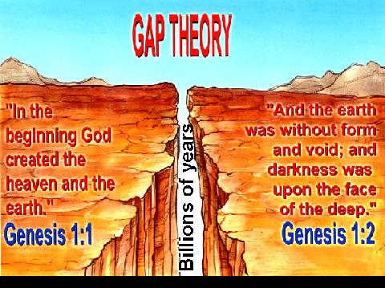
Gap Creationism
Bible is the infallible word of God
Gen 1:1 Earth created w/ dinosaurs, prehistoric life, etc.
Cataclysmic event; flood destruction cause by Satan
Gen 1:2 Earth is recreated in 6 X 24-hour days
Notes:
The Gap Theory, also known as the Ruin-Reconstruction Theory or Gap Creationism, suggests that a time gap equaling millions (or perhaps even billions) of years occurred between Genesis 1:1 and 1:2. This theory is one of several Old Earth Creationism views.
Although proponents of the gap theory deny the concept of an evolutionary process, they do believe the earth is much older than the 6,000 or so years accounted for in the scriptures. In addition to the age of the earth, the gap theory presents possible solutions to other incompatibilities between scientific theory and the Bible record.
The Gap Theory in a Nutshell
So, what is the gap theory and where do we find it in the Bible?
Genesis 1:1-3
Verse 1: In the beginning God created the heavens and the earth.
Verse 2: The earth was formless and empty, and darkness covered the deep waters. And the Spirit of God was hovering over the surface of the waters.
Verse 3: Then God said, "Let there be light," and there was light.
According to the gap theory, creation unfolded as follows. In Genesis 1:1, God created the heavens and the earth, complete with dinosaurs and other prehistoric life that we see in fossil records. Then, as some scholars suggest, a cataclysmic event took place—perhaps a flood (indicated by the "deep waters" in verse 2) brought on by Lucifer's rebellion and fall from heaven to earth. As a result, the earth was ruined or destroyed, reducing it to the "formless and empty" state of Genesis 1:2. In verse 3, God began the process of recreating life. The gap theory is new. It was first introduced in 1814 by Scottish theologian Thomas Chalmers in an attempt to reconcile the six-day biblical creation account with the newly defined geologic ages being set forth by leading geologists of that era.

Slide 5
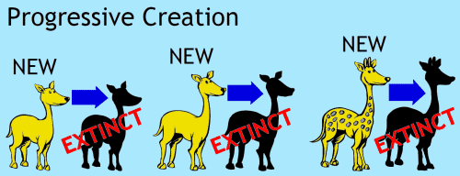
Progressive Creationism
Bible is figurative not literal
God created over millions of years
Agrees w/ mainstream science on the earth’s age
Species appear all at once and "fully formed.“
Rejects evolution; accepts adaptation
Notes:
Progressive creationism (see for comparison intelligent design) is the religious belief that God created new forms of life gradually over a period of hundreds of millions of years. As a form of Old Earth Creationism, it accepts mainstream geological and cosmological estimates for the age of the earth, some tenets of biology such as microevolution as well as archaeology to make its case. In this view creation occurred in rapid bursts in which all "kinds" of plants and animals appear in stages lasting millions of years. The bursts are followed by periods of stasis or equilibrium to accommodate new arrivals. These bursts represent instances of God creating new types of organisms by divine intervention. As viewed from the archaeological record, progressive creationism holds that "species do not gradually appear by the steady transformation of its ancestors; [but] appear all at once and "fully formed."
The view rejects macroevolution, claiming it is biologically untenable and not supported by the fossil record,[2] as well as rejects the concept of universal descent from a last universal common ancestor. Thus the evidence for macroevolution is claimed to be false, but microevolution is accepted as a genetic parameter designed by the Creator into the fabric of genetics to allow for environmental adaptations and survival. Generally, it is viewed by proponents as a middle ground between literal creationism and evolution.

Slide 6
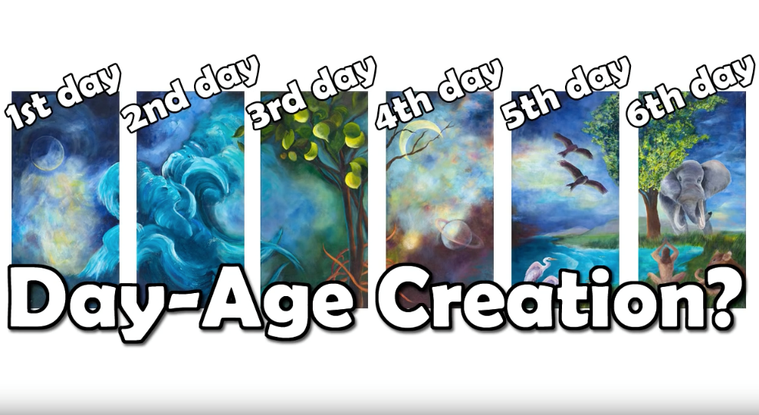
Day-age Creationism
Bible concept are not literal defined Hebrew word “yom” as a time period
One day = thousands – billions of years
Split w/ scientific conclusions created by God or evolution started by God
Earth (Cosmos) is 13.8 billion
Notes:
Day-age Creationism, a type of Old Earth Creationism, is an interpretation of the creation accounts in Genesis. It holds that the six days referred to in the Genesis account of creation are not ordinary 24-hour days, but are much longer periods (from thousands to billions of years). The Genesis account is then reconciled with the age of the earth. Proponents of the Day-age Theory can be found among both theistic evolutionists, who accept the scientific consensus on evolution, and progressive creationists, who reject it. The theories are said to be built on the understanding that the Hebrew word yom is also used to refer to a time period, with a beginning and an end and not necessarily that of a 24-hour day.
The differences between the young Earth interpretation of Genesis and modern scientific theories such as Big Bang, abiogenesis, and common descent are significant. The young earth interpretation says that everything in the universe and on Earth was created in six 24-hour days, estimated to have occurred some 6,000 years ago. Modern scientific observations, however, put the age of the universe at 13.8 billion years and the earth at 4.5 billion years, with various forms of life, including humans, being formed gradually over time.
The day-age theory attempts to reconcile these views by asserting that the creation "days" were not ordinary 24-hour days, but actually lasted for long periods of time (as day-age implies, the "days" each lasted an age). According to this view, the sequence and duration of the creation "days" may be paralleled to the scientific consensus for the age of the earth and the universe.

Slide 7

Theistic Evolution
Bible is not the word of God
Scientific conclusions created by God
Earth (Cosmos) is 13.8 billion
Humans are the result of evolution started by God
Notes:
Theistic evolution, theistic evolutionism, evolutionary creationism, divine direction, or God-guided evolution are views that regard religious teachings about God as compatible with modern scientific understanding about biological evolution. Theistic evolution is not in itself a scientific theory, but a range of views about how the science of general evolution relates to religious beliefs in contrast to special creation views.
Supporters of Theistic Evolution generally harmonize evolutionary thought with belief in God, rejecting the conflict thesis regarding the relationship between religion and science – they hold that religious teachings about creation and scientific theories of evolution need not contradict each other.
Theistic Evolution as the position that "evolution is real, but that it was set in motion by God",[3] and characterizes it as accepting "that evolution occurred as biologists describe it, but under the direction of God".[4] He lists out six general premises on which different versions of theistic evolution typically rest. They include:
1) The prevailing cosmological model, with the universe coming into being about 13.8 billion years ago;
2) A fine-tuned universe;
3) Evolution and natural selection;
4) No special supernatural intervention is involved once evolution got under way;
5) Humans are a result of these evolutionary processes;

Slide 8
Creation Beliefs
Which one is correct?
Young Earth Creationism
Gap Creationism
Progressive Creationism
Day-age Creationism
Theistic Evolution
None of this above
Notes:
{Read}

Slide 9
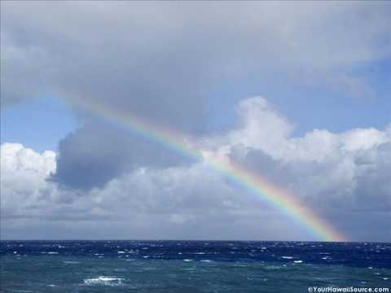
What does the Bible say?
Genesis 1:1
In the beginning God created the heavens and the earth.
Psalms 90:1-2
God existed before the earth.
God has no beginning.
Notes:
Let’s look at the Bible and what does is say and what we (UCG) teach. Gen 1:1 {Read} Psalms 90:1-2 ¹Lord, you have been our dwelling place throughout all generations. ² Before the mountains were born or you brought forth the whole world, from everlasting to everlasting you are God.
{Click}{Read} We as humans need a beginning for our understanding. Normally it is easy for us to start something in chronological order. We do not understand that God and The Word have no beginning. In Rev 22:13 is says that God is beginning and end because the beginnings and the endings are created by God. He declares them. This phrase “In the beginning” is for our understanding and as part of creation it is the first thing created. So in Gen 1: 1 God created or declared the beginning and God created the earth.

Slide 10
First chronological event in scripture?
John 1:1-3 In the beginning was the Word
Revelation 13:8 Lamb slain from (before) the foundation of the world.
Ezekiel 28:14-15 Lucifer is Created.
Psalms 90:1-2 God existed before Earth
Job 38:4-7,Psa 33:6, Isa 42:5, John 1:3 God Laid/Created the foundations of the Earth and everything in it
Notes:
Which scripture is the first Chronological event? {Click} Before the beginning was declared or created.
John 1:1-3 New King James Version (NKJV)
The Eternal Word
1 In the beginning was the Word, and the Word was with God, and the Word was God. ² He was in the beginning with God. ³ All things were made through Him, and without Him nothing was made that was made.
Revelation 13:8 New Living Translation (NLT)
⁸ And all the people who belong to this world worshiped the beast. They are the ones whose names were not written in the Book of Life that belongs to the Lamb who was slaughtered before the world was made
I ordained and anointed you as the mighty angelic guardian.^{[a]}
You had access to the holy mountain of God and walked among the stones of fire.
¹⁵ “You were blameless in all you did from the day you were created until the day evil was found in you
Job 38:4-7 New International Version (NIV)
⁴ “Where were you when I laid the earth’s foundation? Tell me, if you understand.
⁵ Who marked off its dimensions? Surely you know! Who stretched a measuring line across it?
⁶ On what were its footings set, or who laid its cornerstone—
⁷ while the morning stars sang together and all the angels^{[a]} shouted for joy?

Slide 11
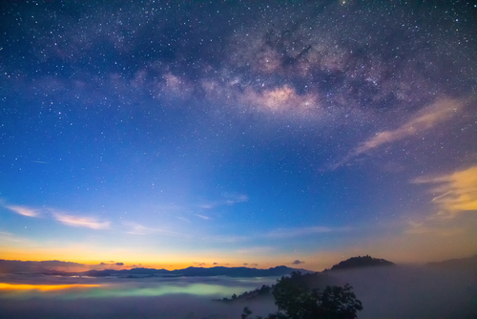
What does the Bible say?
Genesis 1:1
God and the Word made a plan.
The Word Created Lucifer.
The Word Created the Earth
The Morning Stars sang
Notes:
{Click} God and the Word made a plan. (It or they determined that Lamb would be Slain, dimensions and foundations of the Earth, etc.)
{Click} The Word Created Lucifer., other Morning Stars, Angels. The spirit world.
{Click} The Word Created the Earth. Laid the foundations and the corner stone (which man has not yet discovered).
{Click} The Morning Stars (Lucifer, Michael and Gabriel) maybe more sang.

Slide 12
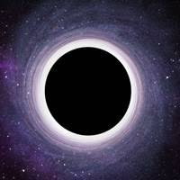
What does the Bible say?
Genesis 1:2 (NIV)
earth was formless and empty
Hebrew words:
hayah Gen 1:2 was or became
tohu Isaiah 45:18 vain, Gen 1:2 formless
Notes:
{Read} Genesis 1:2 (NIV)
² Now the earth was formless and empty, darkness was over the surface of the deep,
We need to look at two Hebrews word that are backed up but other scriptures. They are hayah and tohu. The word was can be translated became. The word tohu is translated here as formless, but is translated in Isaiah 45:18 as vain. In Isaiah 45:18 it says.
Isaiah 45:18 (NKJV) For thus says the Lord, Who created the heavens, Who is God, Who formed the earth and made it, Who has established it, Who did not create it ^{[a]}in vain, Who formed it to be inhabited: “I am the Lord, and there is no other.
Gen 1:2 could be read as follows
but the earth became vain and empty, darkness was over the surface of the deep, and the Spirit of God was hovering over the waters.

Slide 13
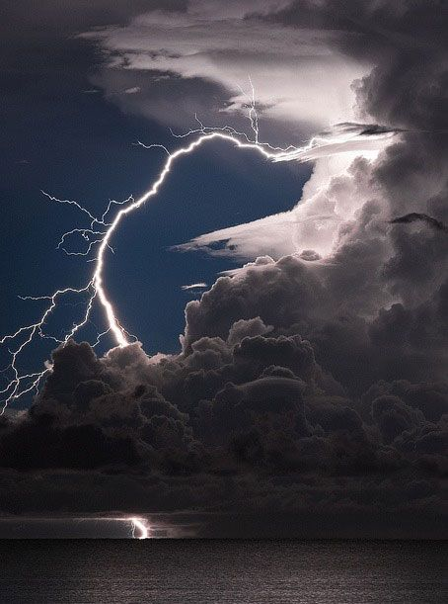
Genesis 1:2 (NIV)
Lucifer cause an Angelic revolt.
Isaiah 14:12-14 Fall of Lucifer
Luke 10:18 Satan fall like lightning
Rev 12:7-9 War in heaven
Notes:
Isaiah 14:12-14 (NKJV) The Fall of Lucifer
12 “How you are fallen from heaven, O [a]Lucifer, son of the morning! How you are cut down to the ground, You who weakened the nations!
13 For you have said in your heart: ‘I will ascend into heaven, I will exalt my throne above the stars of God; I will also sit on the mount of the congregation On the farthest sides of the north;
14 I will ascend above the heights of the clouds, I will be like the Most High.’
Luke 10:18 New King James Version (NKJV)
¹⁸ And He said to them, “I saw Satan fall like lightning from heaven.
Revelation 12:7-9 New King James Version (NKJV)
Satan Thrown Out of Heaven
⁷ And war broke out in heaven: Michael and his angels fought with the dragon; and the dragon and his angels fought, ⁸ but they ^{[a]}did not prevail, nor was a place found for ^{[b]}them in heaven any longer. ⁹ So the great dragon was cast out, that serpent of old, called the Devil and Satan, who deceives the whole world; he was cast to the earth, and his angels were cast out with him.

Slide 14
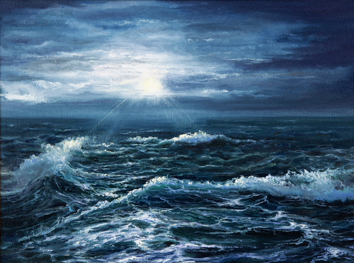
Genesis 1:2 (NIV)
Spirit of God was hovering
God’s Spirit / Power is ready to create.
Could the “New” from waters be a type of Baptism?
First Flood
Notes:
{Read} Genesis 1:2 (NIV) and the Spirit of God was hovering over the waters.
{Click} God’s Spirit or Power is ready to used. All the power needs is a command (The Word). {Click} At Baptism can we picture the Holy Spirit hovering ready to come in to us after the laying on of hands. {Click} this is also know as the “First Flood” It seems the story of Noah is a “Second Flood”

Slide 15

Genesis 1:3 (NIV)
“Let there be light,”
John 8:12 – Jesus; “Light of the World”
Matt 5:14-16 “We are a light in the world”
Rev 21:23 God’s light is brighter than the sun & moon
Life giving light
Notes:
{Read} Genesis 1:3 (NIV) ³ And God said, “Let there be light,” and there was light.
{Click} The first thing created after the beginning was “Light”. This Light was life giving light from God
John 8:12 New King James Version (NKJV)
¹² Then Jesus spoke to them again, saying, “I am the light of the world. He who follows Me shall not walk in darkness, but have the light of life.”
{Click} Matthew 5:14-16 New King James Version (NKJV)
¹⁴ “You are the light of the world. [God is a light that saved the Earth and we must become lights to save the world]
Revelation 21:23 New King James Version (NKJV)
²³ The city had no need of the sun or of the moon to shine ^{[a]}in it, for the ^{[b]}glory of God illuminated it. The Lamb is its light.
This topic of light is all thru scripture. Maybe in the future I can give a message just on the topic of “Llight” in scripture.

Slide 16
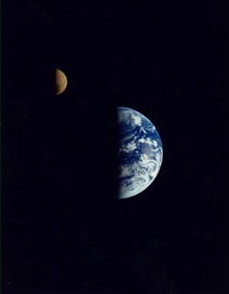
Genesis 1:4 (NIV)
Light, Darkness & Separation
Psalm 139:12 – Only humans experience dark / darkness
Job 26:10 ..horizon is a boundary..
Isa 5:20 Do not call darkness light..
The rotation of the earth causes light & dark
Notes:
{Read} Genesis 1:4 (NIV)
⁴ God saw that the light was good, and he separated the light from the darkness
{Click}
Psalm 139:12 New International Version (NIV)
¹² even the darkness will not be dark to you; the night will shine like the day, for darkness is as light to you.
{Click} Job 26:10 New International Version (NIV)
¹⁰ He marks out the horizon on the face of the waters for a boundary between light and darkness.
{Click} Isaiah 5:20 New International Version (NIV)
²⁰ Woe to those who call evil good and good evil, who put darkness for light and light for darkness, who put bitter for sweet and sweet for bitter.
{Click} {Read} This could be when God started the earth spinning

Slide 17

Genesis 1:5 (NIV)
Day and Night
Hebrew word Yom is used for day, means
Yom; 12 hours (light)
Yom; 24 hours
Yom; Calendar day
Yom; Point in time “Day of the Lord”
Notes:
{Read} Genesis 1:5 (NIV)
⁵ God called the light “day,” and the darkness he called “night.” And there was evening, and there was morning—the first day.
{Click}{Read}{Click}{Read}{Click}{Read}{Click}{Read} {Click}{Read} You need to read Yom in context , but I believe “the first day” is a 24-hour period of time.

Slide 18

Genesis 1:6-8 (NIV)
Sky and the Heavens
Sky is one of the heavens
Psa 19:1 Heavens declare God’s glory
Notes:
{Read} Genesis 1:6-8 (NIV)
⁶ And God said, “Let there be a vault between the waters to separate water from water. ⁷ So God made the vault and separated the water under the vault from the water above it. And it was so.” ⁸ God called the vault “sky.” And there was evening, and there was morning—the second day.
{Click}{Read}
{Click} {Read} Psalm 19:1 (NIV) ¹ The heavens declare the glory of God; the skies proclaim the work of his hands.

Slide 19

Genesis 1:9-13 (NIV)
Land, Vegetation, Trees
Created history or fully matured
Matt 7:17-18 Producing good fruit
Notes:
{Read} Genesis 1:9-13 (NIV)
And God said, “Let the water under the sky be gathered to one place, and let dry ground appear.” And it was so. ¹⁰ God called the dry ground “land,” and the gathered waters he called “seas.” And God saw that it was good.
¹¹ Then God said, “Let the land produce vegetation: seed-bearing plants and trees on the land that bear fruit with seed in it, according to their various kinds.” And it was so. ¹² The land produced vegetation: plants bearing seed according to their kinds and trees bearing fruit with seed in it according to their kinds. And God saw that it was good. ¹³ And there was evening, and there was morning—the third day.
Matthew 7:17-18 New King James Version (NKJV)
¹⁷ Even so, every good tree bears good fruit, but a bad tree bears bad fruit. ¹⁸ A good tree cannot bear bad fruit, nor can a bad tree bear good fruit.

Slide 20
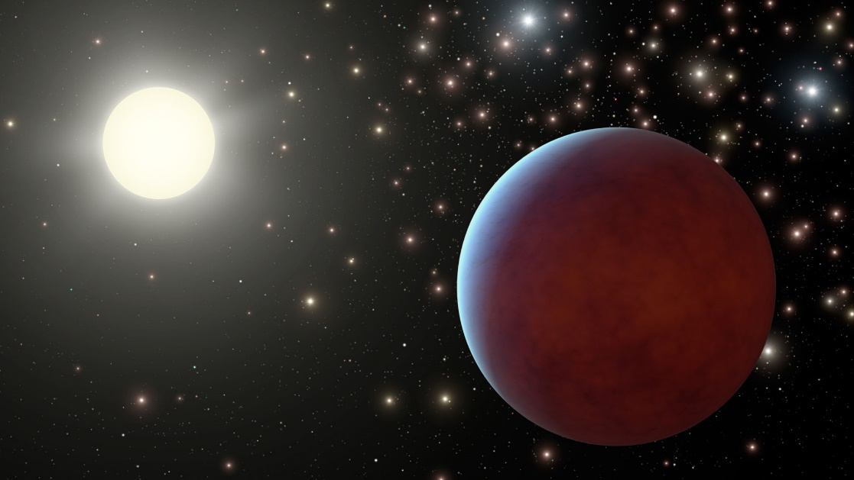
Genesis 1:14-19 (NIV)
Sun, Moon, Stars, Sacred Times
Is this light different from Gen 1:2?
Isa 42:5 – Heavens are stretched
Isa 34:4 ..heavens rolled up like a scroll..
Universe is expanding space.com
Notes:
{Read} Genesis 1:14-19 (NIV)
¹⁴ And God said, “Let there be lights in the vault of the sky to separate the day from the night, and let them serve as signs to mark sacred times, and days and years, ¹⁵ and let them be lights in the vault of the sky to give light on the earth.” And it was so. ¹⁶ God made two great lights—the greater light to govern the day and the lesser light to govern the night. He also made the stars. ¹⁷ God set them in the vault of the sky to give light on the earth, ¹⁸ to govern the day and the night, and to separate light from darkness. And God saw that it was good. ¹⁹ And there was evening, and there was morning—the fourth day.
{Click}{Read} Yes. I think this light is different
Isaiah 42:5 (NIV) ⁵ This is what God the Lord says— the Creator of the heavens, who stretches them out, who spreads out the earth with all that springs from it, who gives breath to its people, and life to those who walk on it:
Isaiah 34:4 New International Version (NIV)
⁴ All the stars in the sky will be dissolved and the heavens rolled up like a scroll;
{Click} space.com
The universe is expanding faster than expected, suggesting that astronomers may have to incorporate some new physics into their theories of how the cosmos works, a new study reports.
The revised expansion rate is about 10% faster than that predicted by observations of the universe's trajectory shortly after the Big Bang, according to the new research. The study also significantly reduces the probability that this disparity is a coincidence, from 1 in 3,000 to just 1 in 100,000.
"This mismatch has been growing and has now reached a point that is really impossible to dismiss as a fluke," study lead author Adam Riess, a professor of physics and astronomy at The Johns Hopkins University in Baltimore, said in a statement.
{Use hand gesture of God scrolling or stretching the universe}
Interesting coincidence – one of Lucifer's meaning is “Light Bearer”, Morning Star or Morning Sun. The Angles are referred to in Scripture as stars. Could it be that one of Satan and Angel’s responsibilities before they rebelled was to provide light to the earth? Is the universe being created or recreated in Gen 1:14-19? {Speculate, explain, but don’t be definitive}.

Slide 21
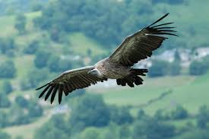
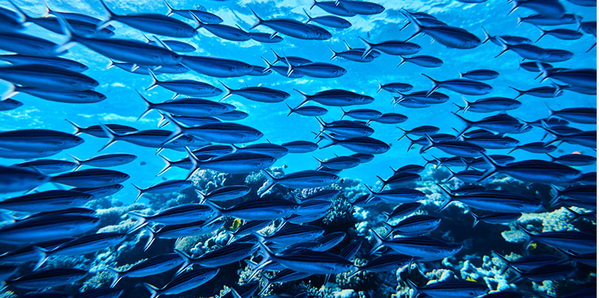
Genesis 1:20-23 (NIV)
Water Creatures, Birds
Hebrew for creature is Nephesh
Nephesh soul, life, lives, person, heart, mind, desire, himself…
Nephesh can only reproduce their kind
Eze 18:20 (NKJV) ..soul can die
Notes:
{Read} Genesis 1:20-23 (NIV)
²⁰ And God said, “Let the water teem with living creatures, and let birds fly above the earth across the vault of the sky.” ²¹ So God created the great creatures of the sea and every living thing with which the water teems and that moves about in it, according to their kinds, and every winged bird according to its kind. And God saw that it was good. ²² God blessed them and said, “Be fruitful and increase in number and fill the water in the seas, and let the birds increase on the earth.” ²³ And there was evening, and there was morning—the fifth day.
{Click}{Read} Different specifics of animals were created to mate and produce
Ezekiel 18:20 New King James Version (NKJV)
²⁰ The soul who sins shall die.

Slide 22
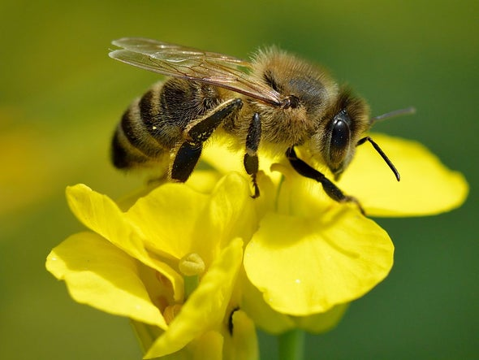
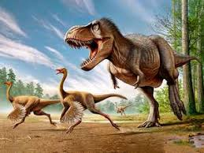
Genesis 1:24-26 (NIV)
Land Creatures
Bees needed to pollinate; sustainweb.org
Job 40 – 41 Behemoth & Leviathan
Notes:
{Read} Genesis 1:24-26 (NIV)
And God said, “Let the land produce living creatures according to their kinds: the livestock, the creatures that move along the ground, and the wild animals, each according to its kind.” And it was so. ²⁵ God made the wild animals according to their kinds, the livestock according to their kinds, and all the creatures that move along the ground according to their kinds. And God saw that it was good.
²⁶ Then God said, “Let us make mankind in our image, in our likeness, so that they may rule over the fish in the sea and the birds in the sky, over the livestock and all the wild animals,^{[a]} and over all the creatures that move along the ground.”
{Click} {Read} Could vegetation live for 1000s of years w/o pollination?
Globally there are more honeybees than other types of bee and pollinating insects, so it is the world’s most important pollinator of food crops. It is estimated that one third of the food that we consume each day relies on pollination mainly by bees, but also by other insects, birds and bats.
Many domestic and imported fruits and vegetables require pollination. Examples include avocados, soybeans, asparagus, broccoli, celery, squash, and sunflowers for oil, cucumbers, citrus fruit, peaches, kiwis, cherries, cranberries and melons. For crops such as blueberries and almonds, the honeybee plays an essential role in pollination of commercial crops, with around 80% of the US crop said to be dependent on honeybees. Honeybees can also pollinate clover and alfalfa, which are fed to cattle, so there are implications for the meat and dairy industry too. And that is not to mention the huge range of manufactured food products made from all these ingredients. In addition, honeybees play a significant role in the pollination of other important crops such as cotton and flax. And there are also a number of valuable non-food products produced by the honeybee, such as beeswax used in cleaning and beauty products
{Click}{Read} Job 40:15-24 New International Version (NIV)
15 “Look at Behemoth, which I made along with you and which feeds on grass like an ox. 16 What strength it has in its loins, what power in the muscles of its belly! 17 Its tail sways like a cedar; the sinews of its thighs are close-knit. 18 Its bones are tubes of bronze, its limbs like rods of iron. 19 It ranks first among the works of God, yet its Maker can approach it with his sword. 20 The hills bring it their produce, and all the wild animals play nearby. 21 Under the lotus plants it lies, hidden among the reeds in the marsh. 22 The lotuses conceal it in their shadow; the poplars by the stream surround it. 23 A raging river does not alarm it; it is secure, though the Jordan should surge against its mouth. 24 Can anyone capture it by the eyes, or trap it and pierce its nose?
Job 41 New International Version (NIV)
41 [a]“Can you pull in Leviathan with a fishhook or tie down its tongue with a rope? 2 Can you put a cord through its nose or pierce its jaw with a hook? 3 Will it keep begging you for mercy? Will it speak to you with gentle words? 4 Will it make an agreement with you for you to take it as your slave for life? 5 Can you make a pet of it like a bird or put it on a leash for the young women in your house? 6 Will traders barter for it? Will they divide it up among the merchants? 7 Can you fill its hide with harpoons or its head with fishing spears? 8 If you lay a hand on it, you will remember the struggle and never do it again! 9 Any hope of subduing it is false; the mere sight of it is overpowering. 10 No one is fierce enough to rouse it. Who then is able to stand against me?
The short answer we do not know. These appear to be two animals that are extinct.

Slide 23
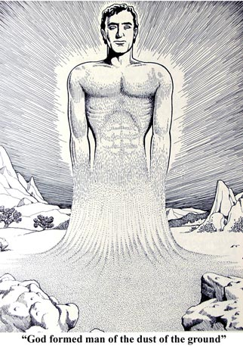
Genesis 1:27-31 (NIV)
Man in the Image of God
Psa 8:3-8 ..little lower than the angels…
Col 1:15 Jesus Christ - image of God – Firstborn over creation
Be in the God family, salvation
Notes:
{Read} Genesis 1:27-31 (NIV)
So God created mankind in his own image,
in the image of God he created them;
male and female he created them.
²⁸ God blessed them and said to them, “Be fruitful and increase in number; fill the earth and subdue it. Rule over the fish in the sea and the birds in the sky and over every living creature that moves on the ground.”
²⁹ Then God said, “I give you every seed-bearing plant on the face of the whole earth and every tree that has fruit with seed in it. They will be yours for food. ³⁰ And to all the beasts of the earth and all the birds in the sky and all the creatures that move along the ground—everything that has the breath of life in it—I give every green plant for food.” And it was so.
³¹ God saw all that he had made, and it was very good. And there was evening, and there was morning—the sixth day.
{Click}Psalm 8:3-8 New International Version (NIV)
³ When I consider your heavens,
the work of your fingers,
the moon and the stars,
which you have set in place,
⁴ what is mankind that you are mindful of them,
human beings that you care for them?^{[a]}
⁵ You have made them^{[b]} a little lower than the angels^{[c]}
and crowned them^{[d]} with glory and honor.
⁶ You made them rulers over the works of your hands;
you put everything under their^{[e]} feet:
⁷ all flocks and herds,
and the animals of the wild,
⁸ the birds in the sky,
and the fish in the sea,
all that swim the paths of the seas.
Colossians 1:15 New International Version (NIV)
The Supremacy of the Son of God
¹⁵ He (The Son, Jesus Christ) is the image of the invisible God, the firstborn over all creation.

Slide 24

Genesis 2:1-2 (NIV)
Sabbath Day
God rested
Then made Sabbath Day is Holy
Day here is sunset to sunset
Notes:
{Read} Genesis 2:1-2 (NIV)
Genesis 2 New International Version (NIV)
2 Thus the heavens and the earth were completed in all their vast array.
² By the seventh day God had finished the work he had been doing; so on the seventh day he rested from all his work. ³ Then God blessed the seventh day and made it holy, because on it he rested from all the work of creating that he had done.
{Click} God rested or reflected, meditated, etc.
{Click} Then God blessed the day and made it Holy
{Click} A day here is sunset to sunset.

Slide 25
Creation Beliefs
Which one is correct?
Young Earth Creationism
Gap Creationism
Progressive Creationism
Day-age Creationism
Theistic Evolution
None of this above
Notes:
{Read} {Click}

Slide 26
Creation Beliefs
Which one is correct?
Gap Creationism is close,
but Young Earth Creationism has some interesting points.
Progressive Creationism - Bad
Day-age Creationism - Worse
Theistic Evolution – You have got to be kidding!!!
Notes:
{Read} {Click}

Slide 27
What are our take a ways?
Intelligent Creator (Elohim) with a plan.
  A Beginning.
  An Angelic world.
  A Physical Earth filled with Light, Vegetation and Creatures (Nephesh).
  Mankind in the image of God.
  More…
Creation has order, harmony and morals. - Shows Gods love for us (His Creation)
Notes:
{Read} {Click} We have an intelligent creators (Elohim) that designed the creation and mankind. Then the Word of God commanding the Spirit of God created everything. God wanted to increase His Family or the “God Kind”. Together they implemented a plan. In this plan they created:
{Click}{Read}{Click}{Read}{Click}{Read}{Click}{Read}
{Click}{Read} {Explain Nightmare if Evolution w/o God were true}

Slide 28
What are our take a ways?
The Creator knows more than we do.
If the Creator wants you to know something, He will tell you. - I don’t know is okay.
Let the bible be definitive / absolute, not us “Young Earth vs. Old Earth”
Creation should help us love God and keep the Sabbath – Exo 20:8-11
The Creation we live in will be restored to the Creation of the beginning – Rom 8:20-24
Notes:
{Read} {Click} This one might be obvious, but God and The Word were there at Creation. They have firsthand accounts of creation. We have “hear-say” accounts of creation. Now our “hear-say” is the bible, but it is still not the same as being there.
{Click}{Read} {Expound it is okay not to know}
{Click}{Read} {Wait} Exodus 20:8-11 New International Version (NIV)
⁸ “Remember the Sabbath day by keeping it holy. ⁹ Six days you shall labor and do all your work, ¹⁰ but the seventh day is a sabbath to the Lord your God. On it you shall not do any work, neither you, nor your son or daughter, nor your male or female servant, nor your animals, nor any foreigner residing in your towns. ¹¹ For in six days the Lord made the heavens and the earth, the sea, and all that is in them, but he rested on the seventh day. Therefore the Lord blessed the Sabbath day and made it holy.
{Click} {Read} {Wait} Romans 8:20-24 New King James Version (NKJV)
²⁰ For the creation was subjected to futility, not willingly, but because of Him who subjected it in hope; ²¹ because the creation itself also will be delivered from the bondage of ^{[a]}corruption into the glorious liberty of the children of God. ²² For we know that the whole creation groans and labors with birth pangs together until now. ²³ Not only that, but we also who have the firstfruits of the Spirit, even we ourselves groan within ourselves, eagerly waiting for the adoption, the redemption of our body. ²⁴ For we were saved in this hope, but hope that is seen is not hope; for why does one still hope for what he sees?

Slide 29
What are our take a ways?
We need to love the Creator and not the Creation – Rom 1:25 (NLT)
To love our Creator means we must love one another. – 1 John 4:7-11
Don’t let “Special Knowledge” of speculative details of Creation week steal your crown. – Is this a Bride of Christ Issue? – Rev 19:7
Notes:
Romans 1:25 New Living Translation (NLT)
²⁵ They traded the truth about God for a lie. So they worshiped and served the things God created instead of the Creator himself, who is worthy of eternal praise! Amen.
1 John 4:12 New Living Translation (NLT)
¹² No one has ever seen God. But if we love each other, God lives in us, and his love is brought to full expression in us.
1 John 4:7-11 New King James Version (NKJV)
Knowing God Through Love
⁷ Beloved, let us love one another, for love is of God; and everyone who loves is born of God and knows God. ⁸ He who does not love does not know God, for God is love. ⁹ In this the love of God was manifested toward us, that God has sent His only begotten Son into the world, that we might live through Him. ¹⁰ In this is love, not that we loved God, but that He loved us and sent His Son to be the propitiation for our sins. ¹¹ Beloved, if God so loved us, we also ought to love one another.
{Click} {Read}. There is a lot you and I don’t know. No human knows all the details of the Recreation week. But there is much we can learn but if believe we have “Special Knowledge” and use it as pride in a believe that we are better than anyone else in the body we will loose our Crown. What ever you believe about Recreation week ask yourself the question “Is this a Bride of Christ Issue?. Are believe in a Creator, our knowledge of Recreation week should take us to Rev 19:7.

Slide 30

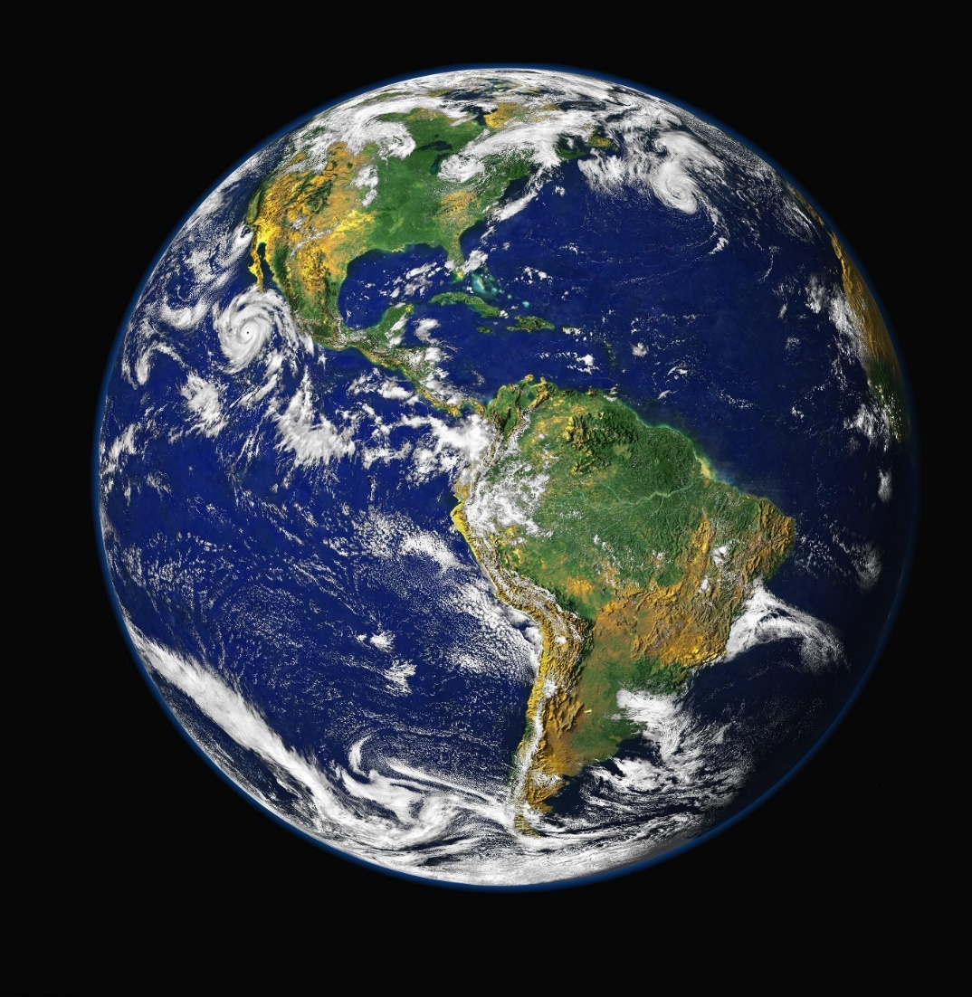
What are our take a ways?
Rev 19:7
Notes:
Revelation 19:7 New King James Version (NKJV)
⁷ Let us be glad and rejoice and give Him glory, for the marriage of the Lamb has come, and His wife has made herself ready.”

