Slide 1
HAPPY SABBATH

Slide 2
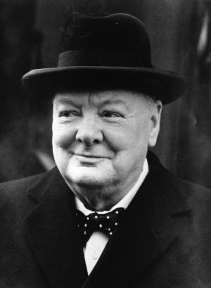
Sir Winston Churchill

Slide 3
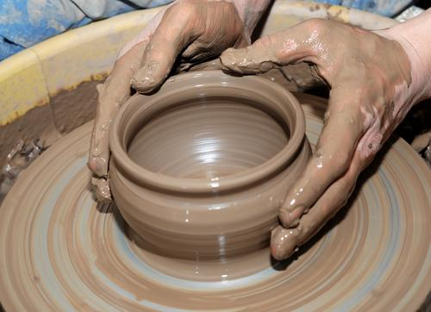
THE POTTER AND THE CLAY

Slide 4
Isa 64:8
But now, O Lord, You are our Father; We are the clay, and You our potter; And all we are the work of Your hand

Slide 5
Job 33:6
I also am formed out of clay

Slide 6
Jer. 18:1-6
The word which came to Jeremiah from the Lord, saying: ² “Arise and go down to the potter’s house, and there I will cause you to hear My words.”³ Then I went down to the potter’s house, and there he was, making something at the wheel. ⁴ And the vessel that he made of clay was marred in the hand of the potter; so he made it again into another vessel, as it seemed good to the potter to make. ⁵ Then the word of the Lord came to me, saying: ⁶ “O house of Israel, can I not do with you as this potter?” says the Lord. “Look, as the clay is in the potter’s hand, so are you in My hand, O house of Israel!

Slide 7
7 VITAL STEPS
Choose The Clay
Weathering The Clay
Wedging The Clay
Shaping The Clay
Firing Th Clay
Decorating The Clay
Judging The Pottery

Slide 8
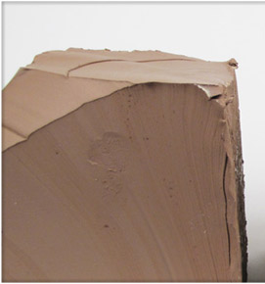
FIRST: Choosing The Clay
God Must Choose Us

Slide 9
John 15:16
¹⁶ You did not choose Me, but I chose you and appointed you that you should go and bear fruit, and that your fruit should remain, that whatever you ask the Father in My name He may give you.

Slide 10
John 6:44
No man can come to me, except the Father which hath sent me draw him

Slide 11
2 Peter 3:9
The Lord is . . . not willing that any should perish, but that all should come to repentance

Slide 12
Rom 9:11-12
¹¹ for the children not yet being born, nor having done any good or evil, that the purpose of God according to election might stand, not of works but of Him who calls, ¹² it was said to her, “The older shall serve the younger.

Slide 13
So then it is not of him that wills, nor of him that runs, but of God that shows mercy” (verse 16)

Slide 14
²¹ Does not the potter have power over the clay, from the same lump to make one vessel for honor and another for dishonor? (Verse 21 .)

Slide 15
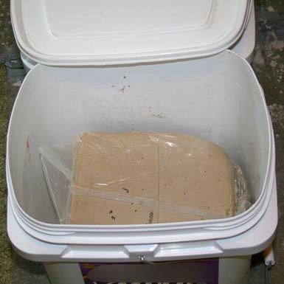
SECOND: Weathering The Clay
Our Stinking Sins

Slide 16
Isa. 64:6-8
⁶ But we are all like an unclean thing, And all our righteousnesses are like filthy rags; We all fade as a leaf, And our iniquities, like the wind, Have taken us away. ⁷ And there is no one who calls on Your name, Who stirs himself up to take hold of You; For You have hidden Your face from us, And have consumed us because of our iniquities. ⁸ But now, O Lord, You are our Father; We are the clay, and You our potter; And all we are the work of Your hand.

Slide 17
Matt. 9: 13
For I am not come to call the (self-) righteous, but sinners to repentance

Slide 18
Job 10:7
Although You know that I am not wicked, And there is no one who can deliver from Your hand?
Job 27:6
My righteousness I hold fast, and will not let it go: my heart shall not reproach me so long as I live

Slide 19
Job 42 :6
Wherefore I ABHOR myself, and repent in dust and ashes

Slide 20

THIRD: Wedging The Clay
Why Beat Clay?

Slide 21
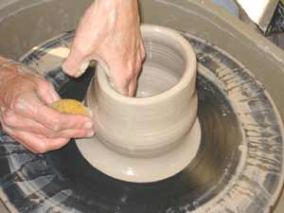
FOURTH: Shaping The Clay
Molding The Pottery

Slide 22
John 7:37-39
If any man thirst, let him come unto me, and drink. He that believeth on me, as the scripture hath said, out of his belly [or innermost being] shall flow rivers of living WATER. But this he spoke of the Spirit, which they that believe in him should receive: for the Holy Spirit was not yet given. . .

Slide 23
Rom. 6:13
YIELD YOURSELVES UNTO GOD
Rom. 12:1
a living sacrifice, holy, acceptable unto God, which is your reasonable service

Slide 24
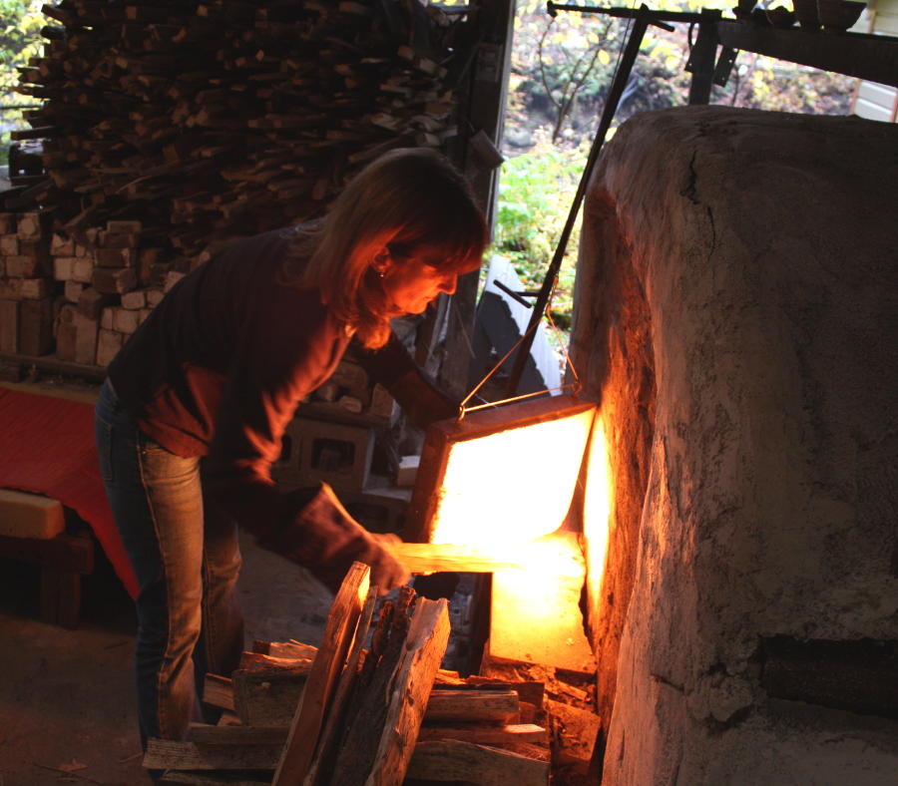
FIFTH: Firing The Clay
Plunged Into Fire

Slide 25
James 1:13
¹³ Let no one say when he is tempted, “I am tempted by God”; for God cannot be tempted by evil, nor does He Himself tempt anyone.

Slide 26
1 Peter 1:6-7
⁶ In this you greatly rejoice, though now for a little while, if need be, you have been grieved by various trials, ⁷ that the genuineness of your faith, being much more precious than gold that perishes, though it is tested by fire, may be found to praise, honor, and glory at the revelation of Jesus Christ,

Slide 27
1 Peter 4:12-13
¹² Beloved, do not think it strange concerning the fiery trial which is to try you, as though some strange thing happened to you; ¹³ but rejoice to the extent that you partake of Christ’s sufferings, that when His glory is revealed, you may also be glad with exceeding joy.

Slide 28
James 1 :2-3
² My brethren, count it all joy when you fall into various trials, ³ knowing that the testing of your faith produces patience.
verse 12
Blessed is the man that endureth temptation: for when he is Tried, he shall receive the CROWN OF LIFE, which the Lord hath promised to them that love him

Slide 29
Heb. 13:5
I WILL NEVER LEAVE YOU, NOR FORSAKE YOU

Slide 30
1 Cor. 10:13
¹³ No temptation has overtaken you except such as is common to man; but Godis faithful, who will not allow you to be tempted beyond what you are able, but with the temptation will also make the way of escape, that you may be able to bear it.

Slide 31
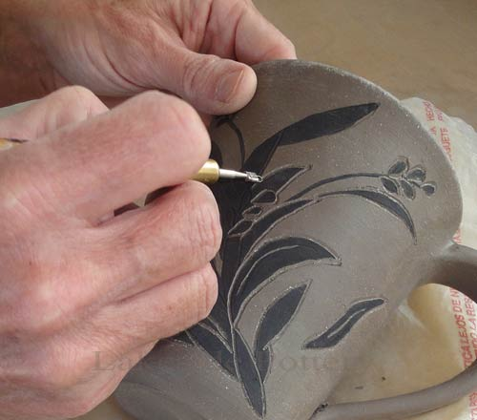
SIXTH: Decorating The Clay
Finishing Touches

Slide 32
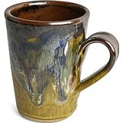
SEVENTH: Judging The Pottery
At Last-A Work Of Art

Slide 33
Abraham (Gen. 22:1- 19)
David (Psalm 51)
Daniel (Dan. 6)
Paul (11 Cor. 11:23-28)

Slide 34
Jesus Christ, our Saviour
Heb. 4:15
Matt. 26:38 through 27:50

Slide 35
Matt. 24:13
He that shall endure unto the end, the same shall be saved

Slide 36
Rev. 21:7
He that overcomes (sin, trials, tests, temptations) SHALL INHERIT ALL THINGS; and I Will be his God, and he shall be my son

Slide 37
ENJOY THE REST OF YOUR SABBATH

