Slide 1

Mothers Day

Slide 2
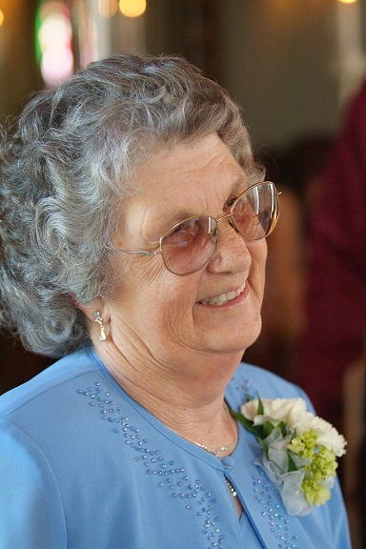
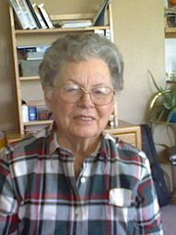
Barb Wolcott Fern Sheppherd

Slide 3
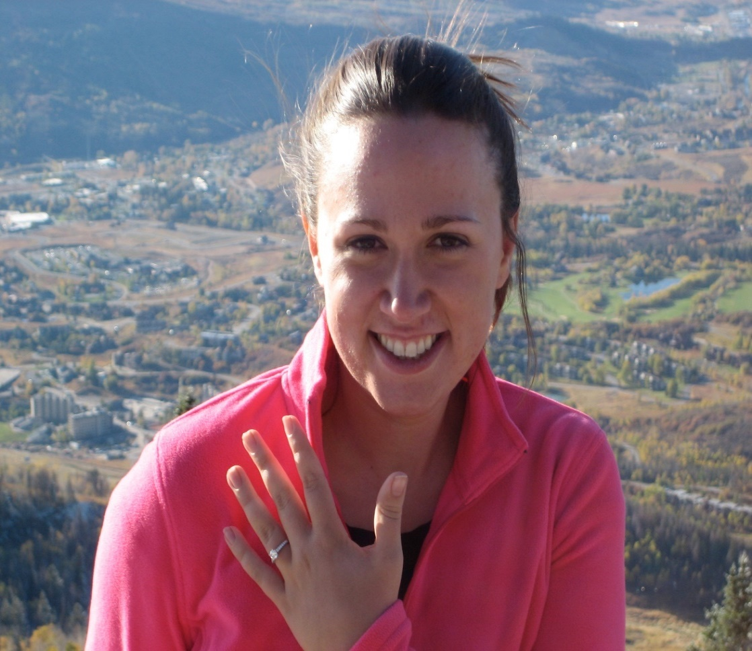
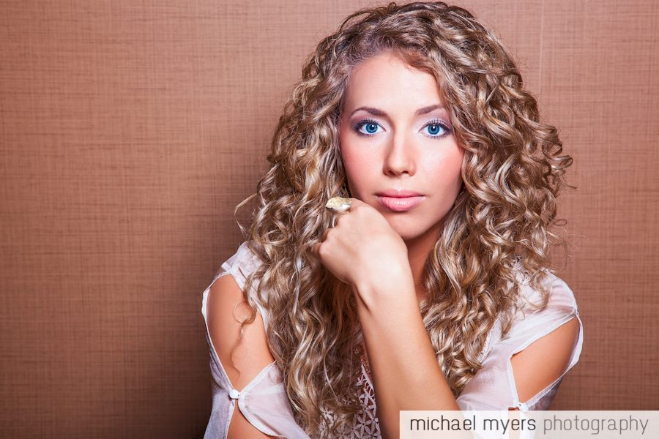
Amanda Harring (Damour) Amber Damour

Slide 4
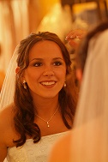
Brandy Damour

Slide 5
“it seemed good to me also, having followed all things closely for some time past, to write an orderly account for you, most excellent Theophilus, that you may have certainty concerning the things you have been taught.”
Luke 1:3-4 ESV
But they had no child, because Elizabeth was barren, and both were advanced in years. Now while he was serving as priest before God when his division was on duty,
Luke 1:7-8 ESV
Now while he was serving as priest before God when his division was on duty, according to the custom of the priesthood, he was chosen by lot to enter the temple of the Lord and burn incense.
Luke 1:8-9 ESV

Slide 6
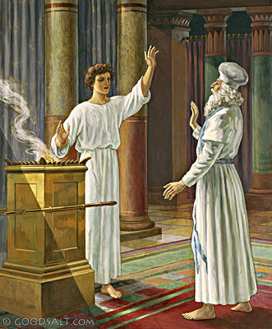

Slide 7
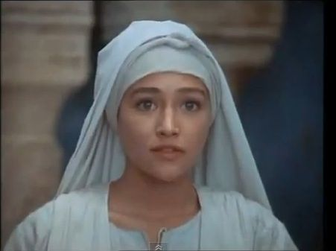
Mary Was Young But Full of Faith

Slide 8
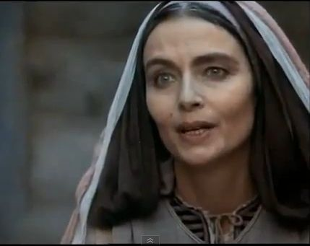
Elizabeth Was Elderly Yet Expecting

Slide 9
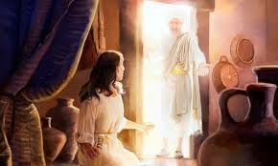
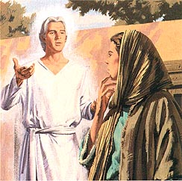

Slide 10
Compare What Happened
Zacharias and Elizabeth (Gabriel)
Luke 1:5-23
Parents are introduced
Reproduction Problem (age)
Gabriel
Reaction “Do not be afraid”
Promised Son (description)
He did not believe
Mary and Gabriel
Luke 1:26-38
Parents are introduced
Reproduction Problem (Virgin)
Gabriel
Reaction “Do not be afraid”
Promised Son (description)
Mary could not understand

Slide 11
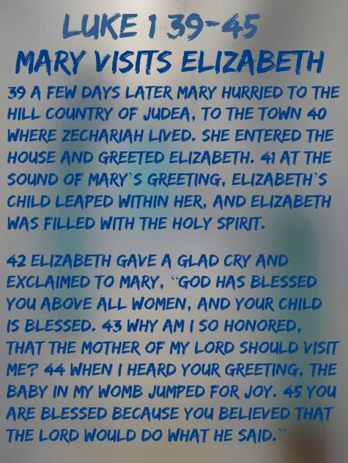

Slide 12
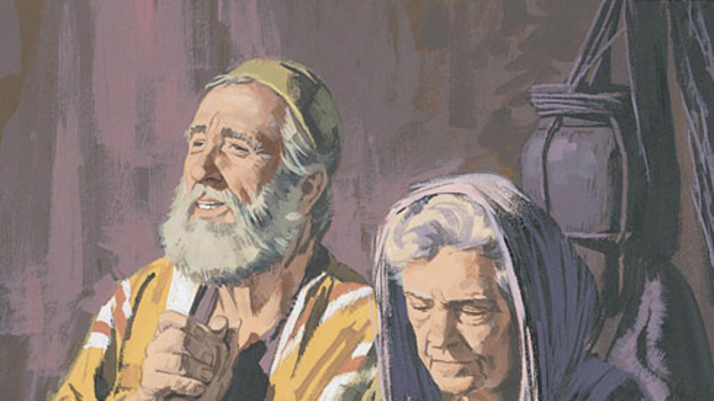
With God All Things Are Possible
Matthew 19:26

Slide 13
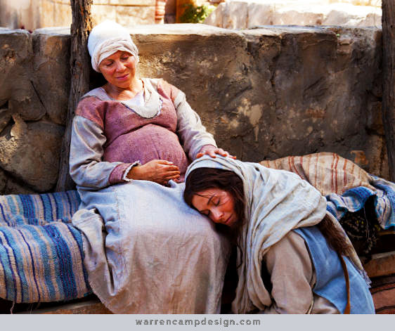
The Importance of Their Time Together
Luke 1:39-44
This meeting would assure a very young and willing Mary that God would do exactly what the Angel had told her

Slide 14
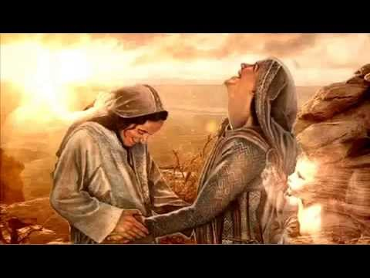
Why Was Time Together So Important?

Slide 15
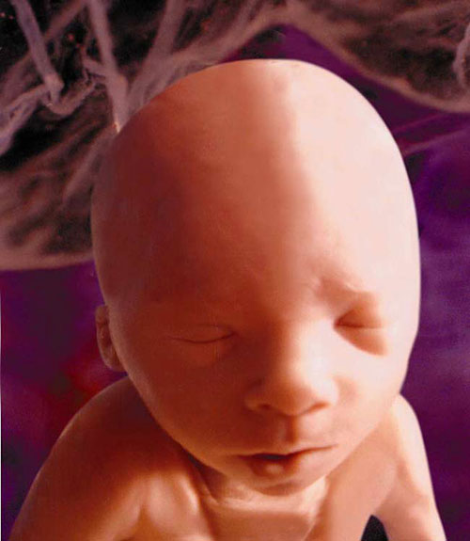
Youngest Prophet In Scripture

Slide 16
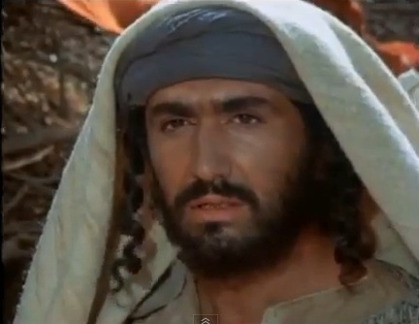
When Did Joseph Know?

Slide 17
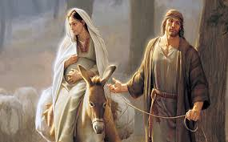

Slide 18
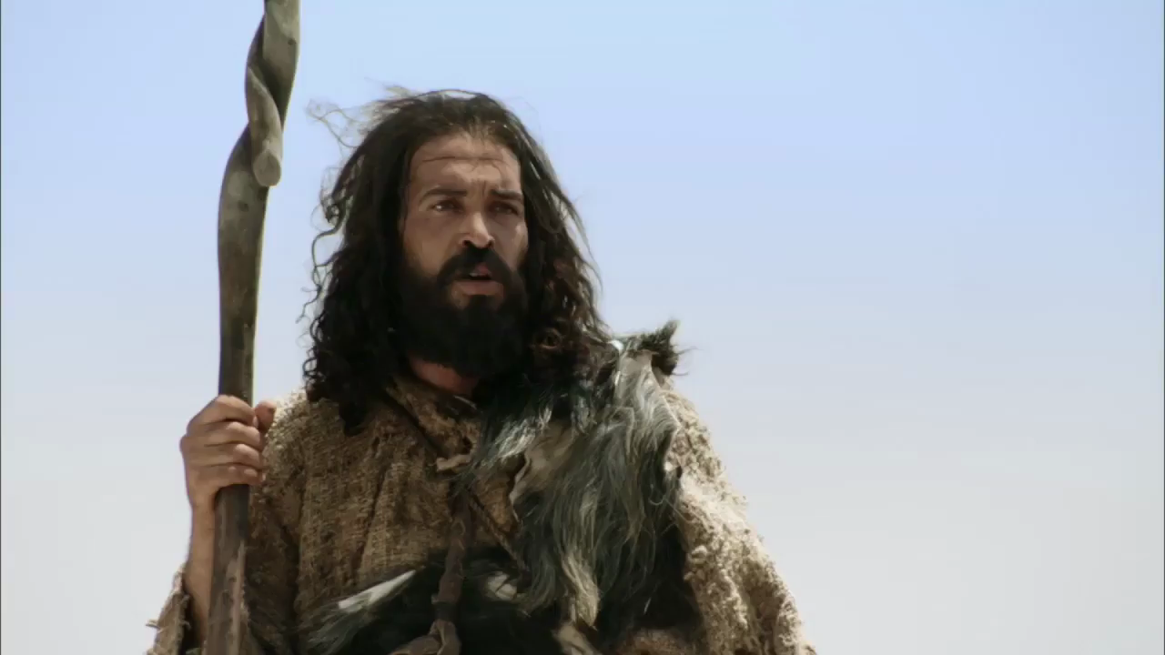
John The Baptist The Cousin of Jesus

Slide 19


Slide 20

“Six months later, Jesus Christ was born. Therefore, Christ is six months younger than his cousin and was born most likely in the fall sometime in the timeframe of September or October of that year.”

Slide 21
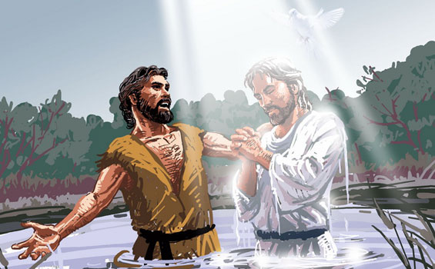
John Baptizing Jesus

Slide 22
Lessons Of Mothers Day
Eph_5:31 "Therefore a man shall leave his father and mother and hold fast to his wife, and the two shall become one flesh."
Eph_6:2 "Honor your father and mother" (this is the first commandment with a promise),
1Th_2:7 But we were gentle among you, like a nursing mother taking care of her own children.
2Ti_1:5 I am reminded of your sincere faith, a faith that dwelt first in your grandmother Lois and your mother Eunice and now, I am sure, dwells in you as well. (ESV)

Slide 23


Slide 24



Slide 25


