Slide 1
Numbers Introduction
Chapter 1
Bible Study

Slide 2
Exodus 19 through Numbers 10:10 —while Israel is at Sinai…
Exodus 19: 1—Israel comes to Mt. Sinai
1st day of the 3rd month after leaving Egypt…where they stayed almost a year
10 months
Exodus 40:1—The tabernacle set up
1st day of the 1st month of the 2nd year after leaving Egypt
Num.7-9:15
Leviticus 1—27
At the foot of Mt. Sinai receiving God’s instructions
1 Month
Numbers 1:1
1st day of the 2nd month of the 2nd year after leaving Egypt
Census taken
Numbers 10: 11—Israel leaves Sinai
20th day of the 2nd month of the 2nd year after leaving Egypt

Slide 3
Numbers
The name of the book “Numbers” was translated from the Greek Septuagint and comes from the first census taken of Israel [Num. 1:1]
A second census was taken of those who would go into the promised land because the first generation who came out of Egypt had died [Num. 26:2]
The Hebrew name Bemidbar, the 5th word of the book, translated into English means “in the wilderness” [more suitable]
The name “Numbers” is from the first census:
Eleven of the Israelite tribes were numbered—603, 550 men who were able to go to war…but because of their duties in the tabernacle, the Levites were not numbered
The census was conducted by the tribal leaders, the head of each tribe—13 months after the Exodus from Egypt

Slide 4
Moses—author of the book of Numbers
Numbers 33:2
²Now Moses wrote down the starting points of their journeys at the command of the Lord. And these are their journeys according to their starting points:
The book of Numbers is mentioned many times in the New Testament:
(I Corinthians 10: 5-10)
⁵But with most of them God was not well pleased, for their bodies were scattered in the wilderness.
Hebrews 3:15-19
¹⁵while it is said: “Today, if you will hear His voice, Do not harden your hearts as in the rebellion.”
¹⁶For who, having heard, rebelled? Indeed, was it not all who came out of Egypt, led by Moses?
¹⁷Now with whom was He angry forty years? Was it not with those who sinned, whose corpses fell in the wilderness?
¹⁸And to whom did He swear that they would not enter His rest, but to those who did not obey?
¹⁹So we see that they could not enter in because of unbelief.

Slide 5
A theme of the book—what Israel should have been
(Int. St. Bible Enc.) “In Numbers God’s presence made the camp itself holy, and Israel was instructed in how to maintain this holiness through their obedience to God’s instructions.
However, what the people were, as opposed to what they should have been, is a theme clearly expressed in Numbers.”
(The Pentateuch, Thomas) “the years of wandering were outside of His (God’s) will, because they were due to disobedience.
The chapters 15-25 give all the knowledge we possess of this long period. God cast a veil of silence over these years, while the old generation was dying out and the new one being trained.”
The Passover of Chapter 9 [before they left Sinai] is the only festival recorded in the book

Slide 6
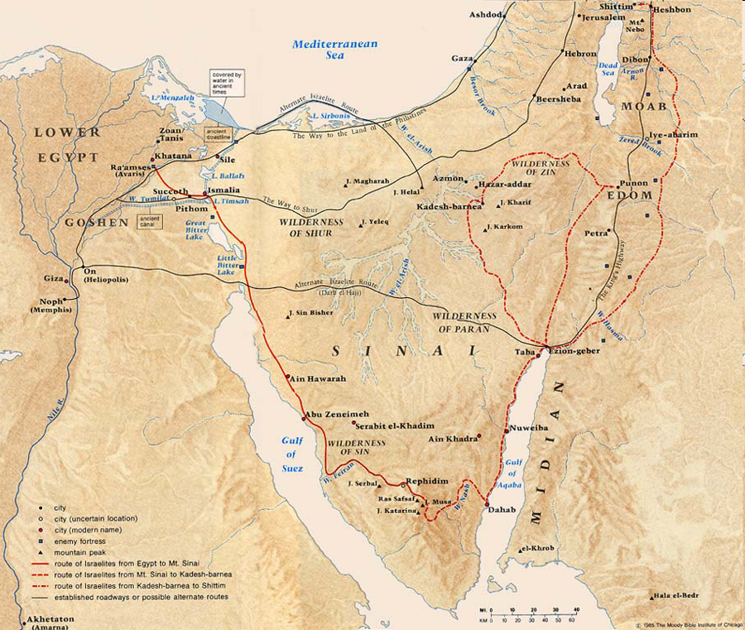
Structure of the book of Numbers:
Section 3 (20:1—36:13)
“On the plains of Moab”
Includes the journey from Kadesh to Moab Ch. 20-21
Section 2 (10:11—19:22)
From Sinai to Kadesh-barnea
38 years around Kadesh
(Deut. 2:14)
Section 1 (1:1—10:10)
Still at Sinai
A period of 19 days

Slide 7
The “Forty Years”—from the time they came out of Egypt
The book of Numbers covers a period of the remaining 39 years of the 40 years of Israel in the wilderness [actually 38 years and nine months]
Numbers 1:1
¹Now the Lord spoke to Moses in the Wilderness of Sinai, in the tabernacle of meeting, on the first day of the second month, in the second year after they had come out of the land of Egypt,
[13 months]
Numbers 33:38
³⁸Then Aaron the priest went up to Mount Hor at the command of the Lord, and died there in the fortieth year after the children of Israel had come out of the land of Egypt, on the first day of the fifth month.
Deuteronomy 1: 3
³Now it came to pass in the fortieth year, in the eleventh month, on the first day of the month, that Moses spoke to the children of Israel according to all that the Lord had given him as commandments to them,

Slide 8
Pattern of the book
At Sinai
Ex. 19—Numbers 10:10
Instructions from God
Sinai to Kadesh
Num. 10:11—12:16
Journey
At Kadesh
Num. 13—19:22
Instructions from God
Kadesh to Moab
Num. 20:1—22:1
Journey
At Moab
Num. 22:2—36:13
Instructions from God

Slide 9
Numbers is not chronological and especially the 1st ten chapters of Numbers are not in chronological order
It is not chronological because emphasis is placed on the census of Israel which is placed first
(Allis) “Israel is not an unorganized and heterogeneous ‘mob’. They are a distinct people, whose names and ages and tribal relationships are definitely known.”
The events of 7—9 take place on the day when the tabernacle was set up one month earlier than the census of chapter 1

Slide 10
The narrative in Numbers is not perfectly chronological—particularly chapters 1--10
A rearrangement of the text in chronological order of chapters 1-10 would be like this:
2nd year after leaving Egypt
1st day of the 1st month
Chapter 9: 15; 7:1 [Ex. 40:2,17]
The 1st day the tabernacle was set up
1st—12th day of 1st month
Chapter 7:2—7:84
For 12 days the tribes brought offerings for the tabernacle consecration
14th day of 1st month
Chapter 9:1-5
On the 14th day the Passover was kept
1st day of 2nd month
Chapter 1:1—6:27
1st day of the 2nd month the census was taken
20th day of the 2nd month
Chapter 10:11
20th day of the 2nd month Israel leaves Sinai

Slide 11
The census is placed first in the book of Numbers although out of chronological order
To show the importance—Israel is an organized people
(Allis) “They are a distinct people, whose names and ages and tribal relationships are definitely known”
The time frame of 1:1—10:10 is nineteen days

Slide 12
Numbers 1
¹Now the Lord spoke to Moses in the Wilderness of Sinai, in the tabernacle of meeting, on the first day of the second month, in the second year after they had come out of the land of Egypt, saying:
“Now”= “And” [OKJ]
(Companion) “Numbers begins with ‘And’, as all the books of the Pentateuch do. It is therefore one whole in five sections, rather than five separate books.”
“in the Wilderness” (Heb. Title) Bemidbar
“because it records what took place there” (Companion)
“first day of the second month, in the 2nd year” since leaving Egypt
It had been 13 months since Israel had left Egypt and they had been at Sinai for about eleven months
They are 20 days from leaving Sinai on the 20th day of the 2nd month

Slide 13
²“Take a census of all the congregation of the children of Israel, by their families, by their fathers’ houses, according to the number of names, every male individually,
³from twenty years old and above—all who are able to go to war in Israel. You and Aaron shall number them by their armies.
⁴And with you there shall be a man from every tribe, each one the head of his father’s house.
v. 2 ‘take a census’—literally calculate the total (1 month after the tabernacle was set up)
The 2nd census mentioned at Sinai—the first mention was a census tax used for the building of the tabernacle [Ex. 30:12-16] Another census 26: 1
v. 3 ‘who are able to go to war’
(Tyndale) “stresses that the nation is being organized to invade the promised land”
v. 4 One man from each tribe is appointed to assist Moses and Aaron in gathering the numbers for his tribe—would be regarded as legitimate by all
“every tribe”
(Companion) “Hence twelve, and, with Moses and Aaron, fourteen”

Slide 14
v. 5-15 The representatives of the twelve tribes and their names
⁵“These are the names of the men who shall stand with you: from Reuben, Elizur the son of Shedeur;
⁶from Simeon, Shelumiel the son of Zurishaddai;
⁷from Judah, Nahshon the son of Amminadab;
⁸from Issachar, Nethanel the son of Zuar;
⁹from Zebulun, Eliab the son of Helon;
¹⁰from the sons of Joseph: from Ephraim, Elishama the son of Ammihud; from Manasseh, Gamaliel the son of Pedahzur;
¹¹from Benjamin, Abidan the son of Gideoni;
¹²from Dan, Ahiezer the son of Ammishaddai;
¹³from Asher, Pagiel the son of Ocran;
¹⁴from Gad, Eliasaph the son of Deuel;£
¹⁵from Naphtali, Ahira the son of Enan.”
¹⁶These were chosen from the congregation, leaders of their fathers’ tribes, heads of the divisions in Israel.
(Tyndale) “Most of the names are theophoric, that is they are compounds in which a name of God is used. Thus Elizur means ‘my God is a rock’. Shelumiel means ‘El [God] is my salvation’.
The function of these leaders…is to lead the tribes, especially on the march to Canaan

Slide 15
v.17-19 The introduction to the census
¹⁷Then Moses and Aaron took these men who had been mentioned by name,
¹⁸and they assembled all the congregation together on the first day of the second month; and they recited their ancestry by families, by their fathers’ houses, according to the number of names, from twenty years old and above, each one individually.
¹⁹As the Lord commanded Moses, so he numbered them in the Wilderness of Sinai.
v. 17 ‘Moses took these men’ “The verb indicates that the leaders fulfilled God’s command to number themselves with regard to their tribal connections.”(New Int. Com. OT)
v. 18 “they assembled all the congregation….the recited their ancestry…”
The census was conducted in a systematic manner and in an orderly fashion
v. 18 (last part) “from twenty years old and above”
under 20 regarded as a member of his father’s house

Slide 16
v. 20-46 The results of the census—all the men twenty yrs. old or more who were able to go to war
²⁰Now the children of Reuben, Israel’s oldest son, their genealogies by their families, by their fathers’ house, according to the number of names, every male individually, from twenty years old and above, all who were able to go to war:
²¹those who were numbered of the tribe of Reuben were forty-six thousand five hundred.
Reuben—46,500
²²From the children of Simeon, their genealogies by their families, by their fathers’ house, of those who were numbered, according to the number of names, every male individually, from twenty years old and above, all who were able to go to war:
²³those who were numbered of the tribe of Simeon were fifty-nine thousand three hundred.
Simeon—59,300

Slide 17
²⁴From the children of Gad, their genealogies by their families, by their fathers’ house, according to the number of names, from twenty years old and above, all who were able to go to war:
²⁵those who were numbered of the tribe of Gad were forty-five thousand six hundred and fifty.
Gad—45,650
²⁶From the children of Judah, their genealogies by their families, by their fathers’ house, according to the number of names, from twenty years old and above, all who were able to go to war:
²⁷those who were numbered of the tribe of Judah were seventy-four thousand six hundred.
Judah—74,600 (the largest)

Slide 18
²⁸From the children of Issachar, their genealogies by their families, by their fathers’ house, according to the number of names, from twenty years old and above, all who were able to go to war:
²⁹those who were numbered of the tribe of Issachar were fifty-four thousand four hundred.
Issachar—54,400
³⁰From the children of Zebulun, their genealogies by their families, by their fathers’ house, according to the number of names, from twenty years old and above, all who were able to go to war:
³¹those who were numbered of the tribe of Zebulun were fifty-seven thousand four hundred.
Zebulon—57,400
³²From the sons of Joseph, the children of Ephraim, their genealogies by their families, by their fathers’ house, according to the number of names, from twenty years old and above, all who were able to go to war:
³³those who were numbered of the tribe of Ephraim were forty thousand five hundred.
Ephraim—40,500

Slide 19
³⁴From the children of Manasseh, their genealogies by their families, by their fathers’ house, according to the number of names, from twenty years old and above, all who were able to go to war:
³⁵those who were numbered of the tribe of Manasseh were thirty-two thousand two hundred.
Manasseh—32,200
Smallest of the tribes, but will grow the most when another census is taken of the new generation [Ch. 26]
³⁶From the children of Benjamin, their genealogies by their families, by their fathers’ house, according to the number of names, from twenty years old and above, all who were able to go to war:
³⁷those who were numbered of the tribe of Benjamin were thirty-five thousand four hundred.
Benjamin—35,400
³⁸From the children of Dan, their genealogies by their families, by their fathers’ house, according to the number of names, from twenty years old and above, all who were able to go to war:
³⁹those who were numbered of the tribe of Dan were sixty-two thousand seven hundred.
Dan—62,700

Slide 20
⁴⁰From the children of Asher, their genealogies by their families, by their fathers’ house, according to the number of names, from twenty years old and above, all who were able to go to war:
⁴¹those who were numbered of the tribe of Asher were forty-one thousand five hundred.
Asher—41,500
⁴²From the children of Naphtali, their genealogies by their families, by their fathers’ house, according to the number of names, from twenty years old and above, all who were able to go to war:
⁴³those who were numbered of the tribe of Naphtali were fifty-three thousand four hundred.
Naphtali—53,400

Slide 21
v. 44 Summarizes how the census was taken
⁴⁴These are the ones who were numbered, whom Moses and Aaron numbered, with the leaders of Israel, twelve men, each one representing his father’s house.
⁴⁵So all who were numbered of the children of Israel, by their fathers’ houses, from twenty years old and above, all who were able to go to war in Israel—
⁴⁶all who were numbered were six hundred and three thousand five hundred and fifty.
v. 45-46 Total—603,550
Critics make light of this number
Genesis 13:16
¹⁶And I will make your descendants as the dust of the earth; so that if a man could number the dust of the earth, then your descendants also could be numbered.
Exodus 1:7
⁷But the children of Israel were fruitful and increased abundantly, multiplied and grew exceedingly mighty; and the land was filled with them.

Slide 22
⁴⁷But the Levites were not numbered among them by their fathers’ tribe;
⁴⁸for the Lord had spoken to Moses, saying:
⁴⁹“Only the tribe of Levi you shall not number, nor take a census of them among the children of Israel;
⁵⁰but you shall appoint the Levites over the tabernacle of the Testimony, over all its furnishings, and over all things that belong to it; they shall carry the tabernacle and all its furnishings; they shall attend to it and camp around the tabernacle.
The Levites were not numbered to be part of the military force of Israel…they have a different responsibility—the care of the tabernacle and its furnishings
Handle the dismantling, movement and assembly
They will guard the tabernacle (attend and camp around it)

Slide 23
⁵¹And when the tabernacle is to go forward, the Levites shall take it down; and when the tabernacle is to be set up, the Levites shall set it up. The outsider who comes near shall be put to death.
⁵²The children of Israel shall pitch their tents, everyone by his own camp, everyone by his own standard, according to their armies;
⁵³but the Levites shall camp around the tabernacle of the Testimony, that there may be no wrath on the congregation of the children of Israel; and the Levites shall keep charge of the tabernacle of the Testimony.”
⁵⁴Thus the children of Israel did; according to all that the Lord commanded Moses, so they did.
v. 53 “the Levites shall camp around the tabernacle”—the Levites “guard” the tabernacle
To serve as a buffer between the testimony (most Holy place) and the rest of the people
(God Spake by Moses, Allis) “The first sign of the holy separation of their God is the fact that the tabernacle is surrounded on three sides by the tents of the Levites, while Moses and the priests encamp in front of it [3:38].
Thus its immediate environs are sacred and sacramental.”

Slide 24
Lesson
Israel was organized according to tribes:
As an effective way to manage a large group of people…made travel more efficient and eventually to divide the promised land
The organization of the camp was ordered by God---they were not a disorganized mob
1 Corinthians 14:40
⁴⁰Let all things be done decently and in order.

