Slide 1


Slide 2
LUKE 11:1-14
Instruct us how to pray (v 1)
Memory jogger (v 2-4)
Persistence (v5-8)
Ask and will be given (v 9-10
Seek and will find (v 9-10)
Knock and door will be opened (v 9-10

Slide 3
Matthew 7:7-8
Instruct us how to pray (v7)
Ask and receive (8)

Slide 4
Matthew 7:11-12
Basic Golden Rules of Prayer
This is what the Law and Prophets Taught
or
Treat others the way you want to be treated

Slide 5
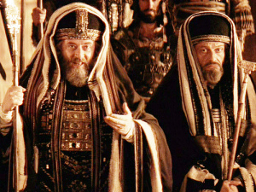
Basically Judaism had lost how to pray

Slide 6
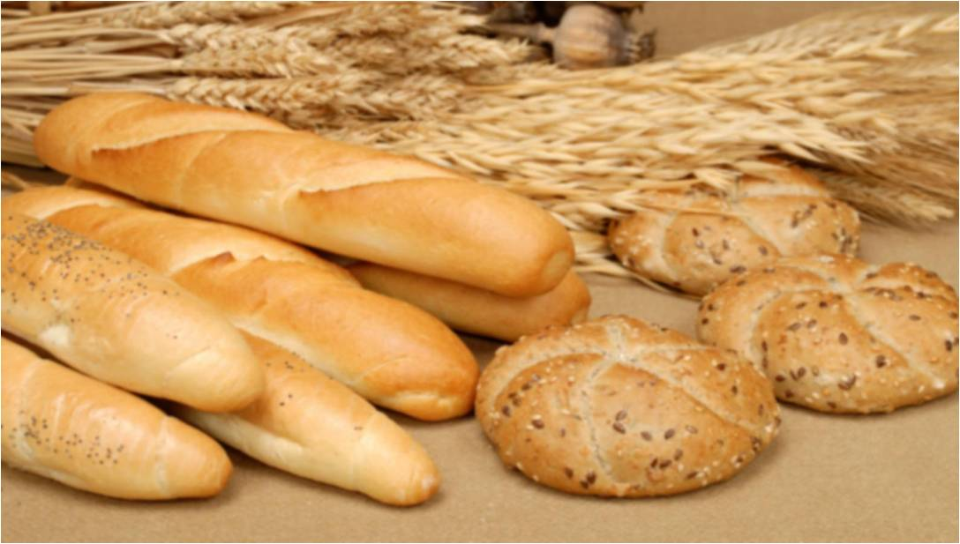
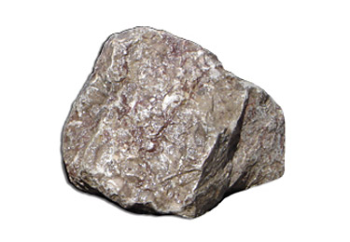
Luke 11:11

Slide 7
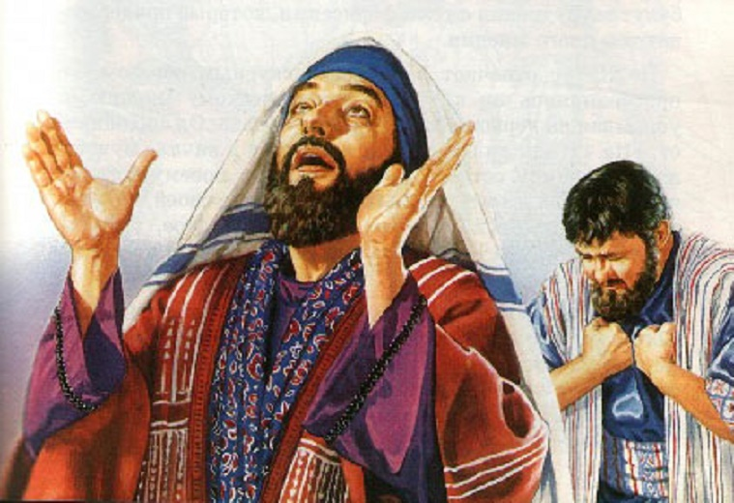
Matthew 6:5-9

Slide 8
Our father (v9) kingdom to come (v10) Daily needs (v11) Forgiveness for our sins (v12) We must practice forgiveness (12)
Chapter Six Of The Gospel Of Matthew
Conditions To Receive Answered Prayer

Slide 9
Lead us not into temptation (v13) But deliver us from the evil one (v 13)
Chapter Six Of The Gospel Of Matthew
Conditions To Receive Answered Prayer

Slide 10
Forgiveness is absolutely essential for answered prayer ( v 14-15)
Chapter Six Of The Gospel Of Matthew
Conditions To Receive Answered Prayer

Slide 11
Fasting humbly (16-18) Seek true treasure (19-21)
Attitude For Answered Prayer
Matthew 6

Slide 12
Lamp of the body are the eyes (v22 - 23)
Motive Behind Our Prayers
Matthew 6

Slide 13
Can’t serve two masters (v24)
Motive Behind Our Prayers
Matthew 6

Slide 14
How you live your life is critical to answered prayer Worry is negative faith (v 25-32)
Motive Behind Our Prayers
Matthew 6

Slide 15
First things first (v 33) Don’t worry about tomorrow (v 34)
Motive Behind Our Prayers
Matthew 6

Slide 16
PSALM 50:15 PSALM 145:18 ; 65:2 Jonah 2:9 “I will sacrifice to Thee with a voice of thanksgiving.”
Motive Behind Our Prayers

Slide 17
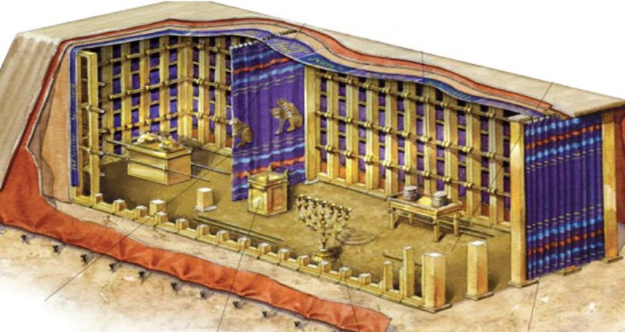
Veil of separation in Old Testament

Slide 18
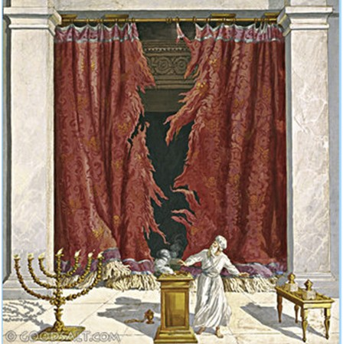
Veil of separation in Old Testament ends with Christ’s death Matthew 27:45-53

Slide 19
“My tongue will sing of your Word for all your commandments are right.” (Psalm 119)
OBEDIENCE MENTIONED 176 TIMES

Slide 20
Pray without ceasing.
( 1 Thessalonians 5:16-17 KJV )

