Slide 1

Happy Sabbath

Slide 2

Revelation 19: 5-7
⁵ Then a voice came from the throne, saying, “Praise our God, all you His servants and those who fear Him, both^{[a]} small and great!”
⁶ And I heard, as it were, the voice of a great multitude, as the sound of many waters and as the sound of mighty thunderings, saying, “Alleluia! For the^{[b]} Lord God Omnipotent reigns! ⁷ Let us be glad and rejoice and give Him glory, for the marriage of the Lamb has come, and His wife has made herself ready.”

Slide 3
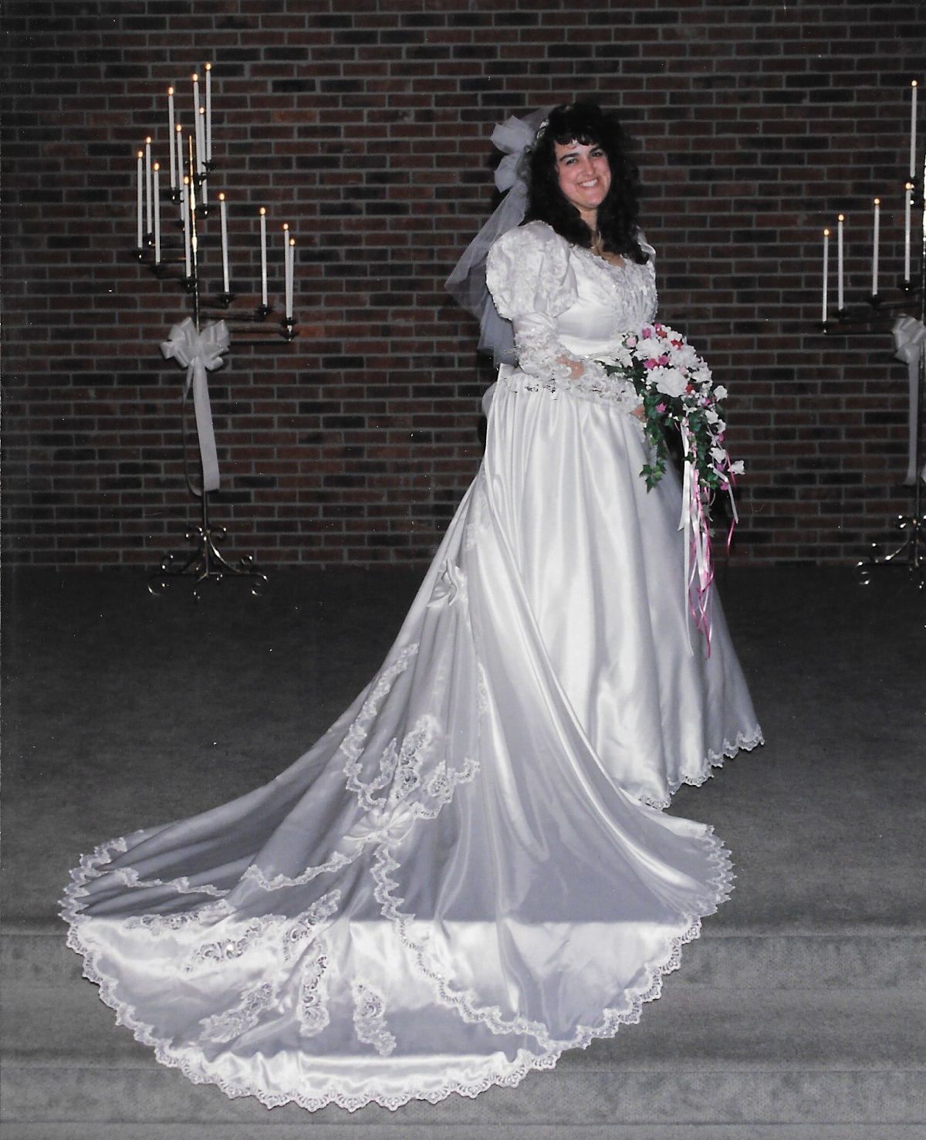

Slide 4
Genesis 3: 16
¹⁶ To the woman He said:
“I will greatly multiply your sorrow and your conception;
In pain you shall bring forth children;
Your desire shall be for your husband,
And he shall rule over you.”

Slide 5
^{Preparing To Be The}
^{Bride Of Christ}

Slide 6
Genesis 2: 18
¹⁸ And the Lord God said, “It is not good that man should be alone; I will make him a helper comparable to him.”

Slide 7
Genesis 2: 21-23
²¹ And the Lord God caused a deep sleep to fall on Adam, and he slept; and He took one of his ribs, and closed up the flesh in its place. ²² Then the rib which the Lord God had taken from man He made into a woman, and He brought her to the man.
²³ And Adam said:
“This is now bone of my bones
And flesh of my flesh;
She shall be called Woman,
Because she was taken out of Man.”

Slide 8
Jesus Christ doesn’t want His bride to be
substandard.
He is not going to be satisfied with an
inferior bride.
So, Jesus Christ will not take anything less than his kind to be His help meet to run the Kingdom of God.

Slide 9
Matthew 5: 48
⁴⁸ Therefore you shall be perfect, just as your Father in heaven is perfect.

Slide 10
1 Peter 3: 4
⁴ rather let it be the hidden person of the heart, with the incorruptible beauty of a gentle and quiet spirit, which is very precious in the sight of God.

Slide 11
Titus 3: 2
² to speak evil of no one, to be peaceable, gentle, showing all humility to all men.

Slide 12
Matthew 11: 28-29
²⁸ Come to Me, all you who labor and are heavy laden, and I will give you rest. ²⁹ Take My yoke upon you and learn from Me, for I am gentle and lowly in heart, and you will find rest for your souls.

Slide 13
Matthew 11: 30
³⁰ For My yoke is easy and My burden is light.”

Slide 14
Proverbs 21: 9
⁹ Better to dwell in a corner of a housetop,
Than in a house shared with a contentious woman.

Slide 15
Proverbs 31: 11
¹¹ The heart of her husband does safely trust in her, so that he shall have no need of spoil.

Slide 16
Isaiah 30: 20-21
²⁰ And though the Lord gives you
The bread of adversity and the water of affliction,
Yet your teachers will not be moved into a corner anymore,
But your eyes shall see your teachers.
²¹ Your ears shall hear a word behind you, saying,
“This is the way, walk in it,”
Whenever you turn to the right hand
Or whenever you turn to the left.

Slide 17
Ruth 1: 16
¹⁶ But Ruth said:
“Entreat me not to leave you,
Or to turn back from following after you;
For wherever you go, I will go;
And wherever you lodge, I will lodge;
Your people shall be my people,
And your God, my God

Slide 18
Isaiah 42: 4
⁴ He will not fail nor be discouraged,
Till He has established justice in the earth;
And the coastlands shall wait for His law.”

Slide 19
1 Corinthians 15: 24-25
²⁴ Then comes the end, when He delivers the kingdom to God the Father, when He puts an end to all rule and all authority and power. ²⁵ For He must reign till He has put all enemies under His feet.

Slide 20
1 Corinthians 15: 28
²⁸ Now when all things are made subject to Him, then the Son Himself will also be subject to Him who put all things under Him, that God may be all in all

Slide 21
Philippians 2: 5-7
⁵ Let this mind be in you which was also in Christ Jesus, ⁶ who, being in the form of God, did not consider it robbery to be equal with God, ⁷ but made Himself of no reputation, taking the form of a bondservant, and coming in the likeness of men.

Slide 22
Luke 12: 37
³⁷ Blessed are those servants whom the master, when he comes, will find watching. Assuredly, I say to you that he will gird himself and have them sit down to eat, and will come and serve them.

Slide 23
HOW CAN WE HELP?
IS THERE ANYTHING WE CAN DO?
CAN WE SERVE SOMEONE?
IS THERE SOMEONE THAT WE CAN MAKE HAPPIER?
IS EVERYBODY COMFORTABLE?

Slide 24
We’re to emanate His attitude of love, of service, of humility, of being willing to be meek, of looking for ways to help to make things better for other people.

Slide 25
Hebrews 13: 5
“I will never leave you nor forsake you.”

Slide 26
“I am looking at my wife rather carefully to see how
faithful she is. Will she endure to the END?”

Slide 27
Hebrews 13: 5
“I will never leave you nor forsake you.”

