Slide 1
The 70 Week Prophecy
What Can We Learn From A Study Of The 70 Week Prophecy

Slide 2

Daniel 9:20-27

Slide 3

Daniel Studied God’s Word While in Captivity

Slide 4
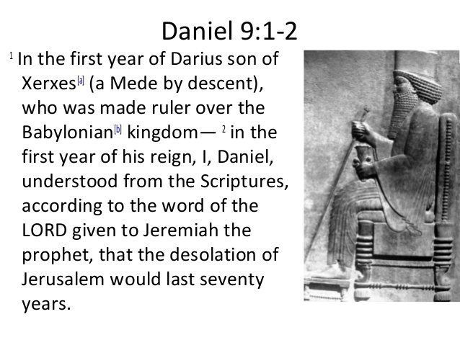

Slide 5
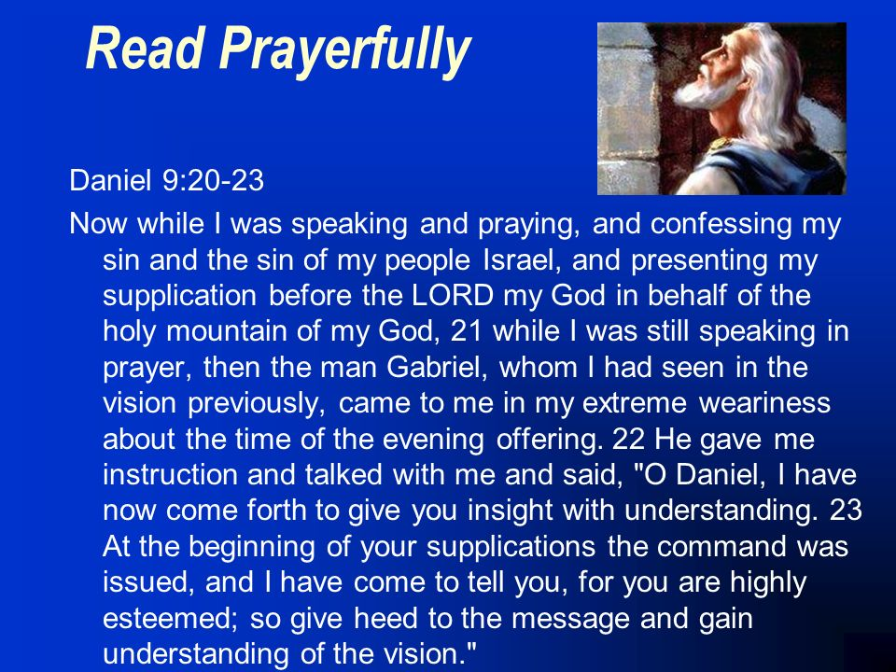

Slide 6
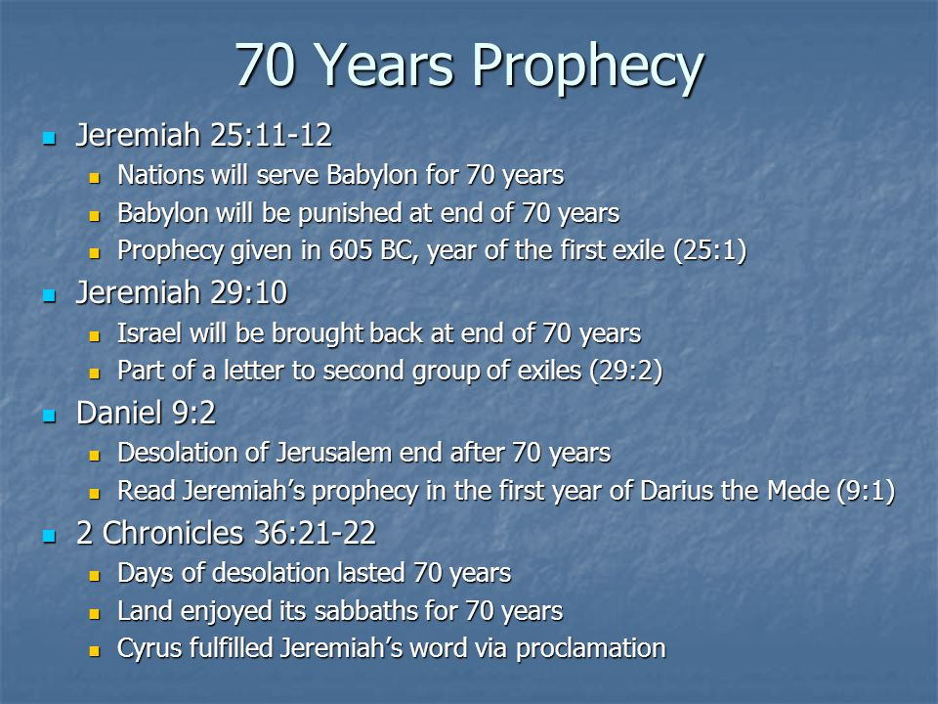

Slide 7
Jeremiah’s Foretold Jews Would Be Punished
“And it shall be, when seventy years are fulfilled I will punish the king of Babylon, and that nation, and the land of the Chaldeans, says Jehovah, for their iniquity, and I will make it an everlasting ruin.” (Jeremiah 25:12 Modern Kings James Version)
“For thus saith the LORD, That after seventy years be accomplished at Babylon I will visit you, and perform my good word toward you, in causing you to return to this place.” (Jeremiah 29:10 KJV)

Slide 8
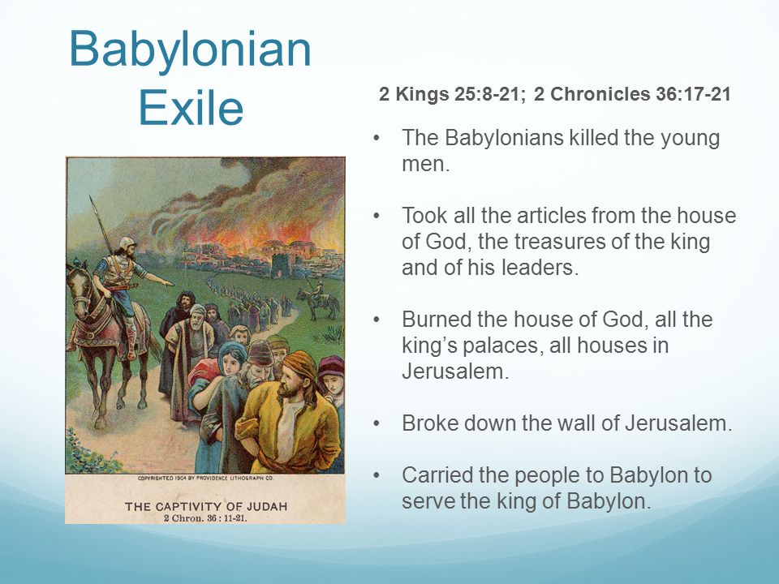
Summary of Babylonian Exile

Slide 9
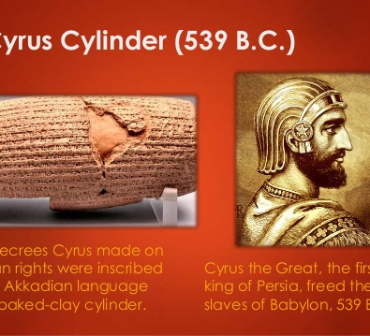
2 Chronicles 36:21-22
“Now in the first year of Cyrus king of Persia, that the word of the LORD by the mouth of Jeremiah might be accomplished, the LORD stirred up the spirit of Cyrus king of Persia, that he made a proclamation throughout all his kingdom, and put it also in writing, saying:
“'Thus saith Cyrus king of Persia: All the kingdoms of the earth hath the LORD, the God of heaven, given me; and He hath charged me to build Him a house in Jerusalem, which is in Judah. Whosoever there is among you of all His people - the LORD his God be with him - let him go up.’”
(2 Chronicles 36:22) Jewish Publication Society Bible

Slide 10
What Is It We Are To Understand?
“When therefore you shall see the abomination of desolation, which was spoken of by Daniel the prophet, standing in the holy place: he that readeth let him understand.” (Matthew 24:15 Douary-Rheims 1899)
“Therefore when you see the abomination of desolation, spoken of by Daniel the prophet, stand in the holy place (whoever reads, let him understand).” (Matthew 24:15 Modern King James Version)
“When, then, you see in the holy place the unclean thing which makes destruction, of which word was given by Daniel the prophet let this be clear to the reader;” (Matthew 24:15 Bible in Basin English; 1965)

Slide 11
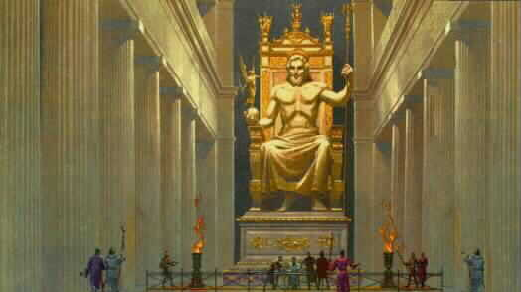
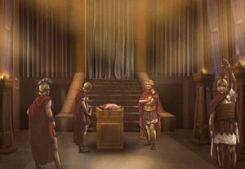
Antiochus Epiphanes
Daniel 11:31
This Took Place In 168 BC
Pig Sacrificed In The Temple

Slide 12
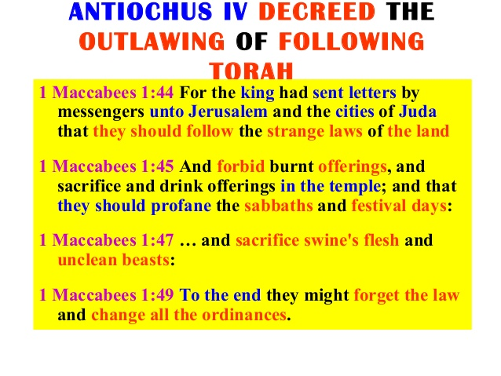

Slide 13
Christ Is Real Offering For Sin
“Having, therefore, a great high priest who penetrated the heavens, Jesus the Son of God, let us hold fast this profession of our hope.
“For we do not have a high priest who cannot sympathize with our weaknesses, but was in all points tempted like as we are, yet without sin.”
(Hebrews 4:14-15 Jubilee Bible)

Slide 14
Who Is The Man Of Sin?
“But^{G1161} there was a certain^{G5100} man,^{G435} called^{G3686} Simon,^{G4613} which beforetime^{G4391} in^{G1722} the^{G3588} same city^{G4172} used sorcery,^{G3096} and^{G2532} bewitched^{G1839} the^{G3588} people^{G1484} of Samaria,^{G4540} giving out^{G3004} that himself^{G1438} (himself) was^{G1511} some^{G5100} great one:^{G3173}
To whom^{G3739} they all^{G3956} gave heed,^{G4337} from^{G575} the least^{G3398} to^{G2193} the greatest,^{G3173} saying,^{G3004} This man^{G3778} is^{G2076} the^{G3588} great^{G3173} power^{G1411} of God.”^{G2316} (Acts 8:9-10 KJV+)
Greek 1411= Power
Greek 3173= in a very wide application)
exceedingly, great (-est)…
Power is no blessing in itself, but when it .
Under this sense may be comprehended civil, political, ecclesiastical, and military power.

Slide 15
Why This Sermon Is Important
G5620
From G5613 and G5037; so too, that is, thus therefore (in various relations of consecution, as shown): - (insomuch) as, so that (then), (insomuch) that, therefore, to, wherefore.
Some translate it as follows:
“For there shall arise false Christs and false prophets, and they shall present great signs and wonders, in order to deceive, if possible, even the elect.” (Matthew 24:24; The Holy Bible in Its Original Order, 2007, Second Edition)

Slide 16
Why Is This Verse Is Important?
For there shall arise false Christs, and false prophets, and shall shew great signs and wonders; insomuch that, if it were possible, they shall deceive the very elect. (Matthew 24:24 KJV)
For^{G1063} there shall arise^{G1453} false Christs,^{G5580} and^{G2532} false prophets,^{G5578} and^{G2532} shall shew^{G1325} great^{G3173} signs^{G4592} and^{G2532} wonders;^{G5059} insomuch that,^{G5620} if^{G1487} it were possible,^{G1415} they shall deceive^{G4105} the^{G3588} very^{G2532} elect.^{G1588} (Matthew 24:24 KJV+)

Slide 17
Modern Kings James Reads As Follows
“But a certain man called Simon had long been conjuring in the city, and amazing the nation of Samaria, claiming himself to be some great one.
All gave heed to him, from the least to the greatest, saying, This one is the great power of God.” (Acts 8:9-10 MKJV)

Slide 18
Could The Man Of Sin Claim To Be The Holy Spirit?
“Let no^{G3361} man^{G5100} deceive^{G1818} you^{G5209} by^{G2596} any^{G3367} means:^{G5158} for^{G3754} that day shall not come, except^{G3362} there come^{G2064} a falling away^{G646} first,^{G4412} and^{G2532} that man^{G444} of sin^{G266} be revealed,^{G601} the^{G3588} son^{G5207} of perdition;^{G684}
Who opposeth^{G480} and^{G2532} exalteth himself^{G5229} above^{G1909} all^{G3956} that is called^{G3004} God,^{G2316} or^{G2228} that is worshipped;^{G4574} so that^{G5620} he^{G846} as^{G5613} God^{G2316} sitteth^{G2523} in^{G1519} the^{G3588} temple^{G3485} of God,^{G2316} shewings^{G584} himself^{G1438} that^{G3754} he is^{G2076} God.”^{G2316}
(2 Thessalonians 2:1-3 KJV)

Slide 19
Could The Man Of Sin Claim To Be The Holy Spirit?
Who opposeth and exalteth himself above all that is called God, or that is worshipped; so that he as God sitteth in the temple of God, **shewing himself that he is God. (2 Thessalonians 2:4 KJV)
Remember ye not, that, when I was yet with you, I told you these things? (2 Thessalonians 2:5 KJV)
From G473 and G2749; to lie opposite, that is, be adverse (figuratively repugnant) to: - adversary, be contrary, oppose.
From G575 and G1166** to show off, that is, exhibit; figuratively to demonstrate, that is, accredit: - (ap-) prove, set forth, shew.

Slide 20
Conclusion
Paul warns Thessalonians what is mentioned in Matthew 24:22-24
We also see the context in verses 8-22 of the same chapter
This ties us to 2 Thessalonians 2:1-5 (he read Daniel 9:27; which is why we read in Matthew 24:15 “… therefore when you see the ‘abomination of desolation’ spoken by the prophet Daniel standing in the (whoever reads let him understand).
Daniel 9:24-26

Slide 21
Breakdown of Daniel 9:24-26
(conclusion continued)
“Seventy weeks are decreed as to your people and as to your holy city, to finish the transgression and to make an end of sins, and to make atonement for iniquity, and to bring in everlasting righteousness, and to seal up the vision and prophecy, and to anoint the Most Holy. (Daniel 9:24a MKJV)
These three things deal with sin. They also deal Daniels people and the holy city (Jerusalem).
b) These three things deal are fulfilled when Christ returns.

Slide 22
Breakdown of Daniel 9:27
(conclusion continued)
“And he shall confirm a covenant with many for one week. And in the midst of the week (Wednesday) he shall cause the sacrifice and the offering to cease; {This is speaking of Christ being scarified and, therefore sacrificial system no longer needed} (Daniel 9:27a).
and upon the wing of abominations shall come one who makes desolate even until the consummation (complete destruction). And the fully determined end which is decreed shall be poured out upon the desolator. (Daniel 9:27b).
{This is speaking of the man of sin mentioned in 2 Thessalonians 2:1-8}

Slide 23
The man of sin comes with Satan backing and supporting him
In Our Near Future is the man of sin. He will be the one who performs lying wonders (2 Thessalonians 2:6-15)
He will come “showing himself that he IS GOD
(2 Thessalonians 2:4)

Slide 24
Why This Sermon Is Important
G5620
From G5613 and G5037; so too, that is, thus therefore (in various relations of consecution, as shown): - (insomuch) as, so that (then), (insomuch) that, therefore, to, wherefore.
Some translate it as follows:
“For there shall arise false Christs and false prophets, and they shall present great signs and wonders, in order to deceive, if possible, even the elect.” (Matthew 24:24; The Holy Bible in Its Original Order, 2007, Second Edition)

Slide 25
Now For The Real Conclusion
“This also, knowing the time, that it is already time to awake out of sleep; for now our salvation is nearer than when we believed.
The night is far spent, the day is at hand; therefore let us cast off the works of darkness, and let us put on the armor of light.
Let us walk becomingly, as in the day; not in carousing's and drinking; not in co-habitation and lustful acts; not in strife and envy.
But put on the Lord Jesus Christ, and do not take thought beforehand for the lusts of the flesh.” (Romans 13:11-14 MKJV)

Slide 26
The 70 Week Prophecy
What Can We Learn From A Study Of The 70 Week Prophecy

