Slide 1


The Failure of Christianity
The Death Of A Religion
Notes:
NOTE:
To change the image on this slide, select the picture and delete it. Then click the Pictures icon in the placeholder to insert your own image.

Slide 2

Christianity In Sad State
Group Born Post-Christian
Elders 1945 or earlier 28 %
Boomer 1946-1964 35 %
Busters 1965-1983 40 %
Millennials 1984-2002 48%
“Un Christian”, David Kinnaman; Baker Books 2012

Slide 3


Problems With The Bible
“Christ cannot be, and will not be, restricted to Christianity.” (The Spirit and Truth Sanctuary),
by D.E. Paulk, 2012
“
This Photo by Unknown Author is licensed under CC BY-NC-ND

Slide 4

C = Islam
O = Peace
E = Male/Female
X = Judaism
I = Wicca/Paganism
S = Eastern Religion
Incorporates Elements Of
This Photo by Unknown Author is licensed under CC BY-NC-ND
This Photo by Unknown Author is licensed under CC BY-SA
This Photo by Unknown Author is licensed under CC BY-NC-ND

Slide 5
American Chrislam
What is American Chrislam?

Slide 6

Humans Have Lost Their Way- With Transhumanism

Slide 7
WHAT IS CHRISLAM?
Hybrid of Christian and Islam
Bible and Koran considered Holy
Worship the same God
They look for common grounds of belief
CAMP = Christian And Muslim for Peace

Slide 8

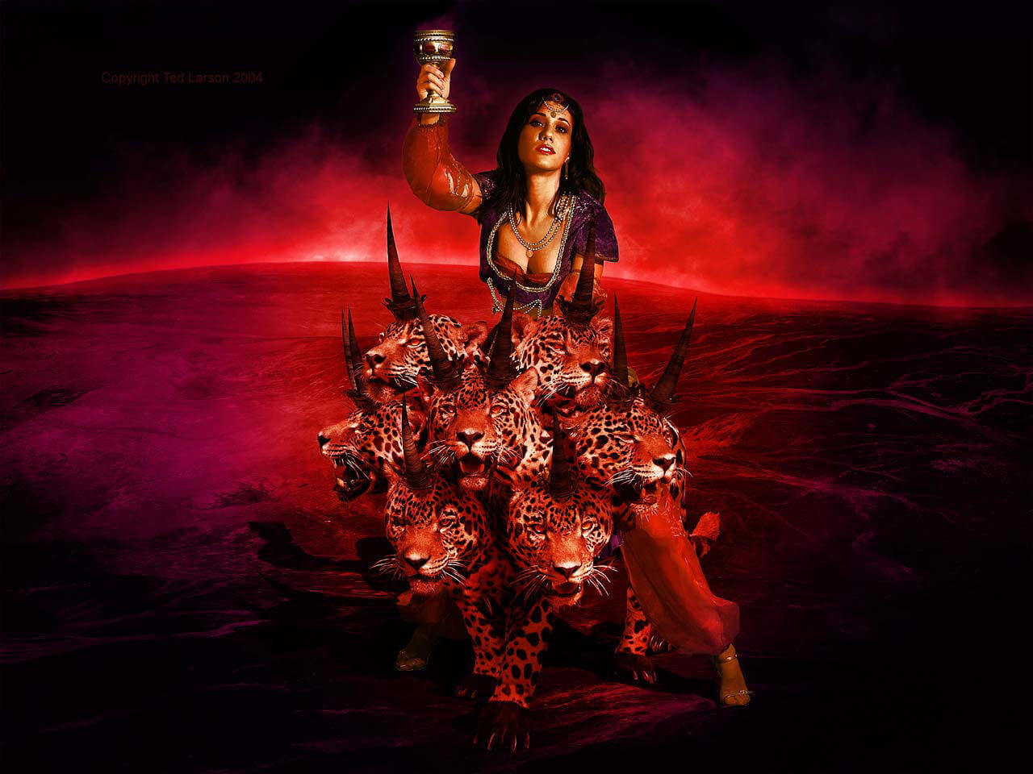
CHRISTIANITY IS SEDUCED BY WORLDLINESS

Slide 9
The Failure of Christianity
The Death Of A Religion
Notes:
NOTE:
To change the image on this slide, select the picture and delete it. Then click the Pictures icon in the placeholder to insert your own image.

