Slide 1

Portsmouth, Ohio
Bible Study
Who is the Antichrist?
Bible Study

Slide 2
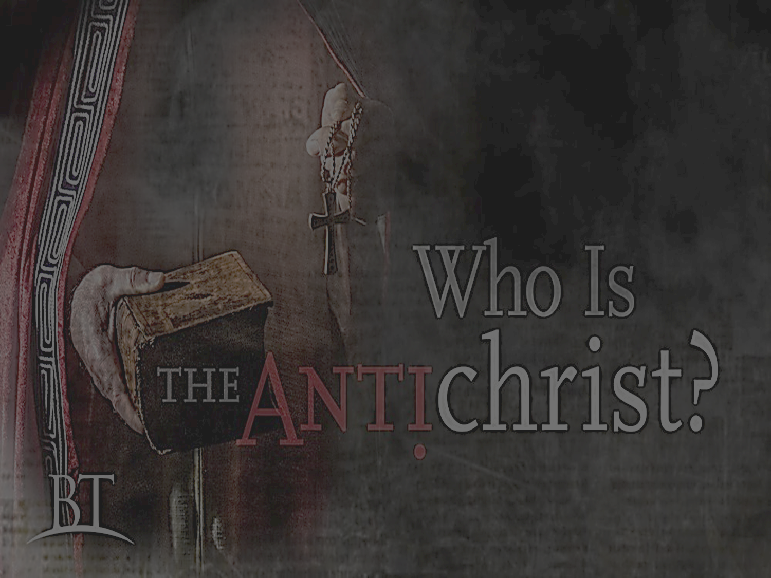


1. What are the various meanings of the word “antichrist”?
Literal meaning: ___________ ______________
Alternative meanings: ____________ of ___________
Or ________________ of ____________
Comprehensive definition: “The term… appears to have become increasingly ______________ to a proper name as the _____________ of all that was __________ to and ____________ to the __________ and _______________ of Christ.”
Against
Christ
adversary
Christ
opponent
equivalent
personification
opposed
contrary
role
ministry

Slide 3

2. The apostle John writes of a “spirit of antichrist”. How do you explain this, and what does John mean?

Slide 4

3. Paul and John write of a “man of sin” and a “false prophet” to come in the end time. Who are these people and what is their role in the future?

Slide 5
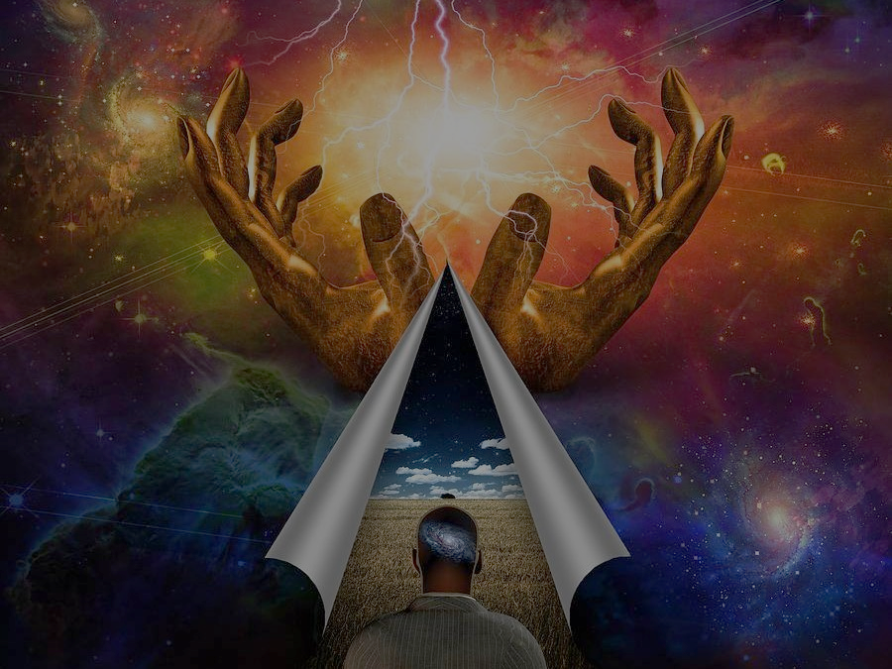


Slide 6

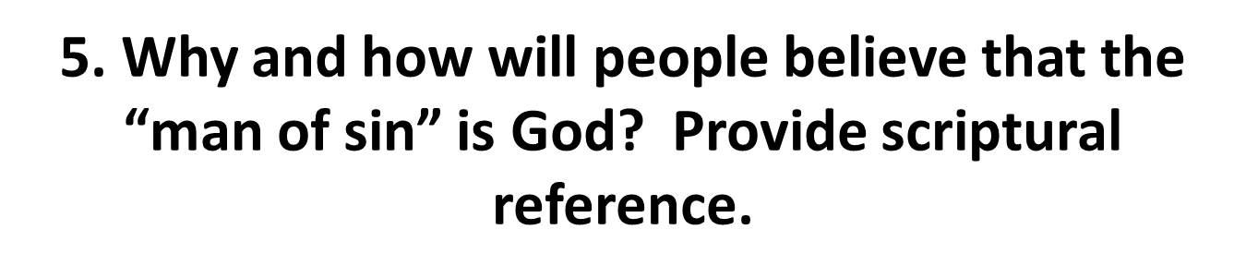

Slide 7
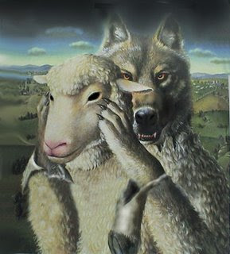


Slide 8
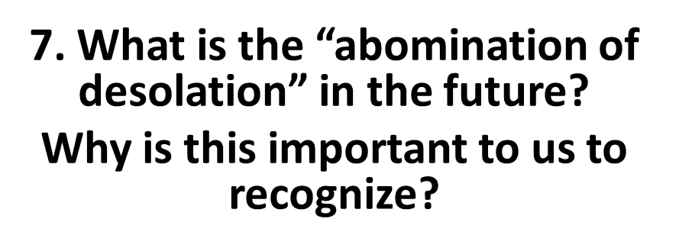


Slide 9
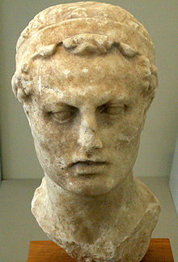
8. In the book of the Maccabees, what is described as happening under the order of Antiochus? How was this resolved?

Slide 10
9. Complete the chart pertaining to the “abomination of desolation”
Past |  | Future
Antiochus acted like he was peaceful to the Jews | =
Antiochus Epiphanes | =
Antiochus stopped daily temple sacrifices | =
Antiochus defiled the temple | =
Marked the beginning of a time of horror and misery for God’s people | =

Slide 11
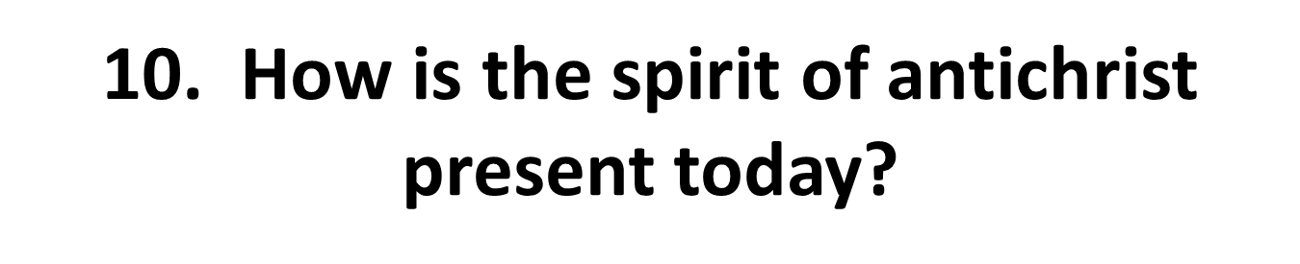

Slide 12
11. How do you understand I John 2:22?
(22) Therefore, when He had risen from the dead, His disciples remembered that He had said this to them; and they believed the Scripture and the word which Jesus had said.

Slide 13
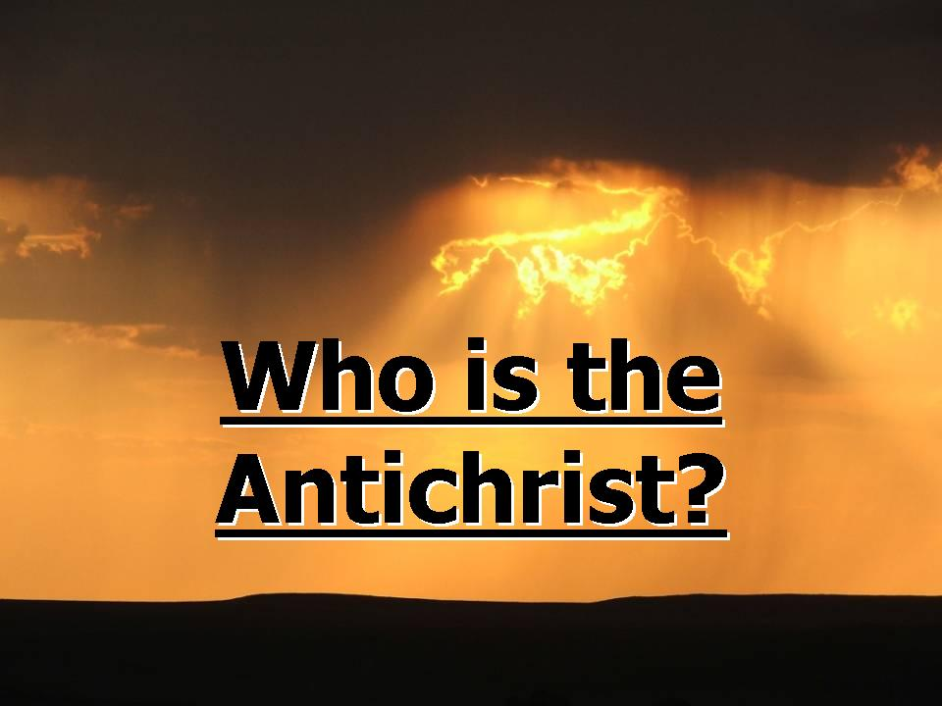
12.
ultimate

Slide 14
