Slide 1
The Word Of God
Notes:
Greetings. {Explain Utah} Today I will cover another Fundamental belief. The Word of God

Slide 2
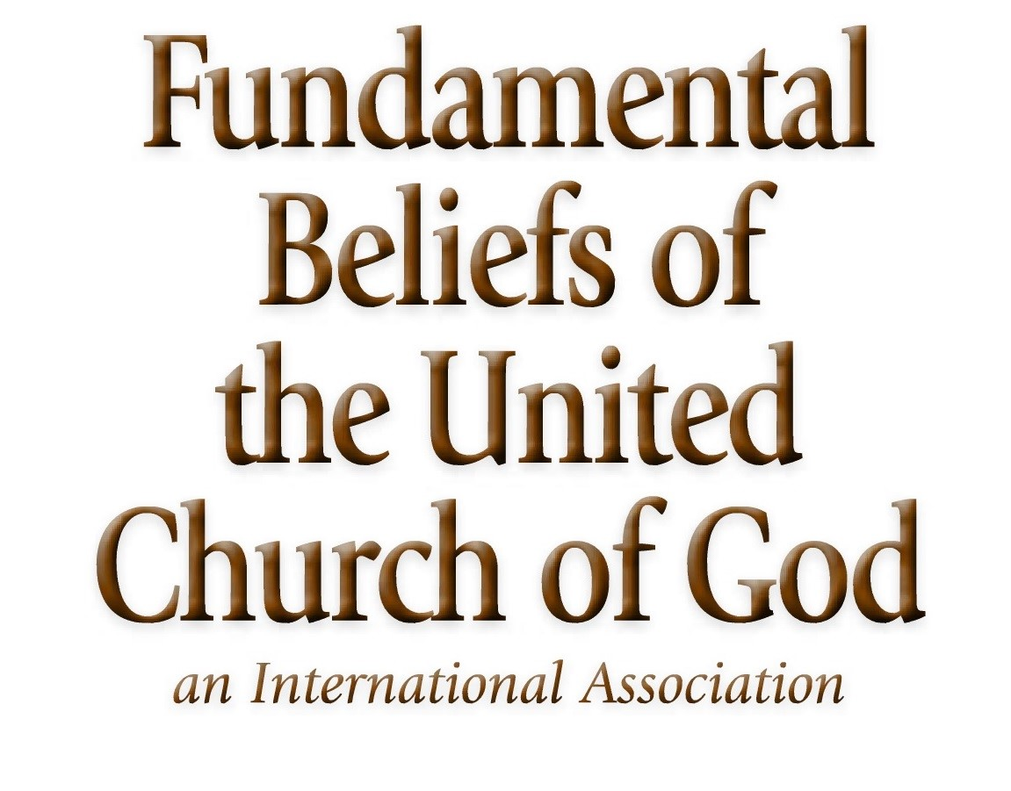
Notes:
Summary statement:
We believe that Scripture, both the Old and New Testament, is God’s
revelation and His complete expressed will to humanity. Scripture is
inspired in thought and word, infallible in the original writings; is the
supreme and final authority in faith and in life; and is the foundation
of all truth (2 Timothy 3:16; 2 Peter 1:20-21; John 10:35; 17:17).

Slide 3
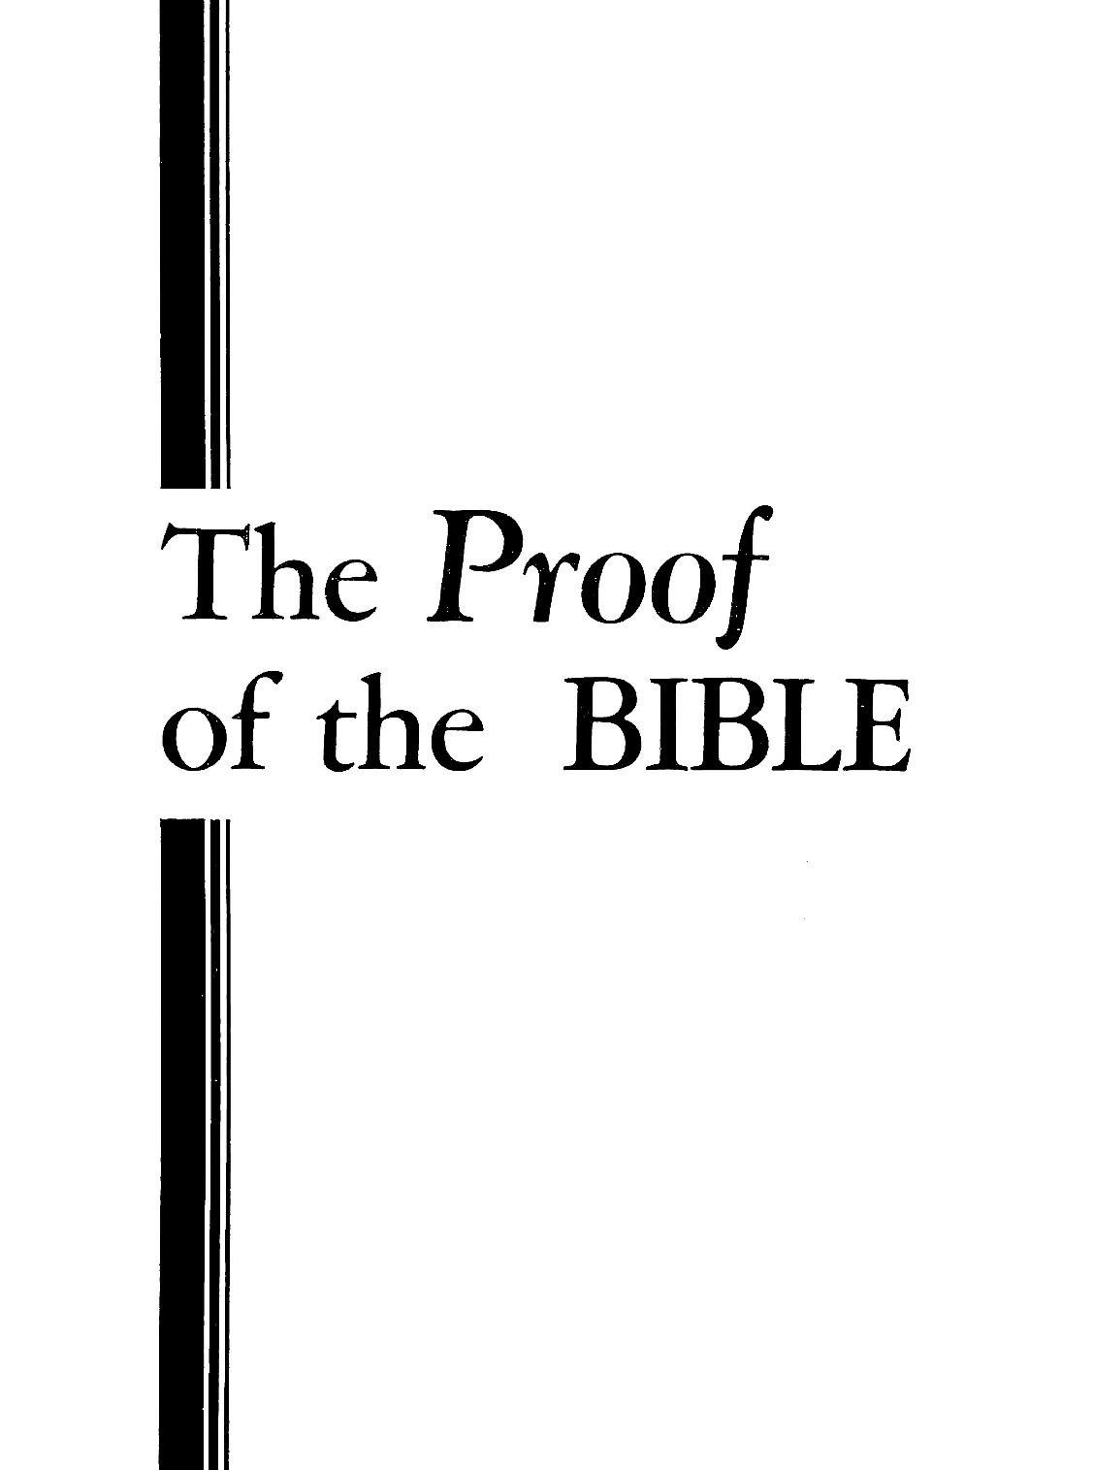
Notes:
But before we dive into the Word of God can we prove the Bible is the Word of God?
Is The BIBLE Superstition or Authority?
Did you ever stop to prove whether the Bible is the divinely inspired Word of God? This is a picture of the booklet I read as a teenager to prove the Bible was the word of God.

Slide 4
Proving the Bible is Word of God?
Work of fiction
Historical writings
Mixture from God and holy/good men
Word of God by faith only
Proven inspired Word of God
Notes:
Here are some ideas or belief people have in the Bible.
Read {Slide}

Slide 5
Proving the Bible is Word of God?
Prophecy is the proof of God’s Word
Has been fulfilled (PAST)
Has yet to be fulfilled (FUTURE)
Future details and specifics set the Bible apart.
Notes:
{Read slide add “Prophecy types” }
The Bible does not just predict the future in vague terms. It is very specific it is so specific the skeptics claim the events were written down after they occurred. No “Seer” or “Psychic” like Nostradamus even comes close to the specific and detail. In recent history Joan Quigley the “Psychic” for Nancy Regan did not predict specifics only vague ideas that good things will happen at a certain time.

Slide 6
Proving the Bible is Word of God?
Prophecy of Ancient Tyre’s Destruction
City that confounds the skeptics
Richest sea port in the ancient world
Notes:
One of the key Prophesies that had already been fulfilled is the Prophesy of Ancient City of Tyre.
{Read slide}
The history of ancient Tyre and how it parallels the bible’s prophecy is hard for skeptics to explain away.

Slide 7
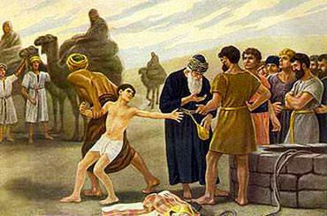
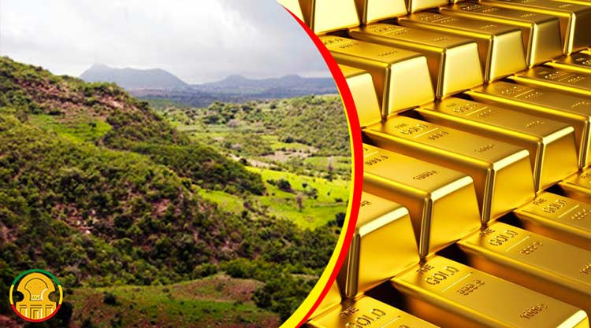
Proving the Bible is Word of God?
Amos 1:9-10 (NIV)
Zechariah 9:3-4 (NIV)
Notes:
In scripture there are multiple places where Tyre is prophesied The timelines are rather far apart which means the different prophets did not meet each other to compare notes.
Amos 1:9-10 (NIV)
⁹ This is what the Lord says: “For three sins of Tyre, even for four, I will not relent. Because she sold whole communities of captives to Edom, disregarding a treaty of brotherhood, ¹⁰ I will send fire on the walls of Tyre that will consume her fortresses.”
Amos was dead before Zechariah was born.
Zechariah 9:3-4 (NIV)
³ Tyre has built herself a stronghold; she has heaped up silver like dust, and gold like the dirt of the streets. ⁴ But the Lord will take away her possessions and destroy her power on the sea, and she will be consumed by fire.
One of the reason God was angry with Tyre is that they raided Israel. Tyre would capture Israelites and then sell them to slavery. There are historical accounts where Tyre especially went after Israel’s children.
Ezekiel was taken to Babylon in 597 during the second captivity of King Nebuchadnezzar. There is no record of Ezekiel comparing notes with Zachariah.
Each prophesy was inspired by God to a different person is in a different generation or time period.

Slide 8
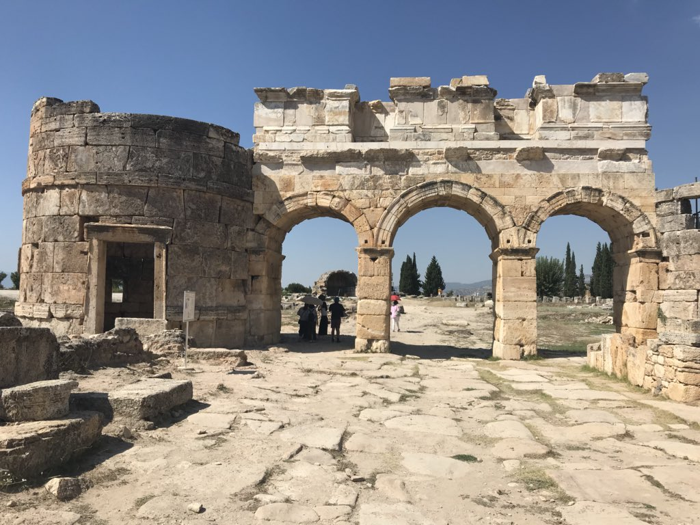
Proving the Bible is Word of God?
Ezekiel 26:1-4 (NIV)
A Prophecy Against Tyre
Notes:
Let’s read Ezekiel’s prophecy.
Ezekiel 26:1-4 (NIV)
A Prophecy Against Tyre
26 In the eleventh month of the twelfth year, on the first day of the month, the word of the Lord came to me: ² “Son of man, because Tyre has said of Jerusalem, ‘Aha! The gate to the nations is broken, and its doors have swung open to me; now that she lies in ruins I will prosper,’³ therefore this is what the Sovereign Lord says: I am against you, Tyre, and I will bring many nations against you, like the sea casting up its waves. ⁴ They will destroy the walls of Tyre and pull down her towers; I will scrape away her rubble and make her a bare rock.

Slide 9
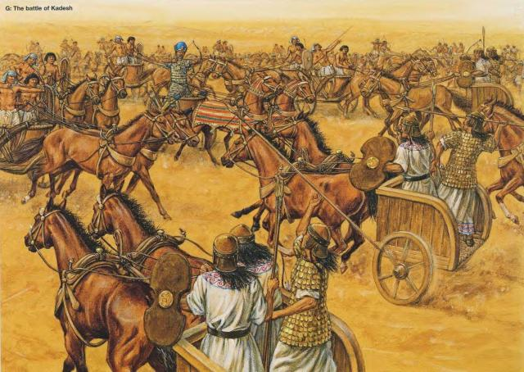
Proving the Bible is Word of God?
Ezekiel 26:5-8 (NIV)
A Prophecy Against Tyre
Notes:
Ezekiel 26:5-8 (NIV)
⁵ Out in the sea she will become a place to spread fishnets, for I have spoken, declares the Sovereign Lord. She will become plunder for the nations, ⁶ and her settlements on the mainland will be ravaged by the sword. Then they will know that I am the Lord.
⁷ “For this is what the Sovereign Lord says: From the north I am going to bring against Tyre Nebuchadnezzar king of Babylon, king of kings, with horses and chariots, with horsemen and a great army. ⁸ He will ravage your settlements on the mainland with the sword; he will set up siege works against you, build a ramp up to your walls and raise his shields against you

Slide 10
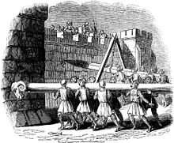
Proving the Bible is Word of God?
Ezekiel 26:9-11 (NIV)
A Prophecy Against Tyre
Notes:
Ezekiel 26:9-11 (NIV)
⁹ He will direct the blows of his battering rams against your walls and demolish your towers with his weapons. ¹⁰ His horses will be so many that they will cover you with dust. Your walls will tremble at the noise of the warhorses, wagons and chariots when he enters your gates as men enter a city whose walls have been broken through. ¹¹ The hooves of his horses will trample all your streets; he will kill your people with the sword, and your strong pillars will fall to the ground.

Slide 11
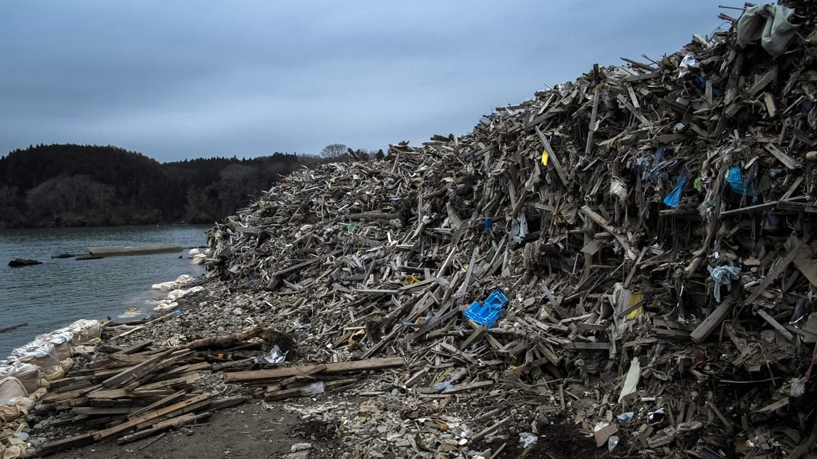
Proving the Bible is Word of God?
Ezekiel 26:12-14 (NIV)
A Prophecy Against Tyre
Notes:
Ezekiel 26:12-14 (NIV)
¹² They will plunder your wealth and loot your merchandise; they will break down your walls and demolish your fine houses and throw your stones, timber and rubble into the sea. ¹³ I will put an end to your noisy songs, and the music of your harps will be heard no more. ¹⁴ I will make you a bare rock, and you will become a place to spread fishnets. You will never be rebuilt, for I the Lord have spoken, declares the Sovereign Lord.

Slide 12
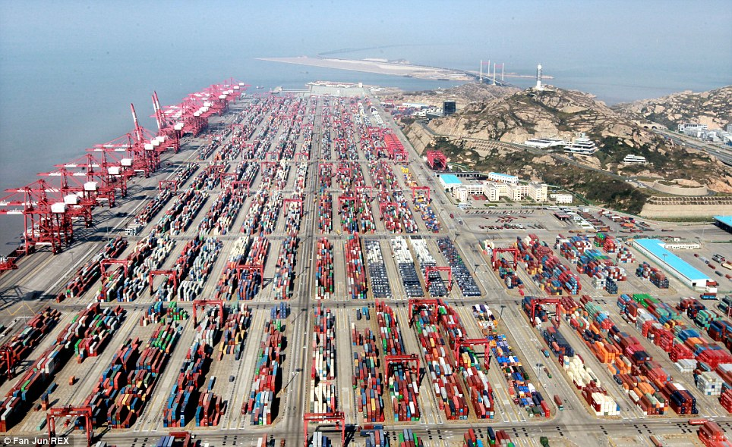
Proving the Bible is Word of God?
Port of Shanghai – Largest Port Today
Predict it’s destruction in specific detail
And it will not be rebuild as a port forever
Notes:
Let’s put this prophecy in a modern context. {Read Slide}

Slide 13
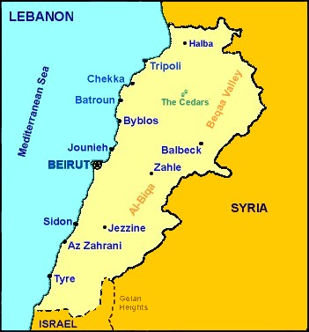
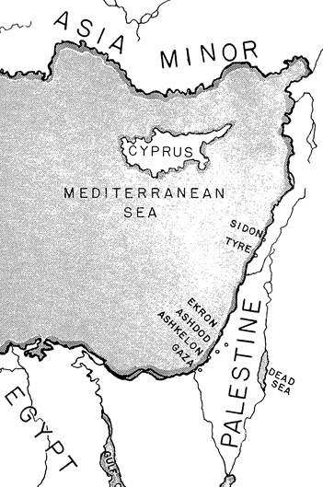
Proving the Bible is Word of God?
Tyre’s strategic location as a port
Notes:
Tyre’s had a strategic location as a port. And the topography of the land was a natural port
{Use laser point to Tyre on both images}

Slide 14
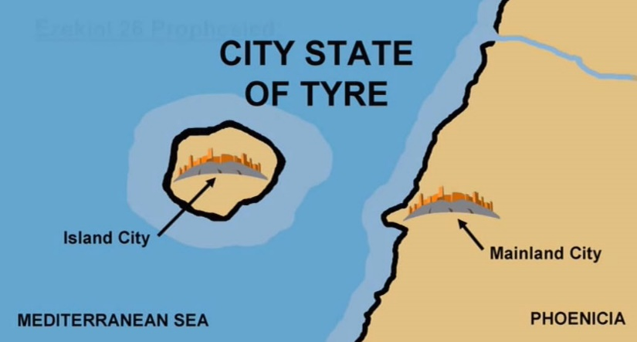
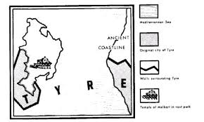
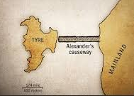
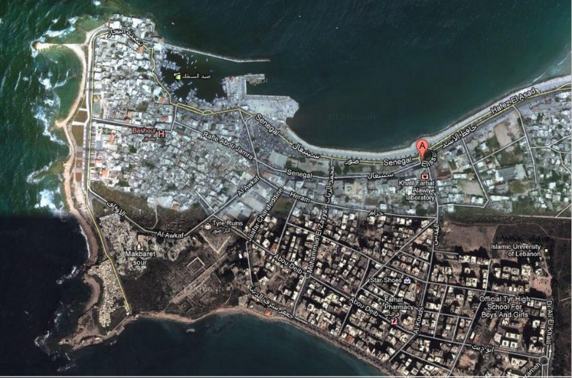
Proving the Bible is Word of God?
Ancient Tyre
Alexander’s Causeway
Tyre today
Notes:
Let’s cover the history. {Use Laser top left) This is how Tyre looked with King Nebuchadnezzar sieged it for 13 years. He ravaged the main land {Laser top Right}
The 200 years and a few wars later Alexander the Great sieged the Island Tyre {Laser bottom left) by building a causeway or mole from the debris of the mainland. After the defeat and for almost 2400 years sediment has gather along side the causeway and {Laser bottom right} this how Tyre looks today. It is not a port and much of the Island lay in ruins.

Slide 15
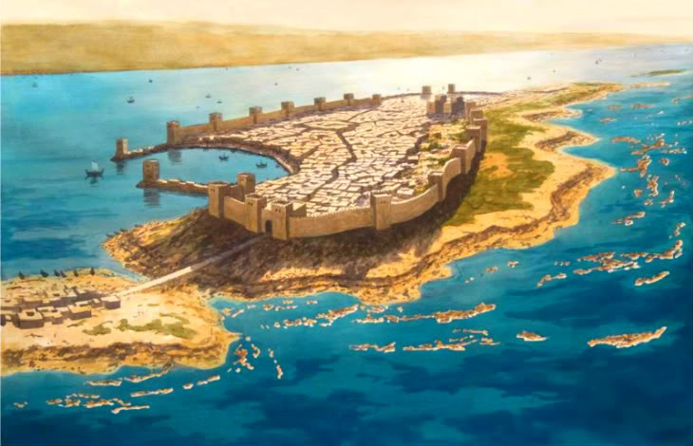
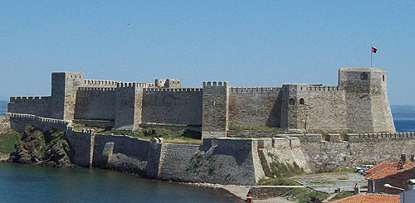
Proving the Bible is Word of God?
Possible examples of Tyre‘s island fortress
Notes:
The top {Laser) is and artist depiction of the Tyre Island fortress.
The bottom (Laser) is a picture of a Middle east island fortress (not Tyre) build in ancient times. This gives you some idea of why people must have thought the prophecy was ridiculous.

Slide 16
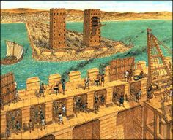
Proving the Bible is Word of God?
Possible examples of Alexander the Great’s Siege Towers
Notes:
The is an artist’s depiction of the causeway being built with the siege towers {Laser}. Alexander’s army built the tallest siege towers up to that time. The towers were between 160 – 200 feet tall. Taller that the walls of Island Tyre.

Slide 17
Proving the Bible is Word of God?
Amos 1 (750 BC)
Ezekiel 26 (585 BC)
Zechariah 9 (519 BC)
Tyre's mainland ravaged by King Nebuchadnezzar
Ezekiel 26:6-11
Fulfilled 573 BC after a 13 years siege
Tyre would be attacked by many nations
Ezekiel 26:3, 12
Fulfilled 573 BC , 332 BC and many more
Notes:
Here is when Amos, Ezekiel and Zechariah wrote down Gods prophecy.
{Click}
Now let’s look at some key fulfillments of this Prophecy of Tyre.
{Click and Read Side}

Slide 18
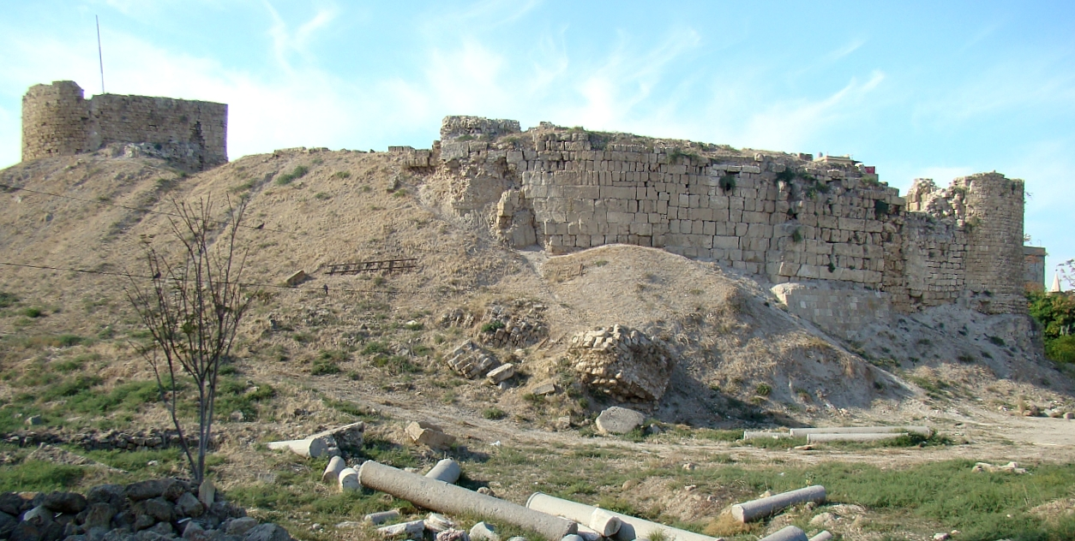
Proving the Bible is Word of God?
Tyre's fortresses would fail
Amos 1:9-10, Ezekiel 26:4,12
Fulfilled: 333-332 BC By Alexander the Great
Notes:
{Read slide}
Picture of the Island ruins.

Slide 19
Proving the Bible is Word of God?
Tyre's stones, timber and soil would be cast into the sea
Ezekiel 26:12 Fulfilled: 333-332 BC By Alexander the Great
Tyre would be scraped and made bare
Ezekiel 26:4 Fulfilled: 333 BC By Alexander the Great
Tyre would lose its power over the sea
Zechariah 9:3-4 Fulfilled: 332 BC
Notes:
{Click Read slide}

Slide 20
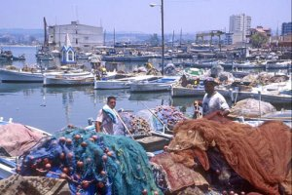
Proving the Bible is Word of God?
Tyre a place to spread fishnets
Ezekiel 26:5 Fulfilled: 332 BC – Today
Notes:
{Read slide}
Tyre’s fishermen with nets today.

Slide 21
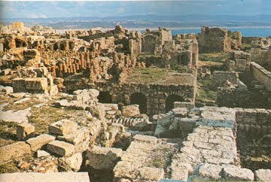
Proving the Bible is Word of God?
Tyre would never be rebuilt
Ezekiel 26:14 Fulfilled: 332 BC – Today
Notes:
{Read slide}
The ancient city of Tyre lies in ruins today.
The fulfillment of this prophesy being so specific in detail could have only come from a super natural being. A being that could predict or event control future events. That being of course is God and these prophecies prove the Bible is the Word of God.

Slide 22
Prophecies that prove the
Bible is Word of God?
Promises to Abraham descendants – Gen 12 - 17
King David’s kingdom was established forever – 2 Sam 7, Jer 33:17
Israel and Judah (Jews) taken into captivity in 3 waves – Isaiah, Ezekiel, Jeremiah
70 Weeks (69) – 1st coming of Jesus Christ – Dan 9
King Nebuchadnezzar golden image – Dan 2
Babylon will rule Judah for 70 years – Jer 25
Babylon's gates will open for Cyrus – Isa 45
Babylon’s kingdom will be overthrown - Isa 13
Judah’s first return to Jerusalem - Jer 32
Notes:
These are other prophecies that prove the Bible is the Word of God
{Read slide}

Slide 23
Prophecies that prove the
Bible is Word of God?
Promises to Abraham descendants – Gen 12 - 17
King’s David Kingdom was established forever – 2 Sam 7, Jer 33:17
Israel and Judah (Jews) Taken in Captive in 3 waves – Isaiah, Ezekiel, Jeremiah
70 Weeks (69) – 1st Coming of Jesus Christ – Dan 9
King Nebuchadnezzar Golden Image – Dan 2
Babylon will rule Judah for 70 years – Jer 25
Babylon's Gates Will Open for Cyrus – Isa 45
Babylon’s Kingdom will be overthrown - Isa 13
Judah’s first return to Jerusalem - Jer 32
Notes:
These are other Prophecies that prove the Bible is the Word of God
{Read slide}

Slide 24
Prophecies that prove the Bible is Word of God?
He would die a humiliating death - Psa 22; Isa 53
He would be rejected - Isa 53:3
He would be betrayed by a friend - Psa 41:9
He would be mocked - Psa 27:7
He would be beaten - Isa 52:14
He would be spit upon - Isa 50:6
He would be given gall / vinegar to drink - Psa 69:21
His side would be pierced - Zec 12:10
They would cast lots for His garments - Psa 22:18
None of His bones would be broken - Psa 34:20
He would be buried in a rich man’s tomb - Isa 53:9
Notes:
How about the Prophecies that Jesus Christ’s crucifixion was fulfilled.
{Read Slide}

Slide 25
How was the Bible canonized?
Old Testament had at least five periods of canonization:
Moses
David
The Temple Singers
King Hezekiah
Ezra
New Testament had at least two canonizations
Paul, Peter and John
2 Timothy 4:13New King James Version (NKJV)
¹³ Bring the cloak that I left with Carpus at Troas when you come—and the books, especially the parchments.
John with Mark and others
Notes:
How was the Bible put together or canonized.
{Read Slide}

Slide 26
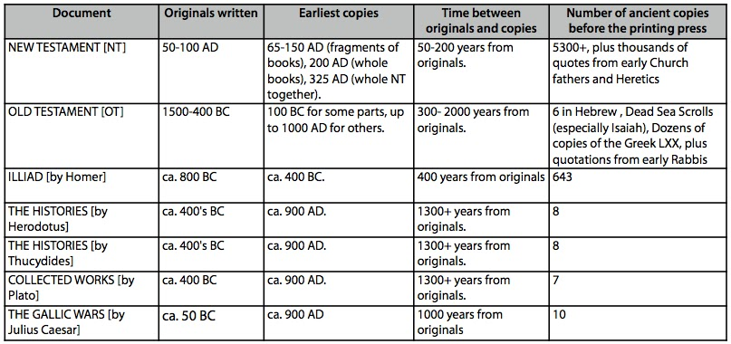
The Accuracy of Scripture
Mr. Nate Bostian http://natebostian.blogspot.com
Notes:
Here is a slide from Mr. Nate Bostian that shows the original works of books compared to copies made later. The New and Old Testament have the shortest time spans between Originals and Copies. Peter Stoner probably 1e17 power cover Texas in coins two feet deep and then walking over reaching in and pulling out the correct coin.
{Read Slide}

Slide 27
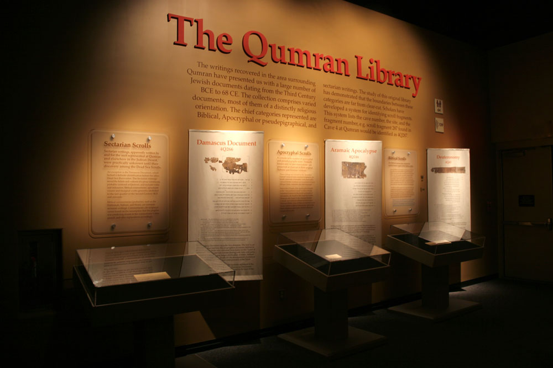
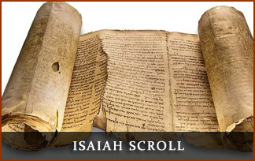
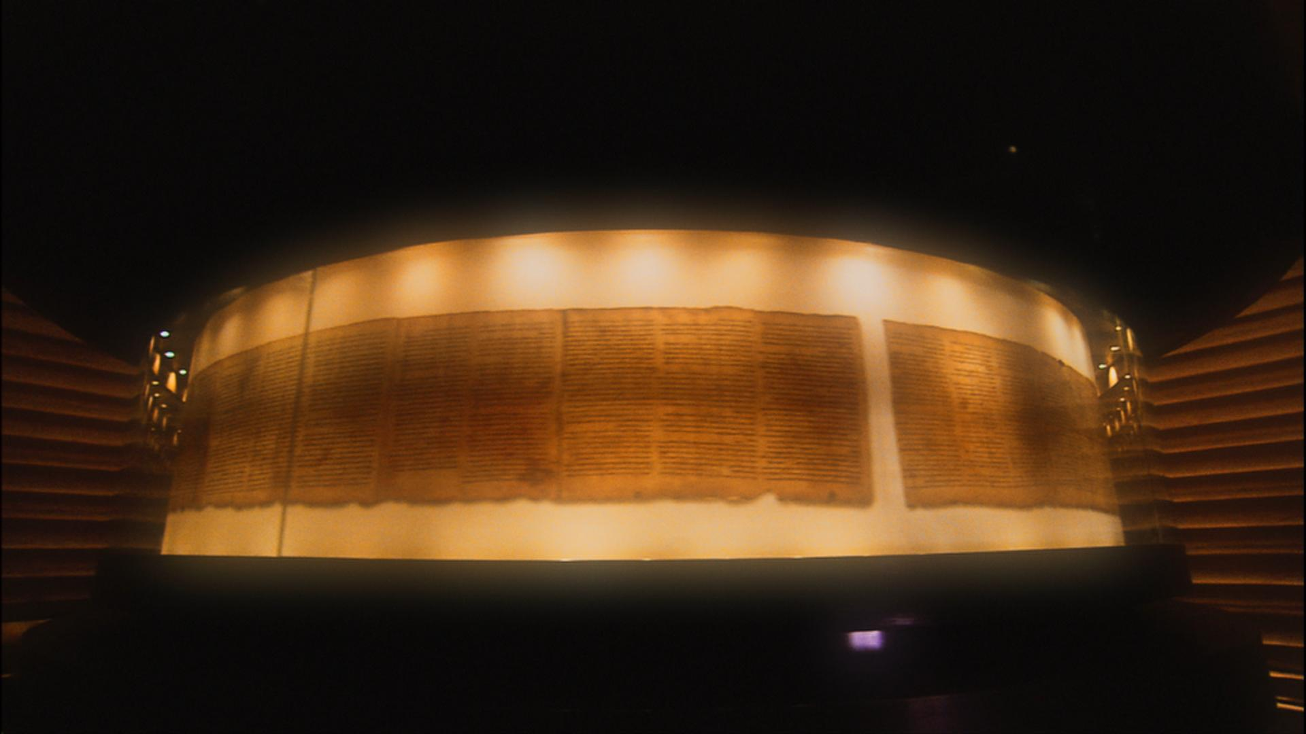
The Accuracy of Scripture
Dead Sea Scrolls
Notes:
Other proof of the accuracy of scripture is the Dead Sea Scrolls
The Dead Sea Scrolls, are a collection of some 981 different texts discovered between 1946 and 1956 in eleven caves in the immediate vicinity of the ancient settlement at Khirbet Qumran in the West Bank. The caves are located about two kilometrs (1.2 miles) inland from the northwest shore of the Dead Sea, from which they derive their name.
The consensus is Scrolls date from 8 BC to 1 AD
The texts are of great historical, religious, and linguistic significance because they include the third oldest known surviving manuscripts of works later included in the Hebrew Bible canon,
Most of the texts are written in Hebrew, with some in Aramaic and a few in Greek.
When compared to todays bibles the accuracy was over 99% correct.

Slide 28
Extra and Lost
Apocrypha – Included in the Catholic Bible
Not scripture
Have some inaccuracies or fictional i.e. stories
Have some conflicts with scripture
If God wanted them in scripture they would be in scripture.
Book of Mormon
False claim and conflicts with scripture
Koran
False claim and conflicts with scripture
Notes:
There are some other books that people claim to be scripture but they are not.
(Click and Read Slide}

Slide 29
Extra and Lost
Book of Enoch – Jude 1:4-15, 2 Peter 2:4,3:13
Book of the Wars of the Lord – Num 21:14
Book of Jasher – 2 Tim 3:8, 2 Sam 1:18, Jos 10:13
Book of Songs – I Kings 8:12-13
Book of Shemaiah the Prophet – 2 Chron 12:15
Epistle to the Laodiceans - Col 4:16
More…
God does not want these as scripture.
These books may contain “Words” from God.
But they are Not Scripture or Word of God.
Notes:
There are many books referenced in scripture – but they are not the Word of God.
(Click and Read Slide}

Slide 30
Word of God
Word of God absolutely is:
Old Testament
New Testament
But What about:
Oral-teaching (Oracles) ?
Revealings?
Notes:
We have proven the Word of God is the bible. But is that all?
(Click and Read Slide}

Slide 31
Word of God
Are oral-teaching (Oracles) the Word of God?
Matthew 4:4 (NIV)
⁴ Jesus answered, “It is written: ‘Man shall not live on bread alone, but on every word (Logos) that comes from the mouth of God.”
Greek:
λόγου (logos) word, speech, divine utterance
Notes:
{Read Slide click} Math 4 is says “every word that comes from the mouth of God”

Slide 32
Word of God
In scripture Logos to refer to the Word of God
In scripture Logos to refer to speech
2 Thessalonians 2:15 (NIV)
¹⁵ So then, brothers and sisters, stand firm and hold fast to the teachings we passed on to you, whether by word of mouth or by letter.
Commentaries: “Oral Discourse”
Oral-Law passed down from God (Jesus Christ)
The New Testament before it was written
Notes:
{Read Side}
The “Term Word of Mouth” is Logos by Mouth, Let’s ready some more

Slide 33
Word of God
Are oral-teaching (Oracles) the Word of God?
It depends..(covered later)
Romans 3:2 (ESV)
² Much in every way. To begin with, the Jews were entrusted with the oracles of God.
Some of the law was passed down by mouth, but at this time all the law and traditions are written down.
Notes:
The answer is
{Read Slide}
I believe in this modern age all the oral-law Oracles have be written down. But are they the “Word of God”?

Slide 34
Word of God
Are “Revealings” the Word of God?
Ephesians 3:2-5New (NKJV)
² if indeed you have heard of the dispensation of the grace of God which was given to me for you, ³ how that by revelation He made known to me the mystery (as I have briefly written already, ⁴ by which, when you read, you may understand my knowledge in the mystery of Christ), ⁵ which in other ages was not made known to the sons of men, as it has now been revealed by the Spirit to His holy apostles and prophets:
Notes:
What about “revealings”?
{Read Slide}

Slide 35
Word of God
Are “Revealings” the Word of God?
Revealings from Jesus Christ are to the Apostles and Prophets. Not just anybody.
Daniel 12:4 (NIV)
⁴ But you, Daniel, roll up and seal the words of the scroll until the time of the end. Many will go here and there to increase knowledge.”
The unsealing of Daniel was a revealing.
Notes:
As we just read {Read Slide}
Currently no one is operating in the role of an Apostle or prophet in the Church (The body). God is not using anyone in that function.

Slide 36
Word of God
Revealings, Oracles (Oral-Law)
Revealings and oracles have to be documented by a trusted source.
Cannot conflict with scripture.
For a very few. (The called and chosen).
Only from a Godly designated group or person
Enhance our understanding. Must make sense.
If God wanted these in scripture they would be there.
I would call these “Words” from God. Not the same as scripture or Word of God.
Notes:
In general for Revealing or an Oracle to from Jesus Christ it must have the following.
{Read Slide} zz

Slide 37
Word of God
John 1:1 (NIV)
The Word became flesh
¹In the beginning was the Word, and the Word was with God, and the Word was God. (Logos)
2 Timothy 3:16-17 (NIV)
¹⁶ All Scripture is God-breathed and is useful for teaching, rebuking, correcting and training in righteousness, ¹⁷ so that the servant of God may be thoroughly equipped for every good work.
¹² Yet to all who did receive him, to those who believed in his name, he gave the right to become children of God—¹³ children born not of natural descent, nor of human decision or a husband’s will, but born of God.
¹⁴ The Word became flesh and made his dwelling among us. We have seen his glory, the glory of the one
Notes:
Here are some characteristics of Word of God
{Read Slide}

Slide 38
Word of God
How to understand Scripture?
Find a trusted source
DO NOT use the internet first
Pray – Scripture is understood from the Holy Spirit
John 16:13 (JCCS) Jim Chance Crazy Simplified
¹³ But when it, the Spirit from God that reveals truth comes, God will use it to guide you into all truth. It does not speak on its own; it will help you remember and recall what you have heard.
The Word Became Flesh
1 In the beginning was the Word, and the Word was with God, and the Word was God. (Logos)
2 Timothy 3:16-17 (NIV)
¹⁶ All Scripture is God-breathed and is useful for teaching, rebuking, correcting and training in righteousness, ¹⁷ so that the servant of God^{[a]}may be thoroughly equipped for every good work.
¹² Yet to all who did receive him, to those who believed in his name, he gave the right to become children of God—¹³ children born not of natural descent, nor of human decision or a husband’s will, but born of God.
¹⁴ The Word became flesh and made his dwelling among us. We have seen his glory, the glory of the one
Notes:
We as called and chosen cannot just read the Word of God. We must understand
{Read Slide}
Point out the JCCS Jim Chance Crazy Simplified version

Slide 39
Word of God
How to understand Scripture?
Seek understanding from trusted scholars
Discuss with those of like minds
Hold fast to what you have proven and build upon it
1 Peter 3:15 (NKJV)
¹⁵ But sanctify the Lord God in your hearts, and always be ready to give a defense to everyone who asks you a reason for the hope that is in you, with meekness and fear;
Notes:
{Read Slide}
We must understand and prepare to give answer when called upon

Slide 40

Word of God
Before Herbert W Armstrong
Jesus Christ revealed how to put the pieces together
Notes:
We can understand the Word of God because Jesus Christ gave that understanding to Mr. Herbert W Armstrong.
The Bible was like a jigsaw puzzle and Jesus Christ showed Mr. Armstrong how to put all the pieces together.
{Read Slide}
United Church of God has it’s understanding from Jesus Christ revealing it to Mr. Herbert W Armstrong.

Slide 41
Translation Issues
Hebrew, Aramaic, Greek to Latin and English
Latin to English
Type of Translation
Religious miss-understandings
Religious bias
One translation is not 100% correct.
One translation of the many will typically give a correct meaning
Thought Word
Thought Word
Notes:
How do we study the Word of God for understanding.
We need many translations and commentaries.
{Read Slide}
Amplified is a Thought for Thought
Young’s Literal is more Word for Word

Slide 42
Word of God
Bible Study Tips?
Find a trusted source (ucg.org, hwastorehouse.com, hwalibrary.com)
Let the Bible interpret itself
Lord (L-o-r-d) = God The Father LORD (L-O-R-D) = God the Son / Savior / Jesus Christ
New Testament explains the Old Testament
Use multiple commentaries
Lookup the Hebrew, Greek or Aramaic yourself
The interpretation must work for all scripture; Not just the one verse
Notes:
Here are some Bible study tips
{Read Slide}

Slide 43
Word of God
By studying the Word of God you will:
Gain Godly knowledge and wisdom
Gain faith
Build your relationship with God the Father and Jesus Christ
Be helped to qualify to receive salvation
Be cleansed and sanctified to be the Bride of Christ
Gain even more
Notes:
{Read Slide}

Slide 44
Word of God
Matthew 5:18 (CEV)
¹⁸ Heaven and earth may disappear. But I promise you that not even a period or comma will ever disappear from the Law. Everything written in it must happen.
Revelation 22:19 (KJV)
¹⁹ And if any man shall take away from the words of the book of this prophecy, God shall take away his part out of the book of life, and out of the holy city, and from the things which are written in this book.
Notes:
The Word of God is very important. We must respect and cherish it.
Read Slide

Slide 45
Word of God
Fundament Beliefs Conclusion
It is not enough to just read and study when it comes to the Bible—or to just try to follow many of its directives. We must be led to know, serve and
rely on the God revealed in its pages—the Father through His Son, Jesus Christ the Word.
Thank You for listening and
have a profitable Sabbath
Notes:
Let’s conclude with the last paragraph from the fundamental beliefs.
{Read Slide}

